Slide 1
Augmented Cognition for Music Play & Interaction
Morgan McGivern - Cognitive Science Capstone

Slide 2
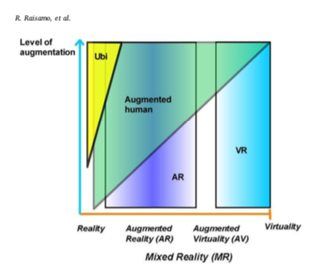
What is Augmented Cognition?
Proposed by Englebart (guy who invented computer mouse) in a study for the Air Force entitled "Augmenting human intellect: a conceptual framework. SRI Summary Report" 1960s~
"Augmented cognition (aka enhanced cognition) is achieved by detecting human cognitive state, using analytical tools to make a correct interpretation of it, and adapting computer's response to match the current and predictive needs of the user (e.g., providing stored or recorded information during natural interaction)" (Raisomo et. al)
Raisamo, R., Rakkolainen, I., Majaranta, P., Salminen, K., Rantala, J., & Farooq, A. (2019). Human augmentation: Past, present and future. International Journal of Human-Computer Studies, 131, 131–143. https://doi.org/10.1016/j.ijhcs.2019.05.008

Slide 3
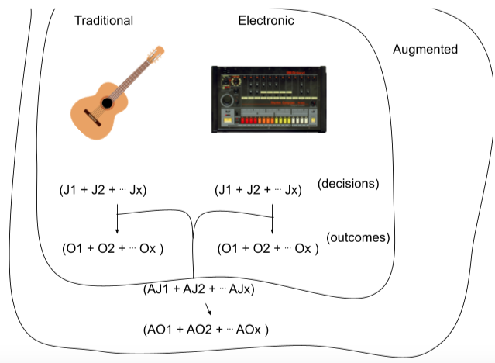
What is Augmented Cognition for Music Play & Interaction?
Simply the mentioned definition mapped into the music domain
Musicians might necessarily be bound by it due to it's usefulness and how musicians are already using crude screens to learn/trade knowledge on
Importantly for every unique decision musicians take in creating an artifact augmentation lets them achieve further than what traditional methods would

Slide 4
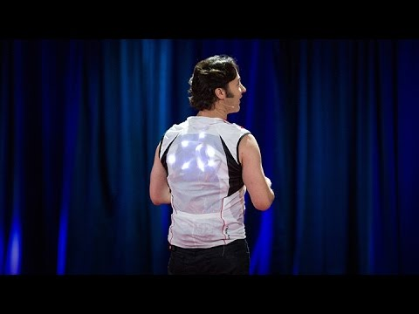

Slide 5
Embodiment, Ubiquitous, & Tool use
Englebart pushes the notion that the computer is a tool
Ubiquitous computing is having many computers, say inside a room, performing multiple functions to form a uniform experience
For musicians this can be applied as a learning tool
Embodiment theory plays in as augmented technology has to do with processing and extending the cognitive system further into its environment through interfaces

Slide 6
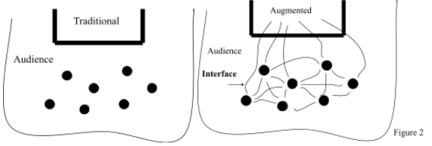
Live Performances
This type of cognition gives really interesting ideas for live performances
Of course, everyone needs access to the technology
It also allows feedback from the audience directly into performances, which seems like a huge attractor

Slide 7
Music Education
Interesting area for music educators as half virtual spaces can use other senses to indicate tonal qualities
While there may be no quick way to download a skill, it may be a quick way to master an instrument by having outside information on an instrument that typically takes a skilled muscle movement or ear
Mixed reality spaces can teach the theremin which is traditionally considered a difficult instrument due to the open pitch space it uses, so what will be next?
We might also consider the ramifications for many other fields of art

Slide 8
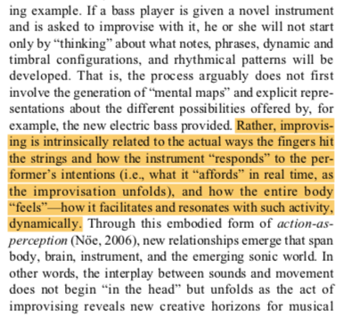
Closing
One of my main takeaways for myself was in this block
van der Schyff, D., Schiavio, A., Walton, A., Velardo, V., & Chemero, A. (2018). Musical creativity and the embodied mind: Exploring the possibilities of 4E cognition and dynamical systems theory. Music & Science, 1, 205920431879231–. https://doi.org/10.1177/2059204318792319

