Slide 1
The Dreamhome Online Real-estate Company Management System

Slide 2
Agenda
Project overview
Conceptual data model
Use case diagram
Class diagram
Logical data model
Physical data model
Database application
Lessons learned

Slide 3
Project Overview
Dreamhome is a real-estate company with several branches over Scotland. It manages owners’ properties and rents them to clients.
The staff at Dreamhome comprise managers, supervisors, and assistants. A manager is responsible for the day-to-day running of a branch.
Users of the system will be mostly managers and staff.

Slide 4
Conceptual Data Model
The goal of the conceptual database design is to construct a model of the data used in an application, independent of physical considerations.
We also want to describe how the data is going to be used by the database system users – what kind of functionality the database application is going to provide to the users.

Slide 5
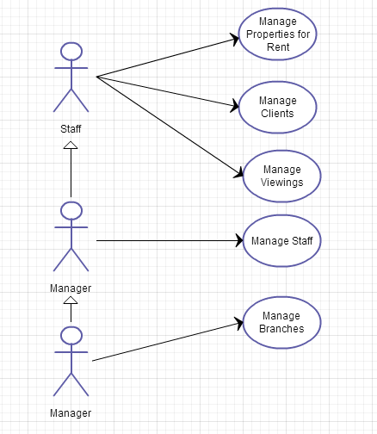
Use Case Diagram
Supervisor

Slide 6
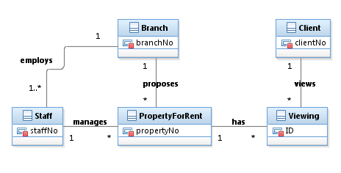
Class Diagram

Slide 7
Logical Data Model
The goal of logical database design is to construct a data model for an application based on a particular data model, but independent of a particular DBMS and other physical considerations.
The Dreamhome database will be built using the relational data model.
We also want the database to be operational both in MS Access and in MySQL.

Slide 8
Logical Data Model
Steps:
Build user views
Build local data models
Merge local data models to build a global data model (view integration).
The result of logical data modeling is a set of normalized relations in 3rd normal form.

Slide 9
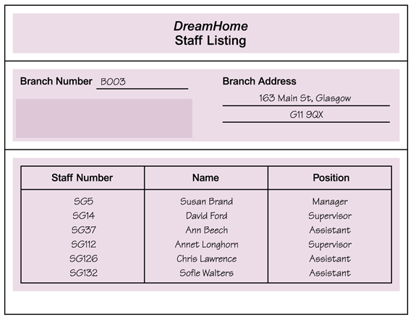
Logical Data Model
Example: Staff Listing view and its local data model
Branch(branchNo, street, city, address)
Staff(staffNo, fName, lName, position)

Slide 10
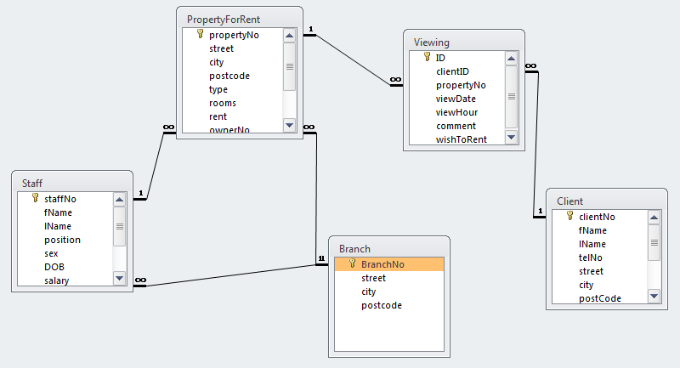
Logical Data Model

Slide 11
Physical Data Model
The goal of physical database design is to produce a description of the implementation of the database in a DBMS.
The database was created in MS Access and later migrated to MySQL and is operational in both DBMSs.
MS Access database is more suited for in-house use while MySQL is more suited for Web-based applications.

Slide 12
Physical Data Model
CREATE TABLE `Viewing` (
`ID` INTEGER NOT NULL AUTO_INCREMENT,
`clientID` VARCHAR(5),
`propertyNo` VARCHAR(5),
`viewDate` DATETIME,
`viewHour` VARCHAR(5),
`comment` VARCHAR(255),
`wishToRent` TINYINT(1) DEFAULT 0,
INDEX (`clientID`),
INDEX (`ID`),
PRIMARY KEY (`ID`),
FOREIGN KEY ('clientID') references 'Client'('clientNo'),
FOREIGN KEY ('propertyNo') references 'PropertyForRent'
) ENGINE=myisam DEFAULT CHARSET=utf8;

Slide 13
Database Application
A Web database application has been built using MySQL and PHP.
It runs on moxie server with Apache.
The part developed is the Manager restricted Staff Management system.
Managers login into the system for authentication purposes.

Slide 14
Dreamhome Staff Management
The Dreamhome Staff Management application lets users:
List the staff working at a branch
Add staff
Update staff information
Delete staff.\
Demo:
http://moxie.cs.oswego.edu/~bichinda/dreamhome/login.php (username: Brand, password: SG5)

Slide 15
Dreamhome Staff Management
Files:
login.php (login)
dreamhome.php (general menu)
branch.php (list of staff per branch)
add.php (add staff interface)
add-staff.php (add staff to the database)
delete.php (delete staff interface)
delete-staff.php (delete staff from the database)
update.php (update staff interface)
update-staff.php (update staff from the database)
logout.php (logout)
functions.php (all functions called by the other pages)

Slide 16
Dreamhome Staff Management
login.php
dreamhome.php
branch.php
add.php
update.php
delete.php
add-staff.php
update-staff.php
delete-staff.php

Slide 17
Conclusion
Lessons learned …

