Slide 1
Normalization

Slide 2
Learning Objectives
Define what is normalization and its purpose in database design
Differentiate between the types of normal forms 1NF, 2NF, 3NF, BCNF, and 4NF
Transform from lower normal forms to higher normal forms
Use concurrently normalization and E-R modeling to produce a good database design
Practice the usefulness of denormalization to generate information efficiently

Slide 3
Acknowledgments
Some of these slides have been adapted from Thomas Connolly and Carolyn Begg

Slide 4
Normalization
Main objective in developing a logical data model for relational database systems is to create an accurate representation of the data, its relationships, and constraints.
To achieve this objective, must identify a suitable set of relations.

Slide 5
Normalization
Four most commonly used normal forms are first (1NF), second (2NF) and third (3NF) normal forms, and Boyce–Codd normal form (BCNF).
Based on functional dependencies among the attributes of a relation.
A relation can be normalized to a specific form to prevent possible occurrence of update anomalies.

Slide 6
Normalization
Normalization is the process for assigning attributes to entities
Reduces data redundancies
Helps eliminate data anomalies
Produces controlled redundancies to link tables
Normalization stages
1NF - First normal form
2NF - Second normal form
3NF - Third normal form
4NF - Fourth normal form

Slide 7
Data Redundancy
Major aim of relational database design is to group attributes into relations to minimize data redundancy and reduce file storage space required by base relations.
Problems associated with data redundancy are illustrated by comparing the following Staff and Branch relations with the StaffBranch relation.

Slide 8
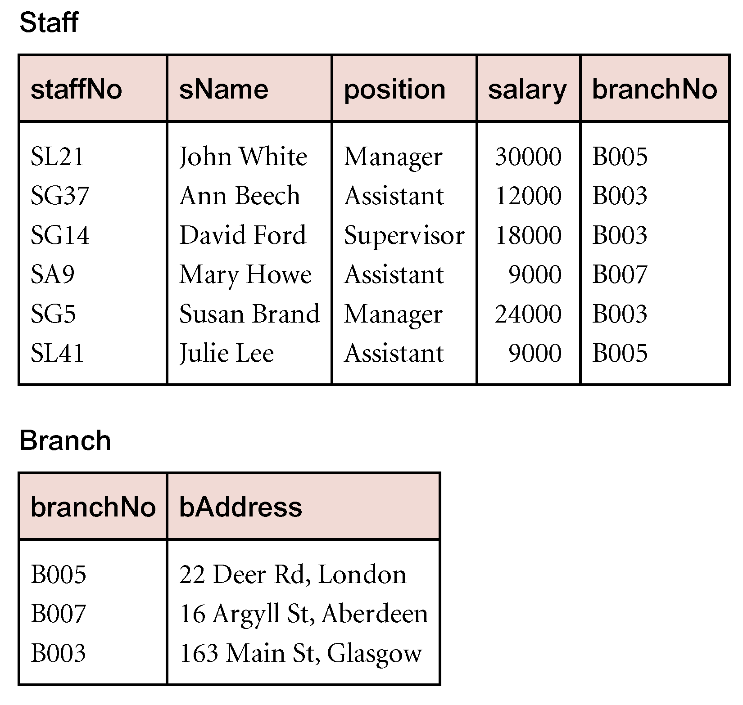
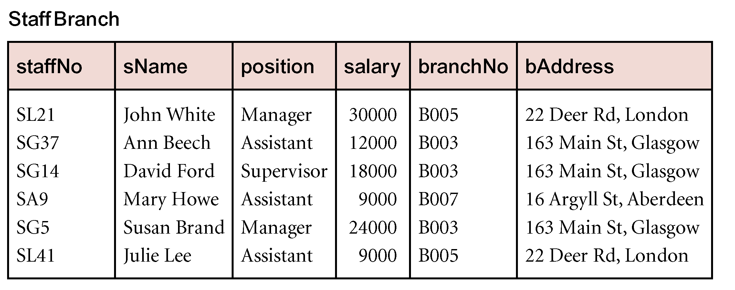
Data Redundancy

Slide 9
Data Redundancy
StaffBranch relation has redundant data: details of a branch are repeated for every member of staff.
In contrast, branch information appears only once for each branch in Branch relation and only branchNo is repeated in Staff relation, to represent where each member of staff works.

Slide 10
Update Anomalies
Relations that contain redundant information may potentially suffer from update anomalies.
Types of update anomalies include:
Insertion,
Deletion,
Modification.

Slide 11
Functional Dependency
Main concept associated with normalization.
Functional Dependency
Describes relationship between attributes in a relation.
If A and B are attributes of relation R, B is functionally dependent on A (denoted A → B), if each value of A in R is associated with exactly one value of B in R.

Slide 12
Functional Dependency
Property of the meaning (or semantics) of the attributes in a relation.
Diagrammatic representation:
Determinant of a functional dependency refers to attribute or group of attributes on left-hand side of the arrow.

Slide 13
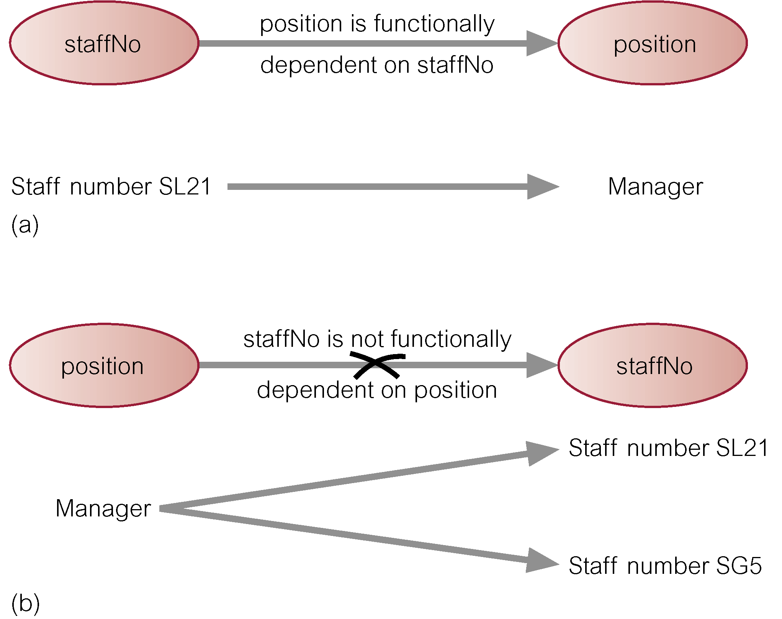
Example - Functional Dependency

Slide 14
Functional Dependency
Main characteristics of functional dependencies used in normalization:
have a 1:1 relationship between attribute(s) on left and right-hand side of a dependency;
hold for all time;
are nontrivial.

Slide 15
Functional Dependency
Complete set of functional dependencies for a given relation can be very large.
Important to find an approach that can reduce set to a manageable size.
Need to identify set of functional dependencies (X) for a relation that is smaller than complete set of functional dependencies (Y) for that relation and has property that every functional dependency in Y is implied by functional dependencies in X.

Slide 16
Dependency Diagram (1NF)

Slide 17
The Process of Normalization
Formal technique for analyzing a relation based on its primary key and functional dependencies between its attributes.
Often executed as a series of steps. Each step corresponds to a specific normal form, which has known properties.
As normalization proceeds, relations become progressively more restricted (stronger) in format and also less vulnerable to update anomalies.

Slide 18
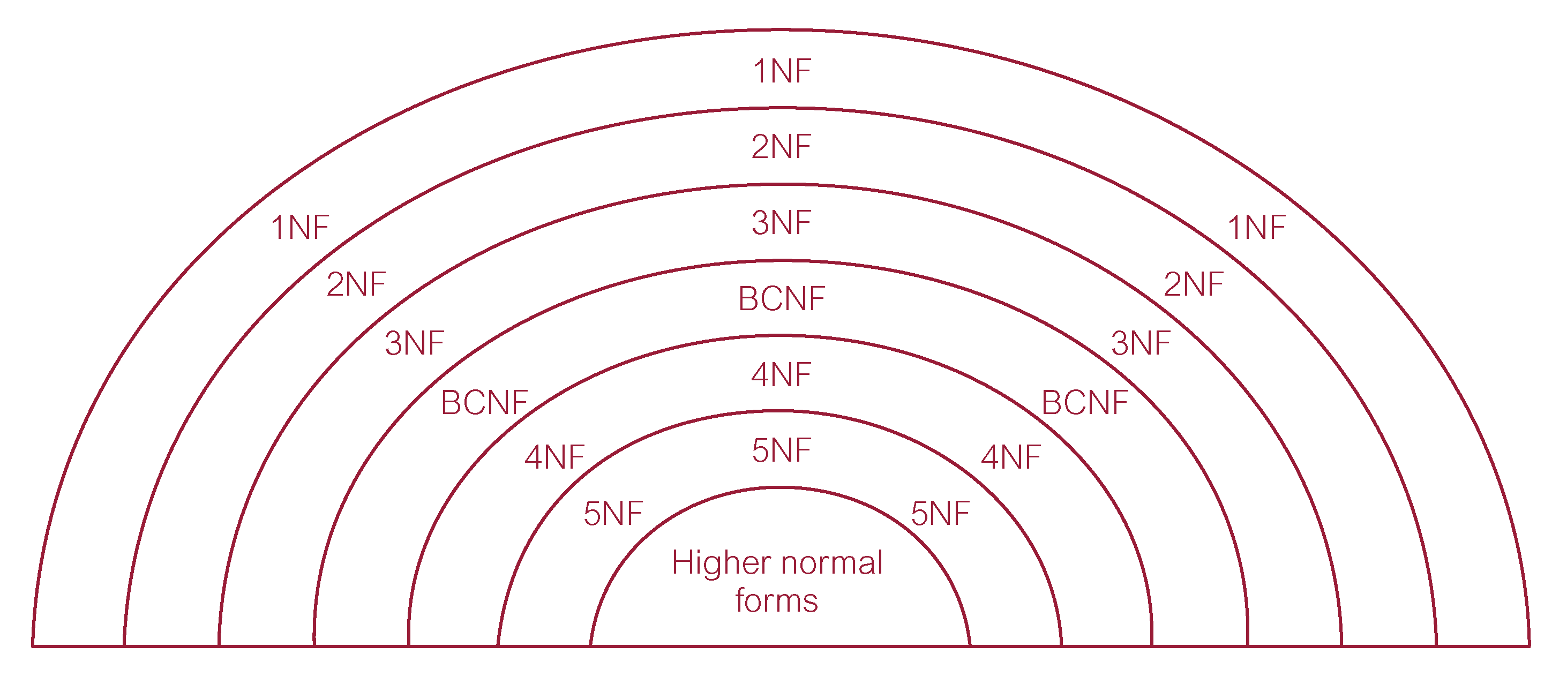
Relationship Between Normal Forms

Slide 19
Unnormalized Form (UNF)
A table that contains one or more repeating groups.
To create an unnormalized table:
transform data from information source (e.g. form) into table format with columns and rows.

Slide 20
First Normal Form (1NF)
A relation in which intersection of each row and column contains one and only one value.

Slide 21
UNF to 1NF
Nominate an attribute or group of attributes to act as the key for the unnormalized table.
Identify repeating group(s) in unnormalized table which repeats for the key attribute(s).

Slide 22
UNF to 1NF
All key attributes defined
No repeating groups in table
All attributes dependent on
primary key

Slide 23
Second Normal Form (2NF)
Based on concept of full functional dependency:
A and B are attributes of a relation,
B is fully dependent on A if B is functionally dependent on A but not on any proper subset of A.
2NF - A relation that is in 1NF and every non-primary-key attribute is fully functionally dependent on the primary key (no partial dependency)

Slide 24
1NF to 2NF
Identify primary key for the 1NF relation.
Identify functional dependencies in the relation.
If partial dependencies exist on the primary key remove them by placing them in a new relation along with copy of their determinant.

Slide 25
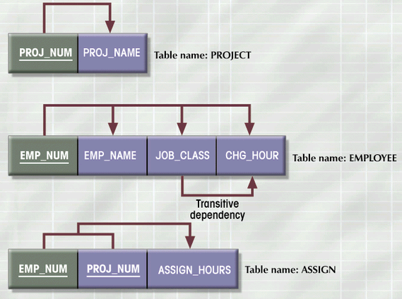
2NF Conversion Results
Figure 4.5

Slide 26
Third Normal Form (3NF)
Based on concept of transitive dependency:
A, B and C are attributes of a relation such that if A → B and B → C,
then C is transitively dependent on A through B. (Provided that A is not functionally dependent on B or C).
3NF - A relation that is in 1NF and 2NF and in which no non-primary-key attribute is transitively dependent on the primary key.

Slide 27
2NF to 3NF
Identify the primary key in the 2NF relation.
Identify functional dependencies in the relation.
If transitive dependencies exist on the primary key remove them by placing them in a new relation along with copy of their determinant.

Slide 28
3NF Conversion Results
Prevent referential integrity violation by adding a JOB_CODE
PROJECT (PROJ_NUM, PROJ_NAME)
ASSIGN (PROJ_NUM, EMP_NUM, HOURS)
EMPLOYEE (EMP_NUM, EMP_NAME, JOB_CLASS)
JOB (JOB_CODE, JOB_DESCRIPTION, CHG_HOUR)

Slide 29
General Definitions of 2NF and 3NF
Second normal form (2NF)
A relation that is in 1NF and every non-primary-key attribute is fully functionally dependent on any candidate key.
Third normal form (3NF)
A relation that is in 1NF and 2NF and in which no non-primary-key attribute is transitively dependent on any candidate key.

Slide 30
Boyce–Codd Normal Form (BCNF)
Based on functional dependencies that take into account all candidate keys in a relation, however BCNF also has additional constraints compared with general definition of 3NF.
BCNF - A relation is in BCNF if and only if every determinant is a candidate key.

Slide 31
Boyce–Codd normal form (BCNF)
Difference between 3NF and BCNF is that for a functional dependency A → B, 3NF allows this dependency in a relation if B is a primary-key attribute and A is not a candidate key.
Whereas, BCNF insists that for this dependency to remain in a relation, A must be a candidate key.
Every relation in BCNF is also in 3NF. However, relation in 3NF may not be in BCNF.

Slide 32
Boyce–Codd normal form (BCNF)
Violation of BCNF is quite rare.
Potential to violate BCNF may occur in a relation that:
contains two (or more) composite candidate keys;
the candidate keys overlap (i.e. have at least one attribute in common).

Slide 33
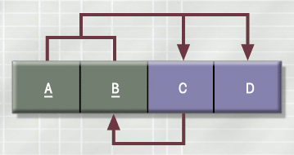
3NF Table Not in BCNF
Figure 4.7

Slide 34
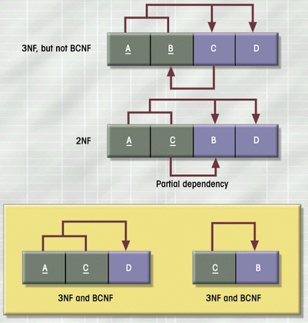
Decomposition of Table Structure to Meet BCNF

Slide 35
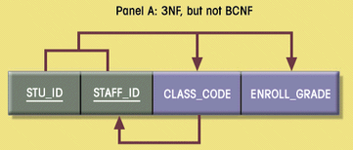
BCNF Conversion Results

Slide 36
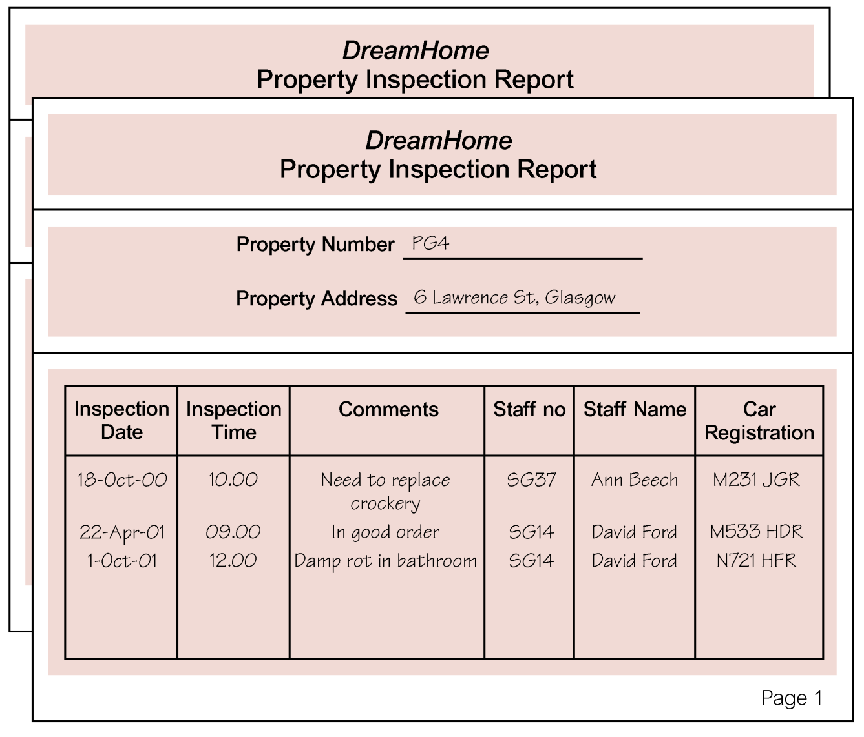
Review of Normalization (UNF to BCNF)

Slide 37
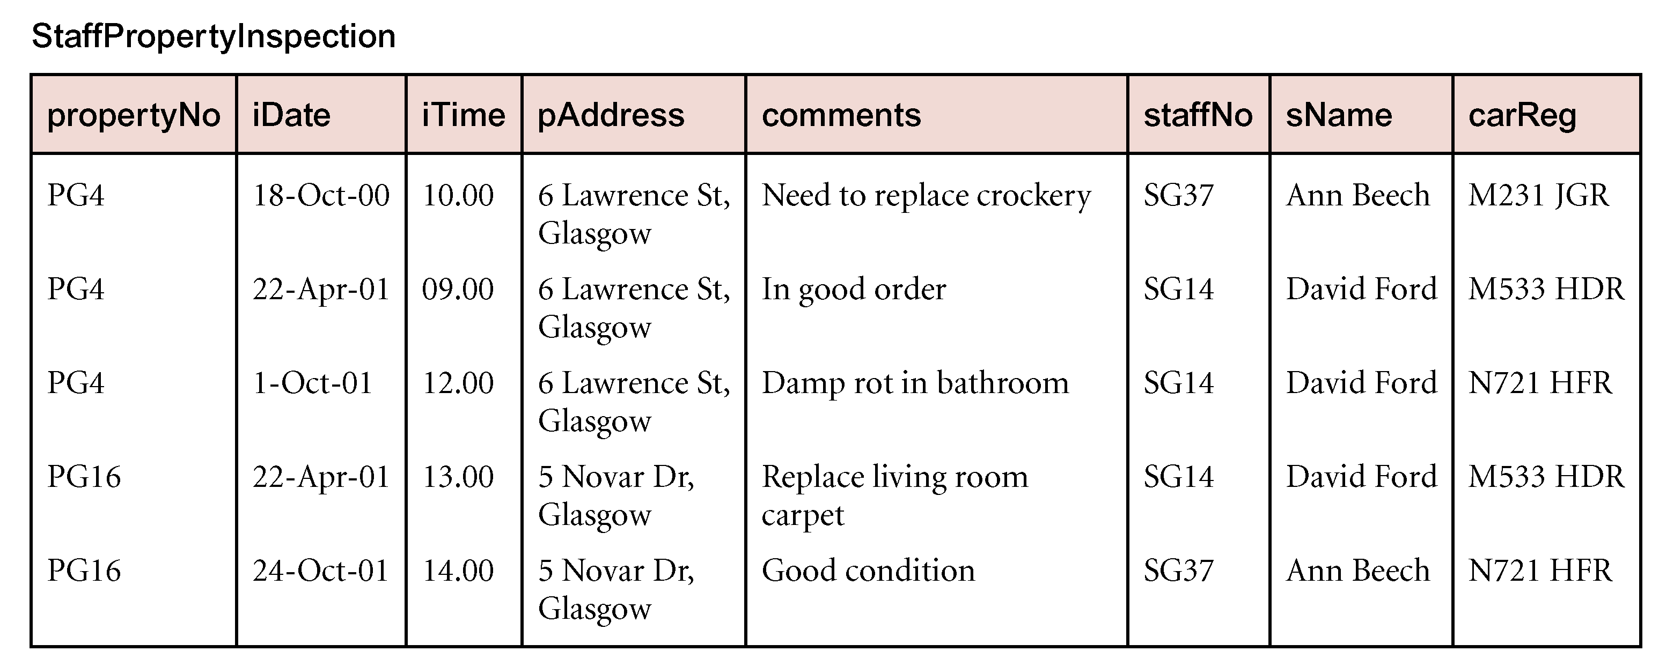
Review of Normalization (UNF to BCNF)

Slide 38
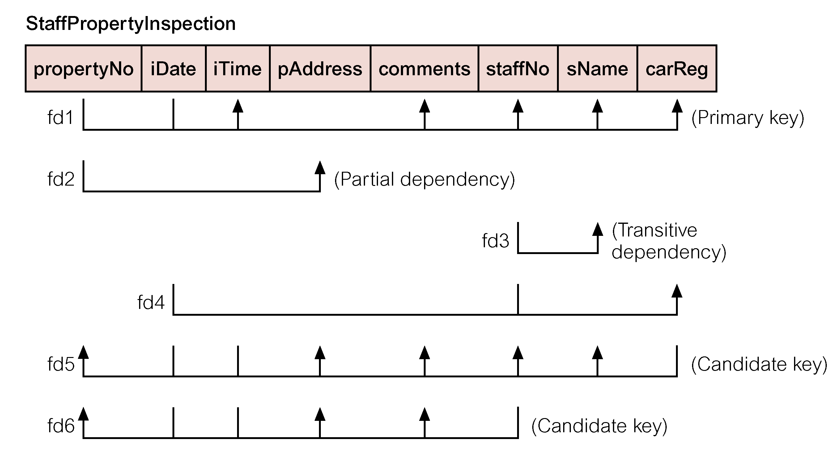
Review of Normalization (UNF to BCNF)

Slide 39
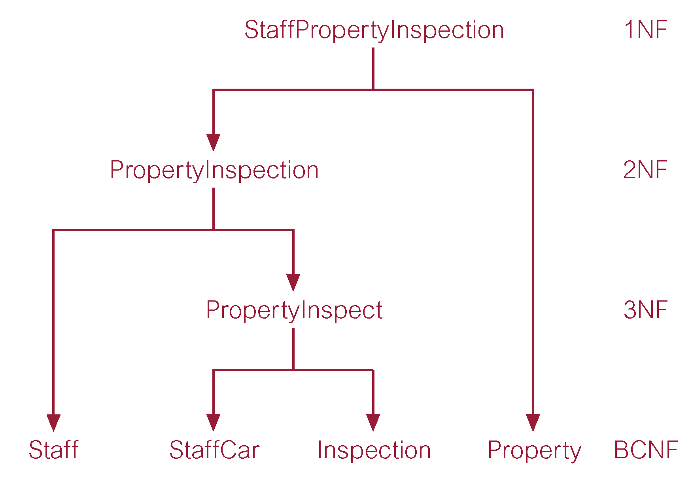
Review of Normalization (UNF to BCNF)

Slide 40
Fourth Normal Form (4NF)
Although BCNF removes anomalies due to functional dependencies, another type of dependency called a multi-valued dependency (MVD) can also cause data redundancy.
Possible existence of MVDs in a relation is due to 1NF and can result in data redundancy.

Slide 41
Fourth Normal Form (4NF) - MVD
Dependency between attributes (for example, A, B, and C) in a relation, such that for each value of A there is a set of values for B and a set of values for C. However, set of values for B and C are independent of each other.

Slide 42
Fourth Normal Form (4NF)
MVD between attributes A, B, and C in a relation using the following notation:
A ⎯⎯ØØ B
A ⎯⎯ØØ C

Slide 43
Fourth Normal Form (4NF)
MVD can be further defined as being trivial or nontrivial.
MVD A ⎯⎯ØØ B in relation R is defined as being trivial if (a) B is a subset of A or (b) A ∪ B = R.
MVD is defined as being nontrivial if neither (a) nor (b) are satisfied.
Trivial MVD does not specify a constraint on a relation, while a nontrivial MVD does specify a constraint.

Slide 44
Fourth Normal Form (4NF)
Defined as a relation that is in BCNF and contains no nontrivial MVDs.

Slide 45
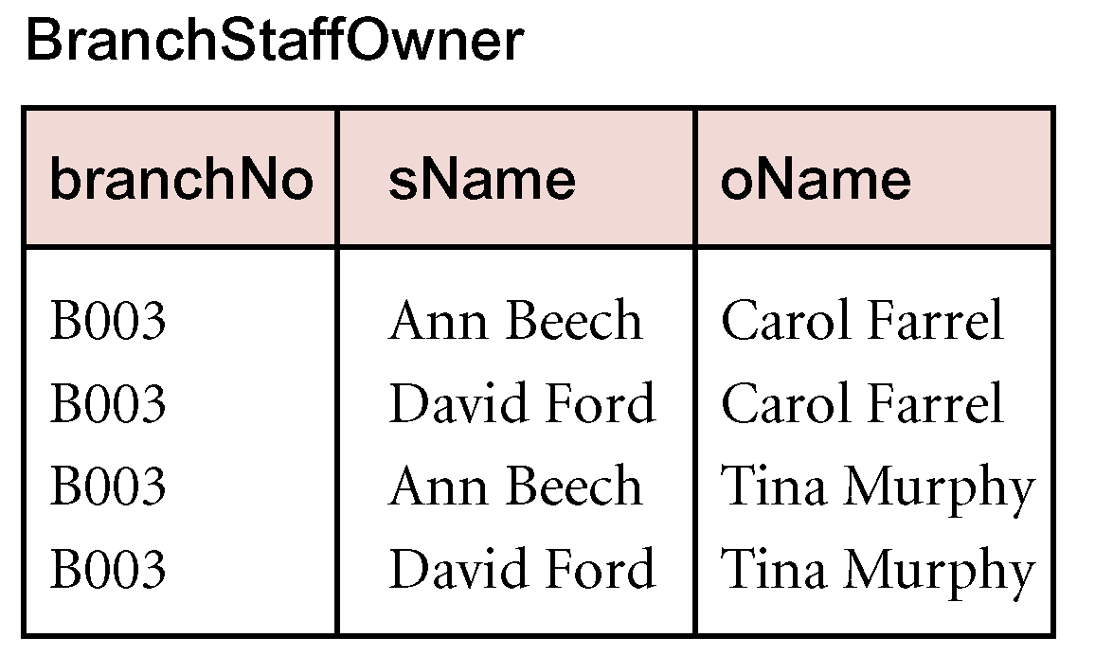
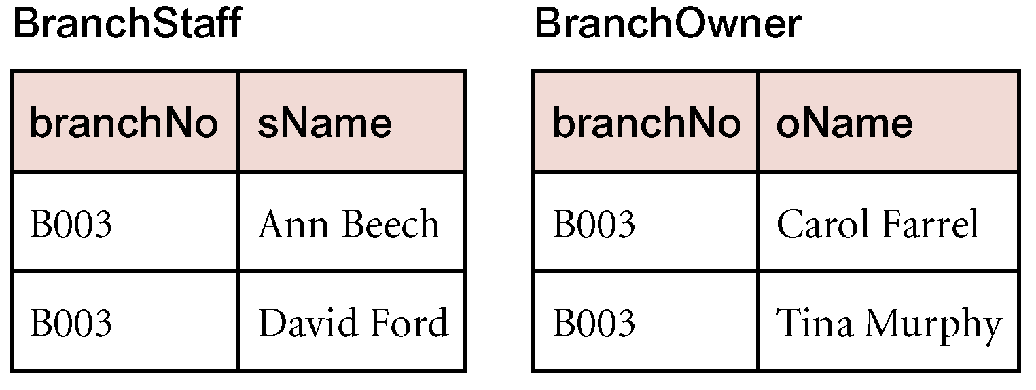
4NF - Example

Slide 46
3NF Table Not in BCNF
Figure 4.7

Slide 47
Decomposition of Table Structure to Meet BCNF

Slide 48
Decomposition into BCNF
Figure 4.9

Slide 49
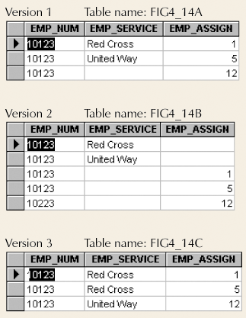
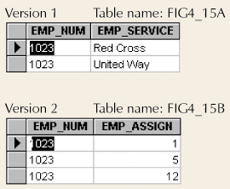
4NF Conversion Results
Set of Tables in 4NF
Multivalued Dependencies (an employee can work for many services and on many projects

Slide 50
Denormalization
Normalization is one of many database design goals
Normalized table requirements
Additional processing
Loss of system speed
Normalization purity is difficult to sustain due to conflict in:
Design efficiency
Information requirements
Processing

Slide 51
Unnormalized Table Defects
Data updates less efficient
Indexing more cumbersome
No simple strategies for creating views

Slide 52
Summary
We will use normalization in database design to create a set of relations in 3FN normal form:
Each entity has a unique primary key, and each attribute depends upon the primary key
No partial dependency
No transitive dependency

