Slide 1
Conceptual Data Modeling

Slide 2
Learning Objectives
How to use ER modeling to build a local conceptual data model based on information given in a view of the enterprise.
How to validate resultant conceptual model to ensure it is a true and accurate representation of a view of the enterprise.
How to document process of conceptual database design.
End-users play an integral role throughout process of conceptual database design.

Slide 3
Acknowledgments
Some of these slides have been adapted from Thomas Connolly and Carolyn Begg

Slide 4
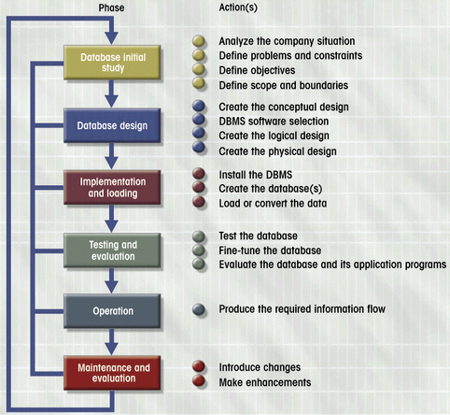
Database Lifecycle (DBLC)
Figure 6.3

Slide 5
Use case diagram

Slide 6
Methodology Overview - Conceptual Database Design
Step 1 Build conceptual data model
  Step 1.1 Identify entity types
  Step 1.2 Identify relationship types
  Step 1.3 Identify and associate attributes with entity or relationship types
  Step 1.4 Determine attribute domains
  Step 1.5 Determine unique identifier (will become a key) attributes
  Step 1.6 Consider use of enhanced modeling concepts (optional step)
  Step 1.7 Check model for redundancy
  Step 1.8 Validate local conceptual model against user transactions
  Step 1.9 Review local conceptual data model with user

Slide 7
Class diagram

Slide 8
Step 1 Build Conceptual Data Model
To build a local conceptual data model of an enterprise.
Step 1.1 Identify entity types
  To identify the main entity types that are required by the enterprise.
Step 1.2 Identify relationship types
  To identify the important relationships that exist between the entity types that have been identified.

Slide 9
Step 1 Build Conceptual Data Model
Step 1.3 Identify and associate attributes with entity or relationship types
  To identify and associate attributes with the appropriate entity or relationship types and document the details of each attribute.
Step 1.4 Determine attribute domains
  To determine domains for the attributes in the local conceptual model and document the details of each domain.

Slide 10
Step 1 Build Conceptual Data Model
Step 1.5 Determine candidate and unique identifier attributes
  To identify the candidate key(s) for each entity and if there is more than one candidate key, to choose one to be the unique identifier.
Step 1.6 Consider use of enhanced modeling concepts (optional step)
  To consider the use of enhanced modeling concepts, such as specialization / generalization, aggregation, and composition.

Slide 11
Step 1 Build Conceptual Data Model
Step 1.7 Check model for redundancy
  To check for the presence of any redundancy in the model.
Step 1.8 Validate conceptual model against user transactions
  To ensure that the conceptual model supports the transactions required.
Step1.9 Review local conceptual data model with user
  To review the local conceptual data model with the user to ensure that the model is a ‘true’ representation of the user’s view of the enterprise.

Slide 12
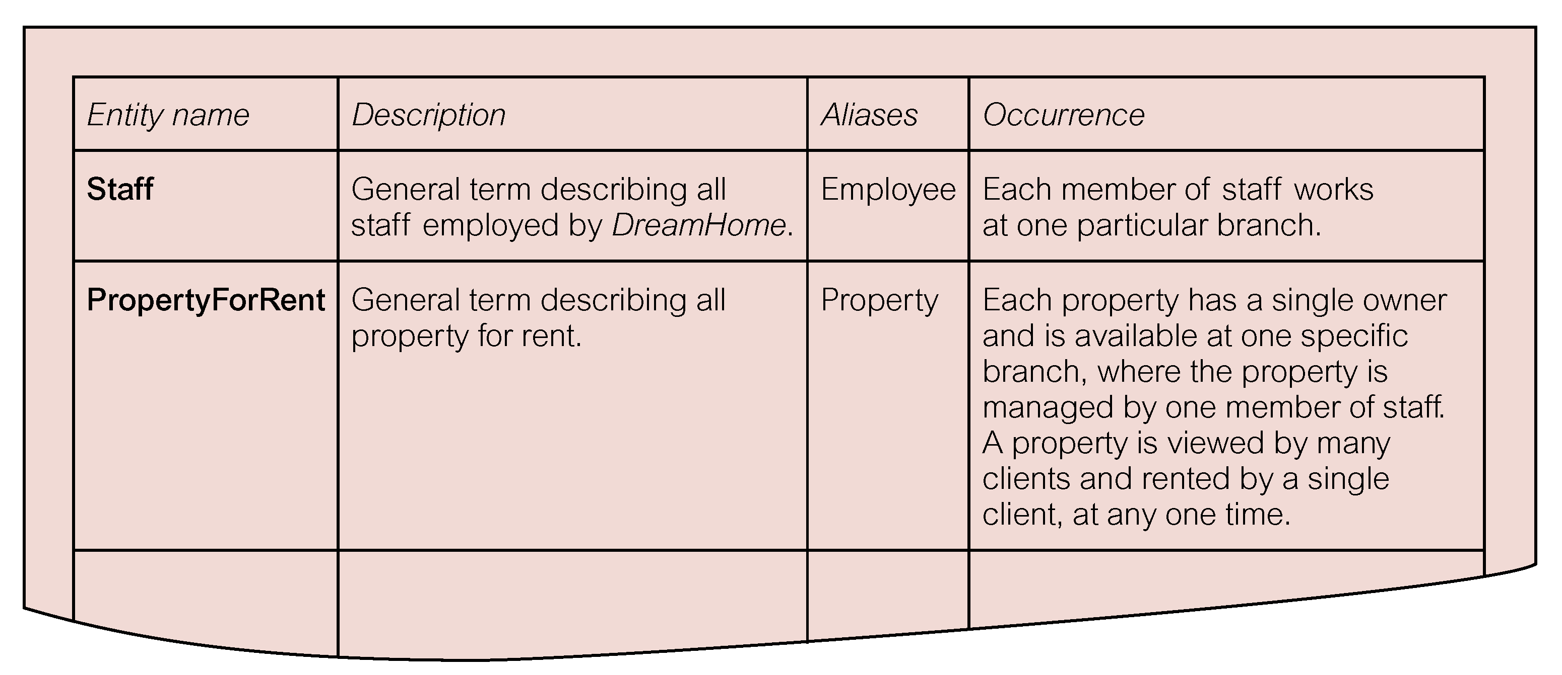
Extract from Data Dictionary for Staff View of DreamHome Showing Description of Entities

Slide 13
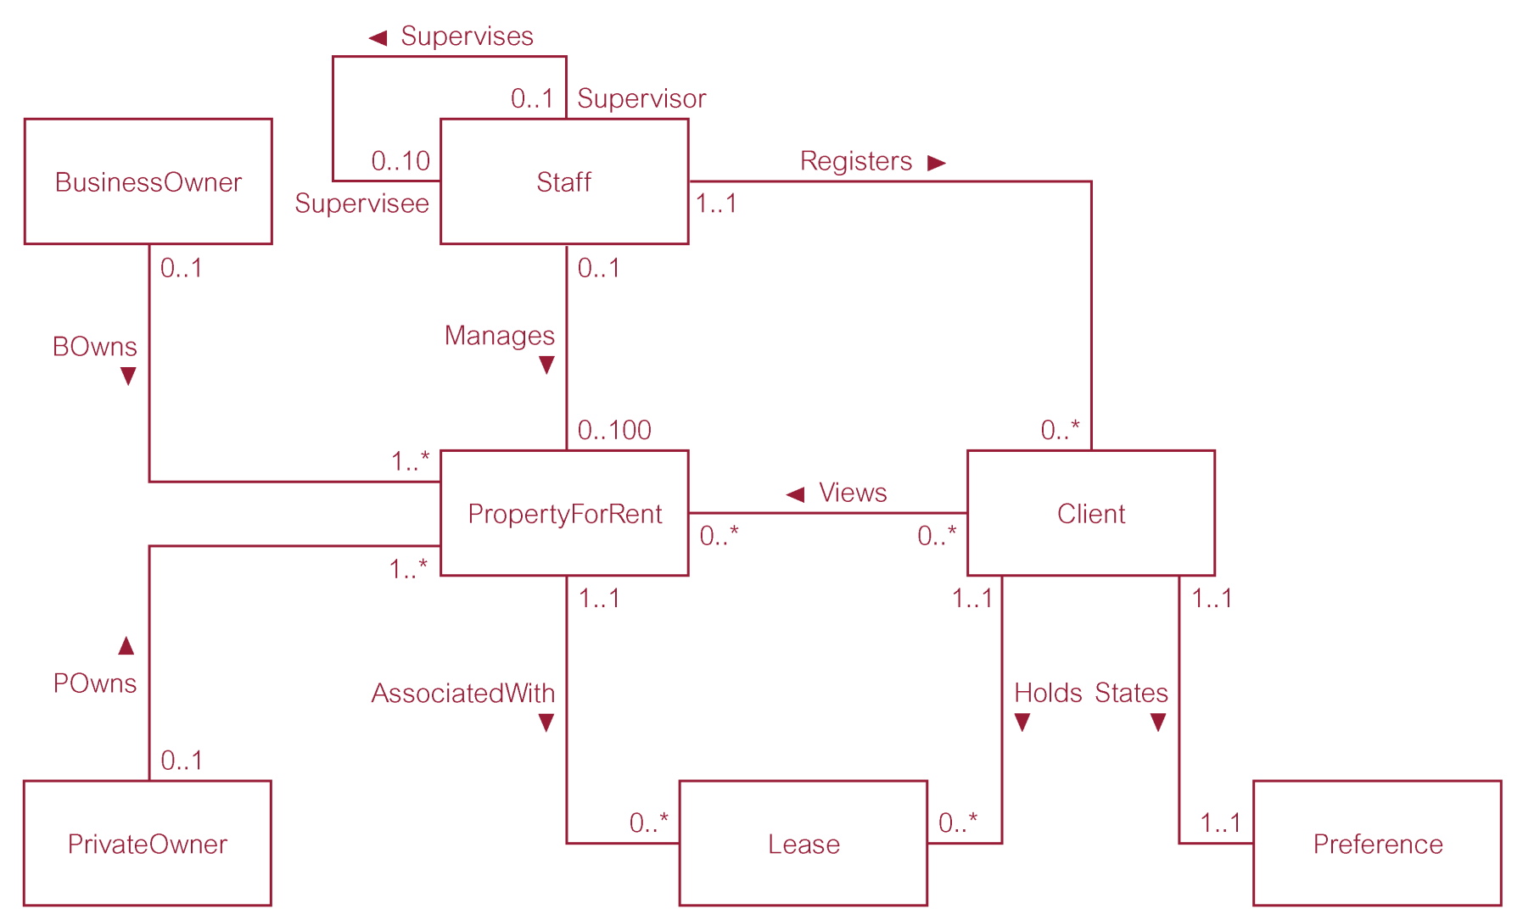
First-cut ER diagram for Staff View of DreamHome

Slide 14
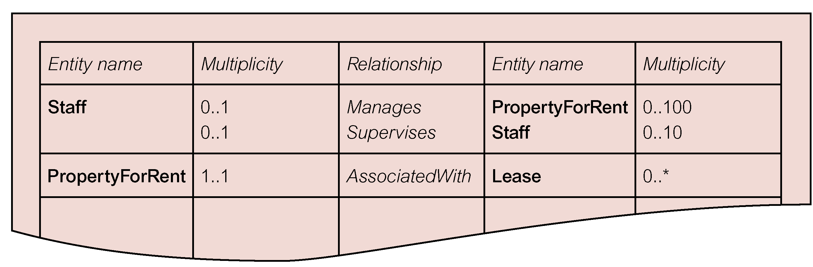
Extract from Data Dictionary for Staff View of DreamHome Showing Description of Relationships

Slide 15
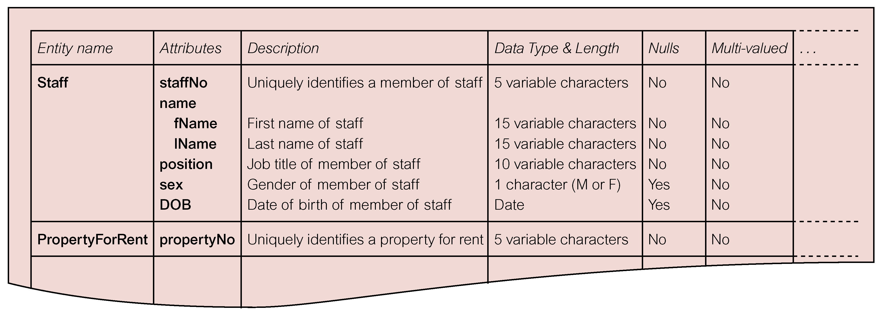
Extract from Data Dictionary for Staff View of DreamHome Showing Description of Attributes

Slide 16
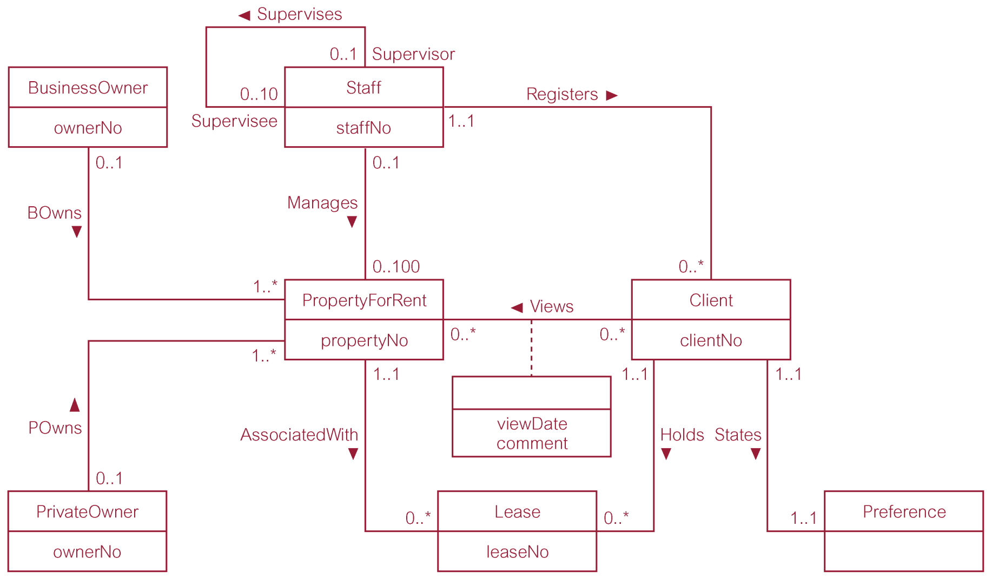
ER Diagram for Staff View of DreamHome with Unique Identifiers Added

Slide 17
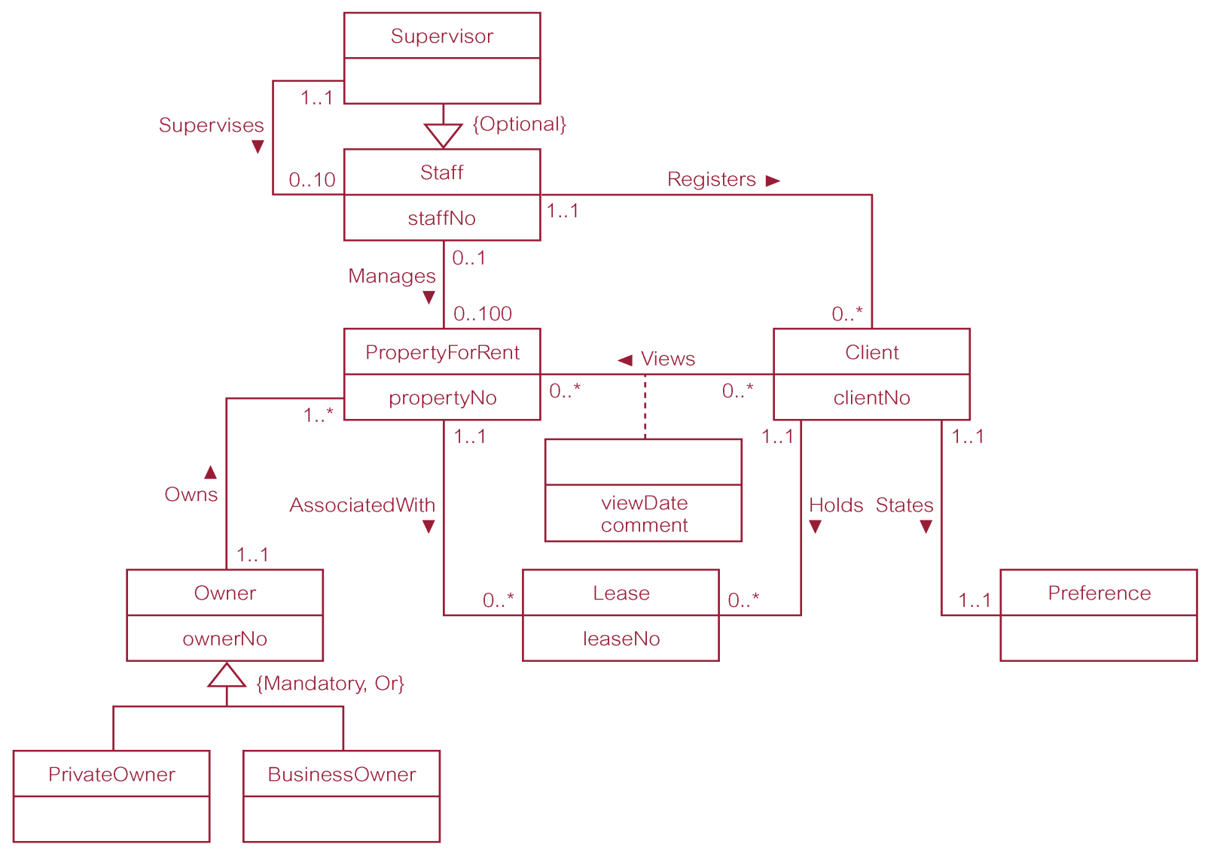
Revised ER Diagram for Staff View of DreamHome with Specialization / Generalization

Slide 18
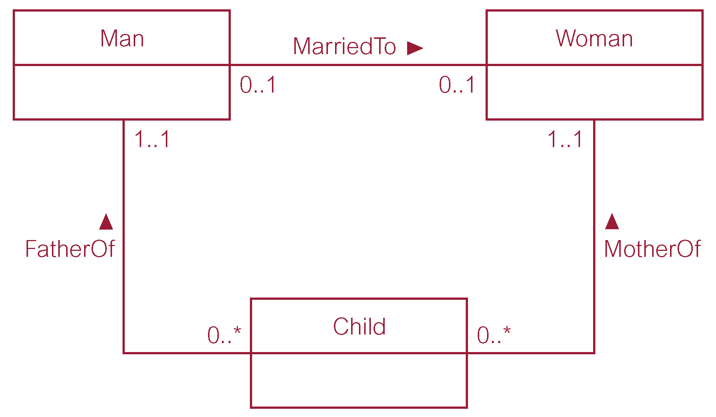
Example of a Non-Redundant Relationship FatherOf

Slide 19
User Transactions in the Staff View
( a) List details of staff supervised by a named Supervisor at the branch.
( b) List details of all Assistants alphabetically by name at the branch.
( c) List the details of property ( including the rental deposit) available for rent at the branch, along with the owner’s details.
( d) List the details of properties managed by a named member of staff at the branch.
.

Slide 20
User Transactions in the Staff View
( e) List the clients registering at the branch and the names of the members of staff who registered the clients.
( f ) Identify properties located in Glasgow with rents no higher than £ 450.
( g) Identify the name and telephone number of an owner of a given property.
( h) List the details of comments made by clients viewing a given property.

Slide 21
User Transactions in the Staff View
( i) Display the names and phone numbers of clients who have viewed a given property but not supplied comments.
( j) Display the details of a lease between a named client and a given property.
( k) Identify the leases due to expire next month at the branch.
( l) List the details of properties that have not been rented out for more than three months.
( m) Produce a list of clients whose preferences match a particular property.

Slide 22
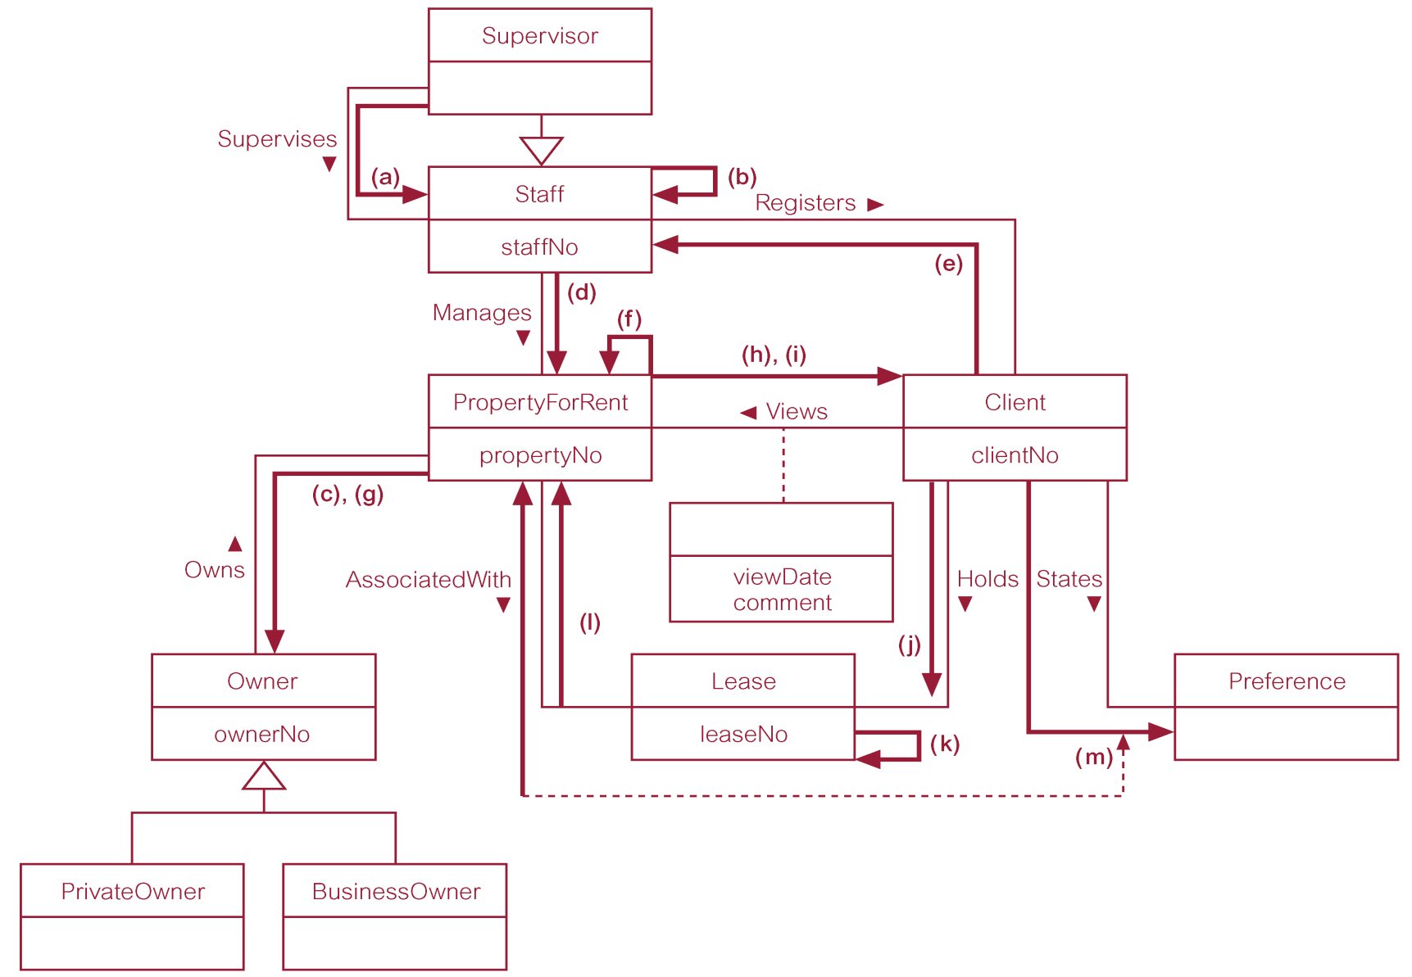
Using Pathways to Check that the Conceptual Model Supports the User Transactions

Slide 23
Data analysis and Requirements
Focus on:
  Information needs
  Information users
  Information sources
  Information constitution
Data sources
  Developing and gathering end-user data views
  Direct observation of current system
  Interfacing with systems design group
Business rules

Slide 24
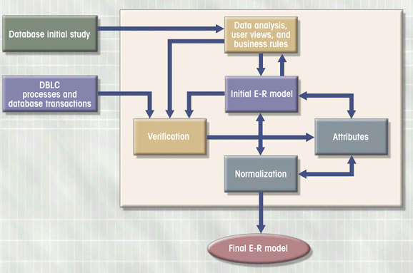
E-R Modeling is Iterative

