Slide 1
Database System Life Cycle

Slide 2
Objectives
Purpose of a design methodology.
Database design has three main phases: conceptual, logical, and physical design.

Slide 3
Acknowledgments
Some of these slides have been adapted from Thomas Connolly and Carolyn Begg

Slide 4
Design Methodology
Structured approach that uses procedures, techniques, tools, and documentation aids to support and facilitate the process of design.
Database design methodology has 3 main phases:
  Conceptual database design;
  Logical database design;
  Physical database design.

Slide 5
Preliminary Phase :
Database Initial Study
Purposes
  Analyze company situation
    Operating environment
    Organizational structure
  Define problems and constraints
  Define objectives
  Define scope and boundaries

Slide 6
Business Rules
What are business rules, what is their source, and why are they crucial?
Business rules are precise statements, derived from a detailed description of the organization's operations, that define one or more of the following modeling components:
  entities - in the E-R model corresponds to a table
  relationships – are associations between entities
  attributes – are characteristics of entities
  connectivities – are used to describe the relationship classification
  multiplicities – express the specific number of entity occurrences associated with one occurrence of the related entity
  constraints – limitations on the type of data accepted

Slide 7
Business Rules
Examples of business rules are:
  An invoice contains one or more invoice lines, but each invoice line is associated with a single invoice.
  A store employs many employees, but each employee is employed by only one store.
  A college has many departments, but each department belongs to a single college. (This business rule reflects a university that has multiple colleges such as Business, Liberal Arts, Education, Engineering, etc.)
  A driver may be assigned to drive many different vehicles, and each vehicle can be driven by many drivers. (Note: Keep in mind that this business rule reflects the assignment of drivers during some period of time.)
  A client may sign many contracts, but each contract is signed by only one client.

Slide 8
Changing Data into Information
Data
  Raw facts stored in databases
  Need additional processing to become useful
Information
  Required by decision maker
  Data processed and presented in a meaningful form
  Transformation

Slide 9
The Information System
Database
  Carefully designed and constructed repository of facts
  Part of an information system
Information System
  Provides data collection, storage, and retrieval
  Facilitates data transformation
  Components include:
      People
      Hardware
      Software
Database(s)
Application programs
Procedures

Slide 10
The Information System
System Analysis
  Establishes need and extent of an information system
System development
  Process of creating information system
Database development
  Process of database design and implementation
  Creation of database models
  Implementation
    Creating storage structure
    Loading data into database
    Providing for data management

Slide 11
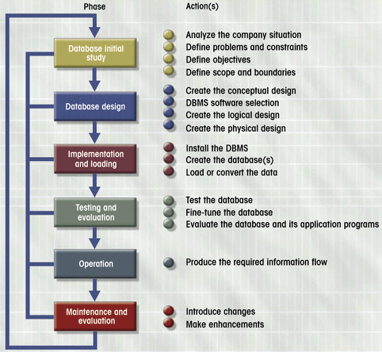
Database Lifecycle (DBLC)
Figure 6.3

Slide 12
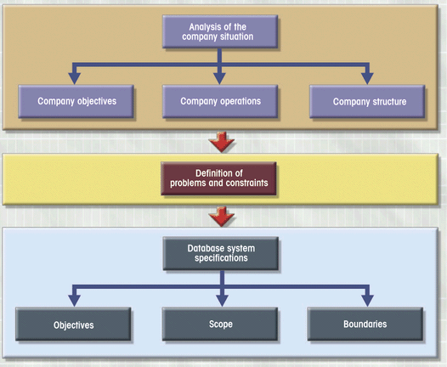
Initial Study Activities

Slide 13
Use case diagram

Slide 14
Conceptual/Logical Database Design
Conceptual database design
  Process of constructing a model of information used in an enterprise, independent of all physical considerations.
Logical database design
  Process of constructing a model of information used in an enterprise based on a specific data model (e.g. relational), but independent of a particular DBMS and other physical considerations.

Slide 15
Physical Database Design
Process of producing a description of the implementation of the database on secondary storage; it describes the base relations, file organizations, and indexes design used to achieve efficient access to the data, and any associated integrity constraints and security measures.

Slide 16
Critical Success Factors in Database Design
Work interactively with users as much as possible.
Follow a structured methodology throughout the data modeling process.
Employ a data-driven approach.
Incorporate structural and integrity considerations into the data models.
Combine conceptualization, normalization, and transaction validation techniques into the data modeling methodology.

Slide 17
Critical Success Factors in Database Design
Use diagrams to represent as much of the data models as possible.
Use a Database Design Language (DBDL) to represent additional data semantics.
Build a data dictionary to supplement the data model diagrams.
Be willing to repeat steps.

Slide 18
Methodology Overview - Conceptual Database Design
Step 1 Build local conceptual data model for each user view
  Step 1.1 Identify entity types
  Step 1.2 Identify relationship types
  Step 1.3 Identify and associate attributes with entity or relationship types
  Step 1.4 Determine attribute domains
  Step 1.5 Determine unique identifier (will become a key) attributes
  Step 1.6 Consider use of enhanced modeling concepts (optional step)
  Step 1.7 Check model for redundancy
  Step 1.8 Validate local conceptual model against user transactions
  Step 1.9 Review local conceptual data model with user

Slide 19
Class diagram

Slide 20
Methodology Overview - Logical Database Design for Relational Model
Step 2 Build and validate local logical data model for each view
  Step 2.1 Remove features not compatible with the relational model (optional step)
  Step 2.2 Derive relations for local logical data model
  Step 2.3 Validate relations using normalization
  Step 2.4 Validate relations against user transactions
  Step 2.5 Define integrity constraints
  Step 2.6 Review local logical data model with user

Slide 21
Methodology Overview - Logical Database Design for Relational Model
Step 3 Build and validate global logical data model
  Step 3.1 Merge local logical data models into global model
  Step 3.2 Validate global logical data model against the
  conceptual data model
  Step 3.3 Check for future growth
  Step 3.4 Review global logical data model with users

Slide 22
Methodology Overview - Physical Database Design for Relational Databases
Step 4 Translate global logical data model for target DBMS
  Step 4.1 Design base relations
  Step 4.2 Design representation of derived data
  Step 4.3 Design enterprise constraints
Step 5 Design physical representation
  Step 5.1 Analyze transactions
  Step 5.2 Choose file organization
  Step 5.3 Choose indexes
  Step 5.4 Estimate disk space requirements

Slide 23
Methodology Overview - Physical Database Design for Relational Databases
Step 6 Design user views
Step 7 Design security mechanisms
Step 8 Consider the introduction of controlled redundancy
Step 9 Monitor and tune the operational system

