Slide 1
The Relational Database Model

Slide 2
Learning Objectives
Terminology of relational model.
How tables are used to represent data.
Connection between mathematical relations and relations in the relational model.
Properties of database relations.
How to identify candidate, primary, and foreign keys.
Meaning of entity integrity and referential integrity.
Purpose and advantages of views.

Slide 3
Acknowledgments
Some of these slides have been adapted from Thomas Connolly and Carolyn Begg

Slide 4
History of the Relational Model
Relational Database Model history
  Proposed by Codd in 1970
  Pioneer projects such as at IBM and UC-Berkeley in mid-1970s
  Today, still the dominant database model:
    IBM DB2, ORACLE, INFORMIX, SYBASE
    MICROSOFT Access, SQL Server
    FOXBASE, PARADOX
    …
The relational model provides a logical representation of the data

Slide 5
Relational Model Terminology
A relation is a table with columns and rows.
  Only applies to logical structure of the database, not the physical structure.
  A relation corresponds to an entity set, or collection of entities. An entity is a person, place, event, or thing about which data is collected
Attribute is a named column of a relation. It corresponds to a characteristic of an entity. They are also called fields.
Domain is the set of allowable values for one or more attributes.

Slide 6
Relational Model Terminology
Tuple is a row of a relation.
Degree is the number of attributes in a relation.
Cardinality is the number of tuples in a relation.
Relational Database is a collection of normalized relations with distinct relation names.
NB a relation is not a relationship, but an entity set.

Slide 7
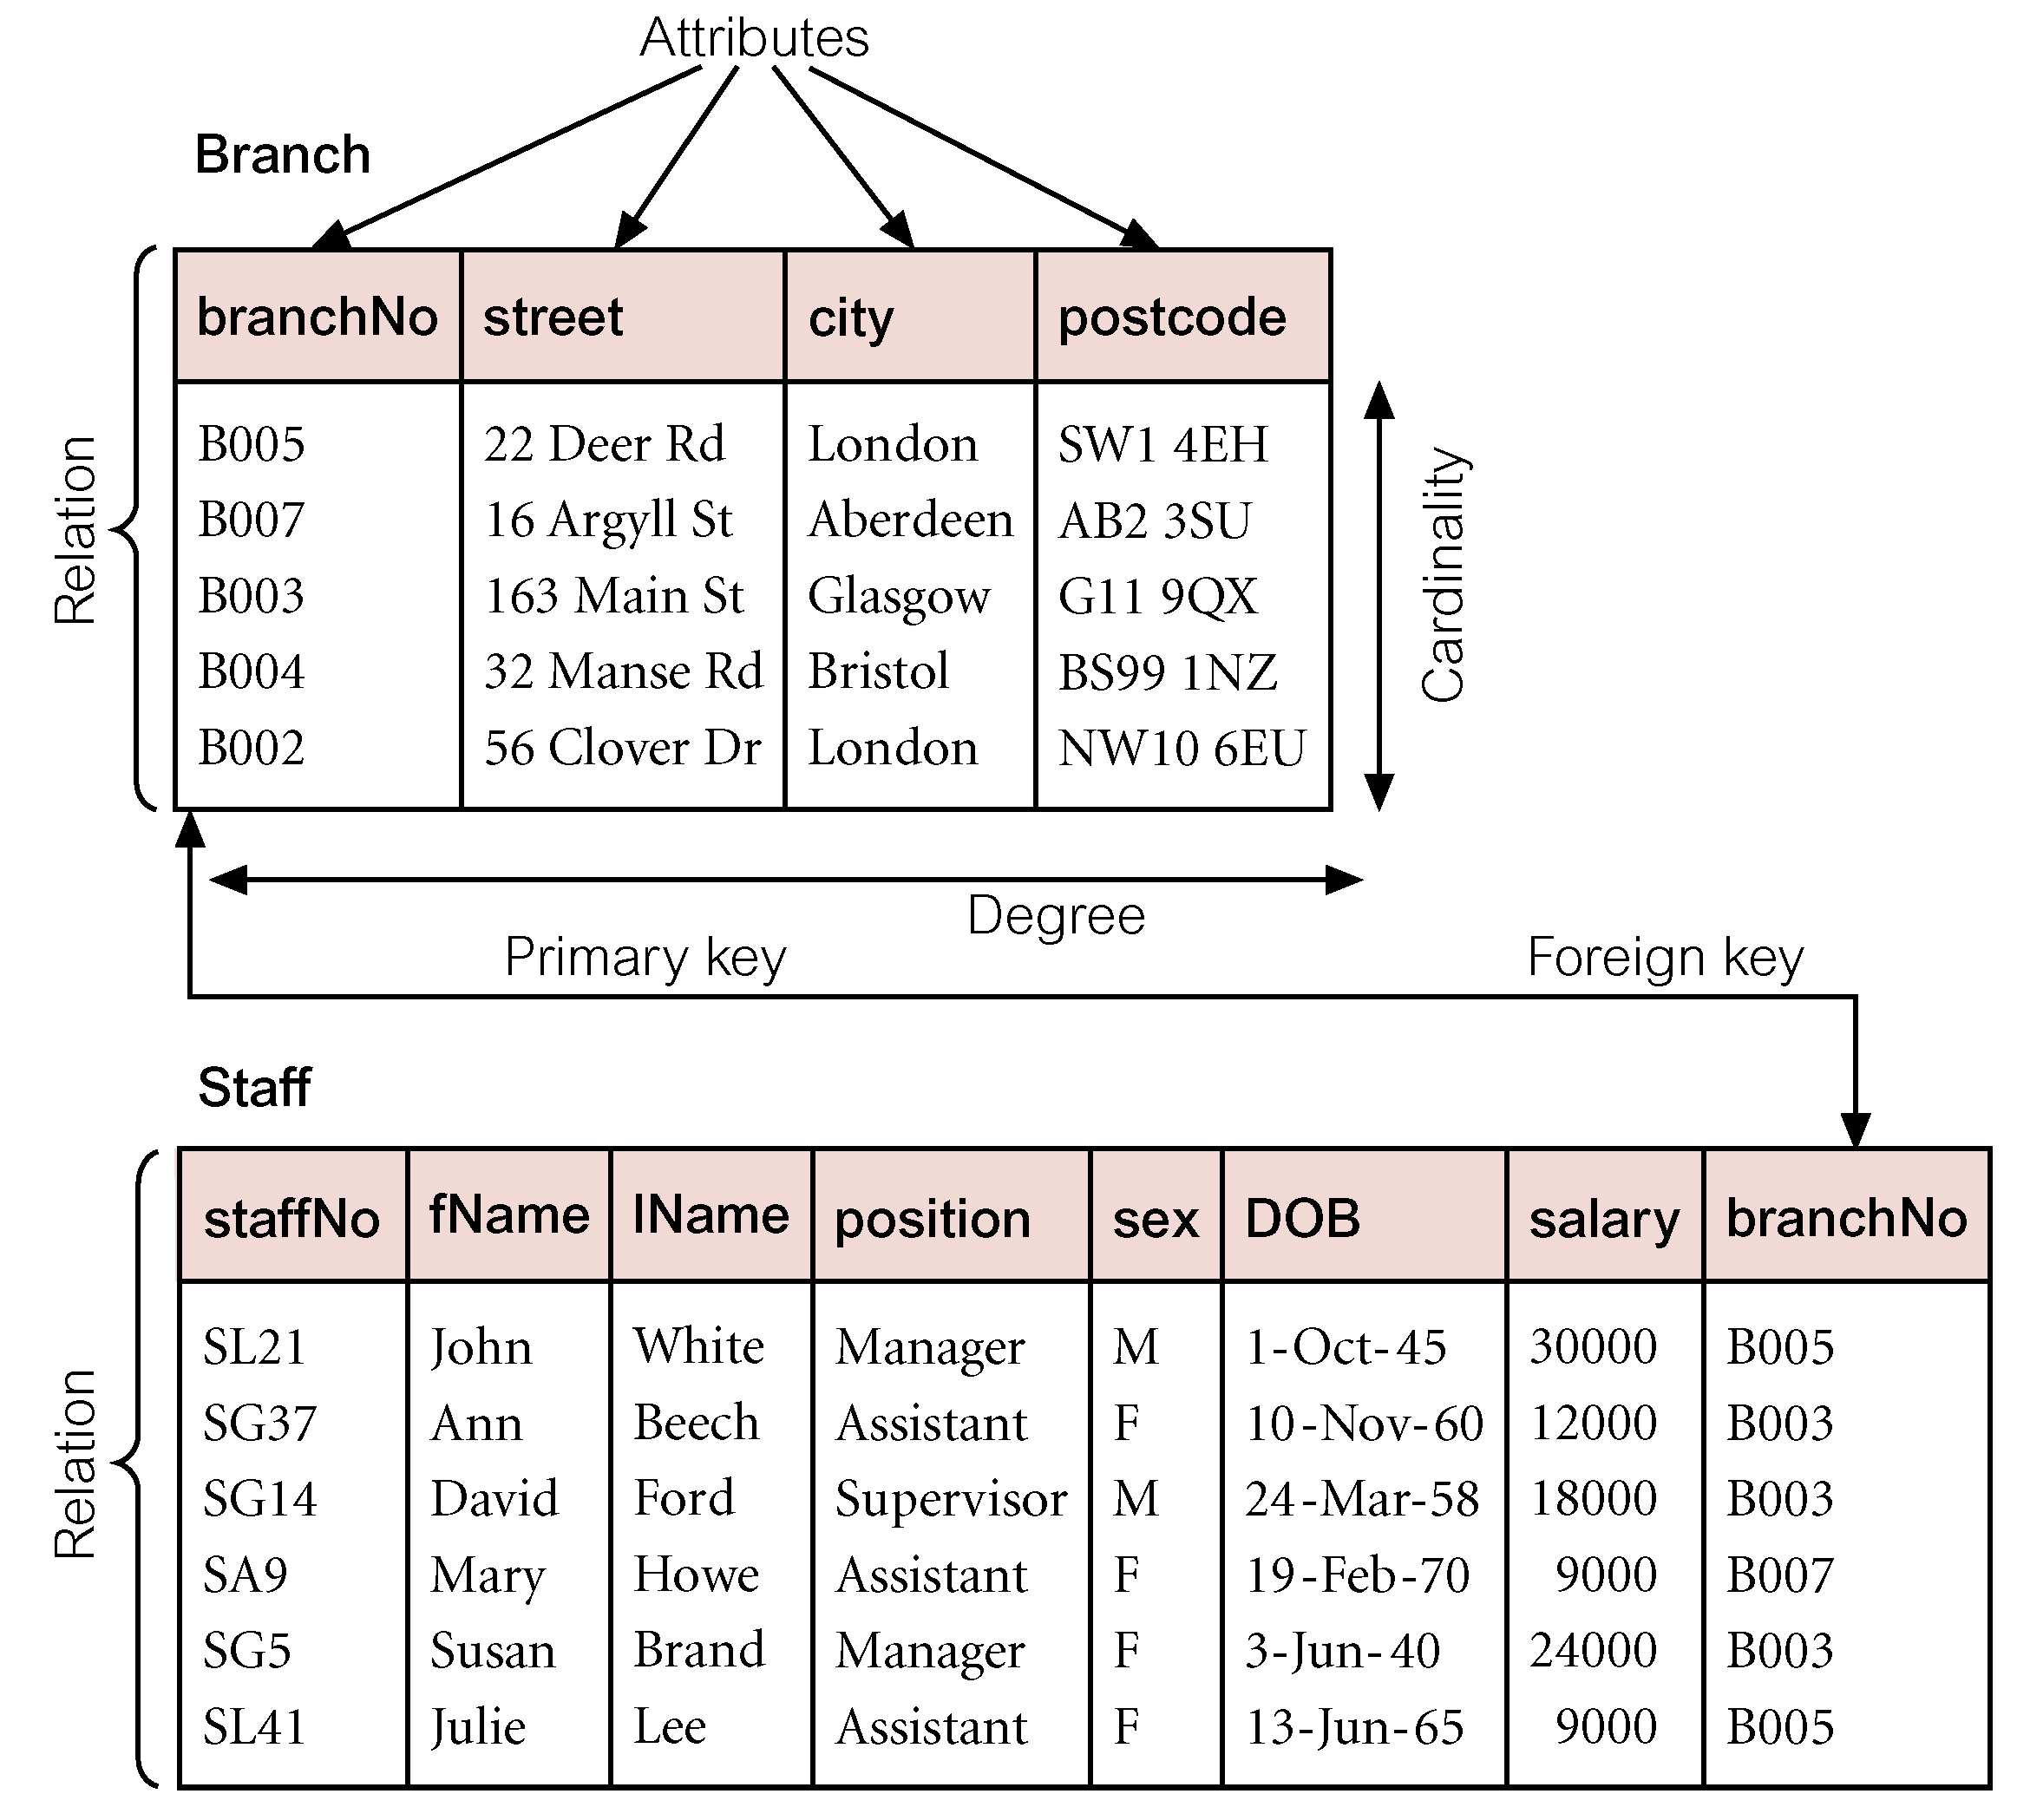
Instances of Branch and Staff (part) Relations

Slide 8
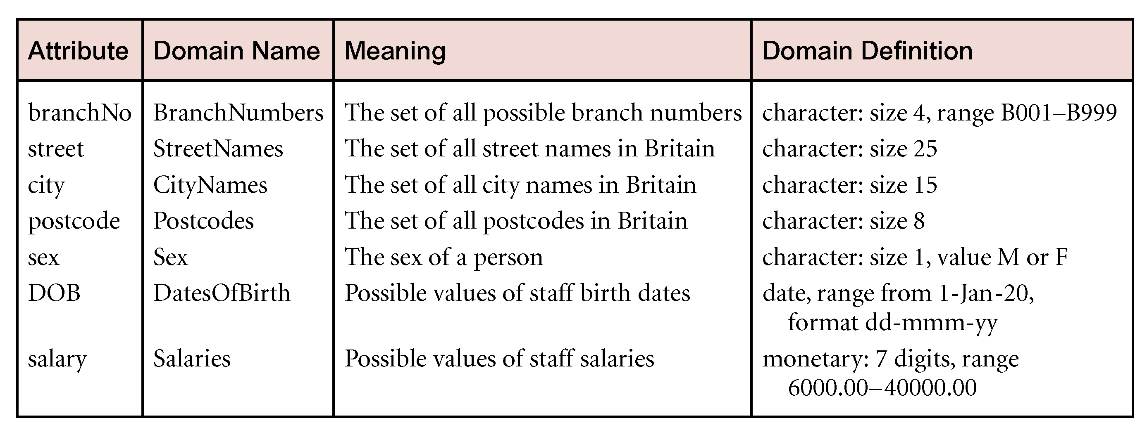
Examples of Attribute Domains

Slide 9
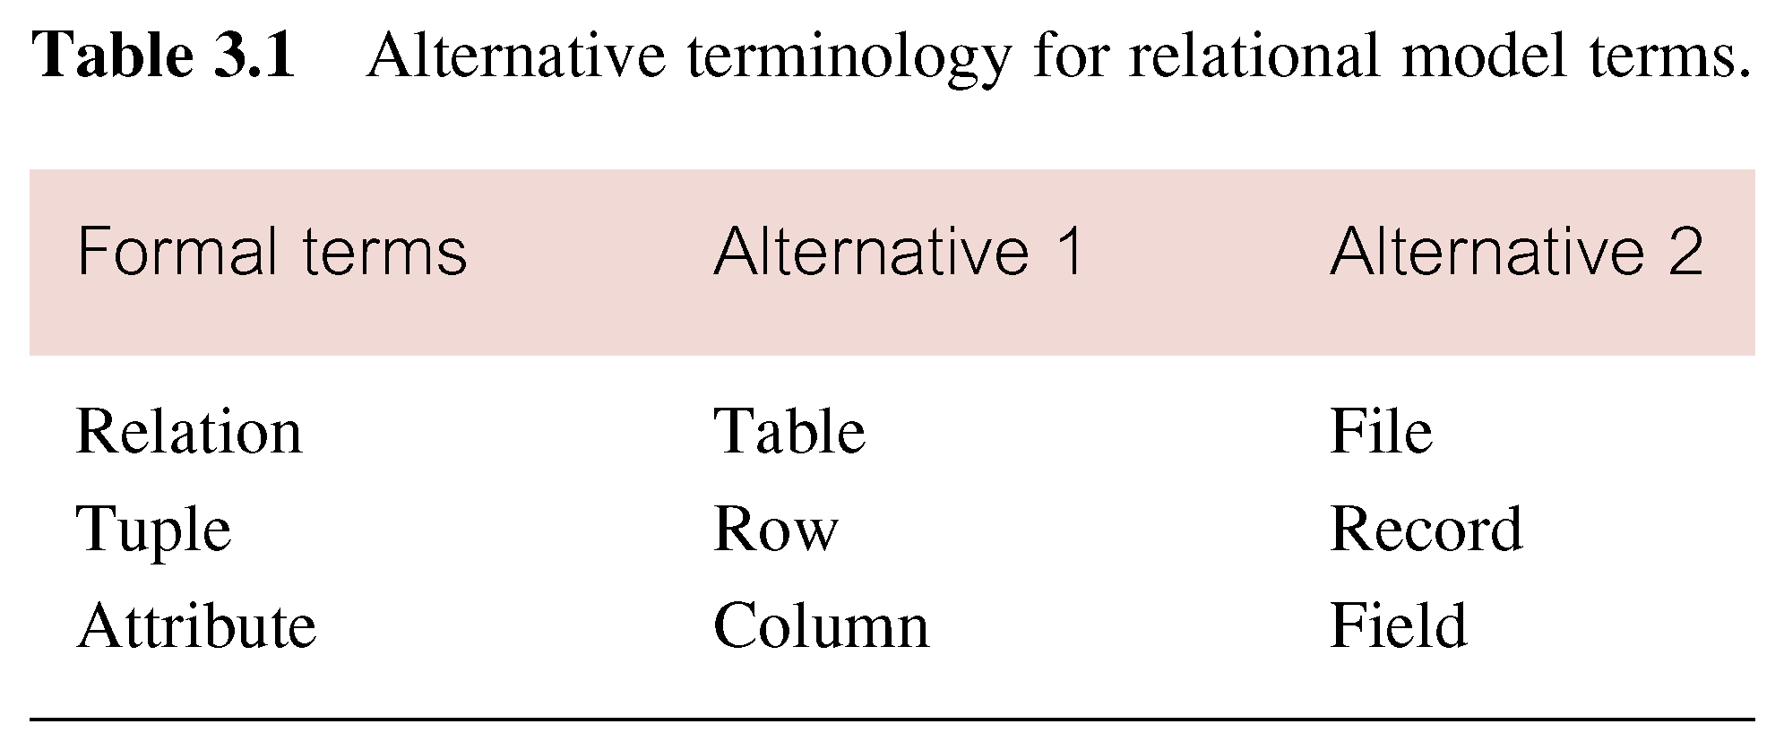
Alternative Terminology for Relational Model

Slide 10
Mathematical Definition of Relation
Consider two sets, D₁ & D₂, where D₁ = {2, 4} and D₂ = {1, 3, 5}.
Cartesian product, D₁ × D₂, is set of all ordered pairs, where first element is member of D₁ and second element is member of D₂.
    D₁ × D₂ = {(2, 1), (2, 3), (2, 5), (4, 1), (4, 3), (4, 5)}
Alternative way is to find all combinations of elements with first from D₁ and second from D₂.

Slide 11
Mathematical Definition of Relation
Any subset of Cartesian product is a relation; e.g.
  R = {(2, 1), (4, 1)}
May specify which pairs are in relation using some condition for selection; e.g.
  second element is 1:
  R = {(x, y) | x ∈D₁, y ∈D₂, and y = 1}
  first element is always twice the second:
  S = {(x, y) | x ∈D₁, y ∈D₂, and x = 2y}

Slide 12
Mathematical Definition of Relation
Consider three sets D₁, D₂, D₃ with Cartesian Product D₁ × D₂ × D₃; e.g.
  D₁ = {1, 3} D₂ = {2, 4} D₃ = {5, 6}
  D₁ × D₂ × D₃ = {(1,2,5), (1,2,6), (1,4,5), (1,4,6), (3,2,5), (3,2,6), (3,4,5), (3,4,6)}
Any subset of these ordered triples is a relation.

Slide 13
Mathematical Definition of Relation
The Cartesian product of n sets (D₁, D₂, . . ., D_{n}) is:
  D₁ × D₂ × . . . × D_{n} = {(d₁, d₂, . . . , d_{n}) | d₁ ∈D₁, d₂ ∈D₂, . . . , d_{n}∈D_{n}}
usually written as:
  n
  XD_{i}
  ^{i = 1}
Any set of n-tuples from this Cartesian product is a relation on the n sets.

Slide 14
Database Relations
Relation schema
  Named relation defined by a set of attribute and domain name pairs.
Relational database schema
  Set of relation schemas, each with a distinct name.

Slide 15
Properties of Relations
Relation name is distinct from all other relation names in relational schema.
Each cell of relation contains exactly one atomic (single) value.
Each attribute has a distinct name.
Values of an attribute are all from the same domain.

Slide 16
Properties of Relations
Each tuple is distinct; there are no duplicate tuples.
Order of attributes has no significance.
Order of tuples has no significance, theoretically.

Slide 17
Table Characteristics
Each RDBMS has its rules for table and column names.
Example: Access
Table names <= 64 (8 is classical)
Column names <= 64 (10 is classical)
Column names cannot start with digit,
or contain special characters
except underscore and a few others
Each RDBMS has its rules for associating a data type to an attribute, but there are classical ones:
text, character, number, date, boolean

Slide 18
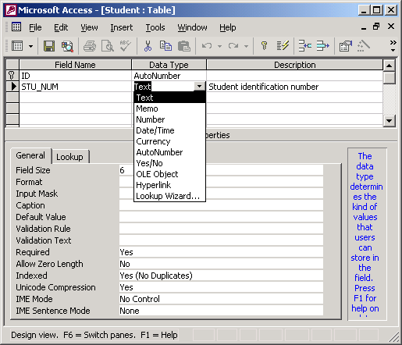
Table Characteristics

Slide 19
Relational Keys
Key
  One or more attributes that determine other attributes
    Key attribute
    Composite key
There needs to be full functional dependence from key to any other attribute

Slide 20
Relational Keys
Keys may be
  Single
  Composite (composed of several key attributes)
Example: staff_fName, staff_lName, staff_init, staff_phone → staff_DOB, staff_position
Functional dependence: attribute A2 is functionally dependent on a composite key A1, but not on any subset of it

Slide 21
Relational Keys
Functional dependence: an attribute A is functionally dependent on an attribute K is each value in column K determines one and only one value in column A. K → A (K determines A).
Attribute K determines attribute A if all rows in the table that agree in value for attribute K must also agree in value for attribute A.
Attribute A is functionally dependent on K if K determines A.

Slide 22
Relational Keys
Superkey
  An attribute, or a set of attributes, that uniquely identifies a tuple within a relation.
Candidate Key
  Superkey (K) such that no proper subset is a superkey within the relation.
  In each tuple of R, values of K uniquely identify that tuple (uniqueness).
  No proper subset of K has the uniqueness property (irreducibility).

Slide 23
Relational Keys
Primary Key
  Candidate key selected to identify tuples uniquely within relation.
Alternate Keys
  Candidate keys that are not selected to be primary key.
Foreign Key
  Attribute, or set of attributes, within one relation that matches candidate key of some (possibly same) relation.

Slide 24
Relational Integrity
Null
  Represents value for an attribute that is currently unknown or not applicable for tuple.
  Deals with incomplete or exceptional data.
  Represents the absence of a value and is not the same as zero or spaces, which are values.

Slide 25
Relational Integrity
Entity Integrity
  In a base relation, no attribute of a primary key can be null.
  Ensures that all entities are unique.
Referential Integrity
  If foreign key exists in a relation, either foreign key value must match a candidate key value of some tuple in its home relation or foreign key value must be wholly null.

Slide 26
Relational Integrity
Enterprise Constraints
  Additional rules specified by users or database administrators.

Slide 27
Relational Database Operators
Relational algebra determines
table manipulations
Key operators (minimally relational RDBMS)
  SELECT
  PROJECT
  JOIN
Other operators
  INTERSECT
  UNION (union compatible tables)
  DIFFERENCE
  PRODUCT
  DIVIDE

Slide 28
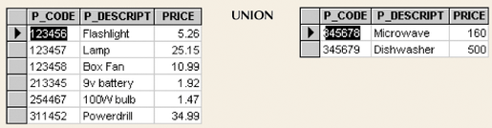
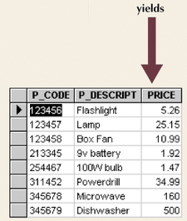
Union
Combines all rows

Slide 29
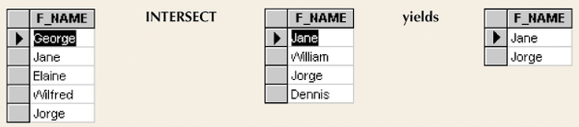
Intersect
Yields rows that appear in both tables
Figure 2.6

Slide 30
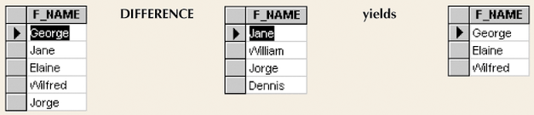
Difference
Yields rows not found in other tables
Figure 2.7

Slide 31
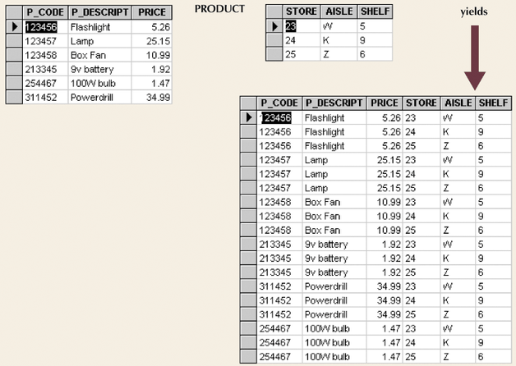
Product
Yields all possible pairs from two tables
Figure 2.8

Slide 32
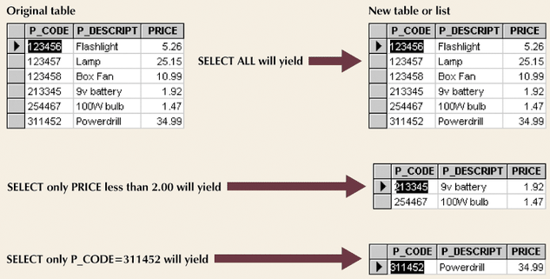
Select
Yields a subset of rows based on specified criterion

Slide 33
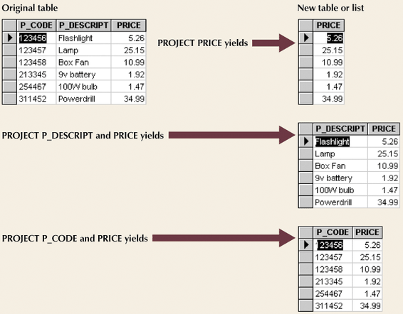
Project
Yields all values for selected attributes
Figure 2.10

Slide 34
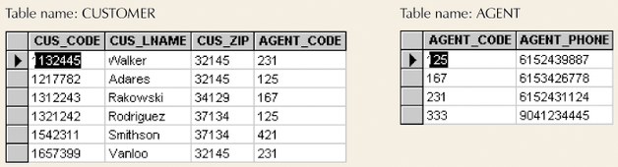
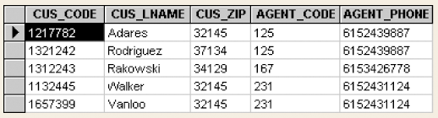
Join
Information from two or more tables is combined
Figure 2.11

Slide 35
Natural Join Process
Links tables by selecting rows with common values in common attribute(s)
Three-stage process
  Product creates one table
  Select yields appropriate rows
  Project yields single copy of each attribute to eliminate duplicate columns
Eliminates duplicates
Does not include rows that are unmatched

Slide 36
Other Joins
EquiJOIN
  Links tables based on equality condition that compares specified columns of tables
  Does not eliminate duplicate columns
  Join criteria must be explicitly defined
Theta JOIN
  EquiJOIN that compares specified columns of each table using operator other than equality one
Outer JOIN
  Matched pairs are retained
  Unmatched values in other tables left null
  Right and left

Slide 37
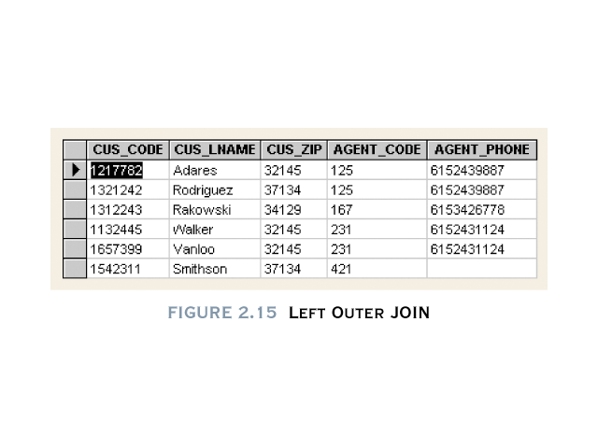
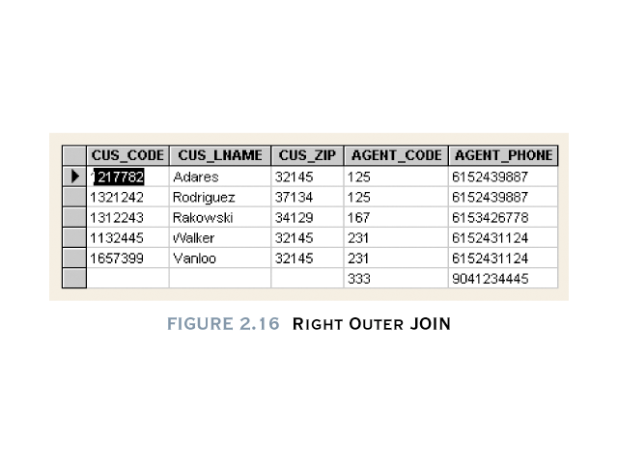
Other Joins

Slide 38
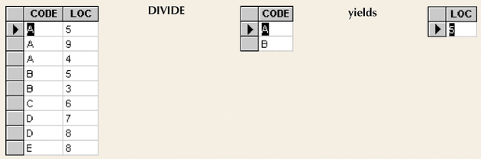
Divide
Requires user of single-column table and two-column table
A value in the unshared column must be associated with each value in the single-column table
Figure 2.17

Slide 39
Views
Base Relation
  Named relation corresponding to an entity in conceptual schema, whose tuples are physically stored in database.
View
  Dynamic result of one or more relational operations operating on base relations to produce another relation.

Slide 40
Views
A virtual relation that does not necessarily actually exist in the database but is produced upon request, at time of request.
Contents of a view are defined as a query on one or more base relations.
Views are dynamic, meaning that changes made to base relations that affect view attributes are immediately reflected in the view.

Slide 41
Purpose of Views
Provides powerful and flexible security mechanism by hiding parts of database from certain users.
Permits users to access data in a customized way, so that same data can be seen by different users in different ways, at same time.
Can simplify complex operations on base relations.

Slide 42
Updating Views
All updates to a base relation should be immediately reflected in all views that reference that base relation.
If view is updated, underlying base relation should reflect change.

Slide 43
Updating Views
There are restrictions on types of modifications that can be made through views:
- Updates are allowed if query involves a single base relation and contains a candidate key of base relation.
- Updates are not allowed involving multiple base relations.
- Updates are not allowed involving aggregation or grouping operations.

Slide 44
Updating Views
Classes of views are defined as:
  theoretically not updateable;
  theoretically updateable;
  partially updateable.

