Slide 1
Web Database Environment

Slide 2
Learning Objectives
Meaning of client–server architecture and advantages of this type of architecture for a DBMS.
The difference between two-tier, three-tier and n-tier client–server architectures
The function of an application server
The meaning of middleware and the different types of middleware that exist
Function and uses of Transaction Processing Monitors.

Slide 3
Learning Objectives
The purpose of a Web service and the technological standards used
The meaning of service-oriented architecture (SOA)
The difference between distributed DBMSs, and distributed processing

Slide 4
Acknowledgments
Some of these slides have been adapted from Thomas Connolly and Carolyn Begg

Slide 5
Multi-user DBMS Architectures
Teleprocessing
Traditional architecture for multi-user systems
One computer with a single central processing unit (CPU) and a number of terminals
Put a huge burden on the central computer
Downsizing
Replacing expensive mainframe computers with more cost-effective networks of personal computers

Slide 6
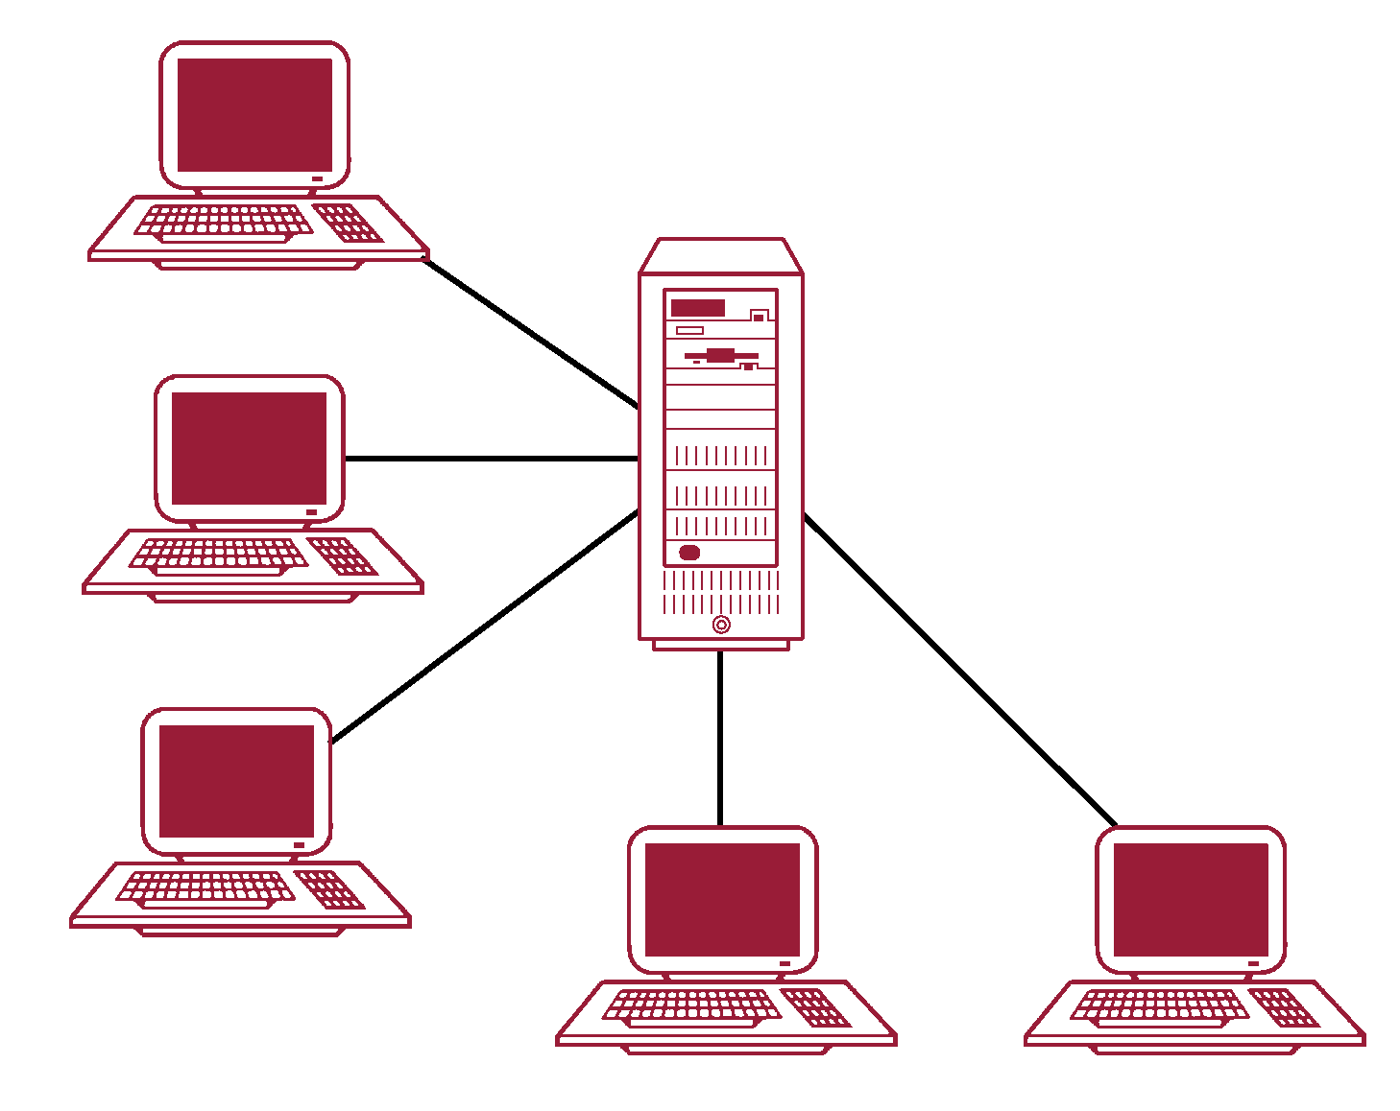
Teleprocessing Topology

Slide 7
Multi-user DBMS Architectures
File-server architecture
Processing is distributed about the network
Three main disadvantages
Large amount of network traffic
Full copy of DBMS required on each workstation
Concurrency, recovery, and integrity control are complex
Multiple DBMSs can access the same files

Slide 8
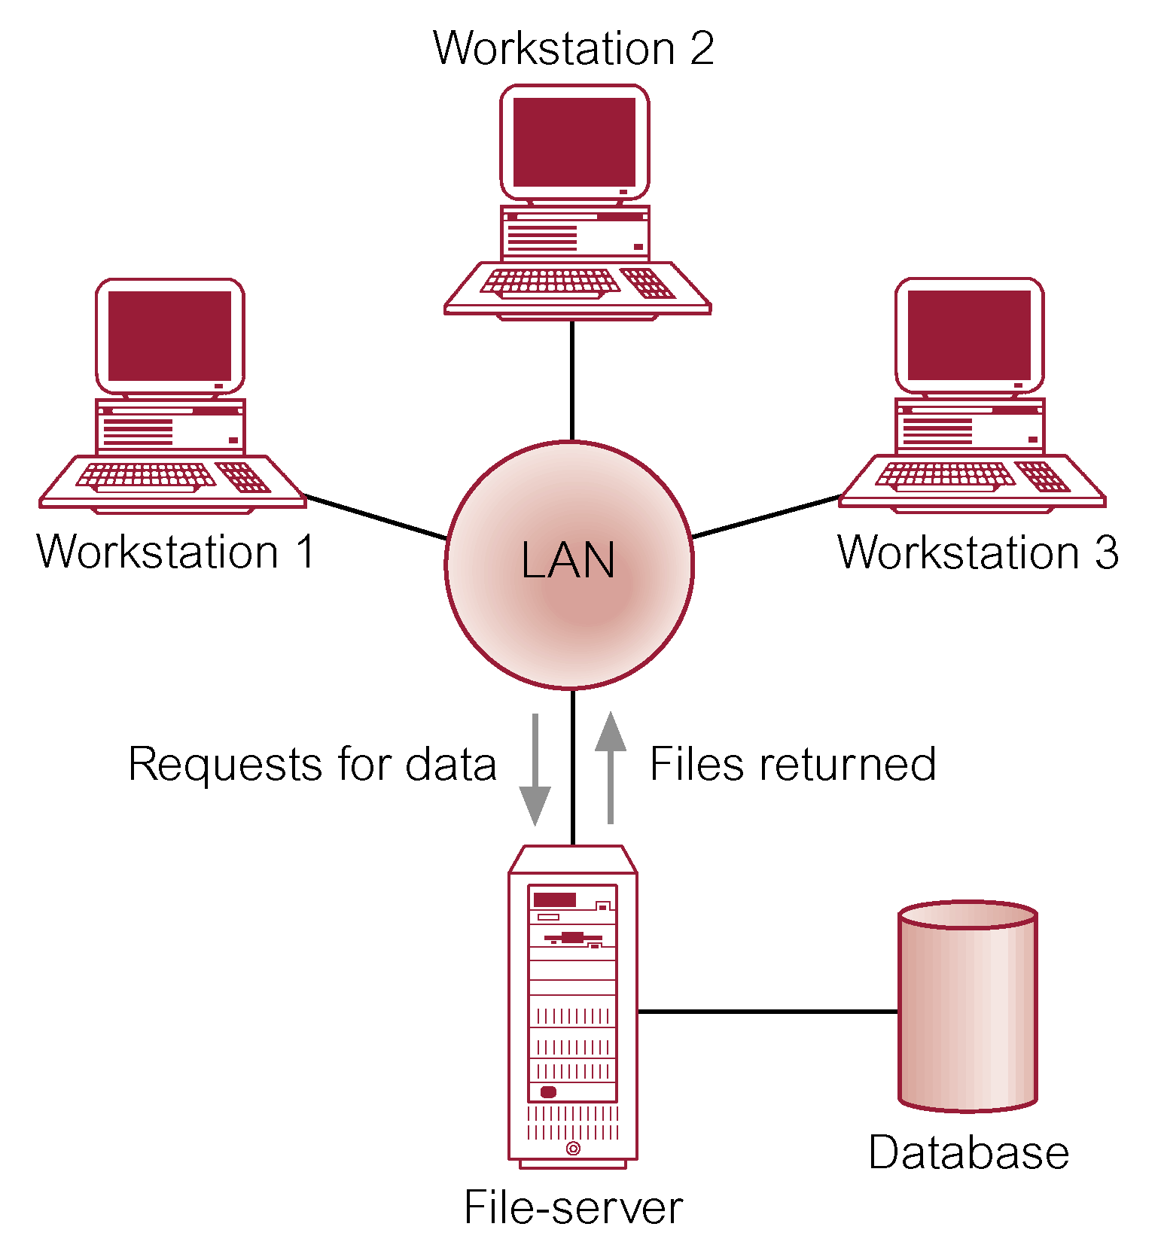
File-Server Architecture

Slide 9
Multi-user DBMS Architectures
Traditional two-tier client–server architecture
Client process requires some resource
Server provides the resource
Basic separation of four main components of business application
Typical interaction between client and server

Slide 10
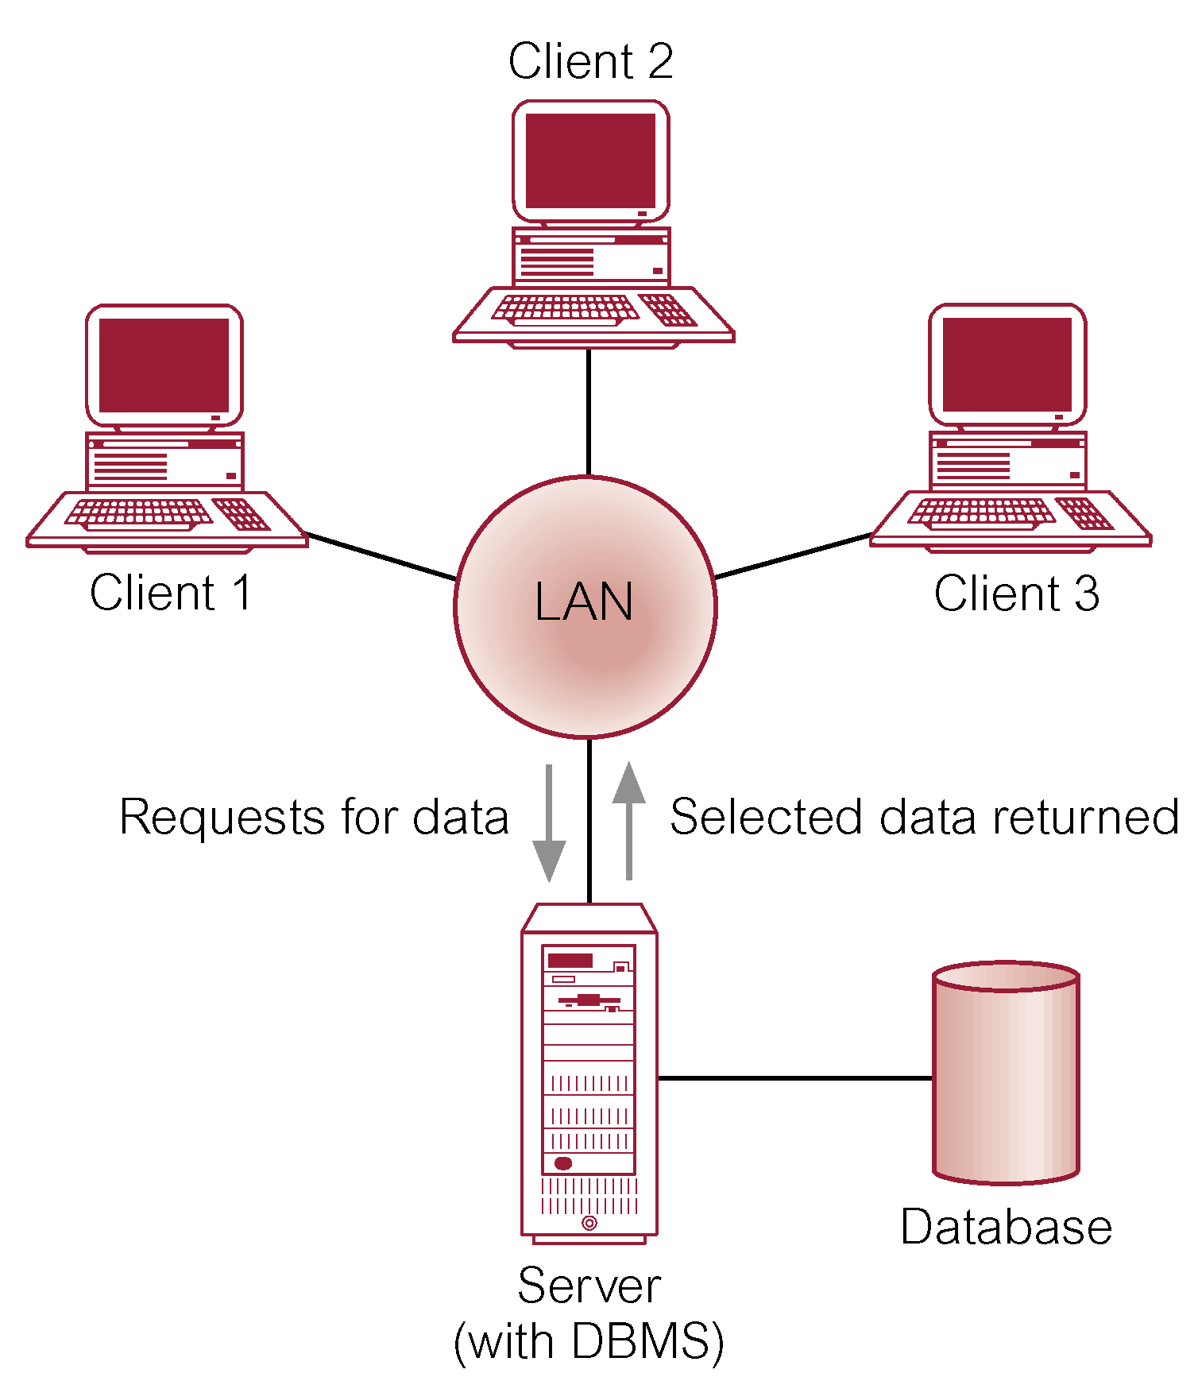
Client-Server Architecture

Slide 11
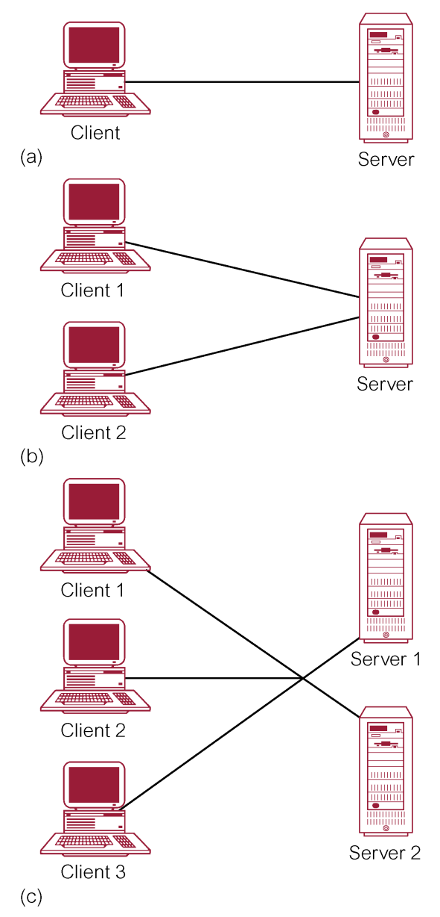
Alternative Client-Server Topologies

Slide 12
Summary of client–server functions

Slide 13
Multi-user DBMS Architectures
Three-tier client–server architecture
User interface layer
Business logic and data processing layer
DBMS
Many advantages over traditional two-tier or single-tier designs

Slide 14
Multi-user DBMS Architectures
N-tier architectures
Three-tier architecture can be expanded to n tiers
Application servers
Hosts an application programming interface (API) to expose business logic and business processes for use by other applications

Slide 15
Multi-user DBMS Architectures
Middleware
Software that mediates with other software
Communication among disparate applications
Six main types
Asynchronous Remote Procedure Call (RPC)
Synchronous RPC
Publish/Subscribe
Message-Oriented middleware (MOM)
Object-request broker (ORB)
SQL-oriented data access

Slide 16
Multi-user DBMS Architectures
Transaction processing monitor
Controls data transfer between clients/servers
Provides a consistent environment, particularly for online transaction processing (OLTP)
Significant advantages
Transaction routing
Managing distributed transactions
Load balancing
Funneling
Increased reliability

Slide 17
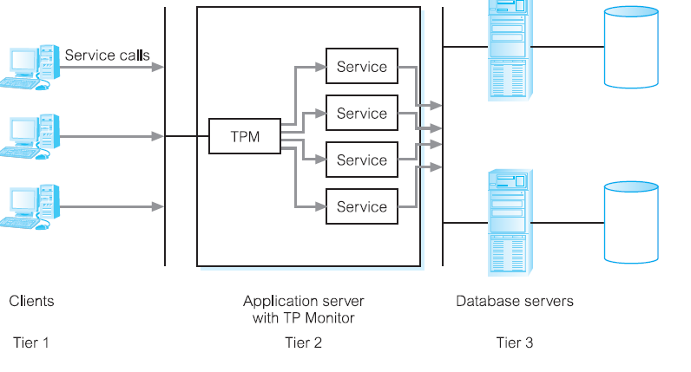
Multi-user DBMS Architectures
Transaction processing monitor of a three-tier client-server architecture

Slide 18
Web Services and Service-Oriented Architectures
Web service
Software system that supports interoperable machine-to-machine interaction over a network
No user interface
Examples of Web services
Uses widely accepted technologies and standards

Slide 19
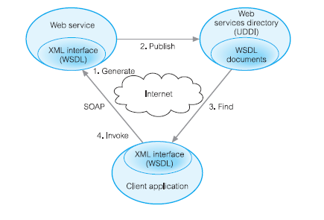
Relationship between WSDL, UDDI, and SOAP

Slide 20
Web Services and Service-Oriented Architectures
Service-Oriented Architectures (SOA)
Architecture for building applications that implement business processes as sets of services
Published at a granularity relevant to the service consumer
Loosely coupled and autonomous services
Web services designed for SOA different from other Web services

Slide 21
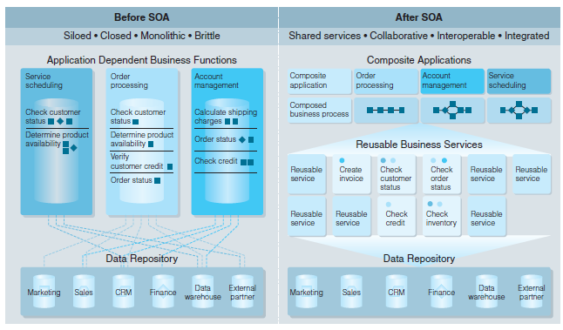
Traditional vs. SOA Architecture

Slide 22
Distributed DBMSs
Distributed database
Logically interrelated collection of shared data physically distributed over a computer network
Distributed DBMS
Software system that permits the management of the distributed database
Makes the distribution transparent to users

Slide 23
Distributed DBMSs
Characteristics of DDBMS
Collection of logically related shared data
Data split into fragments
Fragments may be replicated
Fragments/replicas are allocated to sites
Sites are linked by a communications network
Data at each site is controlled by DBMS
DMBS handles local apps autonomously
Each DBMS in one or more global app

Slide 24
Distributed DBMSs
Distributed processing
Centralized database that can be accessed over a computer network
System consists of data that is physically distributed across a number of sites in the network

