Slide 1
Database Environment

Slide 2
Learning Objectives
Purpose of three-level database architecture.
Contents of external, conceptual, and internal levels.
Purpose of external/conceptual and conceptual/internal mappings.
Meaning of logical and physical data independence.
Distinction between DDL and DML.
A classification of data models.

Slide 3
Learning Objectives
Purpose/importance of conceptual modeling.
Typical functions and services a DBMS should provide.
Software components of a DBMS.
Function and importance of the system catalog.

Slide 4
Acknowledgments
These slides have been adapted from Thomas Connolly and Carolyn Begg

Slide 5
Objectives of Three-Level Architecture
All users should be able to access same data.
A user’s view is immune to changes made in other views.
Users should not need to know physical database storage details.

Slide 6
Objectives of Three-Level Architecture
DBA should be able to change database storage structures without affecting the users’ views.
Internal structure of database should be unaffected by changes to physical aspects of storage.
DBA should be able to change conceptual structure of database without affecting all users.

Slide 7
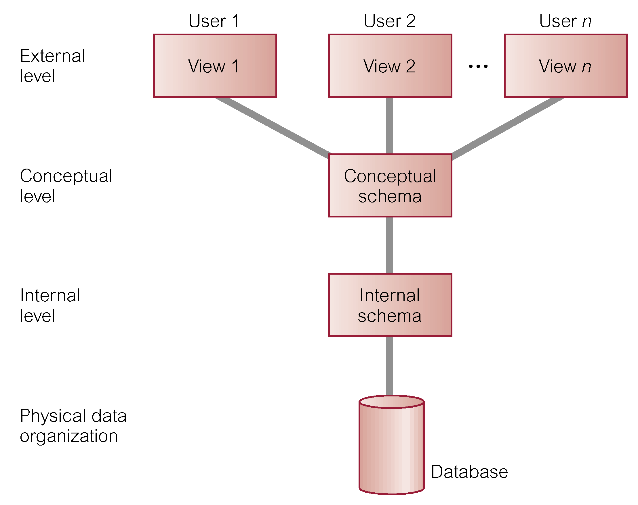
ANSI-SPARC Three-Level Architecture

Slide 8
ANSI-SPARC Three-Level Architecture
External Level
Users’ view of the database.
Describes that part of database that is relevant to a particular user.
Conceptual Level
Community view of the database.
Describes WHAT data is stored in database and relationships among the data.

Slide 9
ANSI-SPARC Three-Level Architecture
Internal Level
Physical representation of the database on the computer.
Describes HOW the data is stored in the database.

Slide 10
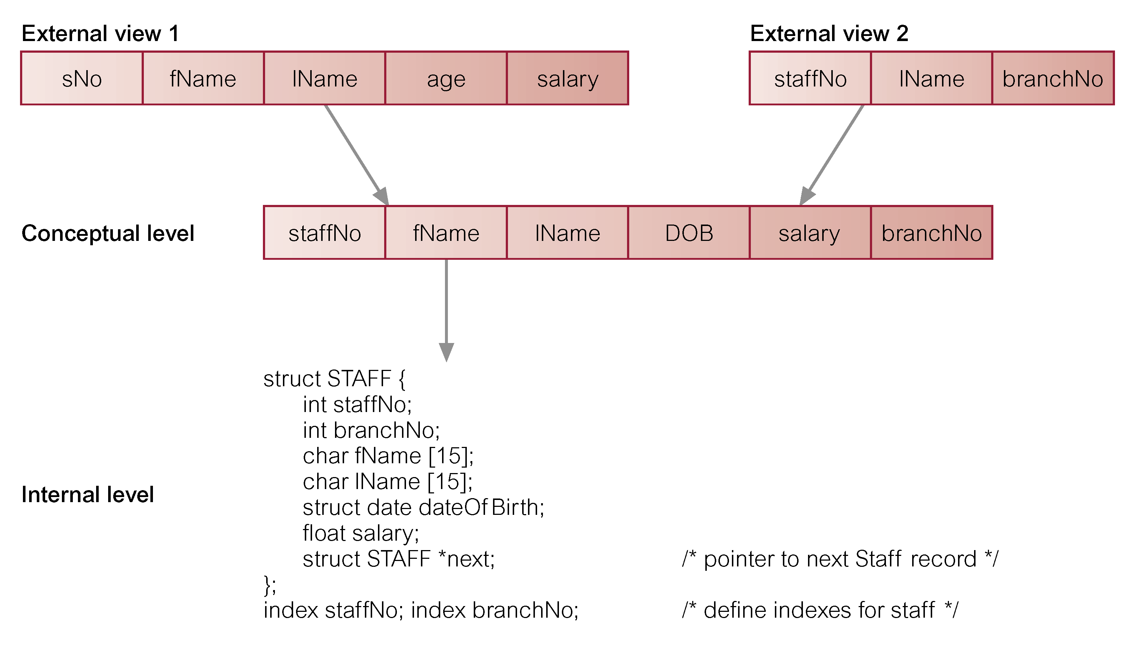
Differences between Three Levels of ANSI-SPARC Architecture

Slide 11
Data Independence
Logical Data Independence
Refers to immunity of external schemas to changes in conceptual schema.
Conceptual schema changes (e.g. addition/removal of entities) should not require changes to external schema or rewrites of application programs.

Slide 12
Data Independence
Physical Data Independence
Refers to immunity of conceptual schema to changes in the internal schema.
Internal schema changes (e.g. using different file organizations, storage structures/devices) should not require change to conceptual or external schemas.

Slide 13
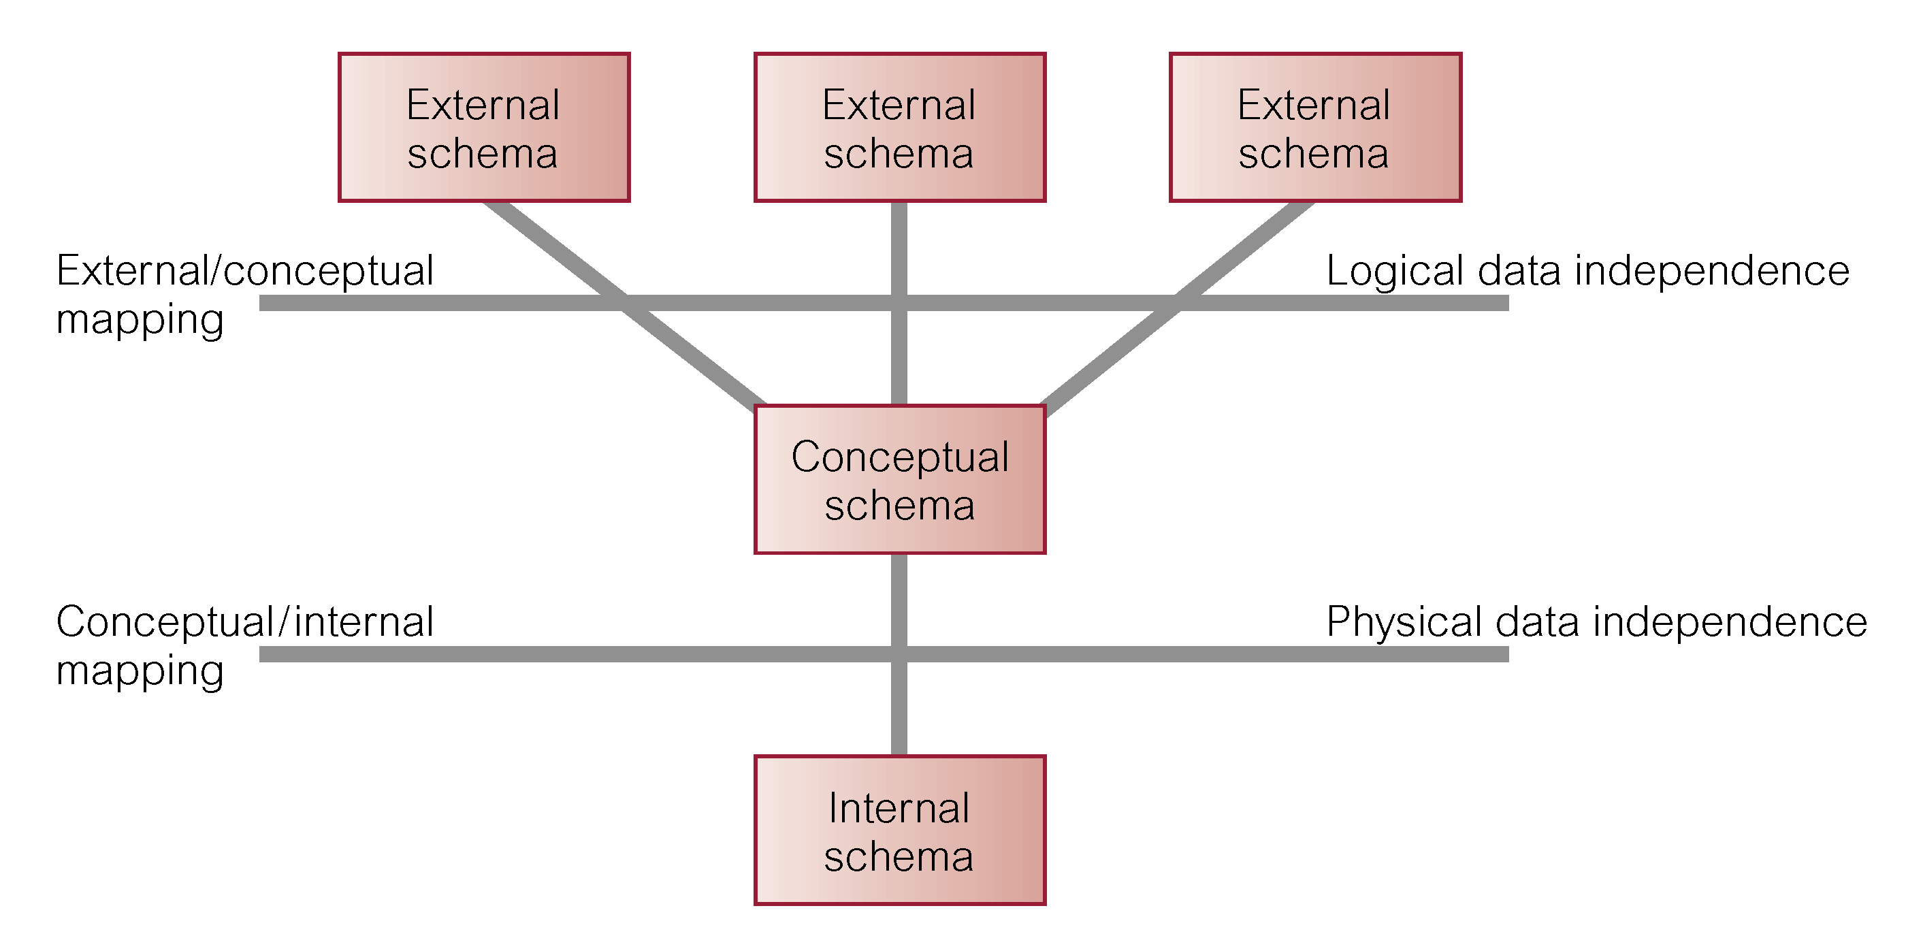
Data Independence and the ANSI-SPARC Three-Level Architecture

Slide 14
Database Languages
Data Definition Language (DDL)
Allows the DBA or user to describe and name entities, attributes, and relationships required for the application
plus any associated integrity and security constraints.

Slide 15
Database Languages
Data Manipulation Language (DML)
Provides basic data manipulation operations on data held in the database.
Procedural DML
allows user to tell system exactly how to manipulate data.
Non-Procedural DML
allows user to state what data is needed rather than how it is to be retrieved.

Slide 16
Database Languages
Fourth Generation Language (4GL) Ex: Microsoft (MS) Access 2010
Query Languages
Forms Generators
Report Generators
Graphics Generators
Application Generators.

Slide 17
Data Model
Integrated collection of concepts for describing data, relationships between data, and constraints on the data in an organization.
Data Model comprises:
a structural part;
a manipulative part;
possibly a set of integrity rules.

Slide 18
Data Model
Purpose
To represent data in an understandable way.
Categories of data models include:
Object-based
Record-based
Physical.

Slide 19
Data Models
Object-Based Data Models
Entity-Relationship
Semantic
Functional
Object-Oriented.
Record-Based Data Models
Relational Data Model
Network Data Model
Hierarchical Data Model.
Physical Data Models

Slide 20
Conceptual Modeling
Conceptual schema is the core of a system supporting all user views.
Should be complete and accurate representation of an organization’s data requirements.
Conceptual modelling is process of developing a model of information use that is independent of implementation details.
Result is a conceptual data model.

Slide 21
Functions of a DBMS
Data Storage, Retrieval, and Update.
A User-Accessible Catalog.
Transaction Support.
Concurrency Control Services.
Recovery Services.

Slide 22
Functions of a DBMS
Authorization Services.
Support for Data Communication.
Integrity Services.
Services to Promote Data Independence.
Utility Services.

Slide 23
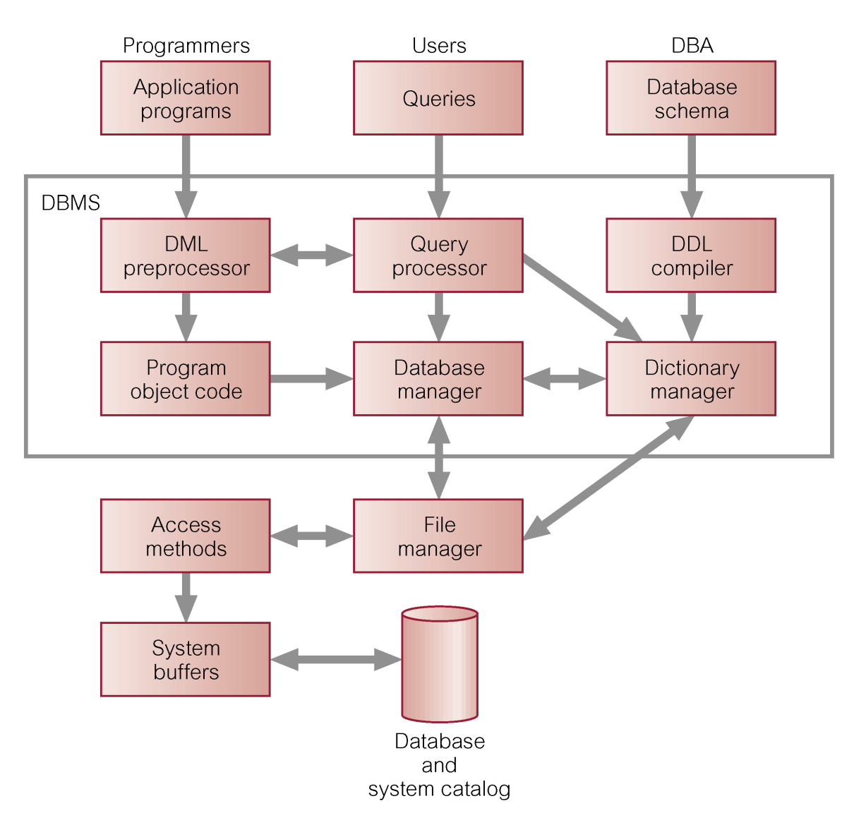
Components of a DBMS

Slide 24
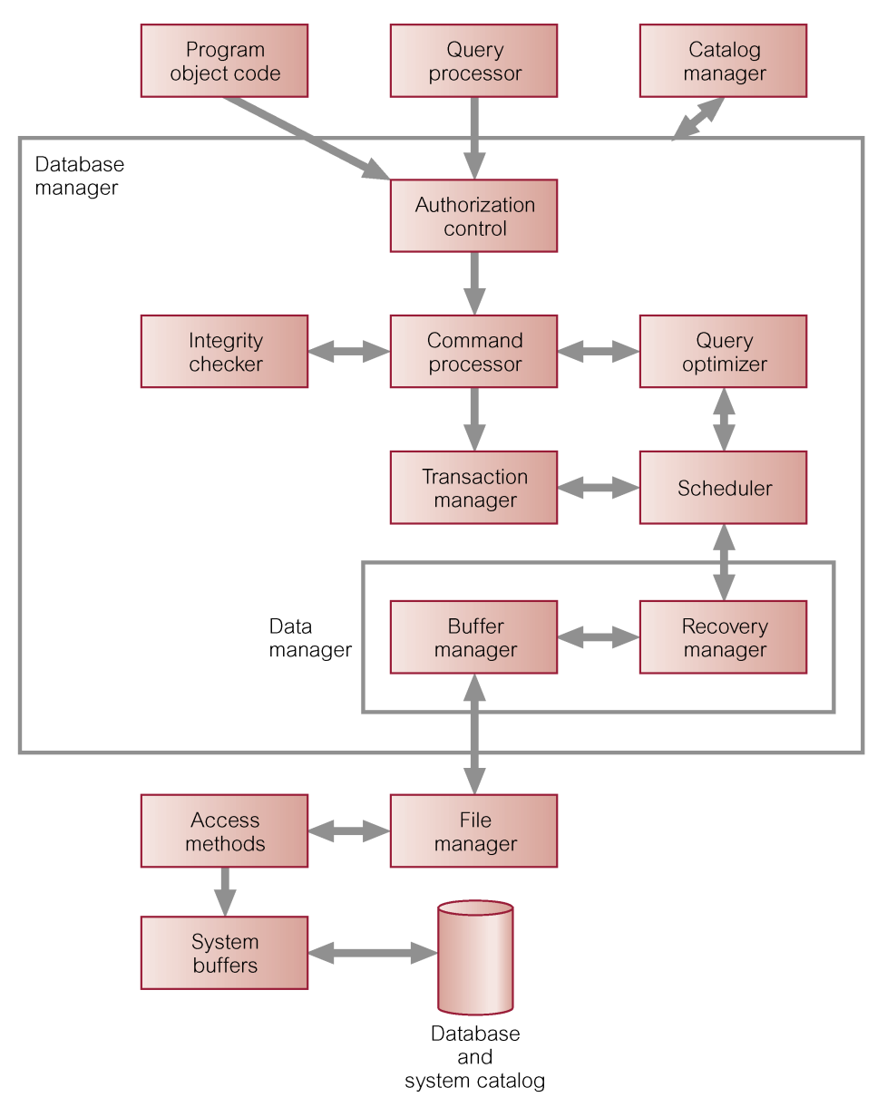
Components of Database Manager (DM)

Slide 25
System Catalog
Repository of information (metadata) describing the data in the database.
Typically stores:
names of authorized users;
names of data items in the database;
constraints on each data item;
data items accessible by a user and the type of access.
Used by modules such as Authorization Control and Integrity Checker.

