Slide 1
Database Application Example
The Dreamhome

Slide 2
Learning Objectives
Fact-finding techniques.
Type of facts collected.
Example of database schema: the Dreamhome real-estate rental company.

Slide 3
Fact-finding Techniques
It is critical to capture the necessary facts to build the required database application.
These facts are captured using fact-finding techniques.
The formal process of using techniques such as interviews and questionnaires to collect facts about systems, requirements, and preferences.
Pearson Education © 2009

Slide 4
When Are Fact-Finding Techniques Used?
Fact-finding used throughout the database application lifecycle. Crucial to the early stages including database planning, system definition, and requirements collection and analysis stages.
Enables developer to learn about the terminology, problems, opportunities, constraints, requirements, and priorities of the organization and the users of the system.
Pearson Education © 2009

Slide 5
Fact-Finding Techniques
A database developer normally uses several fact-finding techniques during a single database project including:
  examining documentation
  interviewing
  observing the organization in operation
  research
  questionnaires
Pearson Education © 2009

Slide 6
Examining Documentation
Can be useful
  to gain some insight as to how the need for a database arose.
  to identify the part of the organization associated with the problem.
  to understand the current system.
Pearson Education © 2009

Slide 7
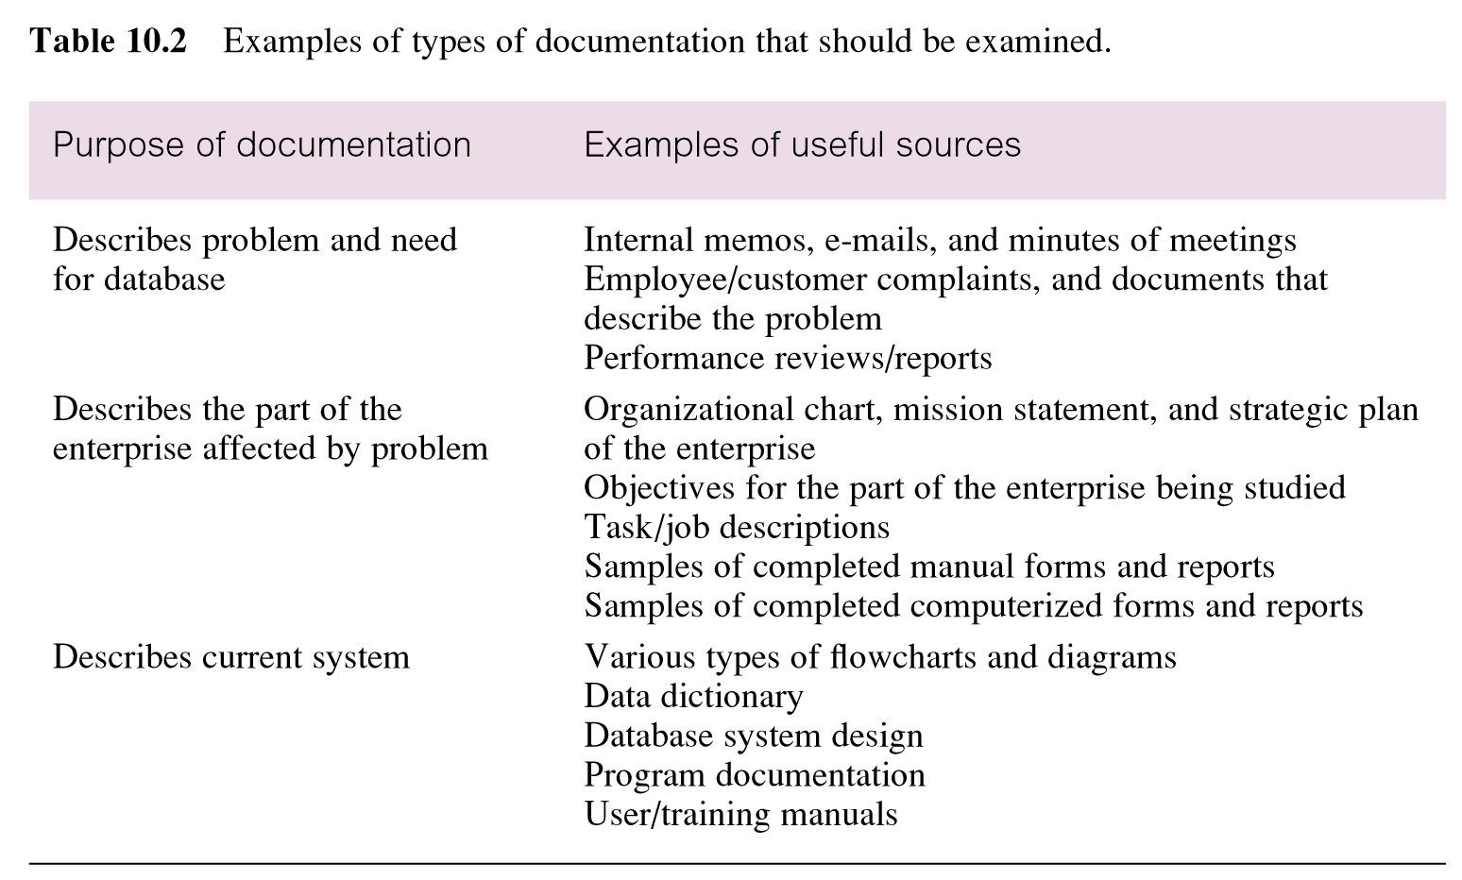
Examples of types of Documentation Examined
Pearson Education © 2009

Slide 8
Interviewing
Most commonly used, and normally most useful, fact-finding technique. Enables collection of information from individuals face-to-face.
Objectives include finding out facts, verifying facts, clarifying facts, generating enthusiasm, getting the end-user involved, identifying requirements, and gathering ideas and opinions.
Pearson Education © 2009

Slide 9
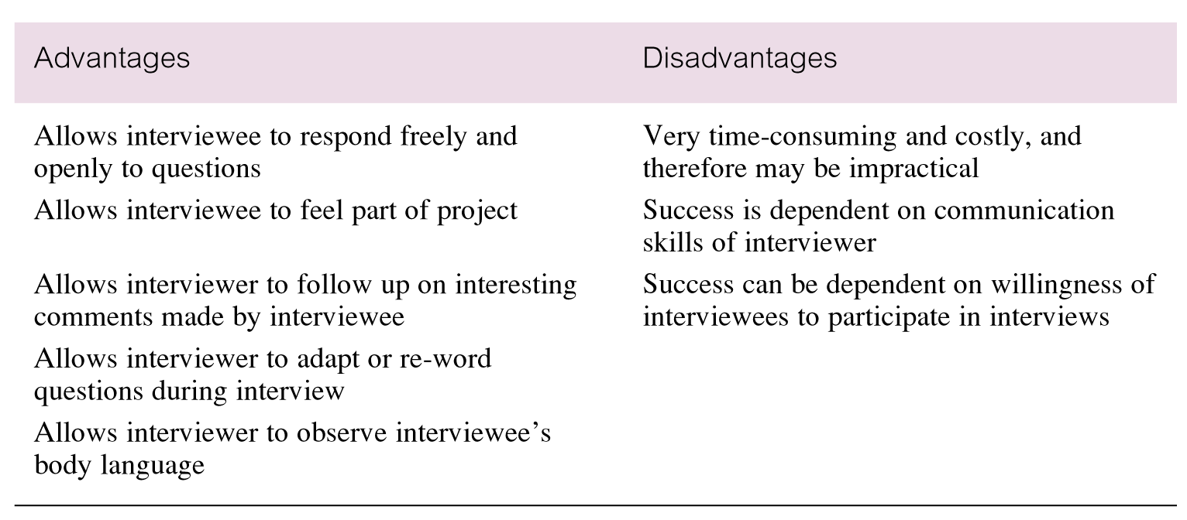
Advantages and disadvantages of interviewing
Pearson Education © 2009

Slide 10
Interviewing
There are two types of interviews unstructured and structured.
Open-ended questions allow the interviewee to respond in any way that seems appropriate.
Closed-ended questions restrict answers to either specific choices or short, direct responses.
Pearson Education © 2009

Slide 11
Observing the Organization in Operation
An effective technique for understanding a system.
Possible to either participate in, or watch, a person perform activities to learn about the system.
Useful when validity of data collected is in question or when the complexity of certain aspects of the system prevents a clear explanation by the end-users.
Pearson Education © 2009

Slide 12
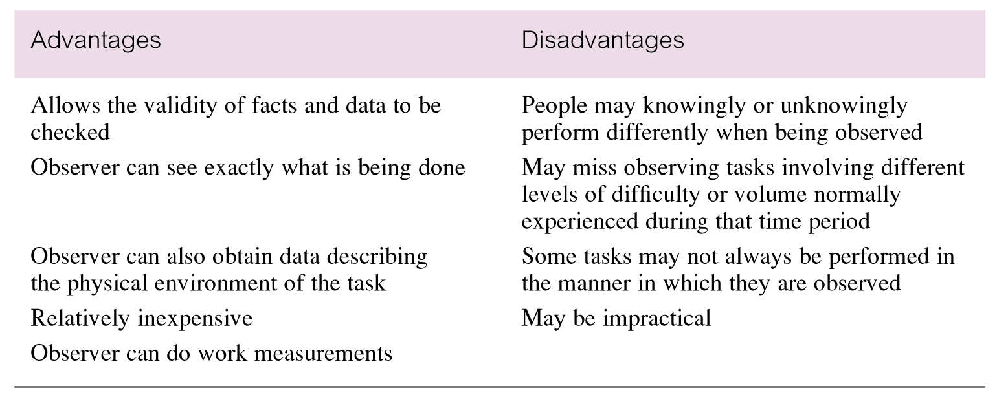
Advantages and disadvantages of using observation
Pearson Education © 2009

Slide 13
Research
Useful to research the application and problem.
Use computer trade journals, reference books, and the Internet (including user groups and bulletin boards).
Provide information on how others have solved similar problems, plus whether or not software packages exist to solve or even partially solve the problem.
Pearson Education © 2009

Slide 14
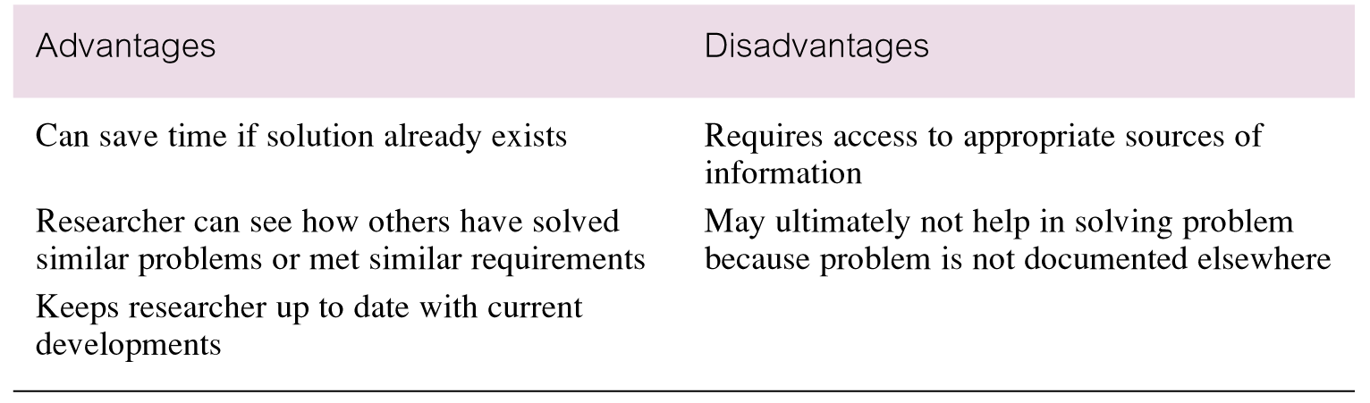
Advantages and disadvantages of using research
Pearson Education © 2009

Slide 15
Questionnaires
Conduct surveys through questionnaires, which are special-purpose documents that allow facts to be gathered from a large number of people while maintaining some control over their responses.
There are two types of questions, namely free-format and fixed-format.
Pearson Education © 2009

Slide 16
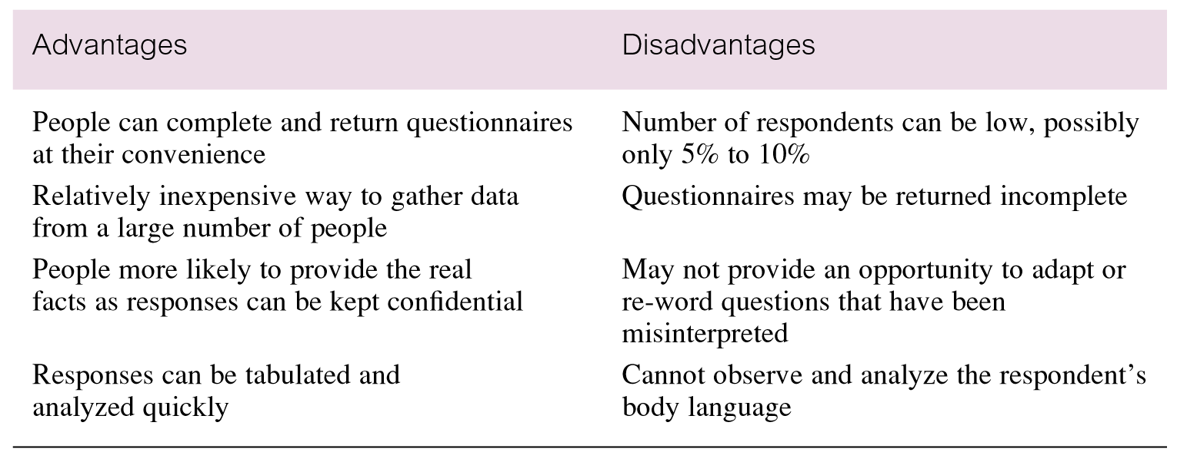
Advantages and disadvantages of using questionnaires
Pearson Education © 2009

Slide 17
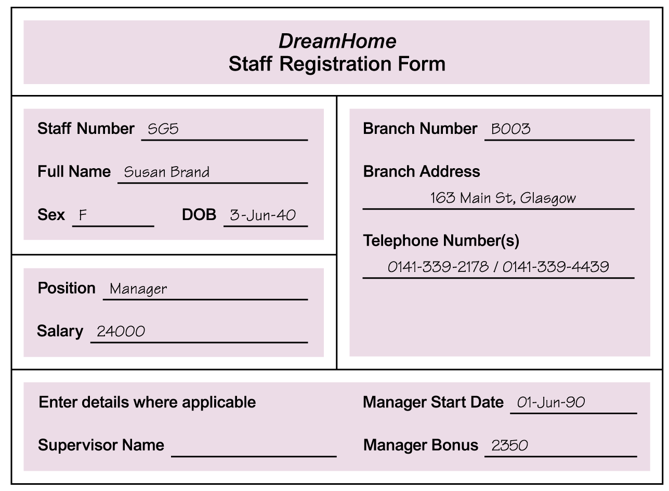
Using Fact-Finding Techniques –
A Worked Example
Pearson Education © 2009

Slide 18
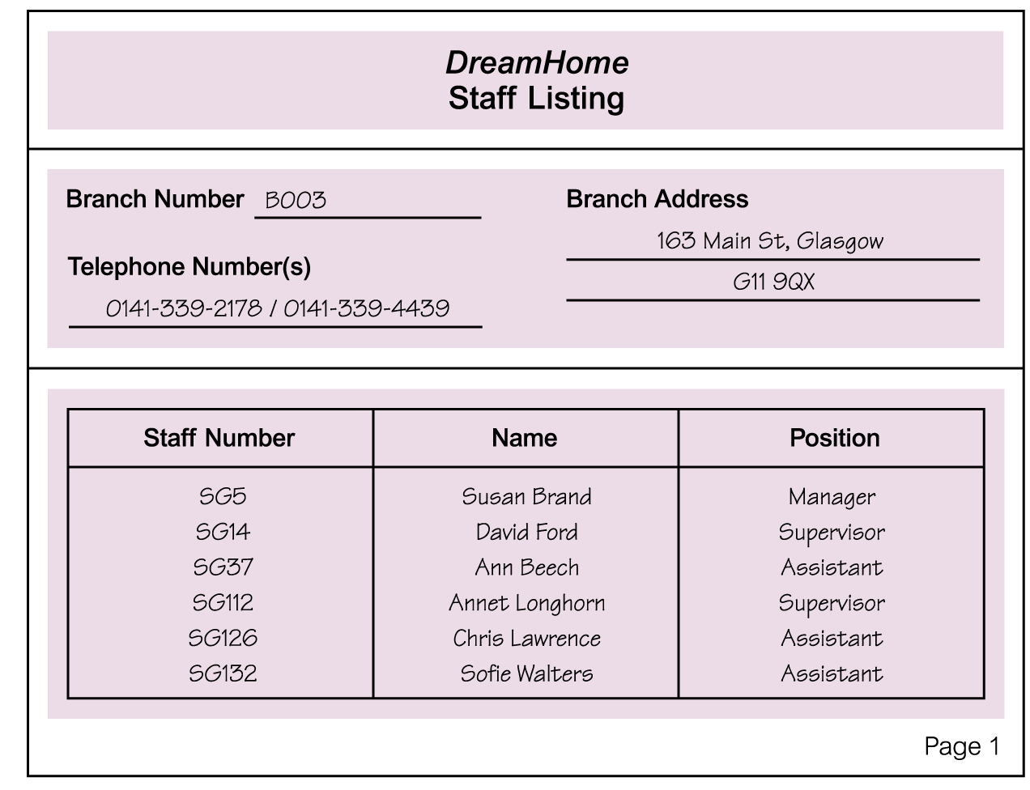
Using Fact-Finding Techniques –
A Worked Example
Pearson Education © 2009

Slide 19
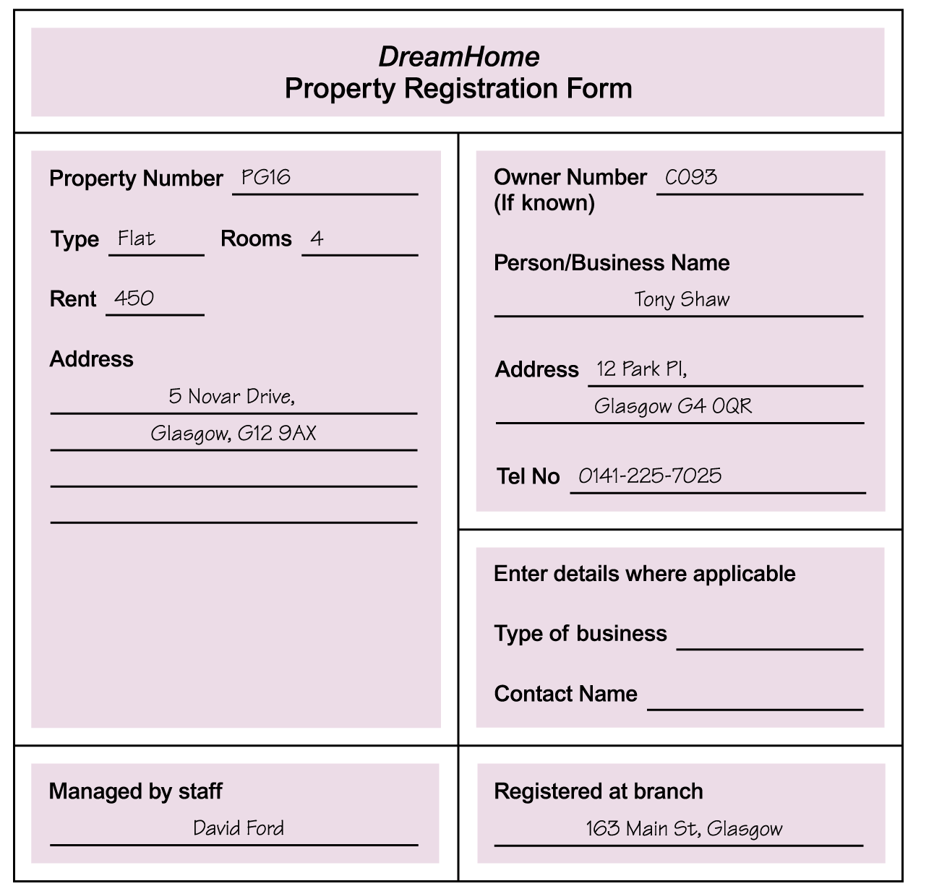
Using Fact-Finding Techniques –
A Worked Example
Pearson Education © 2009

Slide 20
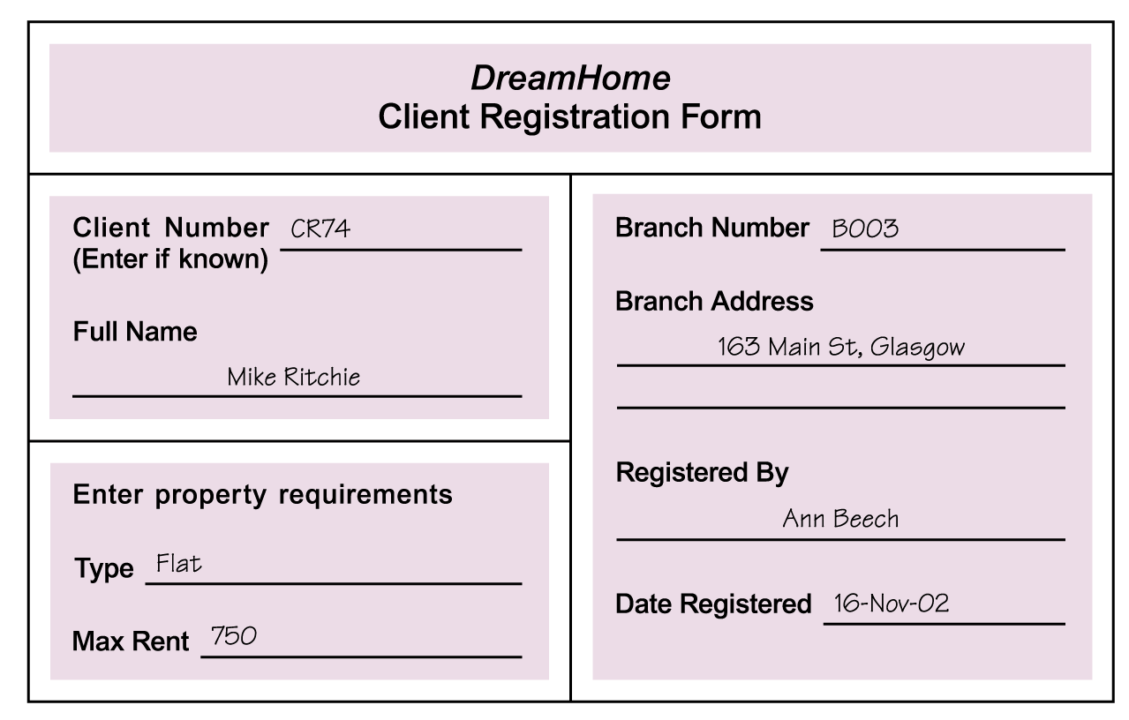
Using Fact-Finding Techniques –
A Worked Example
Pearson Education © 2009

Slide 21
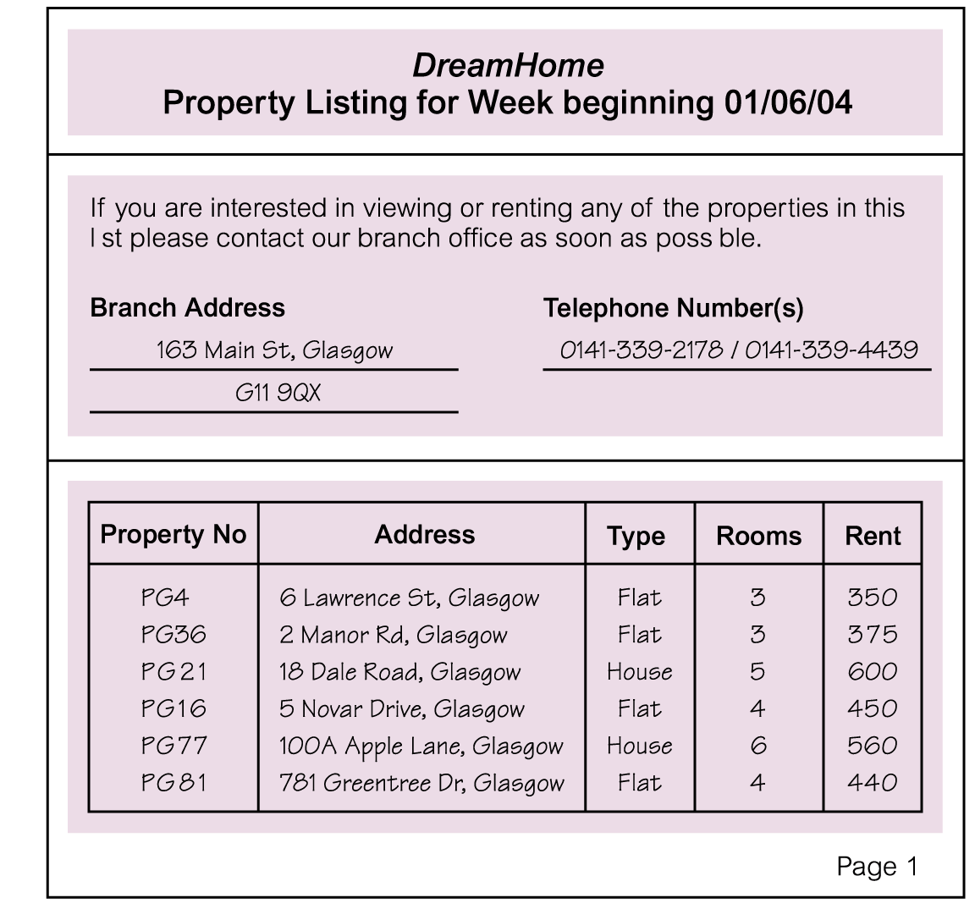
Using Fact-Finding Techniques –
A Worked Example
Pearson Education © 2009

Slide 22
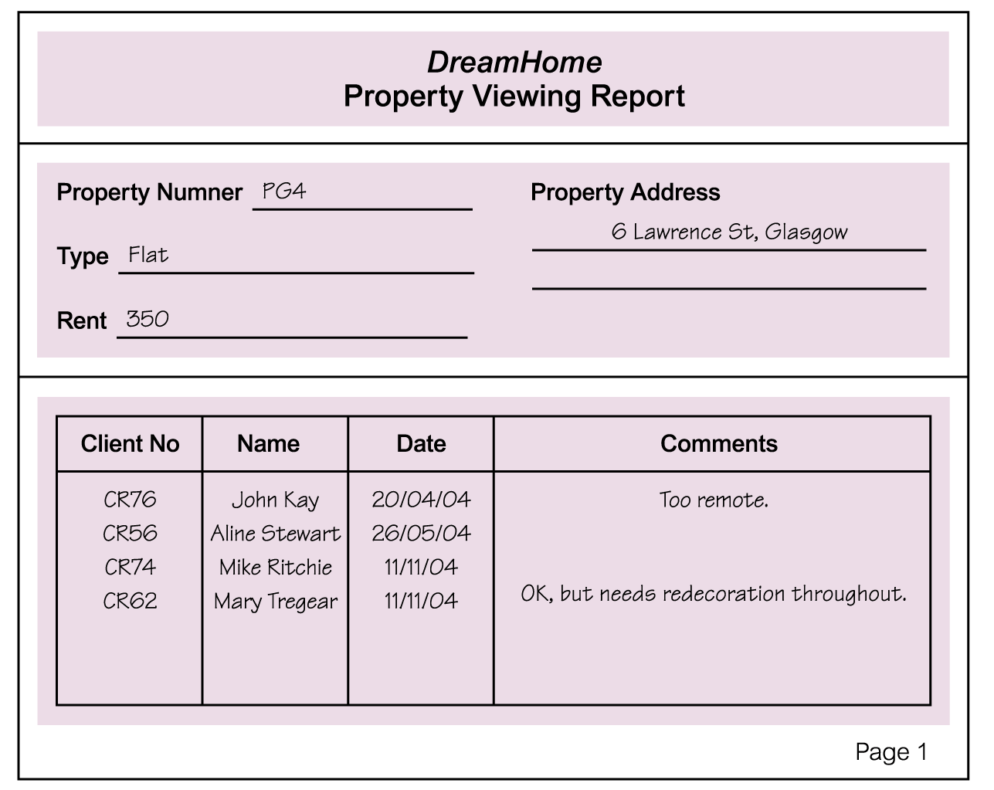
Using Fact-Finding Techniques –
A Worked Example
Pearson Education © 2009

Slide 23
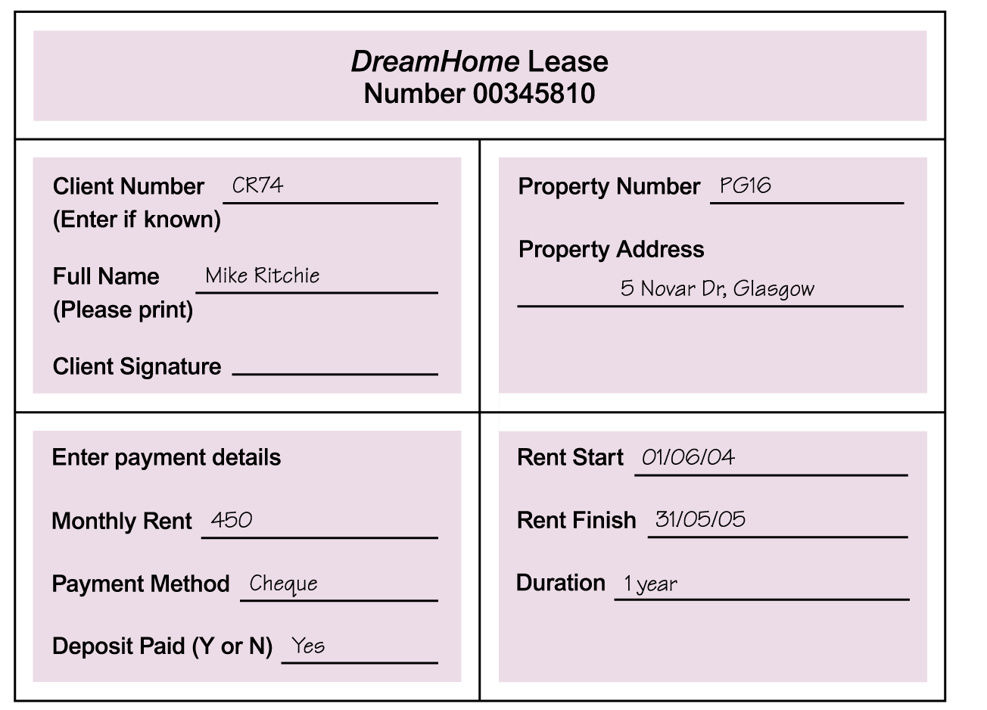
Using Fact-Finding Techniques –
A Worked Example
Pearson Education © 2009

Slide 24
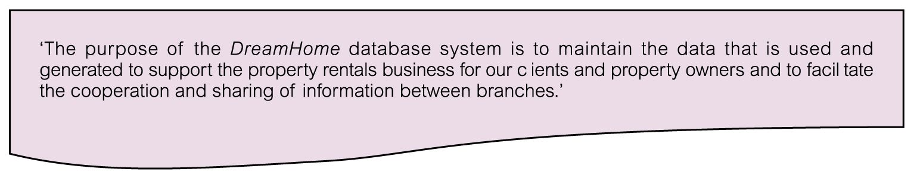
Mission Statement for DreamHome Database System
Pearson Education © 2009

Slide 25
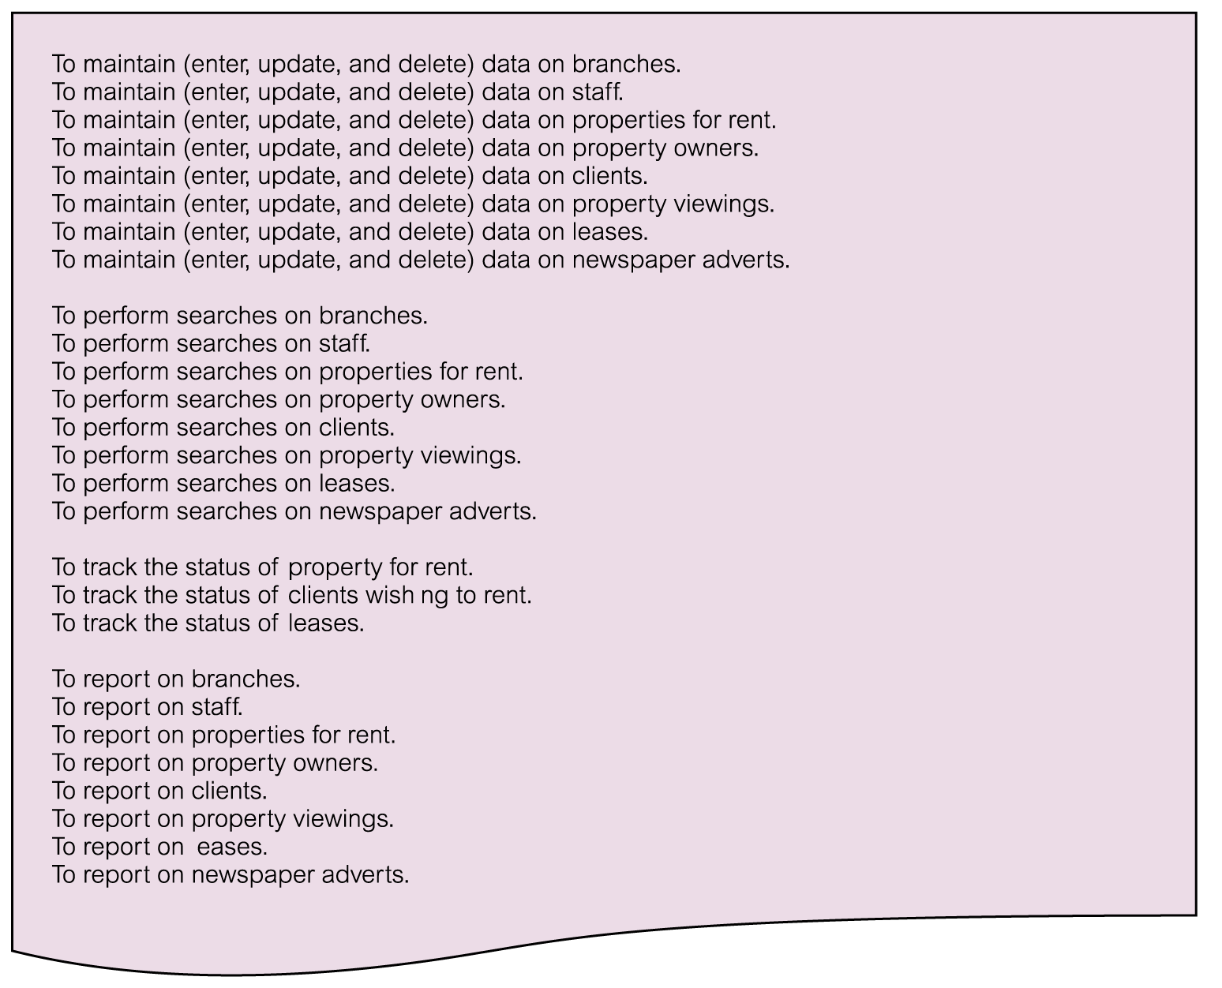
Mission Objectives for DreamHome Database System
Pearson Education © 2009

Slide 26
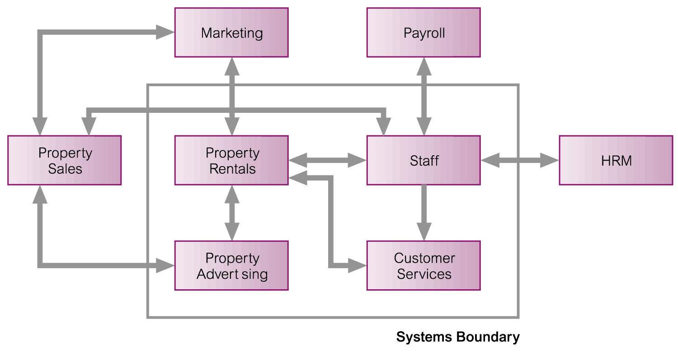
System Boundary for DreamHome Database System
Pearson Education © 2009

