Slide 1
PHP and MySQL Advanced Features

Slide 2
Learning Objectives
Track sessions
Use cookies
Secure a MySQL/PHP application
Example

Slide 3
Tracking Sessions
HTTP is a stateless protocol – it cannot maintain the state between two transactions.
When a user requests a page following another one, HTTP does not track whether both pages come from the same user (they are independent).
Session tracking allows to track a user during a transaction spannign several pages.
Ex: login → choose products → checkout in a shopping cart application.

Slide 4
Tracking Sessions
A PHP session has:
  A unique session ID
  A cryptographically random number.
  Session variables associated with it.
The session ID is generated by PHP and stored on the client side during all the lifetime of a session.
The session ID can either be stored on the client computer in a cookie or passed through URLs.
A session ends:
  When the user closes it or the browser client is closed.
  After a predefined time specified in php.ini file.

Slide 5
Tracking Sessions
Implementing a session:
  Start a session
  session_start();
  (sessions can also be started automatically if PHP sets-up that way)
  Register session variables
  $_SESSION[‘var_name’] = 42;
  Use session variables
  if (isset($_SESSION[‘var_name’] )) …
  Deregister variables unset($_SESSION[‘var_name’] );
  $_SESSION = array()(;
  Destroy the session
  session_destroy();

Slide 6
Tracking Sessions
<?php
session_start();
$_SESSION['sess_var'] = "Hello world!";
echo 'The content of $_SESSION[\'sess_var\'] is '
.$_SESSION['sess_var'].'<br />';
?>
<a href="page2.php">Next page</a>

Slide 7
Tracking Sessions
<?php
session_start();
echo 'The content of $_SESSION[\'sess_var\'] is '
.$_SESSION['sess_var'].'<br />';
unset($_SESSION['sess_var']);
?>
<a href="page3.php">Next page</a>

Slide 8
Tracking Sessions
<?php
session_start();
echo 'The content of $_SESSION[\'sess_var\'] is '
.$_SESSION['sess_var'].'<br />';
session_destroy();
?>

Slide 9
Using Cookies
A cookie is a piece of information that’s stored by a server in a text file on a client’s computer to maintain information about the client during and between browsing sessions.
A server can access only the cookies that it has placed on the client.
Function setcookie takes the name of the cookie to be set as the first argument, followed by the value to be stored in the cookie.
The optional third argument indicates the expiration date of the cookie.
If no expiration date is specified, the cookie lasts only until the end of the current session—that is, when the user closes the browser. This type of cookie is known as a session cookie, while one with an expiration date is a persistent cookie.

Slide 10
Using Cookies
If only the name argument is passed to function setcookie, the cookie is deleted from the client’s computer.
Cookies defined in function setcookie are sent to the client at the same time as the information in the HTTP header; therefore, setcookie needs to be called before any other output
PHP creates the superglobal array $_COOKIE, which contains all the cookie values indexed by their names, similar to the values stored in array $_POST when an HTML5 form is posted

Slide 11
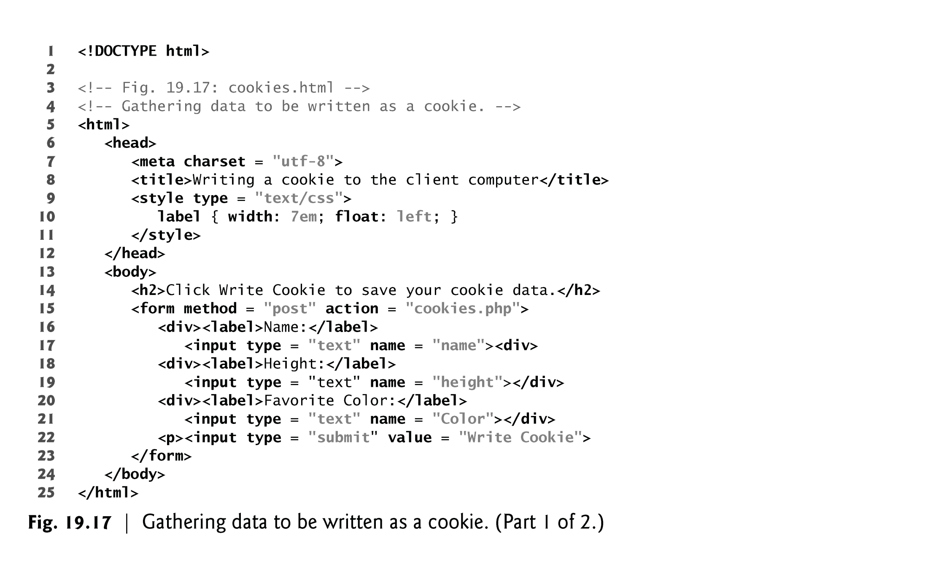

Slide 12
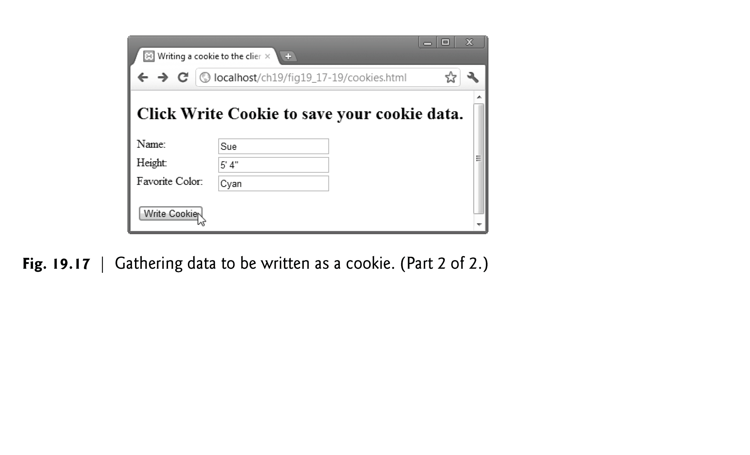

Slide 13
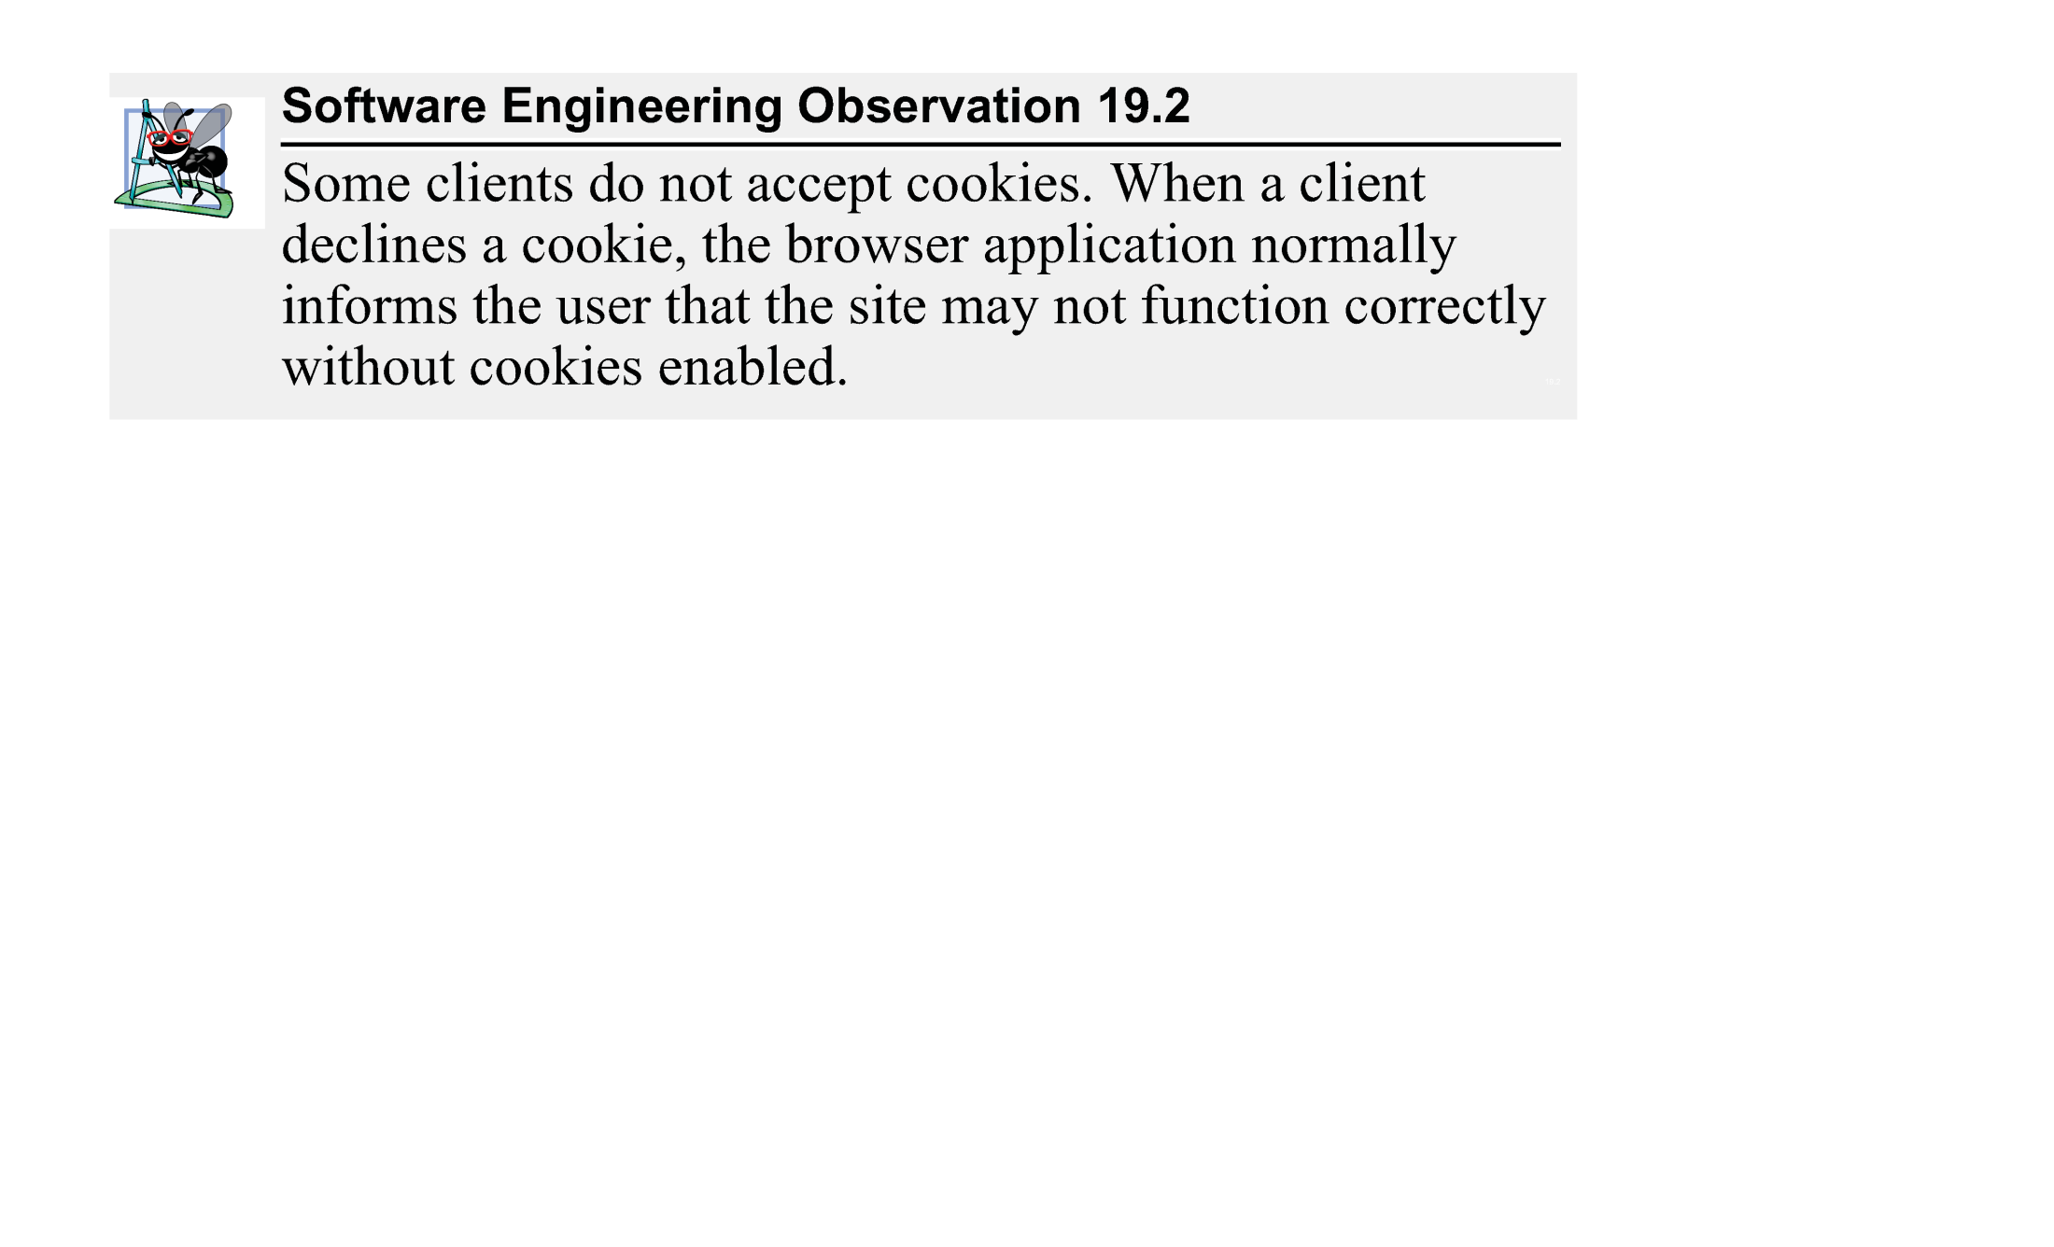

Slide 14
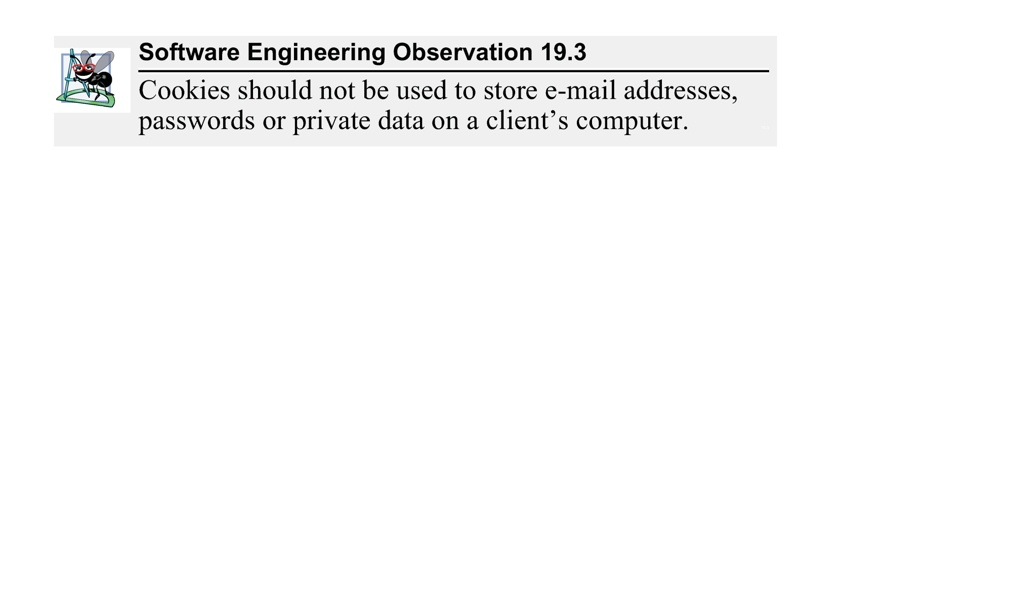

Slide 15
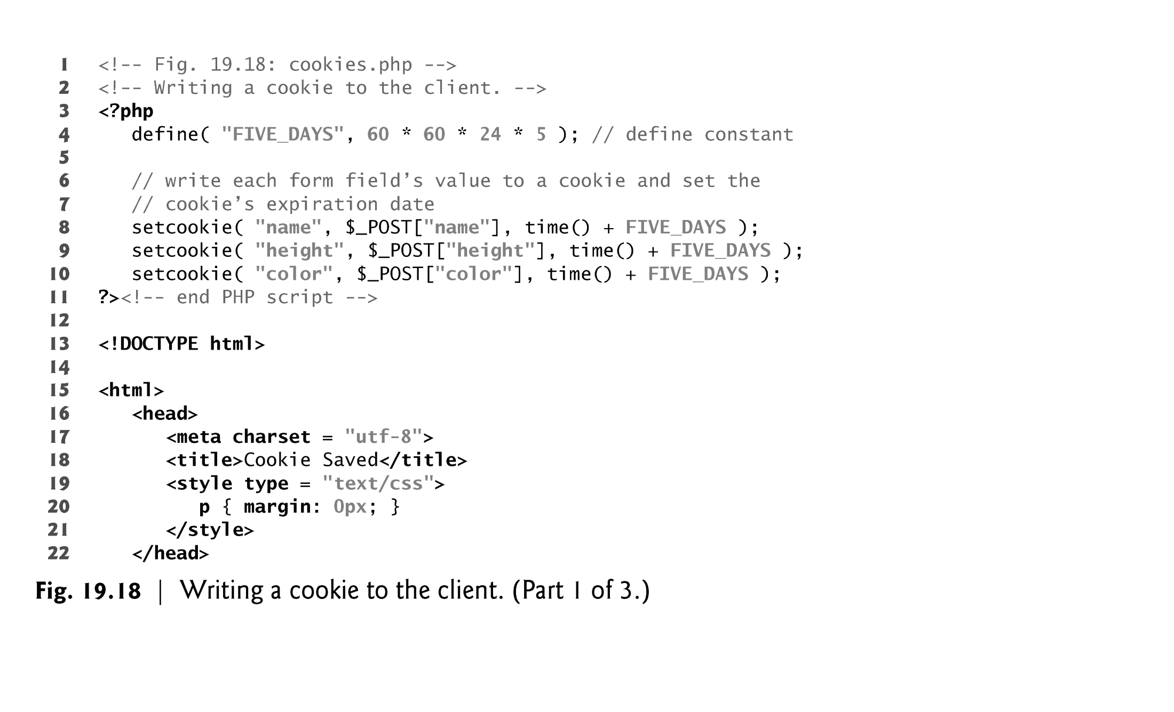

Slide 16
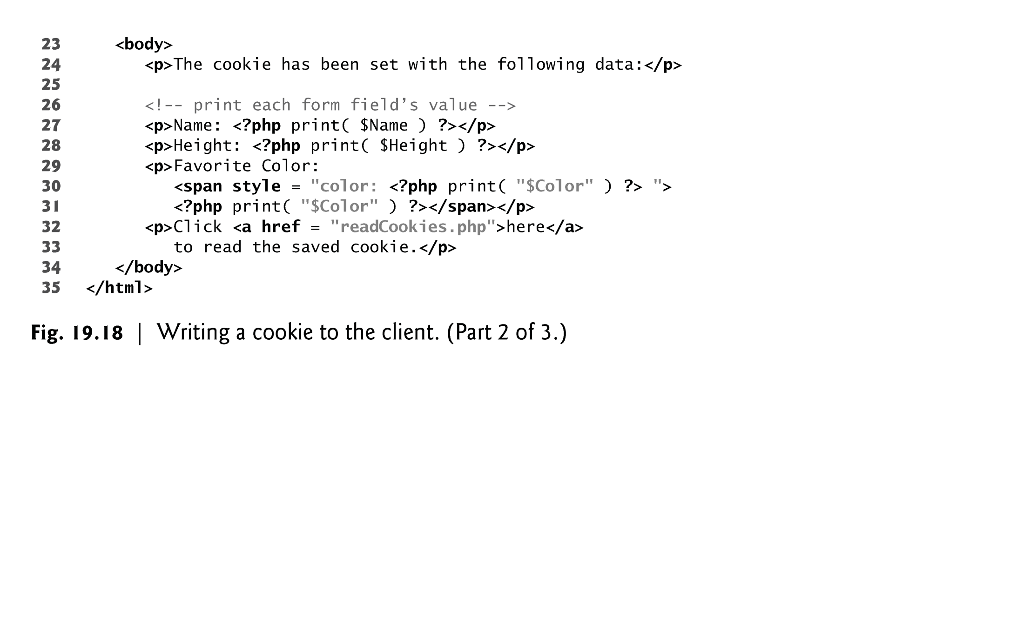

Slide 17
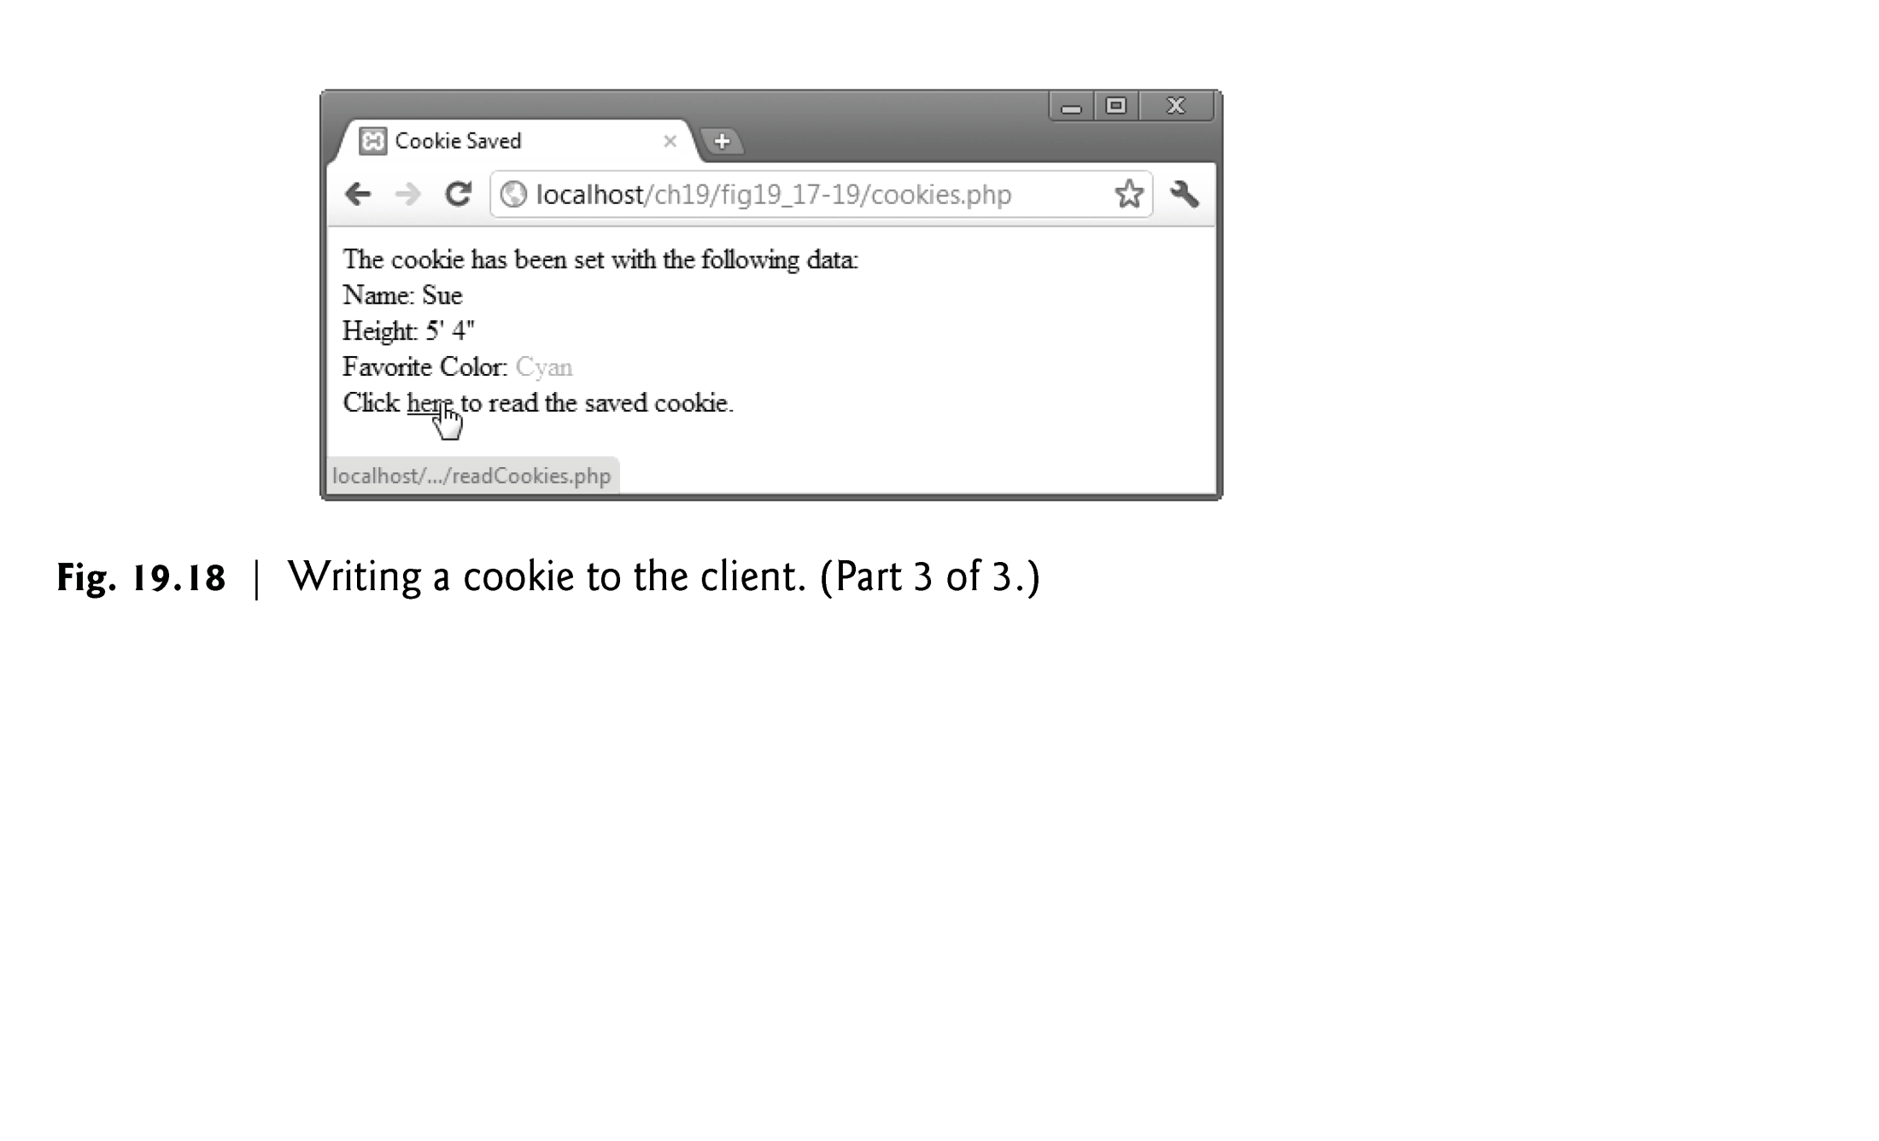

Slide 18
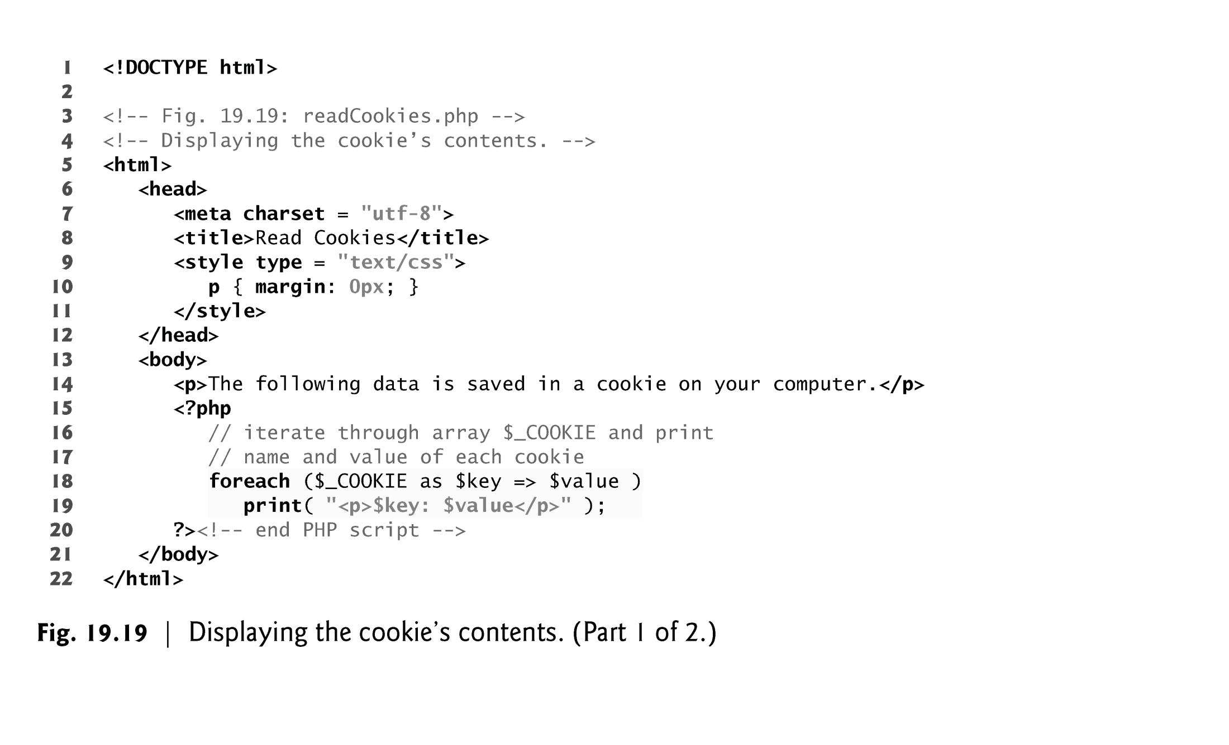

Slide 19
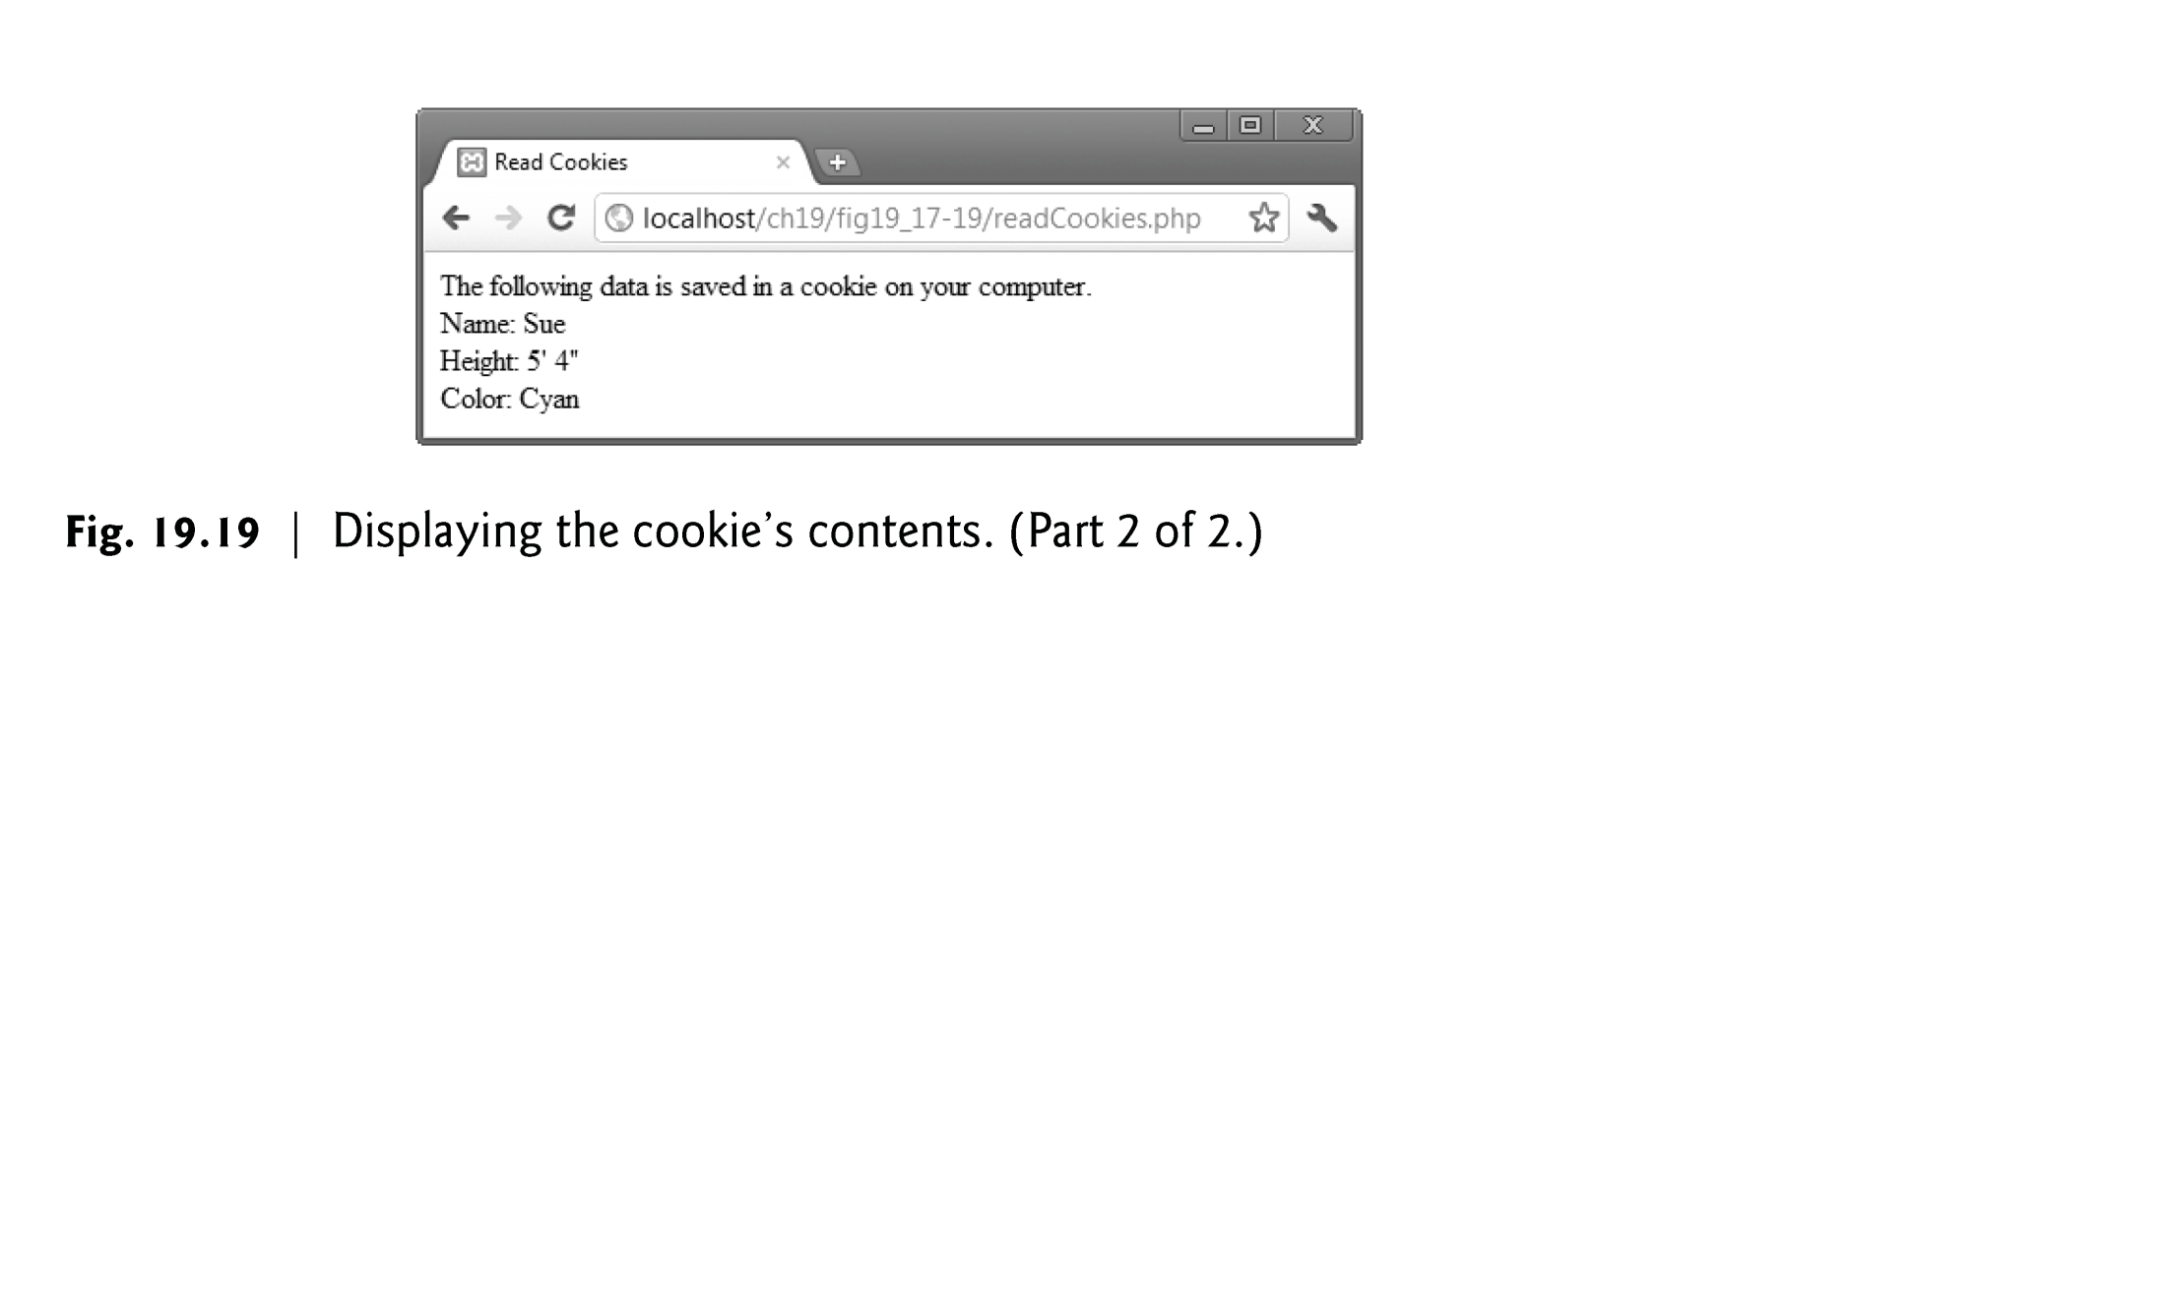

Slide 20
Security Features
Authentication
  Authentication / access control with session control.
  Start a session with a login screen and pass on the authorized user in SESSION variables.
  Apache’s basic authentication
  mod_auth checks against name-password pairs on a server file (.htaccess)
  MySQL authentication
  mod-auth_mysql checks against name-password pairs in a MySQL database

Slide 21
Security Features
Encryption
  Password encryption
  crypt($password)
  MD5($password)
  sha-1($password) (Secure Hash with 40 characters)
  Secure Sockets Layers (SSL) to secure communications between servers and browsers over the Internet
  PGP
  GPG (http://www.gnupgp.org)

Slide 22
Security Features
Code security
  Value checking
  SQL injection prevention – escape strings sent to database server
  mysql_escape_string,
  mysqli::real_escape_string,
  mysqli_real_escape_string

Slide 23
Dreamhome Staff Management
The Dreamhome Staff Management application lets users:
  List the staff working at a branch
  Add staff
  Update staff information
  Delete staff.
http://moxie.cs.oswego.edu/~bichinda/dreamhome/login.php
(username: Brand, password: SG5)

Slide 24
Dreamhome Staff Management
Files:
  login.php (login)
  dreamhome.php (general menu)
  branch.php (list of staff per branch)
  add.php (add staff interface)
  add-staff.php (add staff to the database)
  delete.php (delete staff interface)
  delete-staff.php (delete staff from the database)
  update.php (update staff interface)
  update-staff.php (update staff from the database)
  logout.php (logout)
  functions.php (all functions called by the other pages)

Slide 25
Dreamhome Staff Management
login.php
dreamhome.php
branch.php
add.php
update.php
delete.php
add-staff.php
update-staff.php
delete-staff.php

Slide 26
Templates
Two types of applications
  Applications allowing users to search through a database without requiring them to login
    dhBranchStaff.html (or dhBranch.php) and
    dhBranchStaff.php
  Applications requiring users to login and/or allowing them to search / add / delete / update the database
    Dreamhome staff management system (dreamhome.zip from Angel) by selecting the features useful for the application.

