Slide 1
Web Database Application Development

Slide 2
Learning Objectives
Basics of Internet, Web, HTTP, HTML, URLs.
Advantages and disadvantages of Web as a database platform.
Approaches for integrating databases into Web:
PHP Scripting Language
Common Gateway Interface (CGI)
HTTP Cookies

Slide 3
Introduction
Web most popular and powerful networked information system to date.
As architecture of Web was designed to be platform-independent, can significantly lower deployment and training costs.
Organizations using Web as strategic platform for innovative business solutions, in effect becoming Web-centric.

Slide 4
Internet
Worldwide collection of interconnected networks.
Began in late ‘60s in ARPANET, a US DOD project, investigating how to build networks that could withstand partial outages.
Starting with a few nodes, Internet estimated to have over 945 million users by end of 2004.
2 billion users by 2010.
About 3.5 billion documents on Internet (550 billion if intranets/extranets included).

Slide 5
Intranet and Extranet
Intranet - Web site or group of sites belonging to an organization, accessible only by members of that organization.
Extranet - An intranet that is partially accessible to authorized outsiders.
Whereas intranet resides behind firewall and is accessible only to people who are members of same organization, extranet provides various levels of accessibility to outsiders.

Slide 6
eCommerce and eBusiness
eCommerce - Customers can place and pay for orders via the business’s Web site.
eBusiness - Complete integration of Internet technology into economic infrastructure of the business.

Slide 7
The Web
Web consists of network of computers that can act in two roles:
as servers, providing information;
as clients (browsers), requesting information.
Protocol that governs exchange of information between Web server and browser is HTTP and locations within documents identified as a URL.
Much of Web’s success is due to its simplicity and platform-independence.

Slide 8
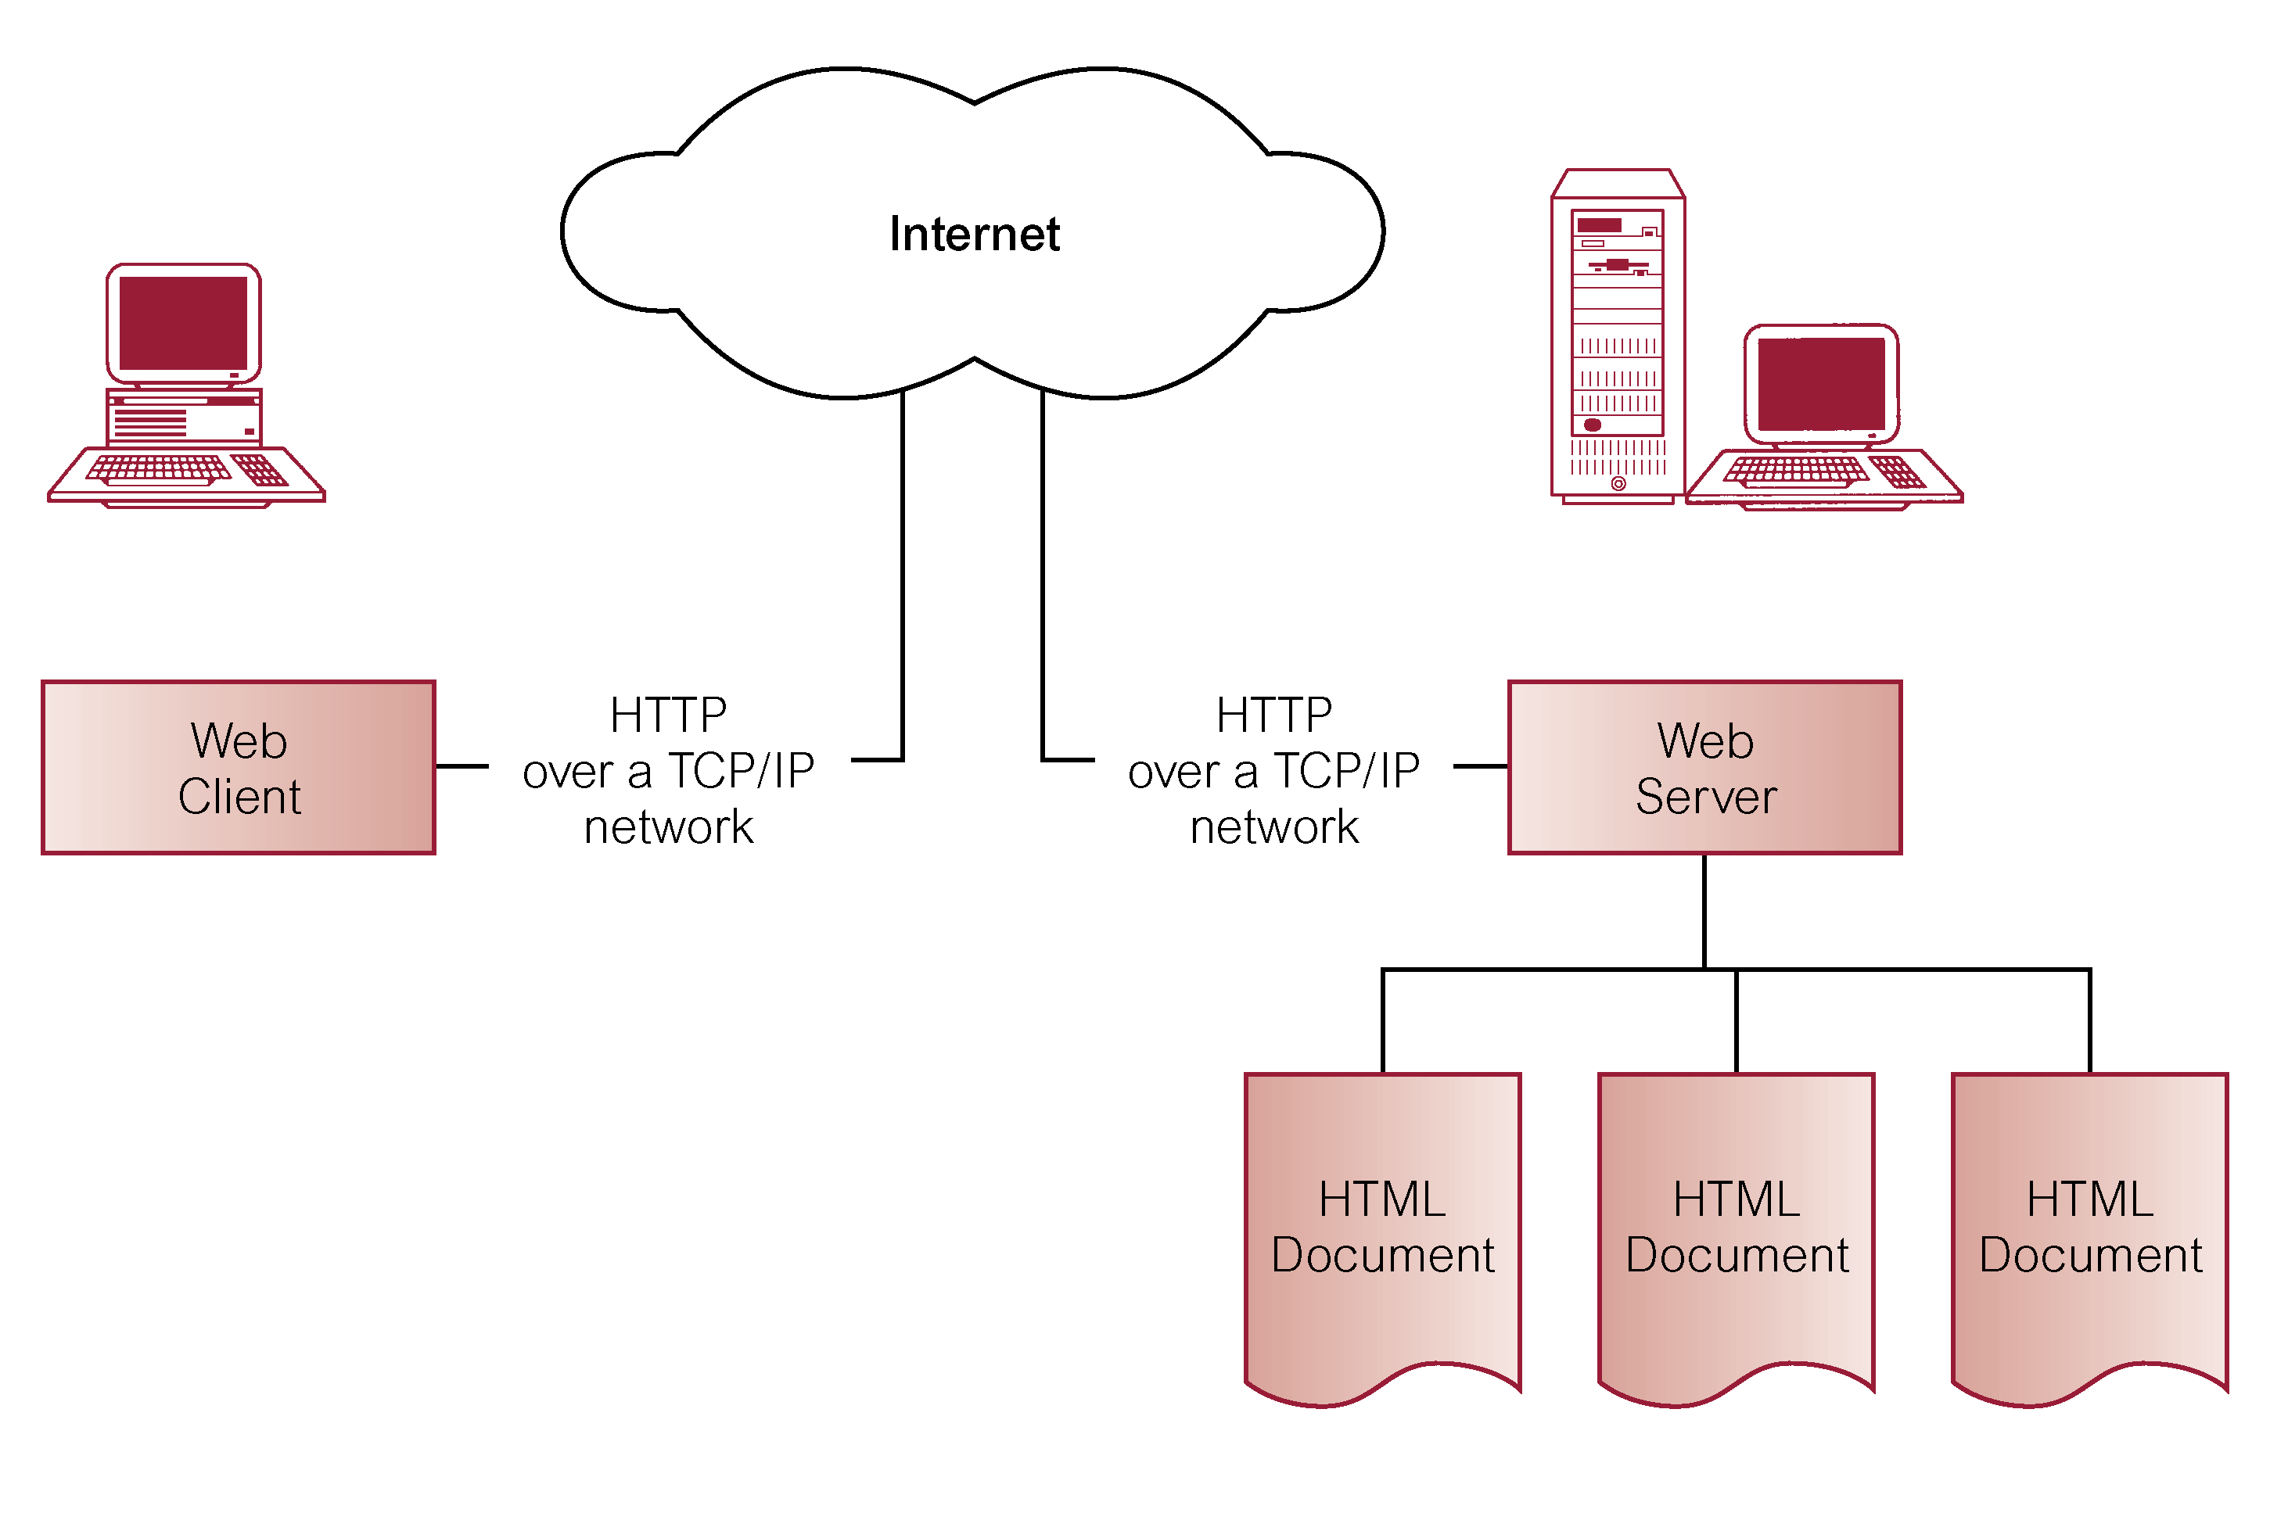
Basic Components of Web Environment

Slide 9
HyperText Transfer Protocol (HTTP)
Protocol used to transfer Web pages through Internet.
Based on request-response paradigm:
Connection - Client establishes connection with Web server.
Request - Client sends request to Web server.
Response - Web server sends response (HTML document)
to client.
Close - Connection closed by Web server.

Slide 10
HyperText Transfer Protocol (HTTP)
HTTP/1.0 is stateless protocol - each connection is closed once server provides response.
This makes it difficult to support concept of a session that is essential to basic DBMS transactions.

Slide 11
HyperText Markup Language (HTML)
Document formatting language used to design most Web pages.
A simple, yet powerful, platform-independent document language.
HTML is application of Standardized Generalized Markup Language (SGML), a system for defining structured document types and markup languages to represent instances of those document types.

Slide 12
HyperText Markup Language (HTML)

Slide 13
Uniform Resource Locators (URLs)
URL consists of three basic parts:
protocol used for the connection,
host name,
path name on host where resource stored.
Can optionally specify:
port through which connection to host should be made,
query string.
http://www.w3.org/Markup/MarkUp.html

Slide 14
Static and Dynamic Web Pages
HTML document stored in file is static Web page.
Content of dynamic Web page is generated each time it is accessed.
Thus, dynamic Web page can:
respond to user input from browser;
be customized by and for each user.
Requires hypertext to be generated by servers.
Need scripts that perform conversions from different data formats into HTML ‘on-the-fly’.

Slide 15
Requirements for Web-DBMS Integration
Ability to access valuable corporate data in a secure manner.
Data- and vendor-independent connectivity to allow freedom of choice in DBMS selection.
Ability to interface to database independent of any proprietary browser or Web server.
Connectivity solution that takes advantage of all the features of an organization’s DBMS.

Slide 16
Requirements for Web-DBMS Integration
Open architecture to allow interoperability with a variety of systems and technologies. For example:
different Web servers;
Microsoft's (Distributed) Common Object Model (DCOM/COM);
CORBA/IIOP (Internet Inter-ORB protocol);
Java/Remote Method Invocation (RMI);
XML;
Web services (SOAP, WSDL, UDDI).
Cost-effective solution that allows for scalability, growth, and changes in strategic directions, and helps reduce applications development costs.

Slide 17
Requirements for Web-DBMS Integration
Support for transactions that span multiple HTTP requests.
Support for session- and application-based authentication.
Acceptable performance.
Minimal administration overhead.
Set of high-level productivity tools to allow applications to be developed, maintained, and deployed with relative ease and speed.

Slide 18
Advantages of Web-DBMS Approach
DBMS advantages
Simplicity
Platform independence
Graphical User Interface
Standardization
Cross-platform support
Transparent network access
Scalable deployment
Innovation

Slide 19
Disadvantages of Web-DBMS Approach
Reliability
Security
Cost
Scalability
Limited functionality of HTML
Statelessness
Bandwidth
Performance
Immaturity of development tools

Slide 20
Approaches to Integrating Web and DBMSs
Scripting Languages.
Common Gateway Interface (CGI).
HTTP Cookies.
Extending the Web Server.
Java, J2EE, JDBC, SQLJ, JDO, Servlets, and JSP.
Microsoft Web Solution Platform: .NET, ASP, and ADO.
Oracle Internet Platform.

Slide 21
Scripting Languages (JavaScript and VBScript)
Scripting languages can be used to extend browser and Web server with database functionality.
As script code is embedded in HTML, it is downloaded every time page is accessed.
Updating browser is simply a matter of changing Web document on server.
Some popular scripting languages are: JavaScript, VBScript, Perl, and PHP.
They are interpreted languages, not compiled, making it easy to create small applications.

