Slide 1
Transaction Management & Concurrency Control

Slide 2
Learning Objectives
What a database transaction is and what its properties are
How database transactions are managed
What concurrency control is and what role it plays in maintaining the database’s integrity
What locking methods are and how they work
How database recovery management is used to maintain database integrity

Slide 3
Acknowledgments
Some of these slides have been adapted from Thomas Connolly and Carolyn Begg

Slide 4
What is a Transaction?
A transaction is a logical unit of database processing work, which can include one or more database operations, such as insertion ,deletion, modification, or retrieval operations.
Transaction processing systems are systems with large databases and hundreds of concurrent users.
Must be either entirely completed or aborted.
No intermediate states are acceptable.
Database moves from one consistent state to another one.
Notes:
4

Slide 5
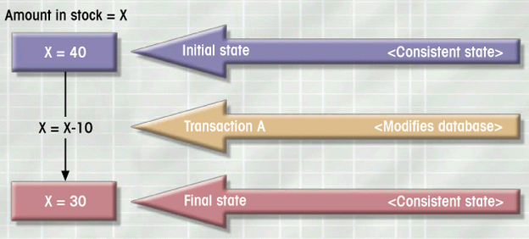
What is a Transaction?
A consistent database state is one in which all data integrity constraints are satisfied.
Example: during transaction, no other transaction must access X.
Notes:
4

Slide 6
What is a Transaction?
Integrity constraints:
Entity integrity and referential integrity are enforced automatically by DBMS.
Other constraints can be added so that they are enforced by the DBMS.
Notes:
4

Slide 7
Example Transaction
Examine current account balance
Consistent state before and after transaction
No changes made to Database
SELECT ACC_NUM, ACC_BALANCE FROM CHECKACC WHERE ACC_NUM = ‘0908110638’;
Notes:
6

Slide 8
Example Transaction
Register credit sale of 100 units of product X to customer Y for $500
Consistent state only if both transactions are fully completed
DBMS doesn’t guarantee transaction represents real-world event
UPDATE PRODUCT SET PROD_QOH = PROD_QOH - 100 WHERE PROD_CODE = ‘X’;
UPDATE ACCT_RECEIVABLE
SET ACCT_BALANCE = ACCT_BALANCE + 500 WHERE ACCT_NUM = ‘Y’;
Notes:
6

Slide 9
Transaction Properties
Atomicity
All transaction operations must be completed
Incomplete transactions aborted
Durability
Permanence of effects of committed transaction
Consistent state is permanently kept
Serializability
Conducts transactions in serial order
Important in multi-user and distributed databases
Isolation
Transaction data cannot be reused until its execution complete
Notes:
9

Slide 10
Transaction Management with SQL
Transaction support
COMMIT (permanently updates database)
ROLLBACK (does not modify database)
User initiated transaction sequence must continue until:
COMMIT statement is reached
ROLLBACK statement is reached
End of a program reached
Program reaches abnormal termination (leads to ROLLBACK)
Notes:
10

Slide 11
Transaction Management with SQL
Register credit sale of 100 units of product X to customer Y for $500
Transaction begins when first SQL statement is encountered, and ends at COMMIT or end
UPDATE PRODUCT SET PROD_QOH = PROD_QOH - 100 WHERE PROD_CODE = ‘X’;
UPDATE ACCT_RECEIVABLE
SET ACCT_BALANCE = ACCT_BALANCE + 500 WHERE ACCT_NUM = ‘Y’;
COMMIT;
Notes:
6

Slide 12
Transaction Log
Tracks all transactions that update database
May be used by ROLLBACK command
May be used to recover from system failure
Log stores
Record for beginning of transaction
Each SQL statement
Operation type (retrieve, update, insert, delete)
Names of objects
Before and after values for updated fields
Pointers to previous and next entries
Commit Statement
Notes:
12

Slide 13
Transaction Log Example
TRL_ID: transaction log record ID
TRX_NUM: transaction number
PREV_PTR: pointer to previous transaction record
NEXT_PTR: pointer to next transaction record
Notes:
12

Slide 14
Concurrency Control
Process of managing simultaneous operations on the database without having them interfere with one another
Ensure serializability of transactions in multiuser database environment
Potential problems in multiuser environments
Lost updates
Uncommitted data
Inconsistent retrievals
Notes:
14

Slide 15
Lost Updates
PROD_QOH = PROD_QOH + 100
PROD_QOH = PROD_QOH - 30

Slide 16
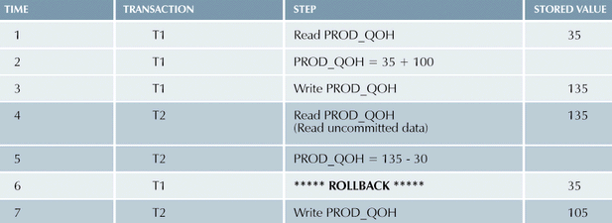
Uncommitted Data
PROD_QOH = PROD_QOH + 100 (ROLLBACK)
PROD_QOH = PROD_QOH - 30

Slide 17
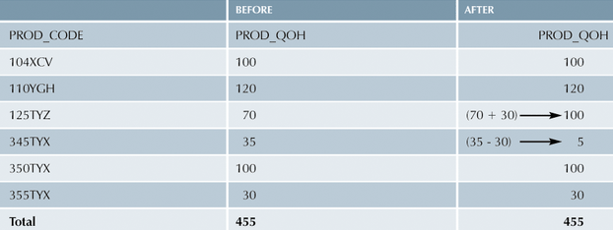
Inconsistent Retrievals

Slide 18
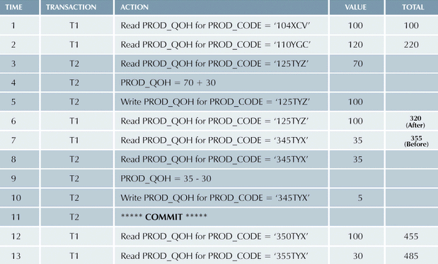
Inconsistent Retrievals

Slide 19
The Scheduler
Establishes order of concurrent transaction execution
Interleaves execution of database operations to ensure serializability
Bases actions on concurrency control algorithms
Locking
Time stamping
Ensures efficient use of computer’s CPU
Notes:
23

Slide 20
Read/Write Conflict Scenarios: Conflicting Database Operations Matrix

Slide 21
Concurrency Control with Locking Methods
Lock guarantees current transaction exclusive use of data item
Acquires lock prior to access
Lock released when transaction is completed
DBMS automatically initiates and enforces locking procedures
Managed by lock manager
Lock granularity indicates level of lock use – database, table, page, row, or field lock levels.
Notes:
25

Slide 22
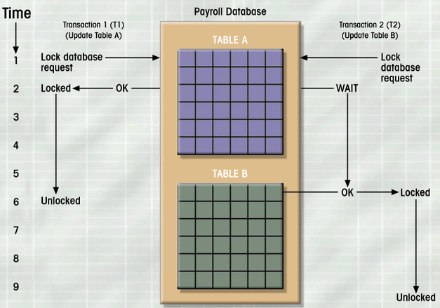
Database-Level Locking Sequence

Slide 23
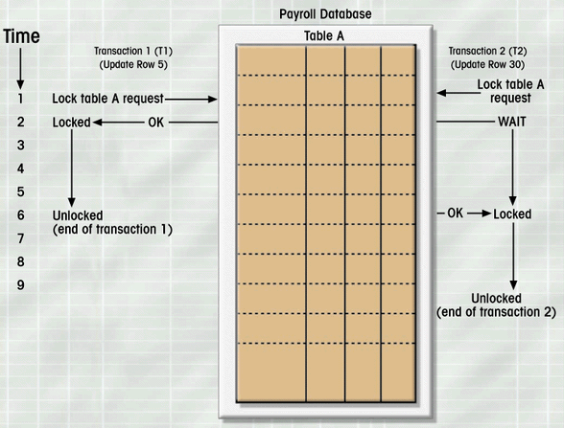
Table-Level Lock

Slide 24
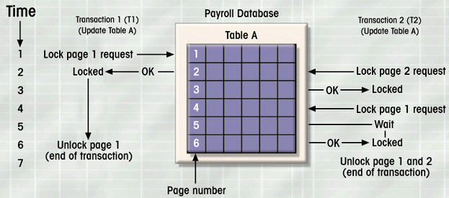
Page-Level Lock Example
A page is a diskpage, a part of the disk of fixed size, such as 4K, 8K, 16K.

Slide 25
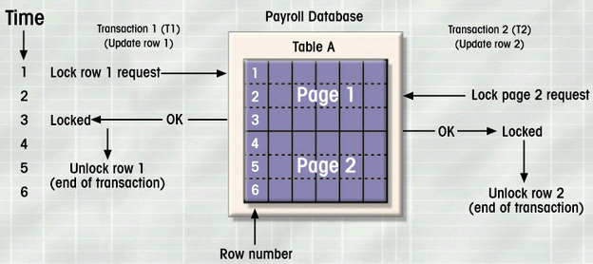
Row-Level Lock Example
Figure 9.5

Slide 26
Lock Types
Two main lock types:
Binary locks
Shared/Exclusive locks
DBMS manages the lock automatically – in MySQL, it is table-level lock in MS Access and SQL Server, it is row-level lock in Oracle, UDB, it is row-level lock
Notes:
31

Slide 27
Binary Locks
Two states
Locked (1)
Unlocked (0)
Locked objects unavailable to other objects – managed by DBMS
Unlocked objects open to any transaction
Each transaction locks object
Transaction unlocks object when complete
Is is possible to change DBMS default with LOCK TABLE and other SQL commands.
Notes:
31

Slide 28
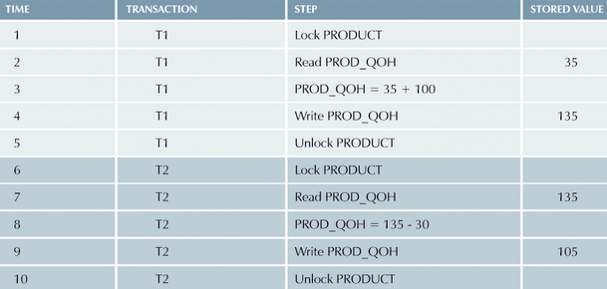
Example of Binary Lock Table
Notes:
31

Slide 29
Shared/Exclusive Locks
Shared
Exists when concurrent transactions granted READ access
Produces no conflict for read-only transactions
Issued when transaction wants to read and exclusive lock not held on item
Exclusive
Exists when access reserved for locking transaction
Used when potential for conflict exists
Exclusive lock granted only if object does not have a lock yet
Issued when transaction wants to update unlocked data

Slide 30
Problems with Locking
Shared/exclusive lock requires important work from the lock manager:
Type of lock must be known before access granted
Several lock operations: READ_LOCK, WRITE_LOCK, UNLOCK.
Transaction schedule may not be serializable
Managed through two-phase locking
Schedule may create deadlocks
Managed by using deadlock detection and prevention techniques

Slide 31
Two-Phase Locking
Growing phase
Shrinking phase
Governing rules
Two transactions cannot have conflicting locks
No unlock operation can precede a lock operation in the same transaction
No data are affected until all locks are obtained

Slide 32
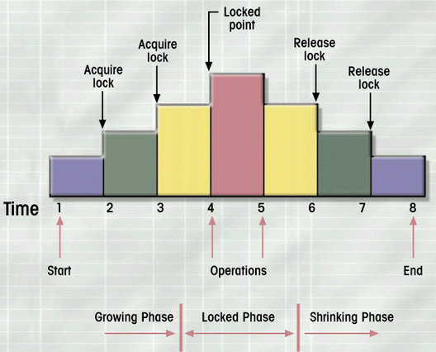
Two-Phase Locking Protocol
Figure 9.6

Slide 33
Deadlocks
Occurs when two transactions wait for each other to unlock data (T1→ X,Y and T2 → Y,X)
Called deadly embrace
Control techniques
Deadlock prevention (abort transaction before deadlock)
Deadlock detection (abort one of the deadlocked transactions)
Deadlock avoidance (get all the locks at once)

Slide 34
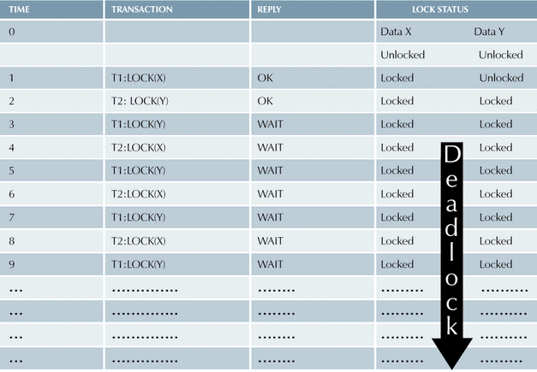
How Deadlock Conditions Created
Table 9.11

Slide 35
Concurrency Control with Time Stamping Methods
Assigns global unique time stamp to each transaction
Produces order for transaction submission for conflicting operations
Properties
Uniqueness
Monotonicity
DBMS executes conflicting operations in time stamp order
Each value requires two additional time stamps fields
Last time field read
Last update
Notes:
42

Slide 36
Concurrency Control with Optimistic Methods
Assumes most database operations do not conflict
Transaction executed without restrictions until committed
Phases:
Read Phase
Validation Phase (check that changes will not affect database integrity)
Write Phase
Notes:
43

Slide 37
Database Recovery Management
Restores a database to previously consistent state
Based on the atomic transaction property
Recovery of transactions, database, system
Level of backup
Full database backup
Differential backup
Transaction log backup
Notes:
44

Slide 38
Causes of Database Failure
Software
Hardware
Programming Exemption
Transaction
External
Notes:
44

Slide 39
Transaction Recovery
Transaction recovery
Write-ahead protocol
Redundant transaction logs
Database buffers
Database checkpoints
Notes:
47

Slide 40
Transaction Recovery
Deferred-write and Deferred-update
Changes are written to the transaction log
Database updated after transaction reaches commit point
Write-through
Immediately updated during execution
Before the transaction reaches its commit point
Transaction log also updated
Transaction fails, database uses log information
to ROLLBACK
Notes:
47

