Slide 1
SQL Graphical Queries Design
Query By Example

Slide 2
Learning Objectives
Create queries with graphical design in Access.
List the main features of Query-By-Example (QBE).
List the types of queries provided by the Microsoft Access DBMS QBE facility.
Use QBE to build queries to select fields and records.
Use QBE to target single or multiple tables.

Slide 3
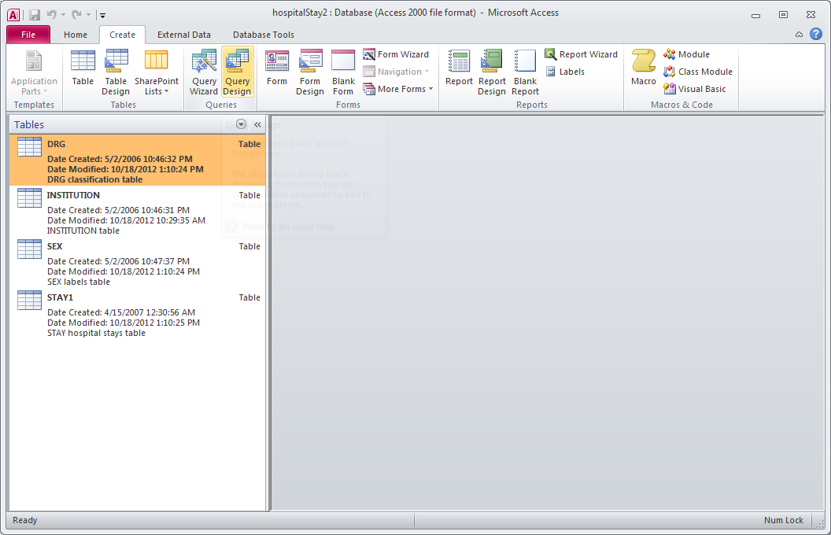
Query Design Opening

Slide 4
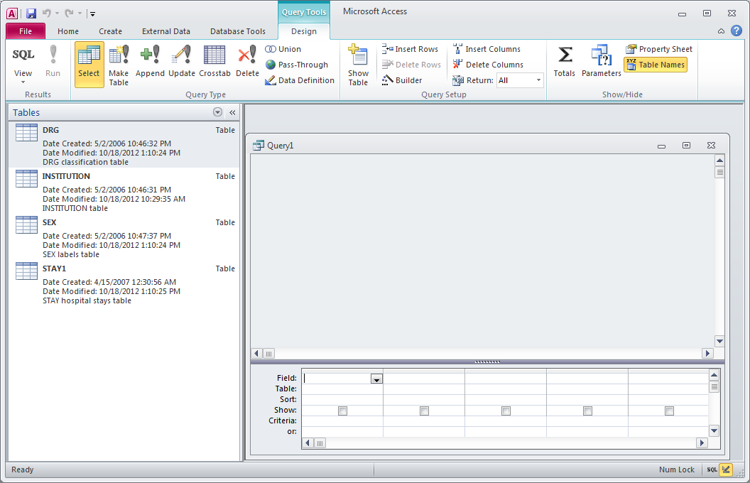
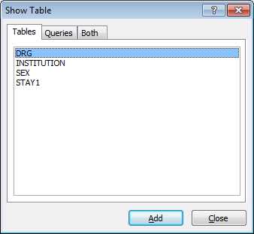

Slide 5
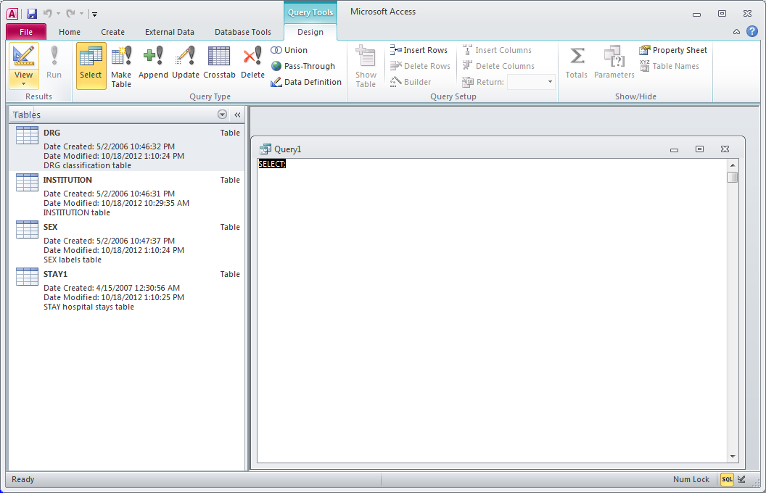

Slide 6
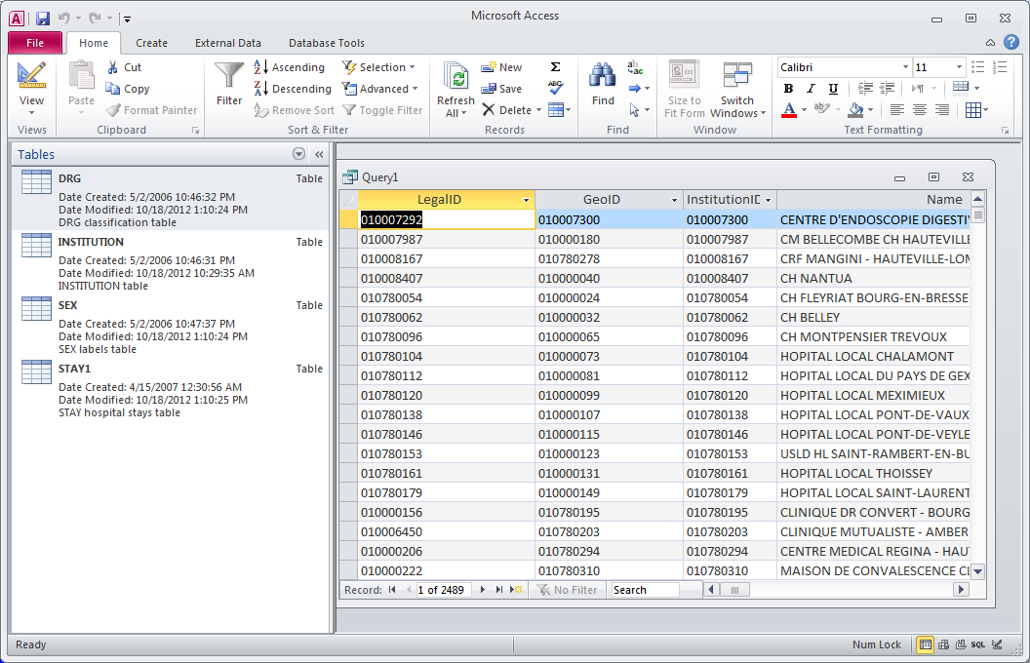

Slide 7
Query Design
Add tables
Create joins
Select fields
Sort order
Criteria
Totals (aggregate operations)

Slide 8
Adding Tables
Right mouse button: add a table

Slide 9
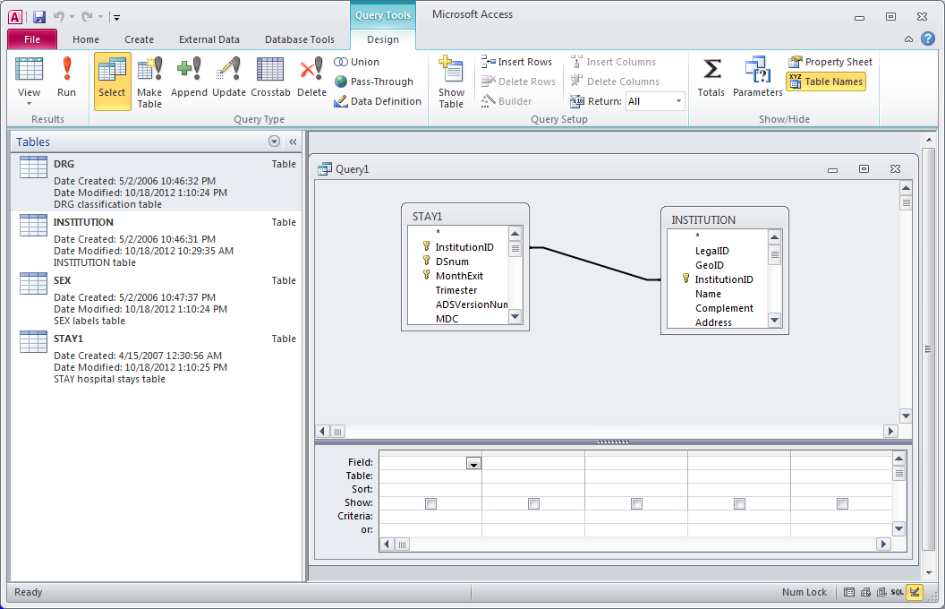
Creating Joins
With the mouse create a join Ex :
[Stay1].[InstitutionID] and
[InstitutionID]

Slide 10
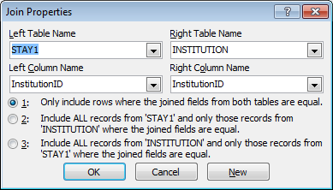
Creating Joins

Slide 11
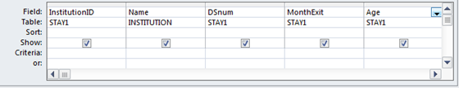
Selecting Fields
Name of selected field
Name of the table
Check to display field

Slide 12
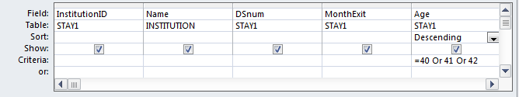
Sort order, Criteria
Sort order
Selection criteria

Slide 13
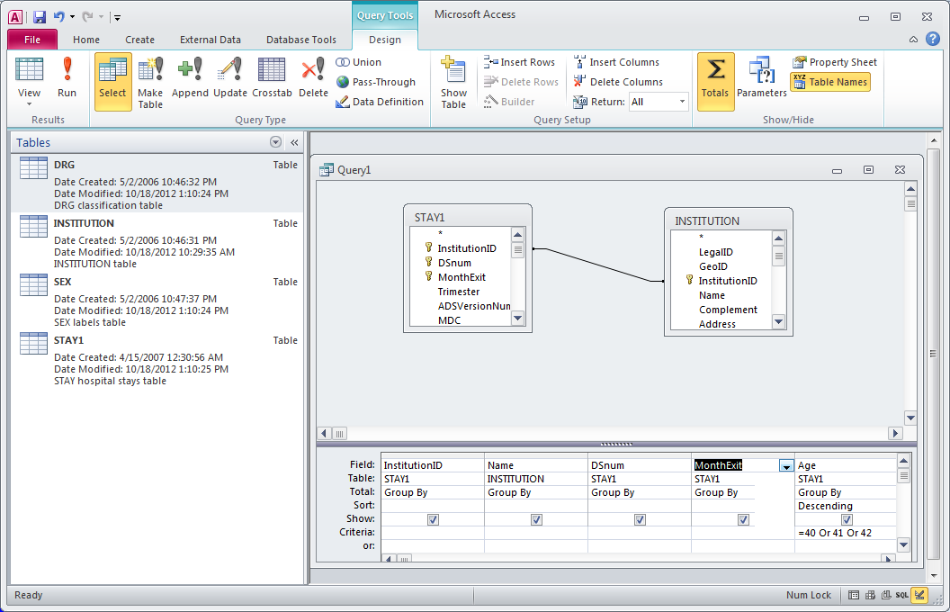
Totals
Right mouse button:
Add one lign of work called totals

Slide 14
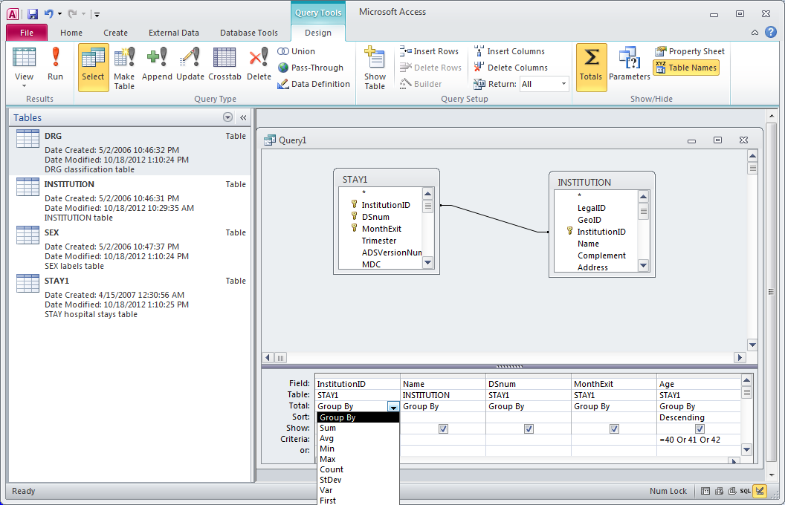
Group by
Totals row
Totals choice: Group by
Drop down list of totals

Slide 15
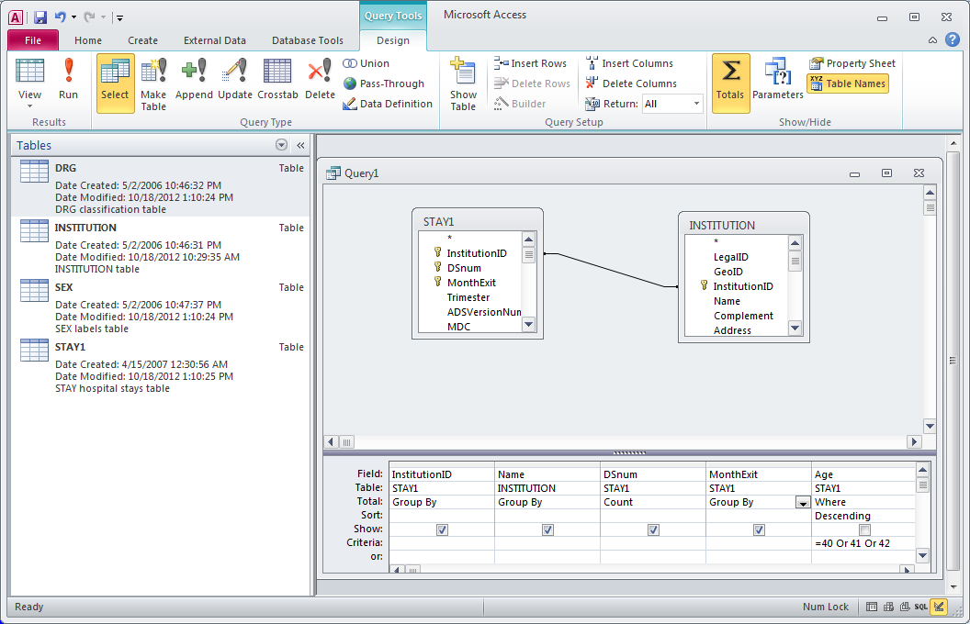
Count and Where
Choice of total: Count
Choice of total: Where

Slide 16
Query-by-Example (QBE)
Visual approach for accessing information in a database through use of query templates.
Example values are entered into template to represent what access to database is to achieve, such as the answer to a query.
Originally developed by IBM in 1970s and has proved so popular that QBE (or similar) is now provided by most DBMSs.
When user constructs a QBE - in background, DBMS creates an equivalent SQL statement.

Slide 17
Query-by-Example (QBE)
Allows user to:
- Ask questions about data in one or more tables.
- Specify the fields we want in the answer.
- Select records according to some criteria.
- Perform calculations on the data in tables.
- Insert and delete records.
- Modify values of fields.
- Create new fields and tables.

Slide 18
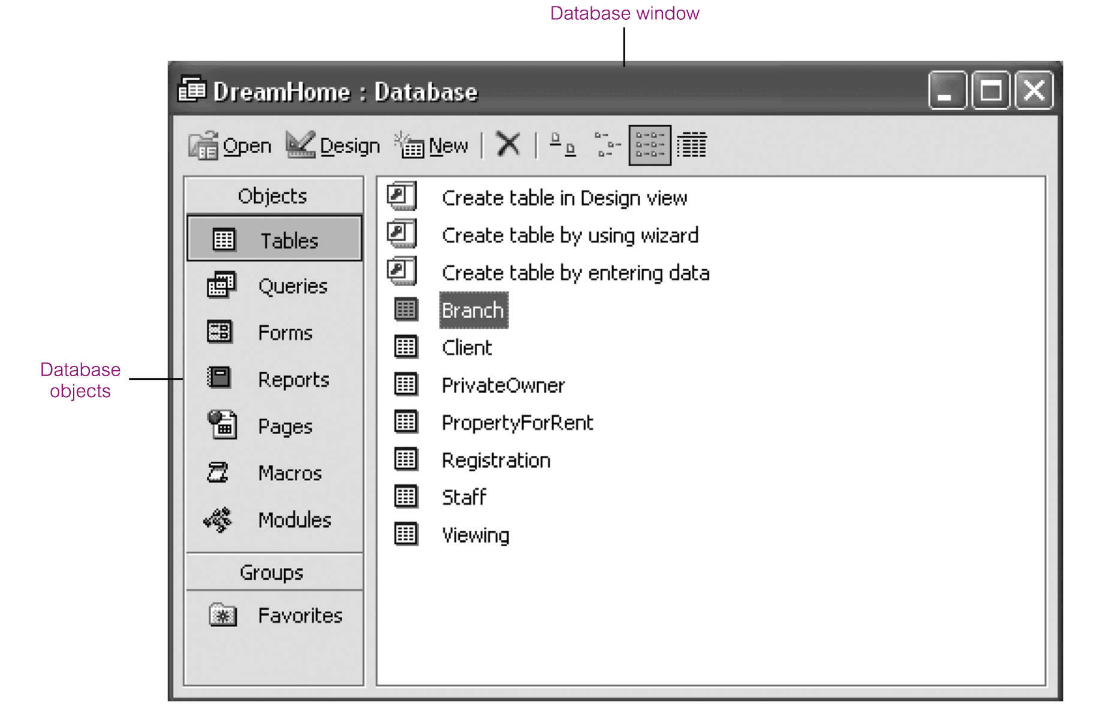
QBE in Microsoft Access

Slide 19
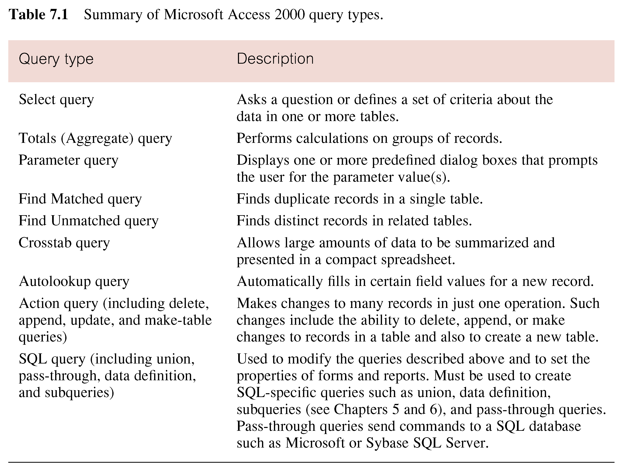
Summary of Microsoft Access Query Types

Slide 20
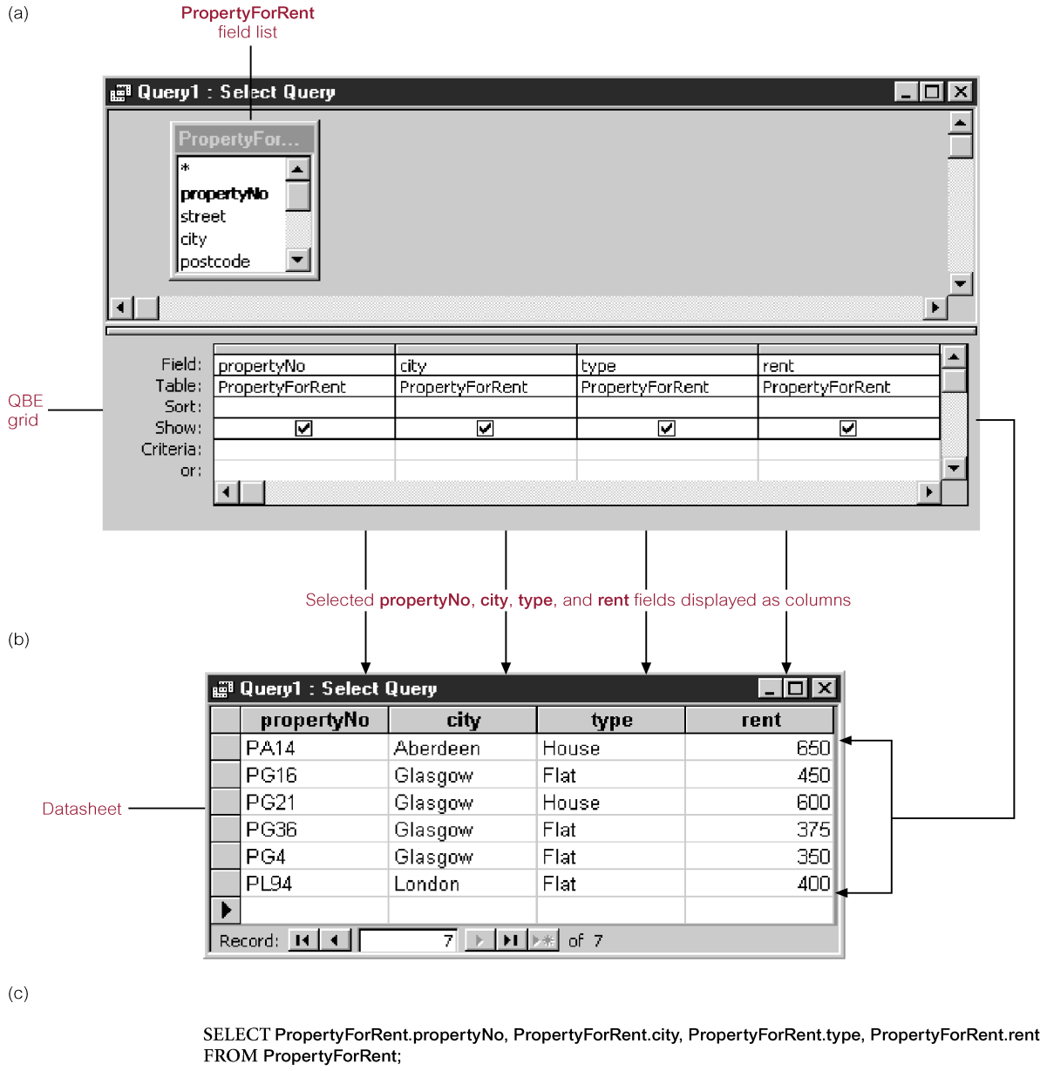
Building Select Queries using QBE - Specifying Criteria

Slide 21
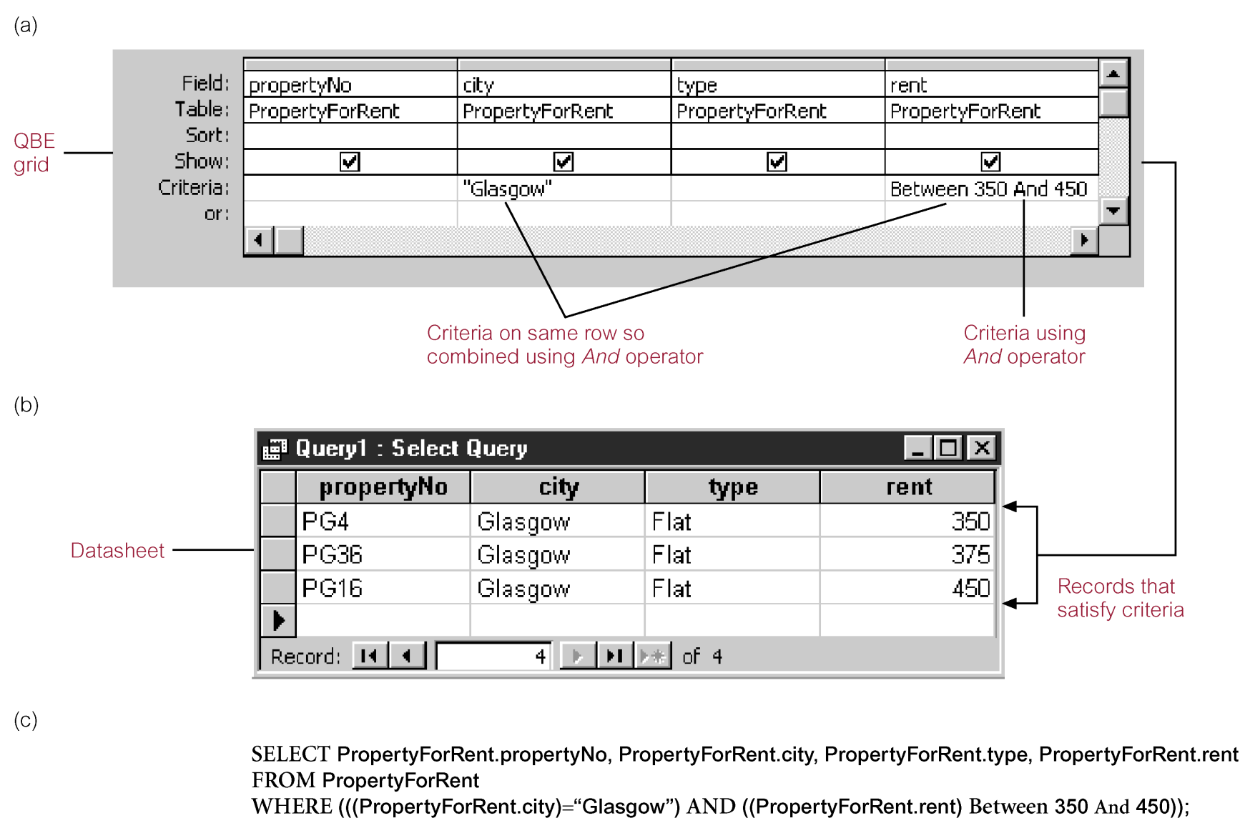
Building Select Queries using QBE - Specifying Criteria

Slide 22
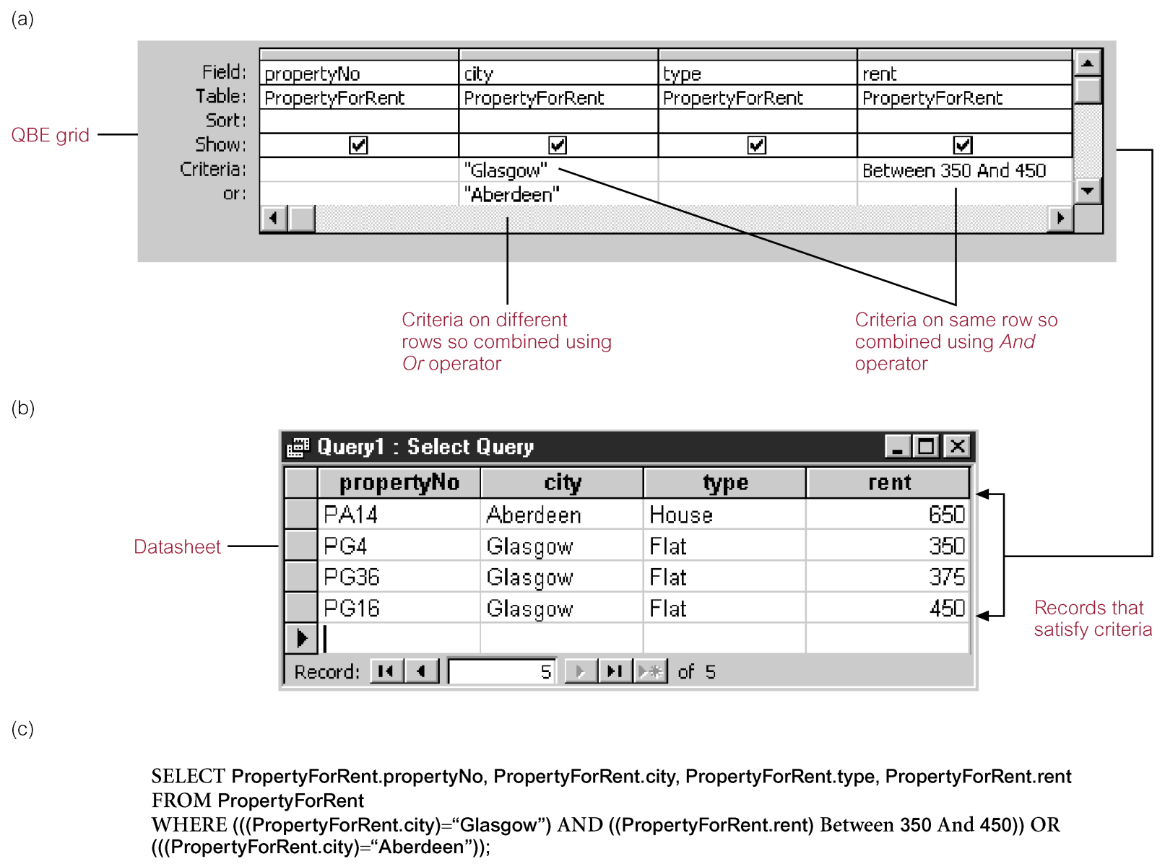
Building Select Queries using QBE - Specifying Criteria

Slide 23
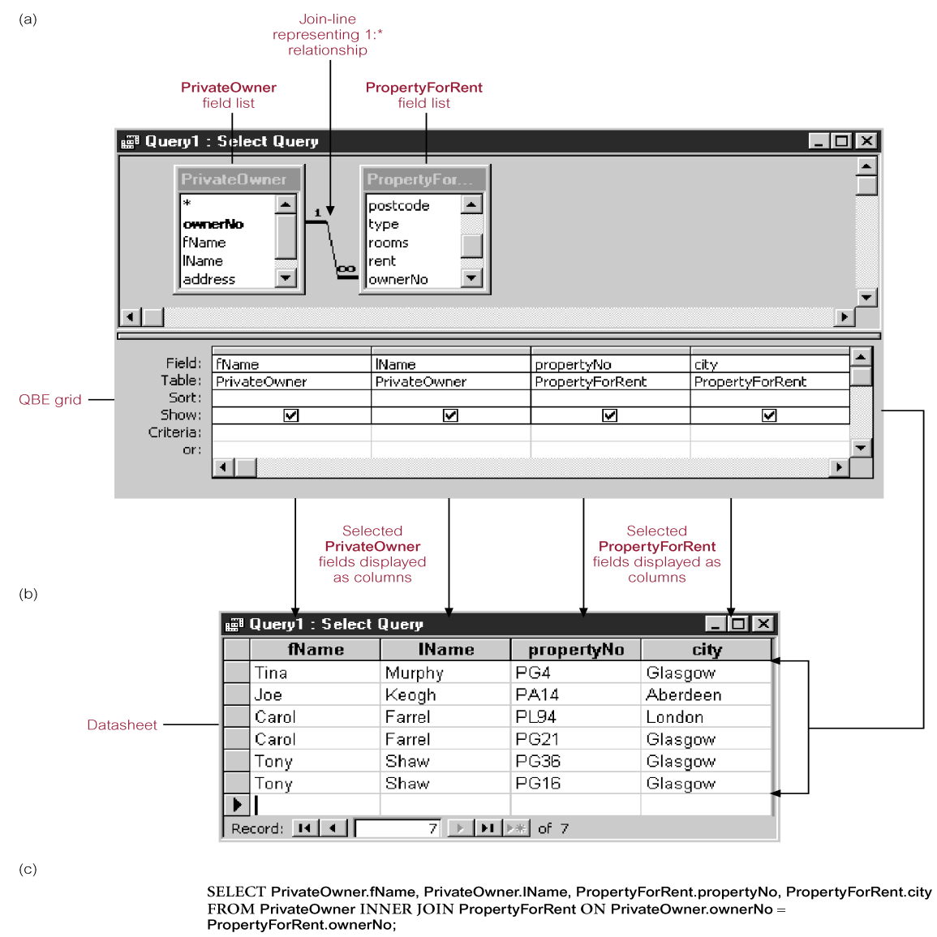
Creating Multi-table Queries

Slide 24
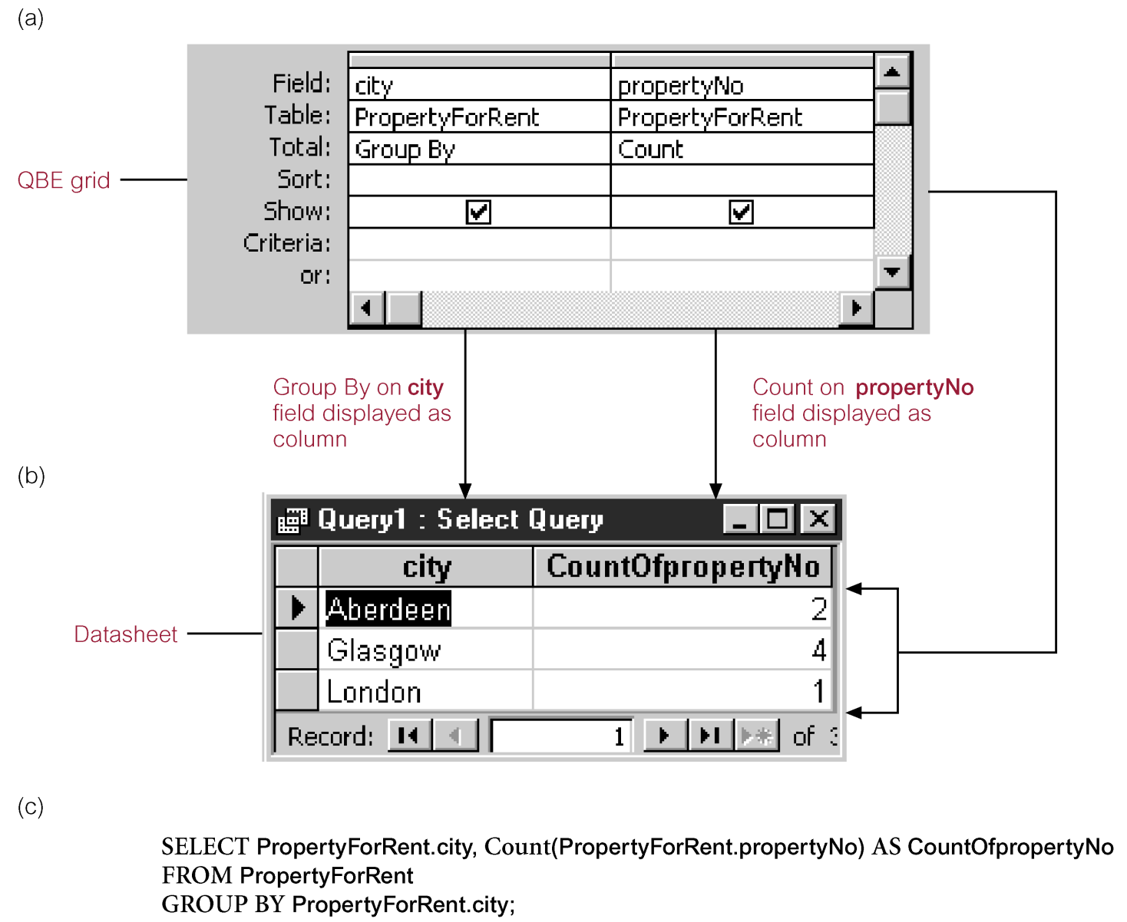
Calculating Totals

Slide 25
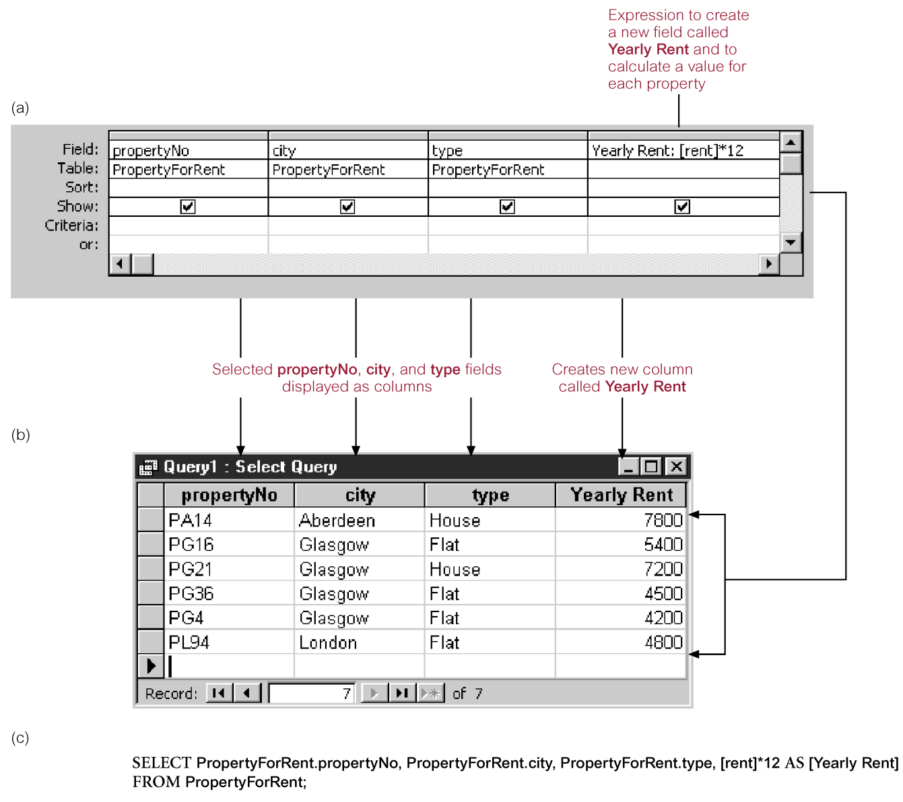
Calculating Totals

Slide 26
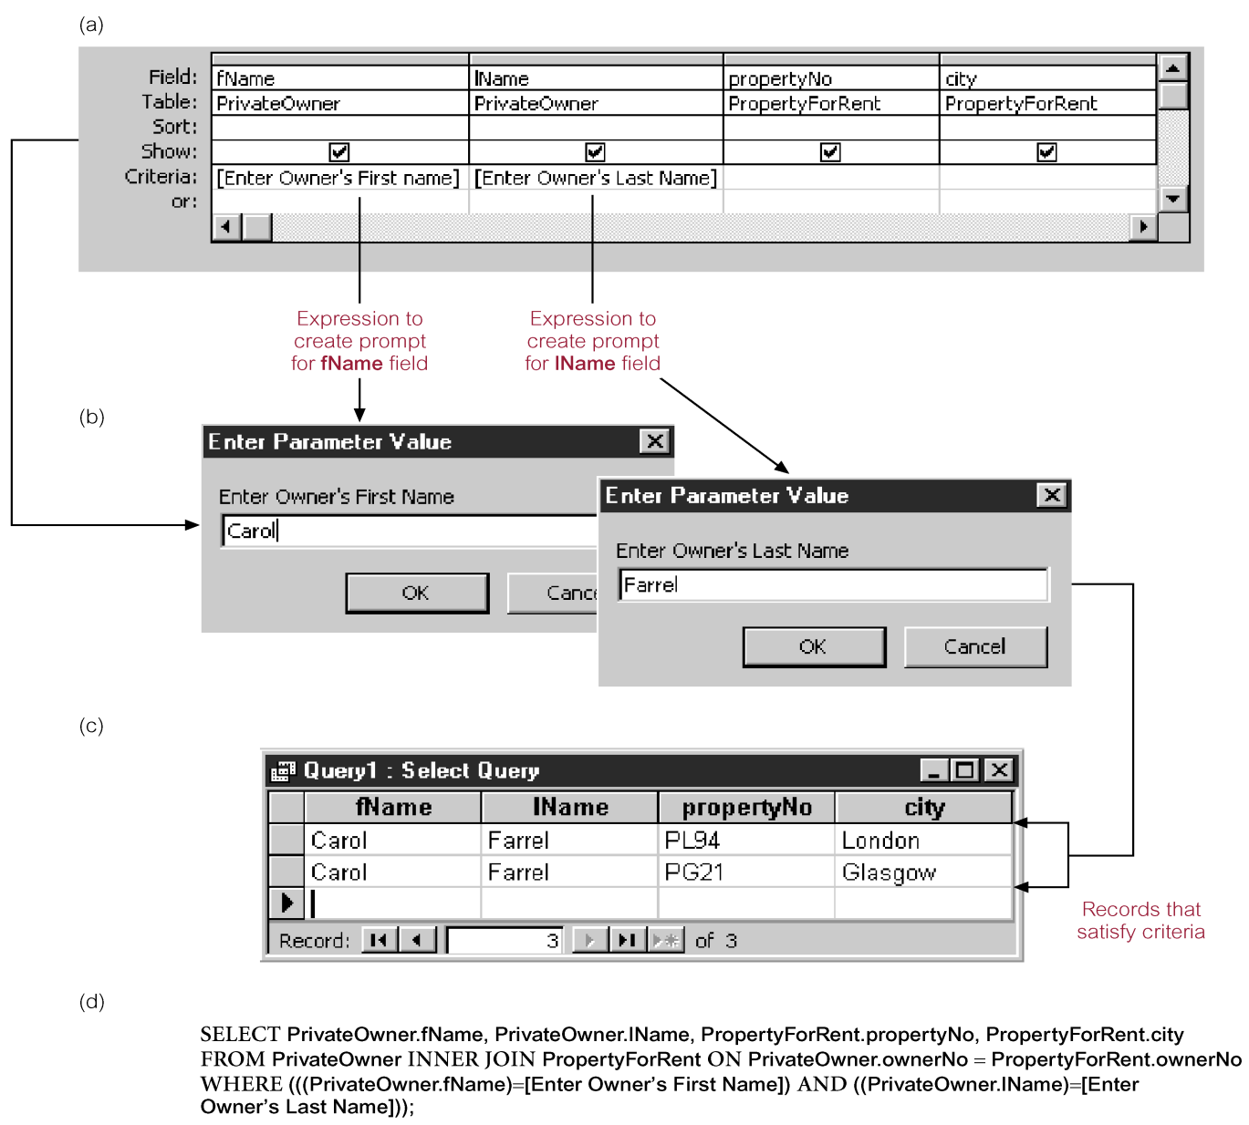
Using Advanced Queries - Parameter Query

Slide 27
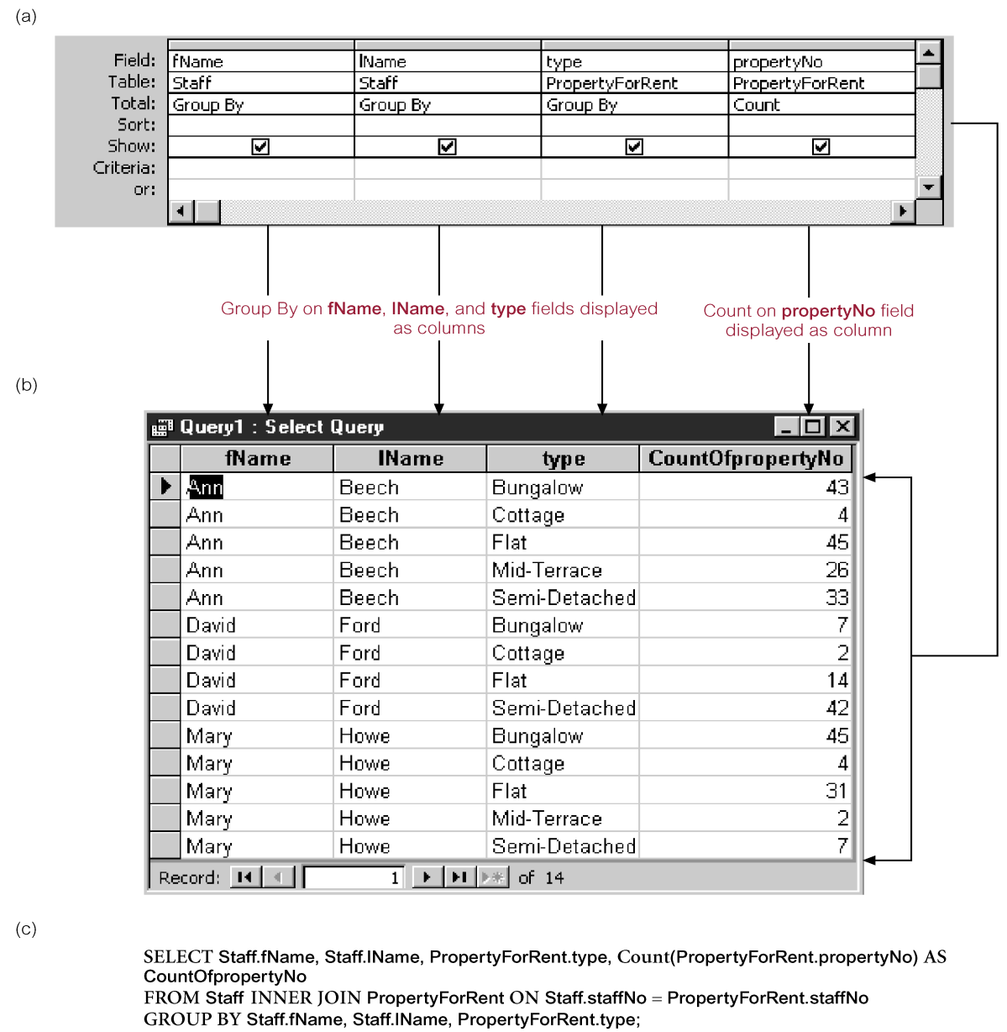
Using Advanced Queries - Crosstab Query

Slide 28
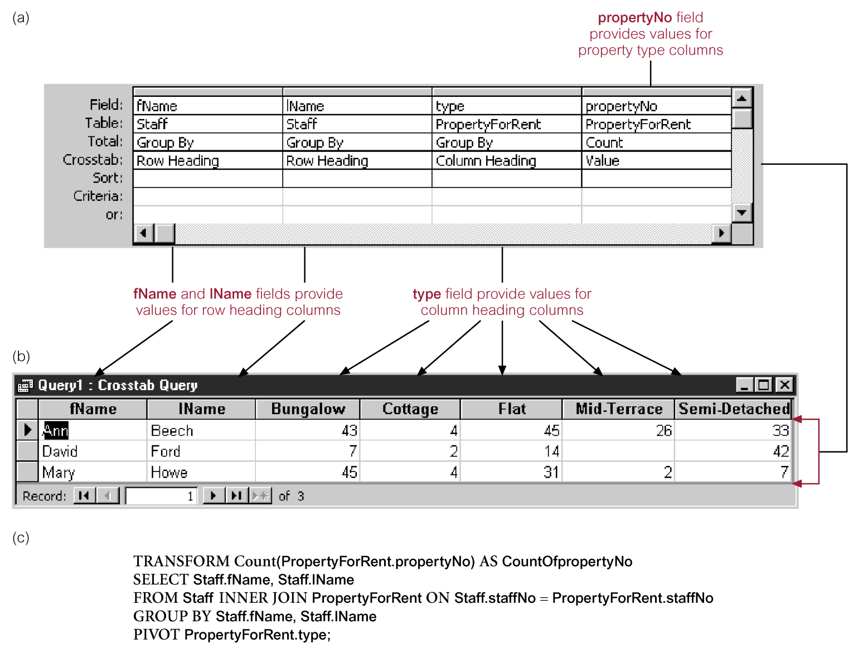
Using Advanced Queries - Crosstab Query

Slide 29
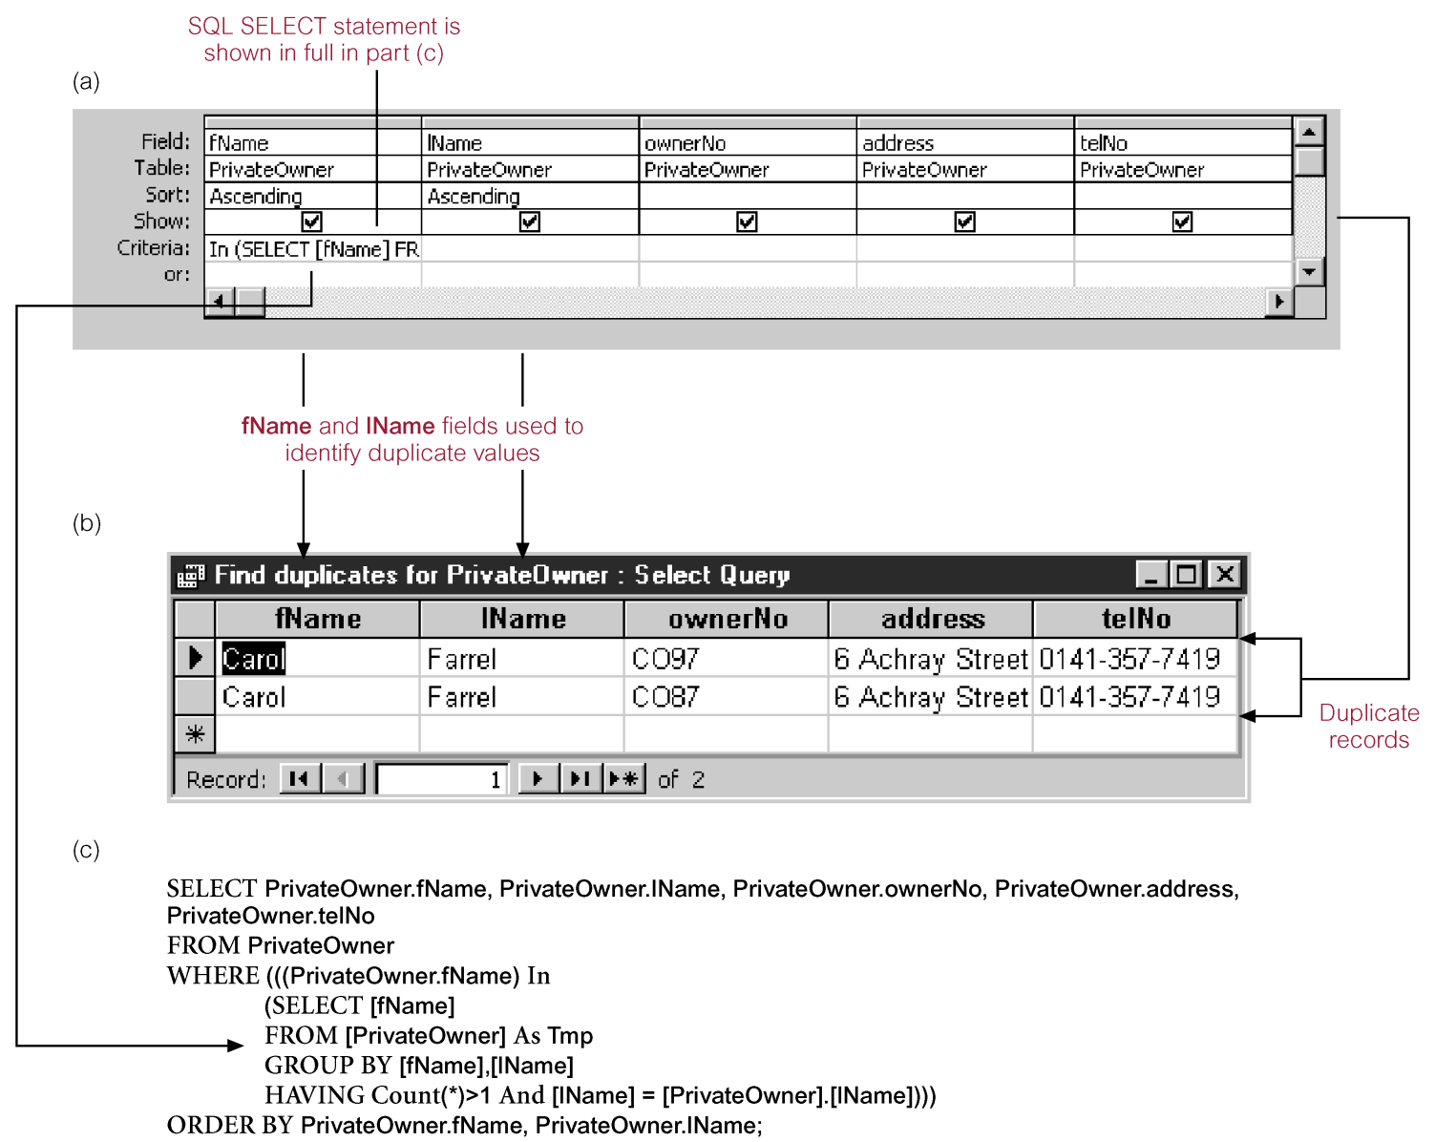
Using Advanced Queries - Find Matched Query

Slide 30
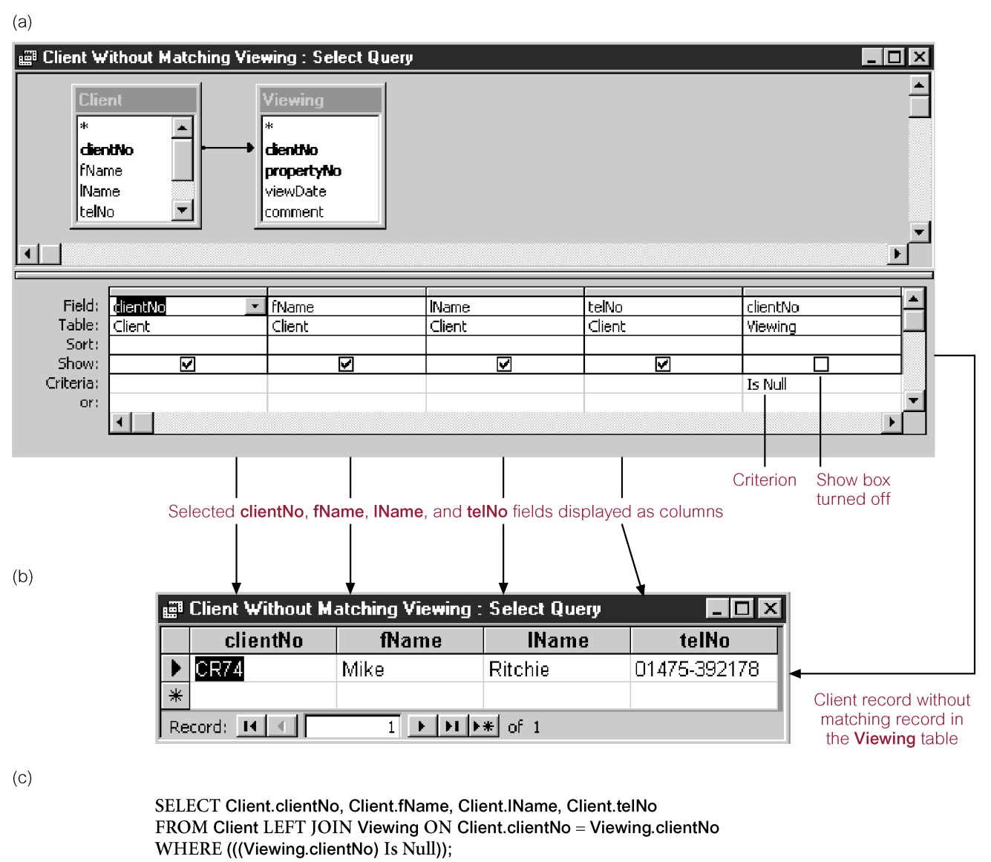
Using Advanced Queries - Find Unmatched Query

Slide 31
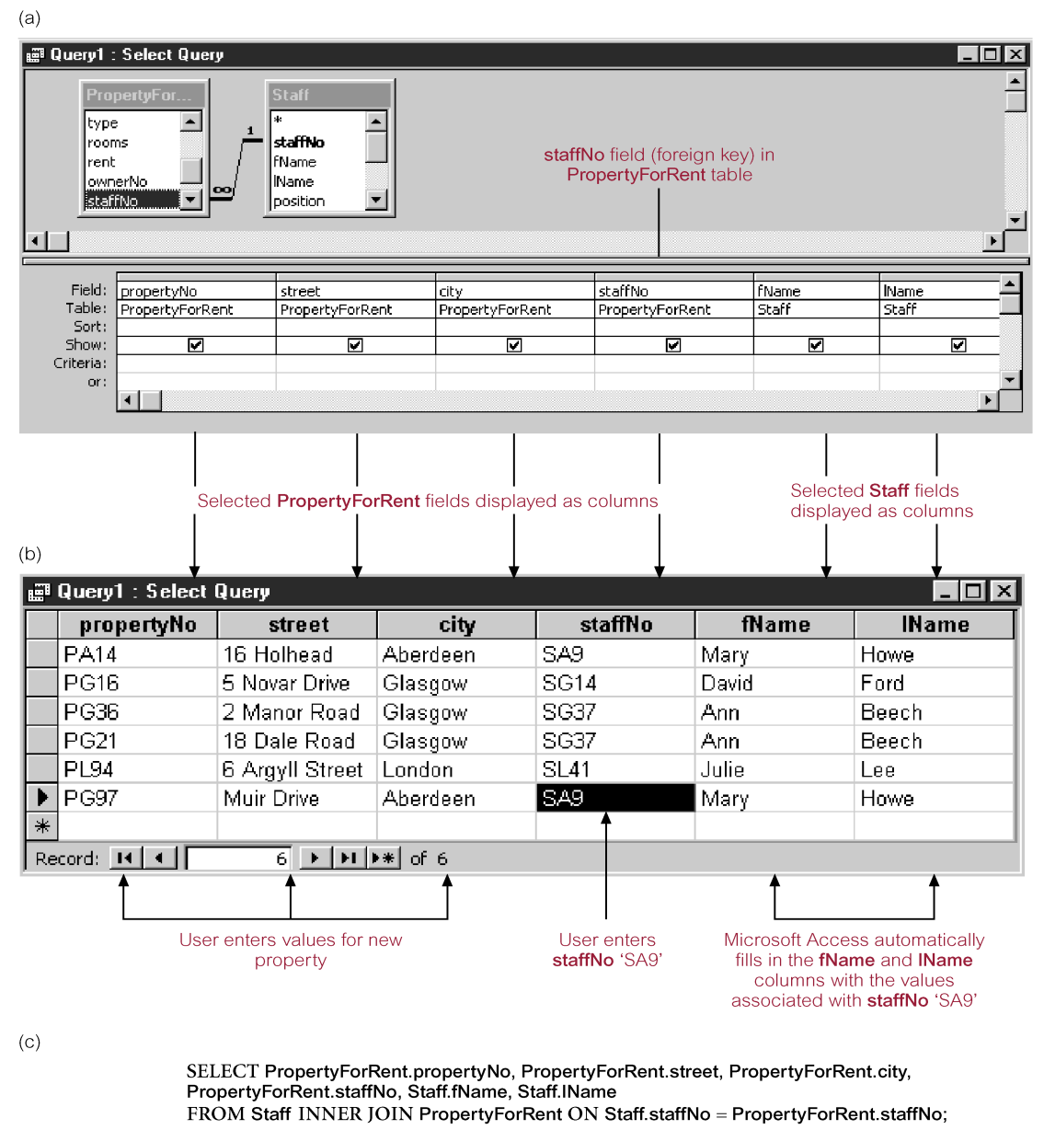
Using Advanced Queries - Autolookup Query

Slide 32
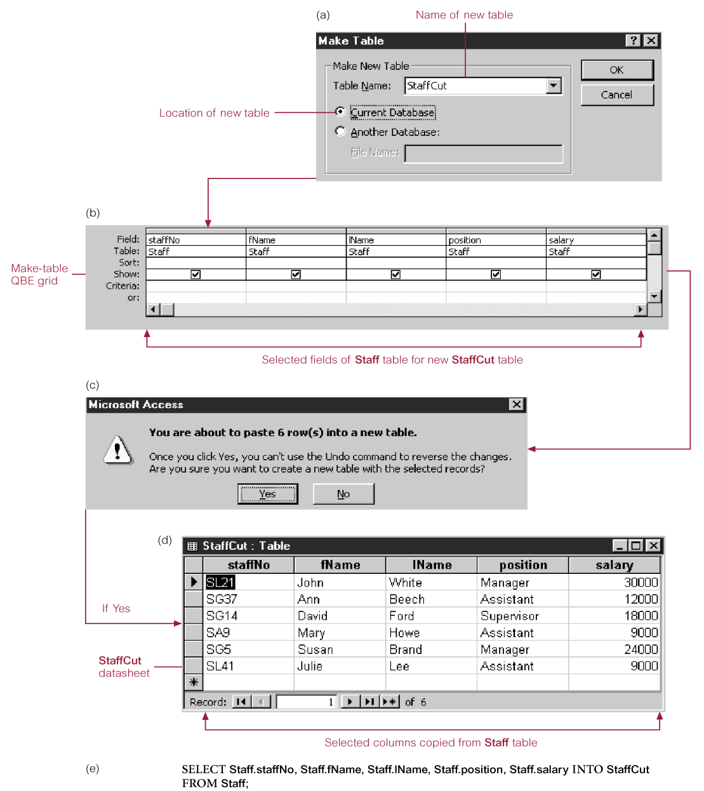
Changing Content of Tables - Make-Table Action Query

Slide 33
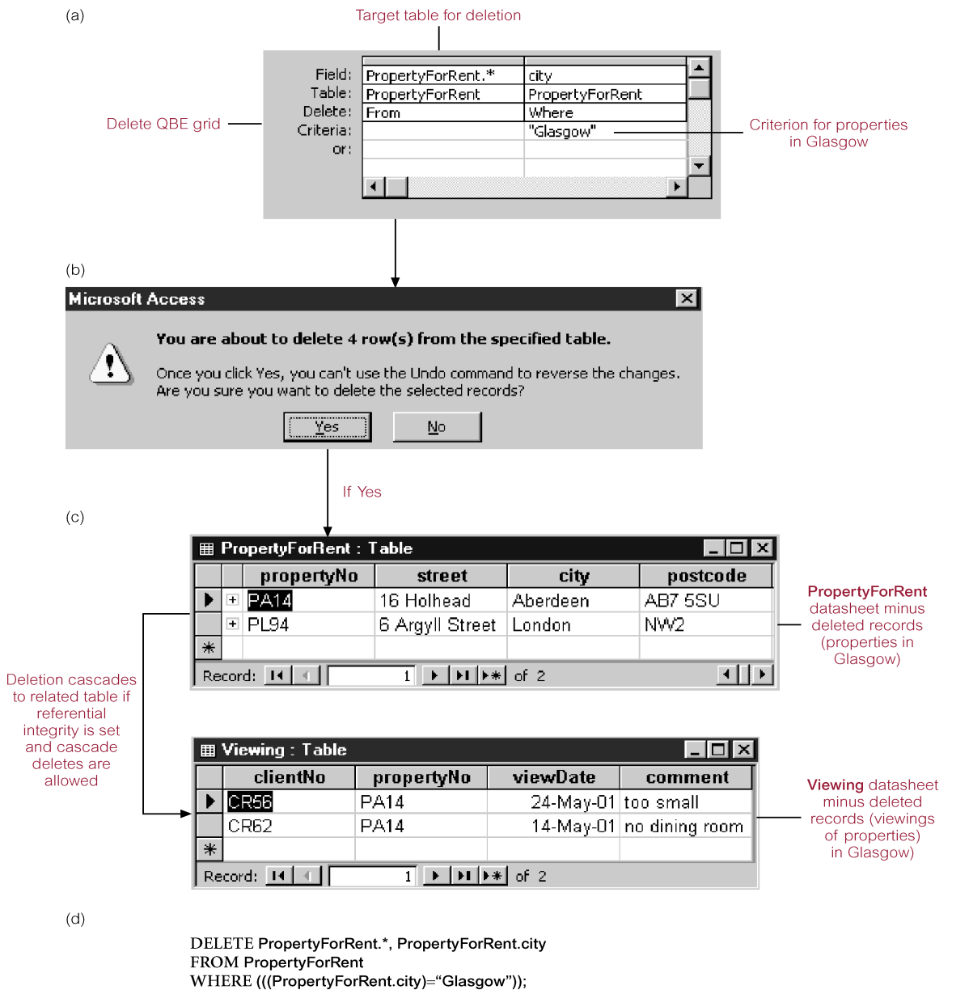
Changing Content of Tables - Delete Action Query

Slide 34
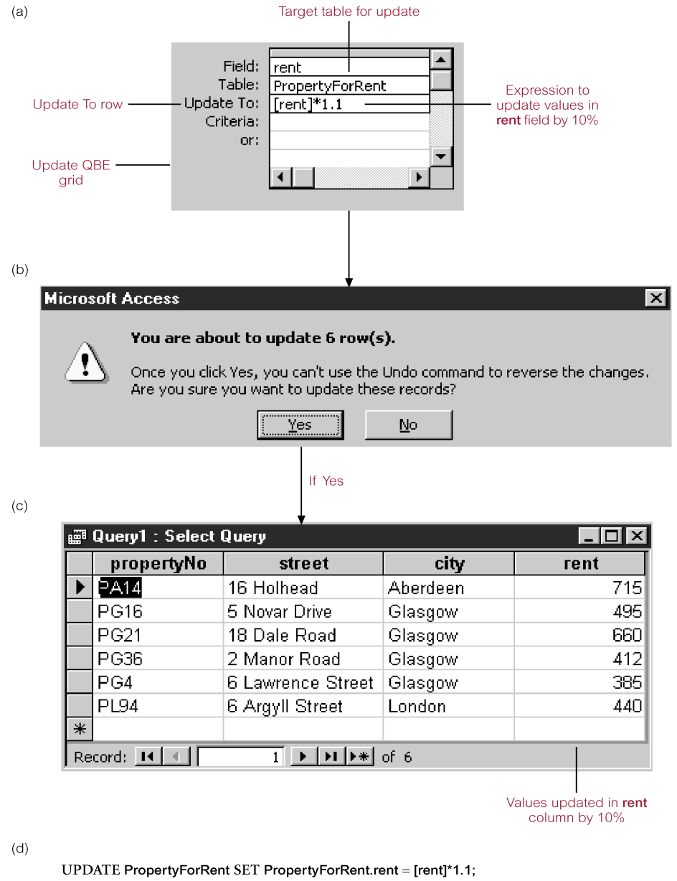
Changing Content of Tables - Update Action Query

Slide 35
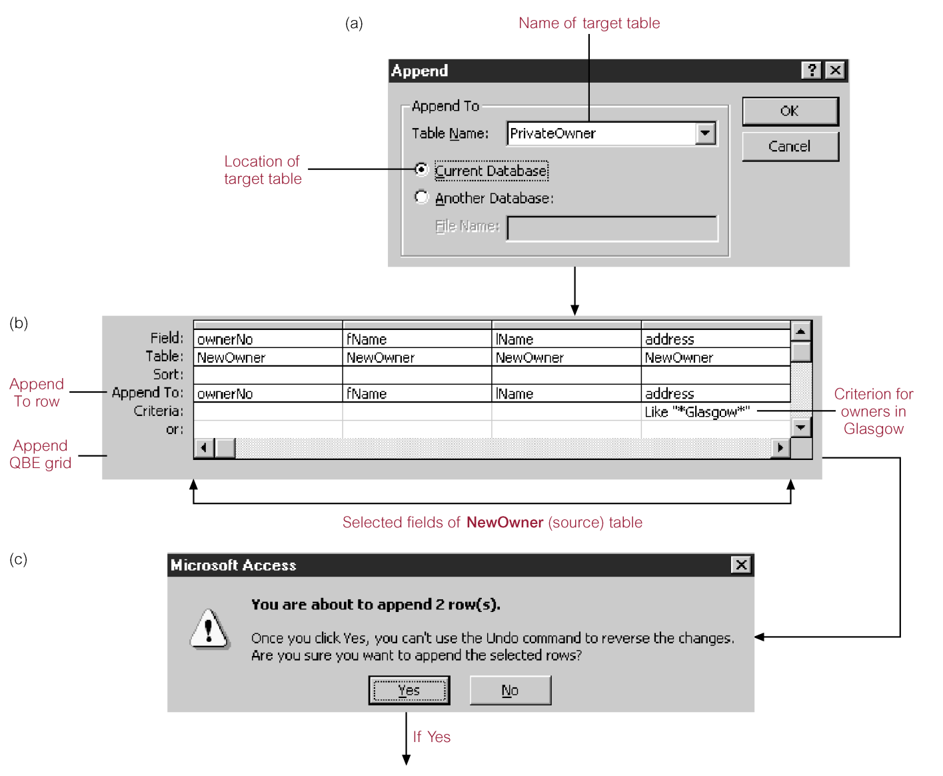
Changing Content of Tables - Append Action Query

Slide 36
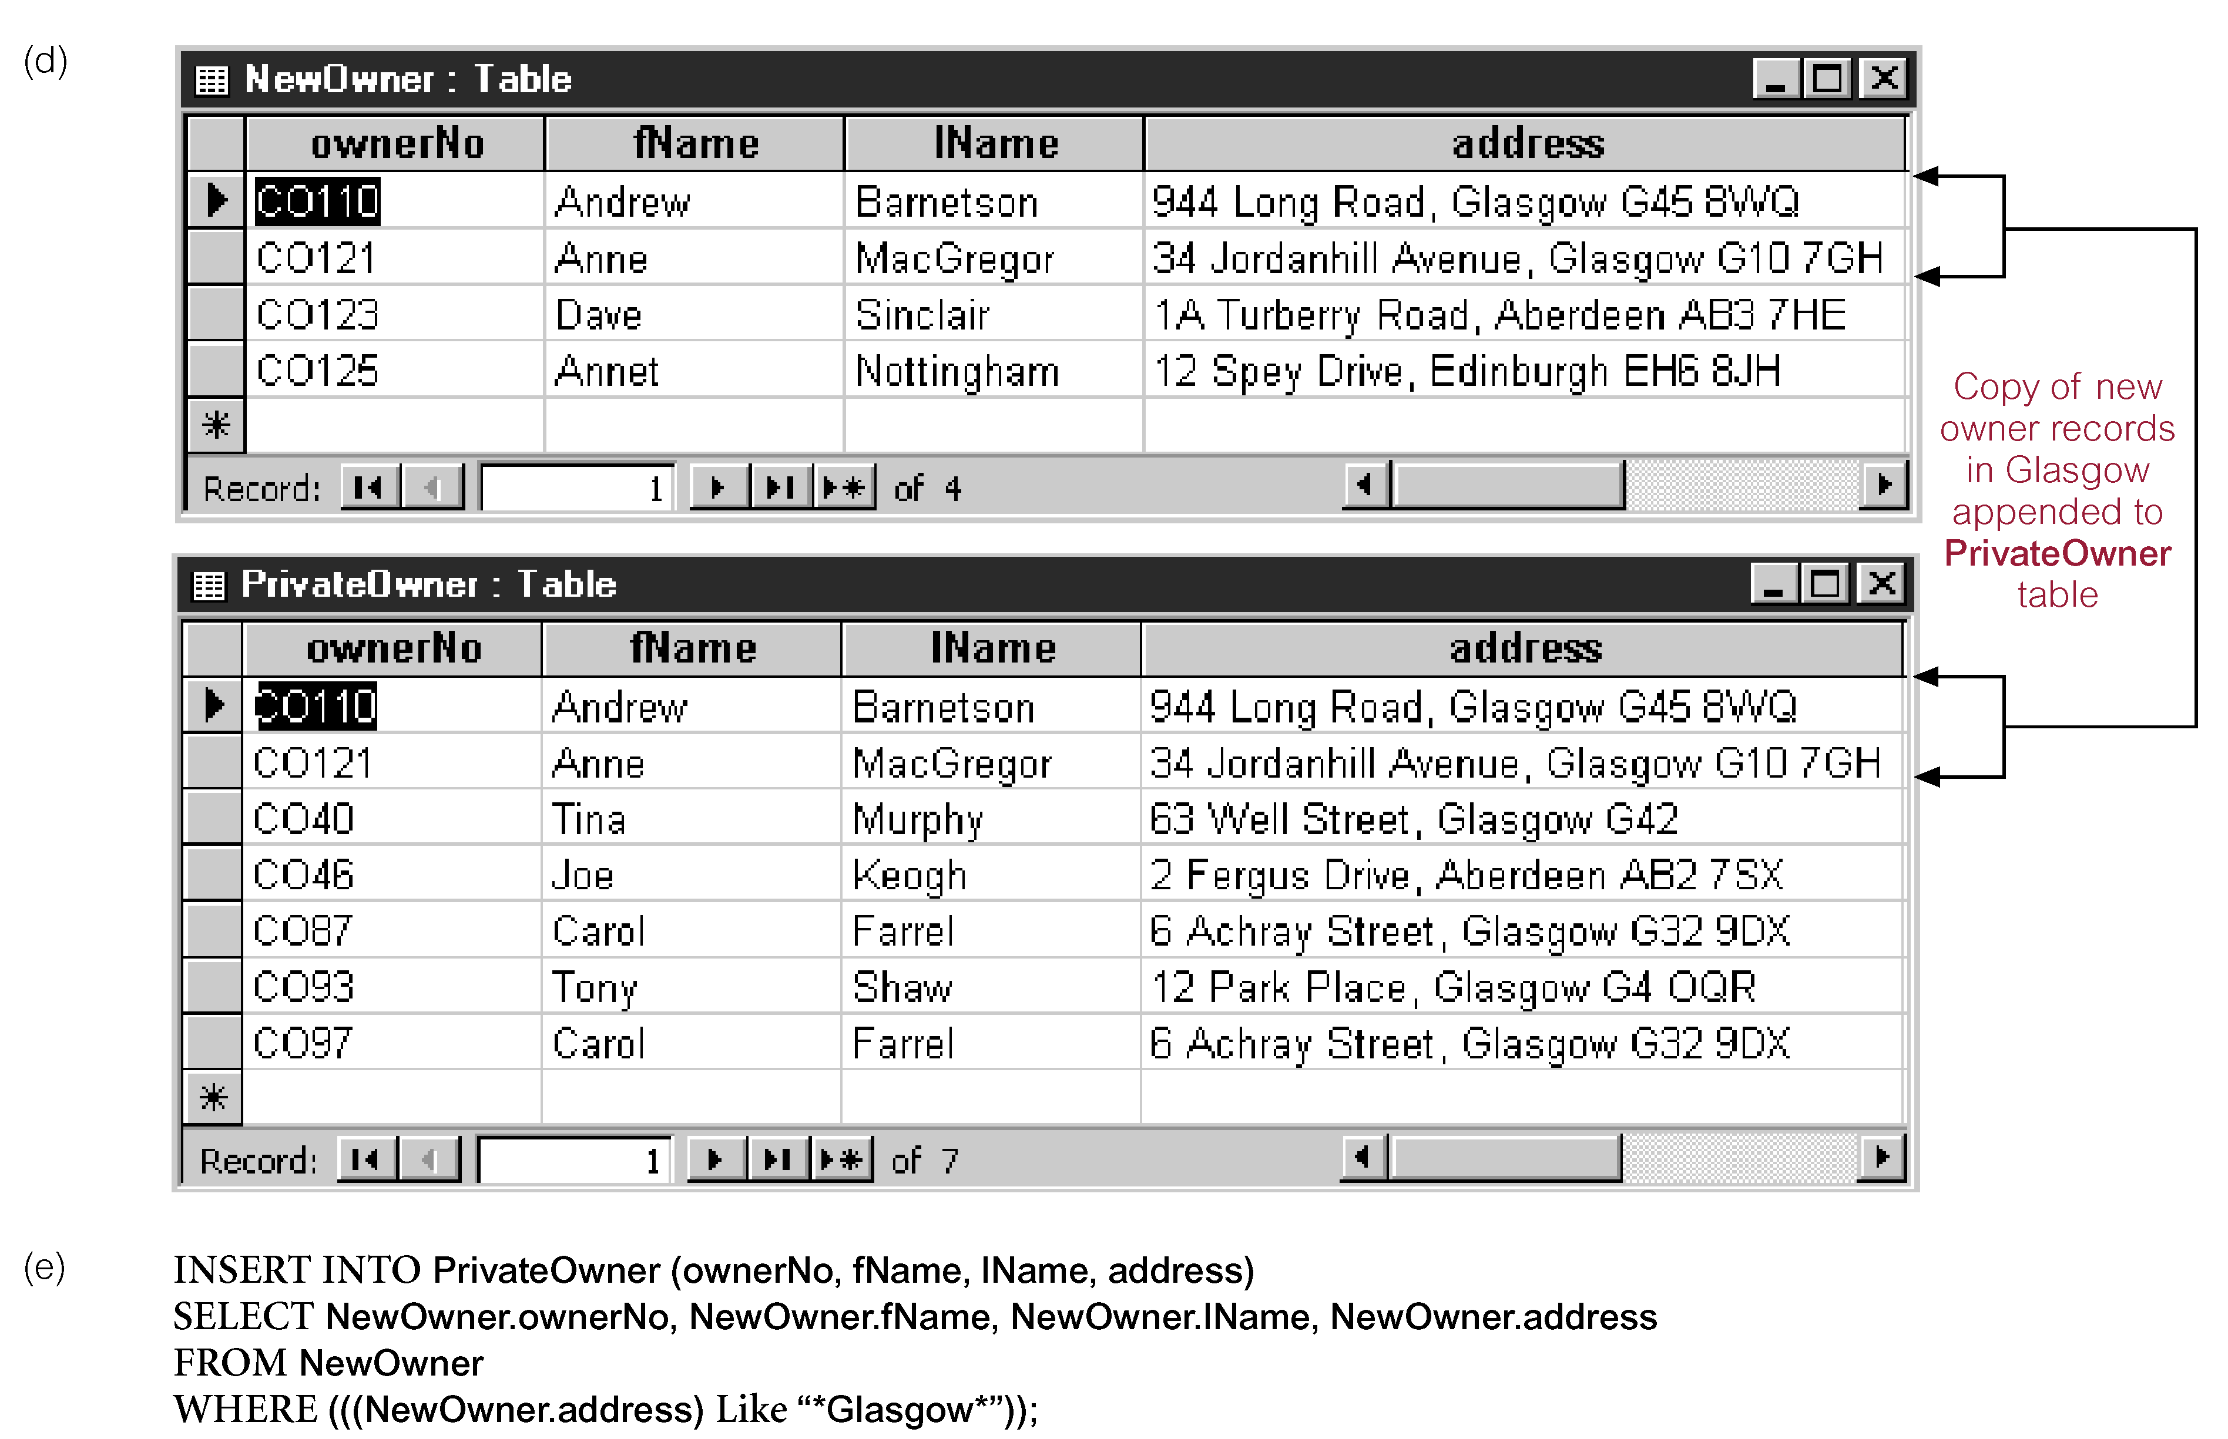
Changing Content of Tables - Append Action Query

