Slide 1
SQL Commands

Slide 2
Acknowledgments
Some of these slides have been adapted from Thomas Connolly and Carolyn Begg

Slide 3
Learning Objectives
Specify the syntax of and practice SQL commands to
Create database objects (tables, domains, views …)
Modify database objects
Delete database objects
Create/ modify / delete keys (primary, foreign, …)

Slide 4
Acknowledgments
These slides have been adapted from Thomas Connolly and Carolyn Begg

Slide 5
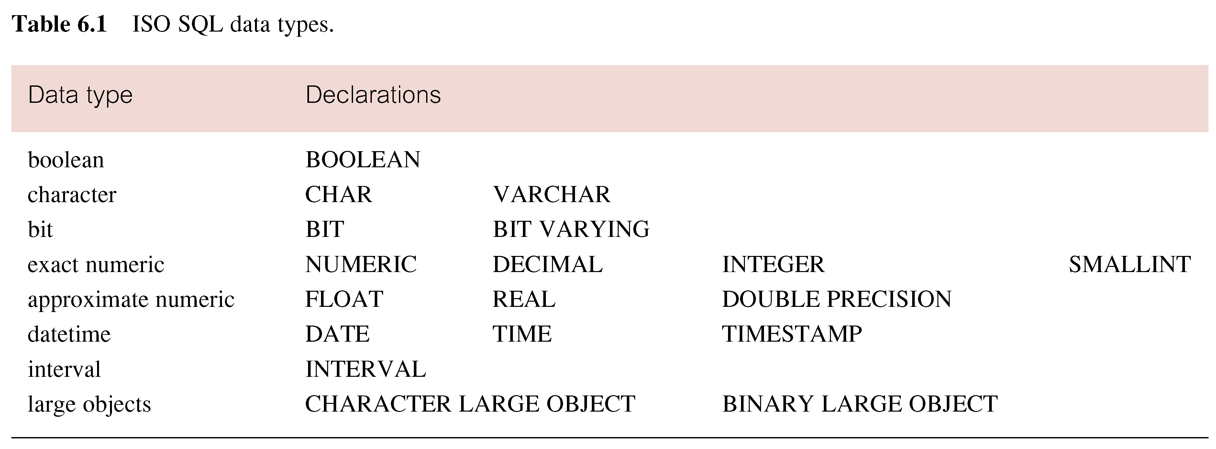
ISO SQL Data Types

Slide 6
Integrity Enhancement Feature
Consider five types of integrity constraints:
Required data.
Domain constraints.
Entity integrity.
Referential integrity.
Enterprise constraints.

Slide 7
Integrity Enhancement Feature
Required Data
position VARCHAR(10) NOT NULL
Domain Constraints
(a) CHECK
sex CHAR NOT NULL
CHECK (sex IN (‘M’, ‘F’))

Slide 8
Integrity Enhancement Feature
(b) CREATE DOMAIN
CREATE DOMAIN DomainName [AS] dataType
[DEFAULT defaultOption]
[CHECK (searchCondition)]
For example:
CREATE DOMAIN SexType AS CHAR
CHECK (VALUE IN (‘M’, ‘F’));
sex SexType NOT NULL

Slide 9
Integrity Enhancement Feature
searchCondition can involve a table lookup:
CREATE DOMAIN BranchNo AS CHAR(4)
CHECK (VALUE IN (SELECT branchNo
FROM Branch));
Domains can be removed using DROP DOMAIN:
DROP DOMAIN DomainName
[RESTRICT | CASCADE]

Slide 10
IEF - Entity Integrity
Primary key of a table must contain a unique, non-null value for each row.
ISO standard supports FOREIGN KEY clause in CREATE and ALTER TABLE statements:
PRIMARY KEY(staffNo)
PRIMARY KEY(clientNo, propertyNo)
Can only have one PRIMARY KEY clause per table. Can still ensure uniqueness for alternate keys using UNIQUE:
UNIQUE(telNo)

Slide 11
IEF - Referential Integrity
FK is column or set of columns that links each row in child table containing foreign FK to row of parent table containing matching PK.
Referential integrity means that, if FK contains a value, that value must refer to existing row in parent table.
ISO standard supports definition of FKs with FOREIGN KEY clause in CREATE and ALTER TABLE:
FOREIGN KEY(branchNo) REFERENCES Branch

Slide 12
IEF - Referential Integrity
Any INSERT/UPDATE that attempts to create FK value in child table without matching candidate key value in parent is rejected.
Action taken that attempts to update/delete a candidate key value in parent table with matching rows in child is dependent on referential action specified using ON UPDATE and ON DELETE subclauses:
CASCADE - SET NULL
SET DEFAULT - NO ACTION

Slide 13
IEF - Referential Integrity
CASCADE: Delete row from parent and delete matching rows in child, and so on in cascading manner.
SET NULL: Delete row from parent and set FK column(s) in child to NULL. Only valid if FK columns are NOT NULL.
SET DEFAULT: Delete row from parent and set each component of FK in child to specified default. Only valid if DEFAULT specified for FK columns
NO ACTION: Reject delete from parent. Default.

Slide 14
IEF - Referential Integrity
FOREIGN KEY (staffNo) REFERENCES Staff ON DELETE SET NULL
FOREIGN KEY (ownerNo) REFERENCES Owner ON UPDATE CASCADE

Slide 15
IEF - Enterprise Constraints
Could use CHECK/UNIQUE in CREATE and ALTER TABLE.
Also have:
CREATE ASSERTION AssertionName
CHECK (searchCondition)
which is very similar to the CHECK clause.

Slide 16
IEF - Enterprise Constraints
CREATE ASSERTION StaffNotHandlingTooMuch
CHECK (NOT EXISTS (SELECT staffNo
FROM PropertyForRent
GROUP BY staffNo
HAVING COUNT(*) > 100))

Slide 17
Data Definition
SQL DDL allows database objects such as schemas, domains, tables, views, and indexes to be created and destroyed.
Main SQL DDL statements are:
CREATE SCHEMA DROP SCHEMA
CREATE/ALTER DOMAIN DROP DOMAIN
CREATE/ALTER TABLE DROP TABLE
CREATE VIEW DROP VIEW
Many DBMSs also provide:
CREATE INDEX DROP INDEX

Slide 18
Data Definition
Relations and other database objects exist in an environment.
Each environment contains one or more catalogs, and each catalog consists of set of schemas.
Schema is named collection of related database objects.
Objects in a schema can be tables, views, domains, assertions, collations, translations, and character sets. All have same owner.

Slide 19
CREATE SCHEMA
CREATE SCHEMA [Name |
AUTHORIZATION CreatorId ]
DROP SCHEMA Name [RESTRICT | CASCADE ]
With RESTRICT (default), schema must be empty or operation fails.
With CASCADE, operation cascades to drop all objects associated with schema in order defined above. If any of these operations fail, DROP SCHEMA fails.

Slide 20
CREATE TABLE
CREATE TABLE TableName
{(colName dataType [NOT NULL] [UNIQUE]
[DEFAULT defaultOption]
[CHECK searchCondition] [,...]}
[PRIMARY KEY (listOfColumns),]
{[UNIQUE (listOfColumns),] […,]}
{[FOREIGN KEY (listOfFKColumns)
REFERENCES ParentTableName [(listOfCKColumns)],
[ON UPDATE referentialAction]
[ON DELETE referentialAction ]] [,…]}
{[CHECK (searchCondition)] [,…] })

Slide 21
CREATE TABLE
Creates a table with one or more columns of the specified dataType.
With NOT NULL, system rejects any attempt to insert a null in the column.
Can specify a DEFAULT value for the column.
Primary keys should always be specified as NOT NULL.
FOREIGN KEY clause specifies FK along with the referential action

Slide 22
Example 1 - CREATE TABLE
CREATE DOMAIN OwnerNumber AS VARCHAR(5)
CHECK (VALUE IN (SELECT ownerNo FROM PrivateOwner));
CREATE DOMAIN StaffNumber AS VARCHAR(5)
CHECK (VALUE IN (SELECT staffNo FROM Staff));
CREATE DOMAIN PNumber AS VARCHAR(5);
CREATE DOMAIN PRooms AS SMALLINT;
CHECK(VALUE BETWEEN 1 AND 15);
CREATE DOMAIN PRent AS DECIMAL(6,2)
CHECK(VALUE BETWEEN 0 AND 9999.99);

Slide 23
Example 1 - CREATE TABLE
CREATE TABLE PropertyForRent (
propertyNo PNumber NOT NULL, ….
rooms PRooms NOT NULL DEFAULT 4,
rent PRent NOT NULL, DEFAULT 600,
ownerNo OwnerNumber NOT NULL,
staffNo StaffNumber
Constraint StaffNotHandlingTooMuch ….
branchNo BranchNumber NOT NULL,
PRIMARY KEY (propertyNo),
FOREIGN KEY (staffNo) REFERENCES Staff
ON DELETE SET NULL ON UPDATE CASCADE ….);

Slide 24
ALTER TABLE
Add a new column to a table.
Drop a column from a table.
Add a new table constraint.
Drop a table constraint.
Set a default for a column.
Drop a default for a column.

Slide 25
Example 2(a) - ALTER TABLE
Change Staff table by removing default of ‘Assistant’ for position column and setting default for sex column to female (‘F’).
ALTER TABLE Staff
ALTER position DROP DEFAULT;
ALTER TABLE Staff
ALTER sex SET DEFAULT ‘F’;

Slide 26
Example 2(b) - ALTER TABLE
Remove constraint from PropertyForRent that staff not allowed to handle more than 100 properties at time. Add new column to Client table.
ALTER TABLE PropertyForRent
DROP CONSTRAINT StaffNotHandlingTooMuch;
ALTER TABLE Client
ADD prefNoRooms PRooms;

Slide 27
DROP TABLE
DROP TABLE TableName [RESTRICT | CASCADE]
e.g. DROP TABLE PropertyForRent;
Removes named table and all rows within it.
With RESTRICT, if any other objects depend for their existence on continued existence of this table, SQL does not allow request.
With CASCADE, SQL drops all dependent objects (and objects dependent on these objects).

Slide 28
Views
View
Dynamic result of one or more relational operations operating on base relations to produce another relation.
Virtual relation that does not necessarily actually exist in the database but is produced upon request, at time of request.

Slide 29
Views
Contents of a view are defined as a query on one or more base relations.
With view resolution, any operations on view are automatically translated into operations on relations from which it is derived.
With view materialization, the view is stored as a temporary table, which is maintained as the underlying base tables are updated.

Slide 30
SQL - CREATE VIEW
CREATE VIEW ViewName [ (newColumnName [,...]) ]
AS subselect
[WITH [CASCADED | LOCAL] CHECK OPTION]
Can assign a name to each column in view.
If list of column names is specified, it must have same number of items as number of columns produced by subselect.
If omitted, each column takes name of corresponding column in subselect.

Slide 31
SQL - CREATE VIEW
List must be specified if there is any ambiguity in a column name.
The subselect is known as the defining query.
WITH CHECK OPTION ensures that if a row fails to satisfy WHERE clause of defining query, it is not added to underlying base table.
Need SELECT privilege on all tables referenced in subselect and USAGE privilege on any domains used in referenced columns.

Slide 32
Example 3 - Create Horizontal View
Create view so that manager at branch B003 can only see details for staff who work in his or her office.
CREATE VIEW Manager3Staff
AS SELECT *
FROM Staff
WHERE branchNo = ‘B003’;

Slide 33
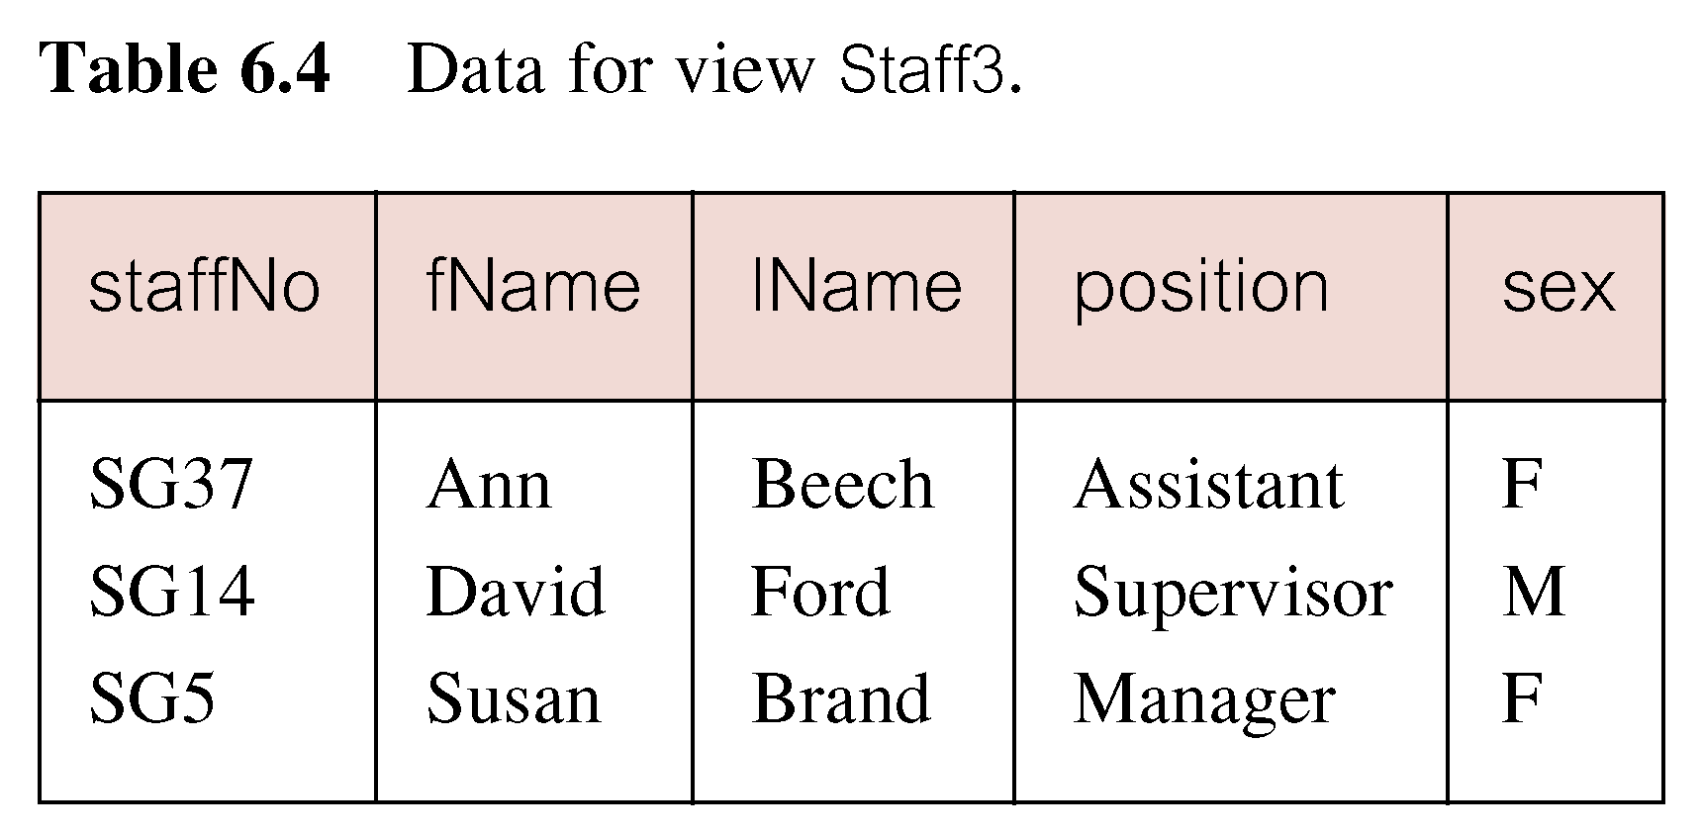
Example 4 - Create Vertical View
Create view of staff details at branch B003 excluding salaries.
CREATE VIEW Staff3
AS SELECT staffNo, fName, lName, position, sex
FROM Staff
WHERE branchNo = ‘B003’;

Slide 34
Example 5 - Grouped and Joined Views
Create view of staff who manage properties for rent, including branch number they work at, staff number, and number of properties they manage.
CREATE VIEW StaffPropCnt (branchNo, staffNo, cnt)
AS SELECT s.branchNo, s.staffNo, COUNT(*)
FROM Staff s, PropertyForRent p
WHERE s.staffNo = p.staffNo
GROUP BY s.branchNo, s.staffNo;

Slide 35
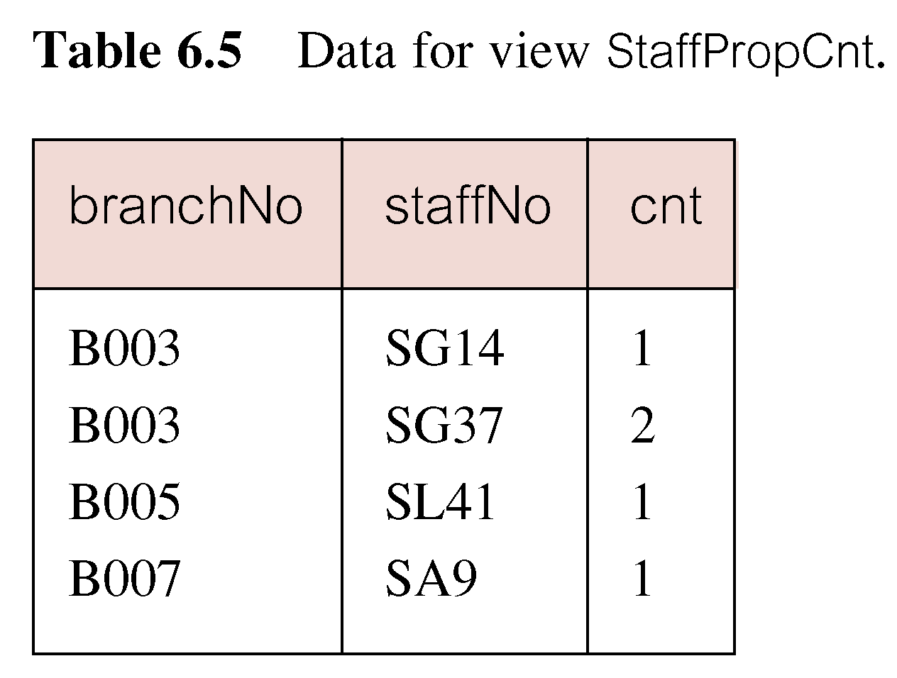
Example 3 - Grouped and Joined Views

Slide 36
SQL - DROP VIEW
DROP VIEW ViewName [RESTRICT | CASCADE]
Causes definition of view to be deleted from database.
For example:
DROP VIEW Manager3Staff;

Slide 37
SQL - DROP VIEW
With CASCADE, all related dependent objects are deleted; i.e. any views defined on view being dropped.
With RESTRICT (default), if any other objects depend for their existence on continued existence of view being dropped, command is rejected.

Slide 38
Advantages of Views
Data independence
Currency
Improved security
Reduced complexity
Convenience
Customization
Data integrity

Slide 39
Disadvantages of Views
Update restriction
Structure restriction
Performance

Slide 40
Transactions
SQL defines transaction model based on COMMIT and ROLLBACK.
Transaction is logical unit of work with one or more SQL statements guaranteed to be atomic with respect to recovery.
An SQL transaction automatically begins with a transaction-initiating SQL statement (e.g., SELECT, INSERT).
Changes made by transaction are not visible to other concurrently executing transactions until transaction completes.

Slide 41
Transactions
Transaction can complete in one of four ways:
- COMMIT ends transaction successfully, making changes permanent.
- ROLLBACK aborts transaction, backing out any changes made by transaction.
- For programmatic SQL, successful program termination ends final transaction successfully, even if COMMIT has not been executed.
- For programmatic SQL, abnormal program end aborts transaction.

Slide 42
Transactions
New transaction starts with next transaction-initiating statement.
SQL transactions cannot be nested.
SET TRANSACTION configures transaction:
SET TRANSACTION
[READ ONLY | READ WRITE] |
[ISOLATION LEVEL READ UNCOMMITTED |
READ COMMITTED|REPEATABLE READ |SERIALIZABLE ]

Slide 43
Access Control - Authorization Identifiers and Ownership
Authorization identifier is normal SQL identifier used to establish identity of a user. Usually has an associated password.
Used to determine which objects user may reference and what operations may be performed on those objects.
Each object created in SQL has an owner, as defined in AUTHORIZATION clause of schema to which object belongs.
Owner is only person who may know about it.

Slide 44
Privileges
Actions user permitted to carry out on given base table or view:
SELECT Retrieve data from a table.
INSERT Insert new rows into a table.
UPDATE Modify rows of data in a table.
DELETE Delete rows of data from a table.
REFERENCES Reference columns of named table in integrity constraints.
USAGE Use domains, collations, character sets, and translations.

Slide 45
Privileges
Can restrict INSERT/UPDATE/REFERENCES to named columns.
Owner of table must grant other users the necessary privileges using GRANT statement.
To create view, user must have SELECT privilege on all tables that make up view and REFERENCES privilege on the named columns.

Slide 46
GRANT
GRANT {PrivilegeList | ALL PRIVILEGES}
ON ObjectName
TO {AuthorizationIdList | PUBLIC}
[WITH GRANT OPTION]
PrivilegeList consists of one or more of above privileges separated by commas.
ALL PRIVILEGES grants all privileges to a user.

Slide 47
GRANT
PUBLIC allows access to be granted to all present and future authorized users.
ObjectName can be a base table, view, domain, character set, collation or translation.
WITH GRANT OPTION allows privileges to be passed on.

Slide 48
Example - GRANT
Give Manager full privileges to Staff table.
GRANT ALL PRIVILEGES
ON Staff
TO Manager WITH GRANT OPTION;
Give users Personnel and Director SELECT and UPDATE on column salary of Staff.
GRANT SELECT, UPDATE (salary)
ON Staff
TO Personnel, Director;

Slide 49
Example - GRANT Specific Privileges to PUBLIC
Give all users SELECT on Branch table.
GRANT SELECT
ON Branch
TO PUBLIC;

Slide 50
REVOKE
REVOKE takes away privileges granted with GRANT.
REVOKE [GRANT OPTION FOR]
{PrivilegeList | ALL PRIVILEGES}
ON ObjectName
FROM {AuthorizationIdList | PUBLIC}
[RESTRICT | CASCADE]
ALL PRIVILEGES refers to all privileges granted to a user by user revoking privileges.

Slide 51
REVOKE
GRANT OPTION FOR allows privileges passed on via WITH GRANT OPTION of GRANT to be revoked separately from the privileges themselves.
REVOKE fails if it results in an abandoned object, such as a view, unless the CASCADE keyword has been specified.
Privileges granted to this user by other users are not affected.

Slide 52
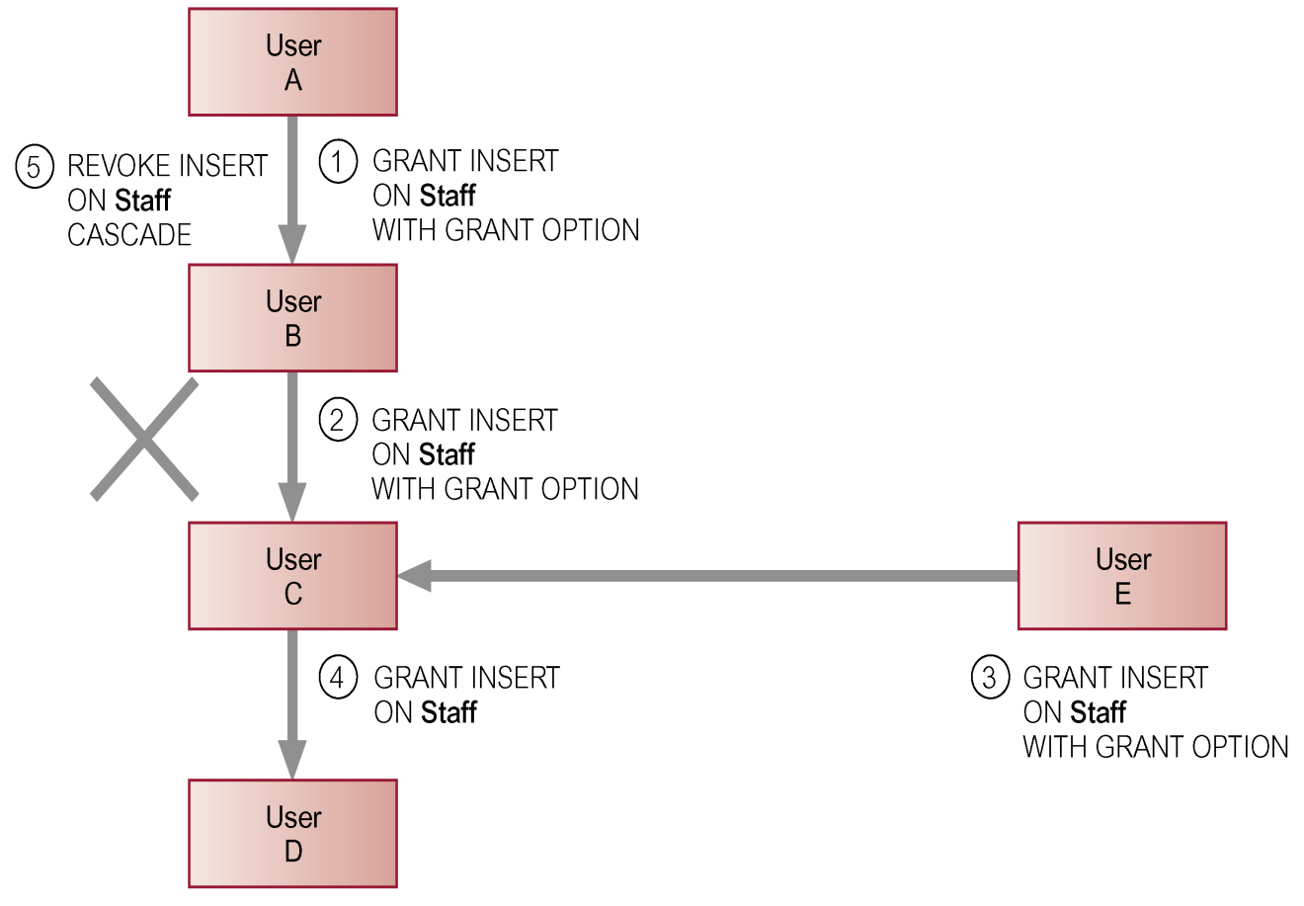
REVOKE

Slide 53
Example - REVOKE Specific Privileges
Revoke privilege SELECT on Branch table from all users.
REVOKE SELECT
ON Branch
FROM PUBLIC;
Revoke all privileges given to Director on Staff table.
REVOKE ALL PRIVILEGES
ON Staff
FROM Director;

