Slide 1
Logical Design

Slide 2
Learning Objectives
How to remove features from a local conceptual model that are not compatible with the relational model.
How to derive a set of relations from a local logical data model.
How to validate these relations using the technique of normalization.
How to validate a logical data model to ensure it supports required user transactions.
How to merge local logical data models based on specific views into a global logical data model of the enterprise.
How to ensure that resultant global model is a true and accurate representation of enterprise.

Slide 3
Acknowledgments
Some of these slides have been adapted from Thomas Connolly and Carolyn Begg

Slide 4
Use case diagram

Slide 5
Class diagram

Slide 6
Logical Design
Translates conceptual design into internal model
Maps objects in model to specific DBMS constructs
Design components
  Tables
  Indexes
  Views
  Transactions
  Access authorities
  Others

Slide 7
Purpose of Database Design
Structure the data in stable structures, called normalized tables
  Not likely to change over time
  Minimal redundancy
Develop a logical database design that reflects actual data requirements
Develop a logical database design from which a physical database design can be developed

Slide 8
Purpose of Database Design
Translate a relational database model into a technical file and database design that balances several performance factors
Choose data storage technologies that will efficiently, accurately and securely process database activities

Slide 9
Process of Database Design
Logical Design
  Based upon the conceptual data model
  Four key stages
    Develop a logical data model for each known user interface / report / view for the application using normalization principles
    Combine normalized data requirements from all user interfaces into one consolidated logical database model
    Translate the conceptual E-R data model for the application into normalized data requirements
    Compare the consolidated logical database design with the translated E-R model and produce one final logical database model for the application

Slide 10
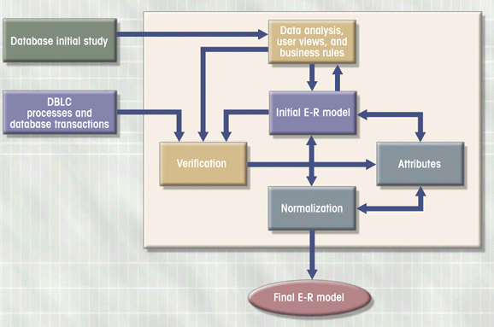
E-R Modeling is Iterative
Figure 6.8

Slide 11
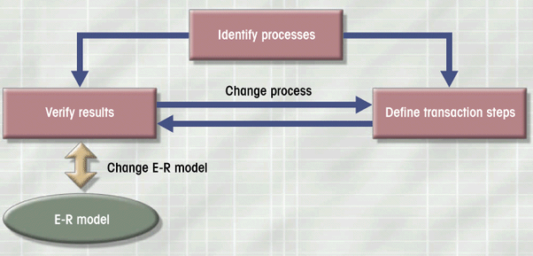
Iterative Process of Verification
Figure 6.10

Slide 12
Distributed Database Design
Design portions in different physical locations
Development of data distribution and allocation strategies

Slide 13
Deliverables and Outcomes
Logical database design must account for every data element on a system input or output
Normalized relations are the primary deliverable
Physical database design results in converting relations into files

Slide 14
Relational Database Model
Well-Structured Relation
  A relation that contains a minimum amount of redundancy and allows users to insert, modify and delete the rows without errors or inconsistencies

Slide 15
Normalization
The process of converting complex data structures into simple, stable data structures
Second Normal Form (2NF)
  Each nonprimary key attribute is identified by the whole key (called full functional dependency)

Slide 16
Normalization
Third Normal Form (3NF)
  Nonprimary key attributes do not depend on each other (called transitive dependencies)
The result of normalization is that every nonprimary key attribute depends upon the whole primary key

Slide 17
Functional Dependencies and
Primary Keys
Foreign Key
  An attribute that appears as a nonprimary key attribute in one relation and as a primary key attribute (or part of a primary key) in another relation
Referential Integrity
  An integrity constraint specifying that the value (or existence) of an attribute in one relation depends on the value (or existence) of the same attribute in another relation

Slide 18
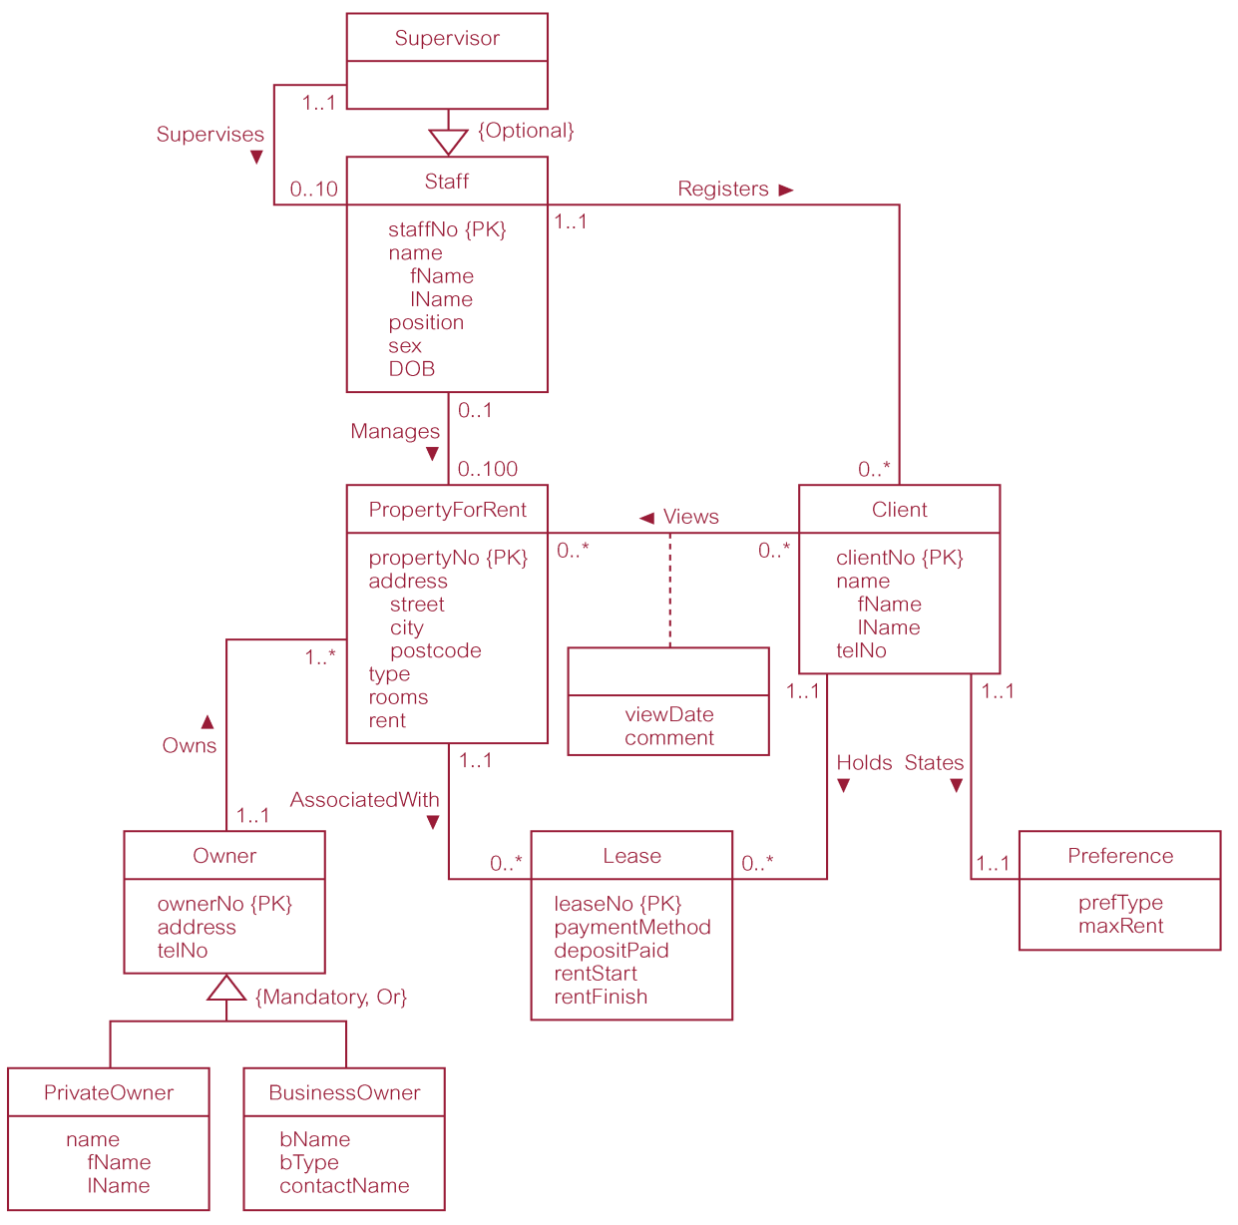
Local Conceptual Data Model for Staff View Showing all Attributes

Slide 19
Step 1 Remove Features not Compatible with the Relational Model
First step Remove features not compatible with the relational model (optional step)
To refine the local conceptual data model to remove features that are not compatible with the relational model. This involves:
  remove *:* binary relationship types;
  remove *:* recursive relationship types;
  remove complex relationship types;
  remove multi-valued attributes.

Slide 20
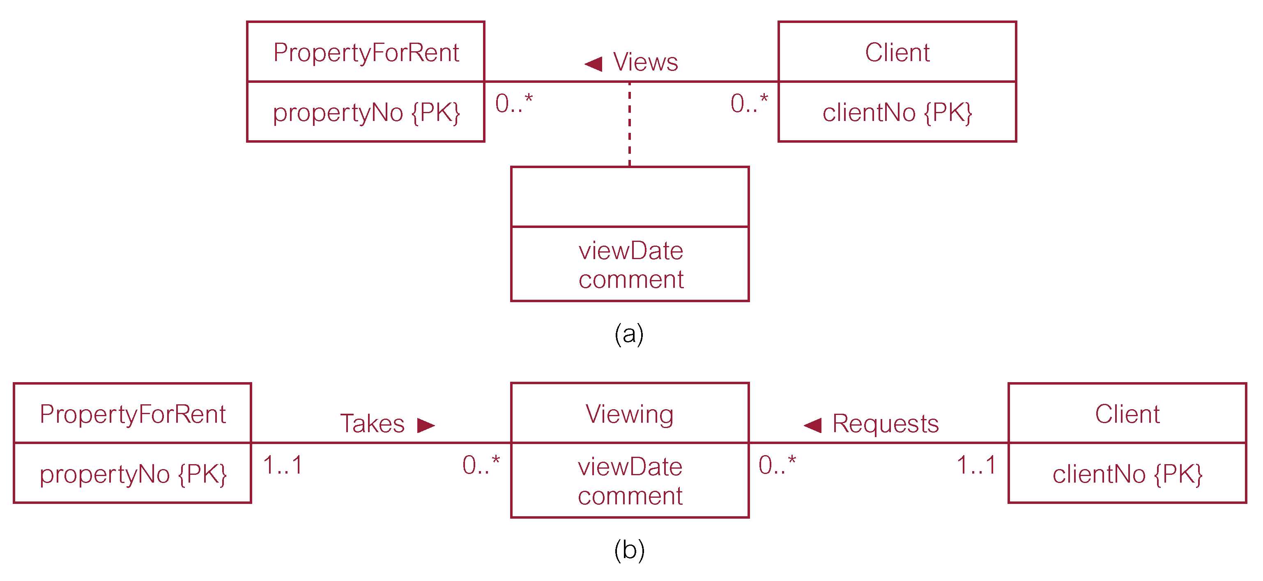
Remove *:* Binary Relationship Types

Slide 21
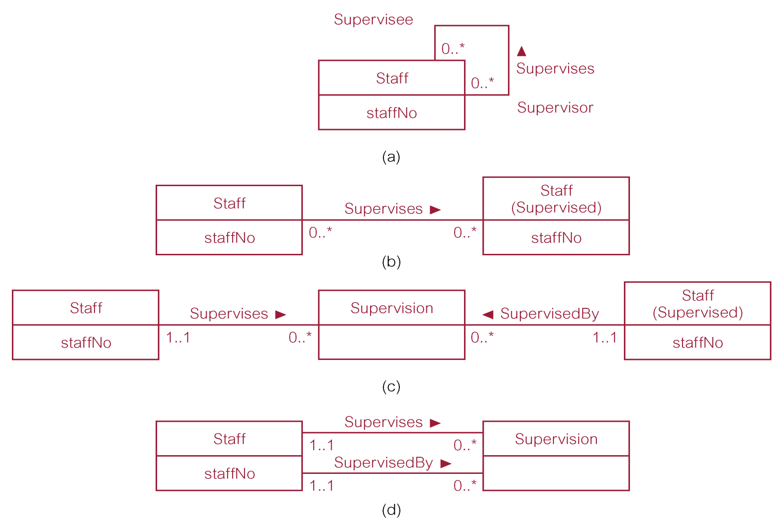
Remove *:* Recursive Relationship Types

Slide 22
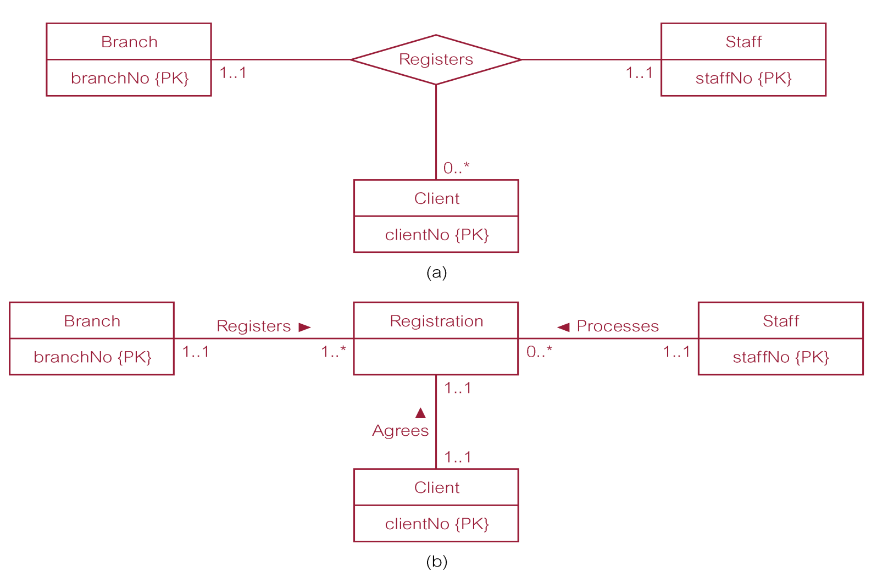
Remove Complex Relationship Types

Slide 23
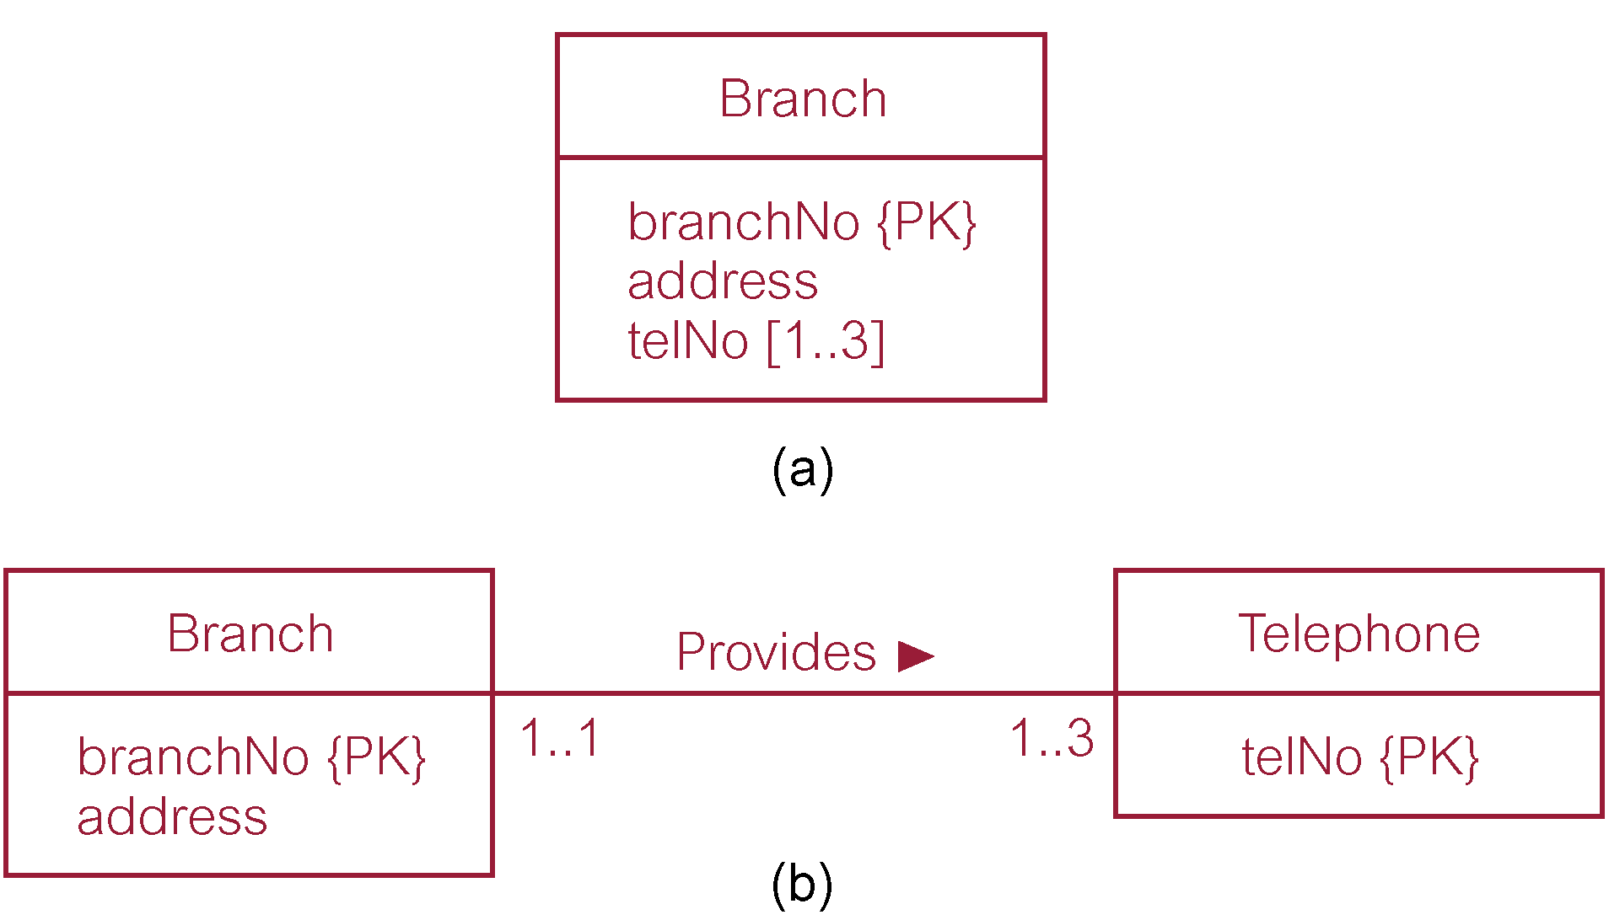
Remove Multi-valued Attributes

Slide 24
Step 2 Build and Validate Local Logical Data Model
Step 2 Derive relations for local logical data model
  To create relations for the local logical data model to represent the entities, relationships, and attributes that have been identified.

Slide 25
Transforming E-R Diagrams into Relations
Represent Entities
  Each regular entity is transformed into a relation
  The identifier of the entity type becomes the primary key of the corresponding relation
  The primary key must satisfy the following two conditions
    The value of the key must uniquely identify every row in the relation
    The key should be nonredundant

Slide 26
Transforming E-R Diagrams into Relations
Represent Relationships
  Binary 1:N Relationships
    Add the primary key attribute (or attributes) of the entity on the one side of the relationship as a foreign key in the relation on the right side
    The one side migrates to the many side
  Binary or Unary 1:1
    Three possible options
      Add the primary key of A as a foreign key of B
      Add the primary key of B as a foreign key of A
      Both of the above

Slide 27
Transforming E-R Diagrams into Relations
Represent Relationships (continued)
  Binary and Higher M:N relationships
    Create another relation and include primary keys of all relations as primary key of new relation
  Unary 1:N Relationships
    Relationship between instances of a single entity type
    Utilize a recursive foreign key
      A foreign key in a relation that references the primary key values of that same relation
  Unary M:N Relationships
    Create a separate relation
    Primary key of new relation is a composite of two attributes that both take their values from the same primary key

Slide 28
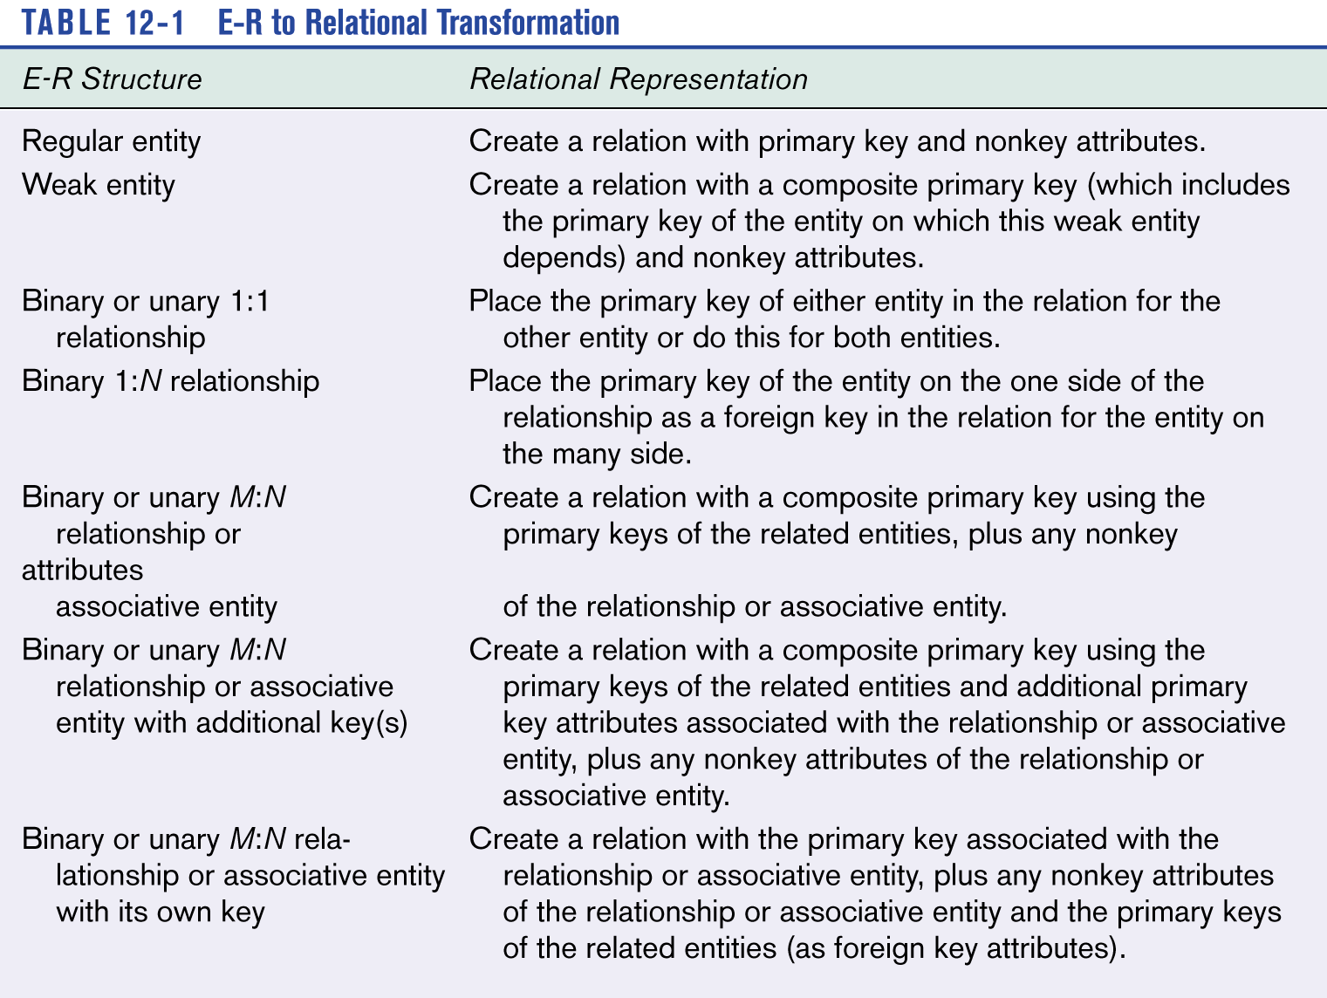

Slide 29
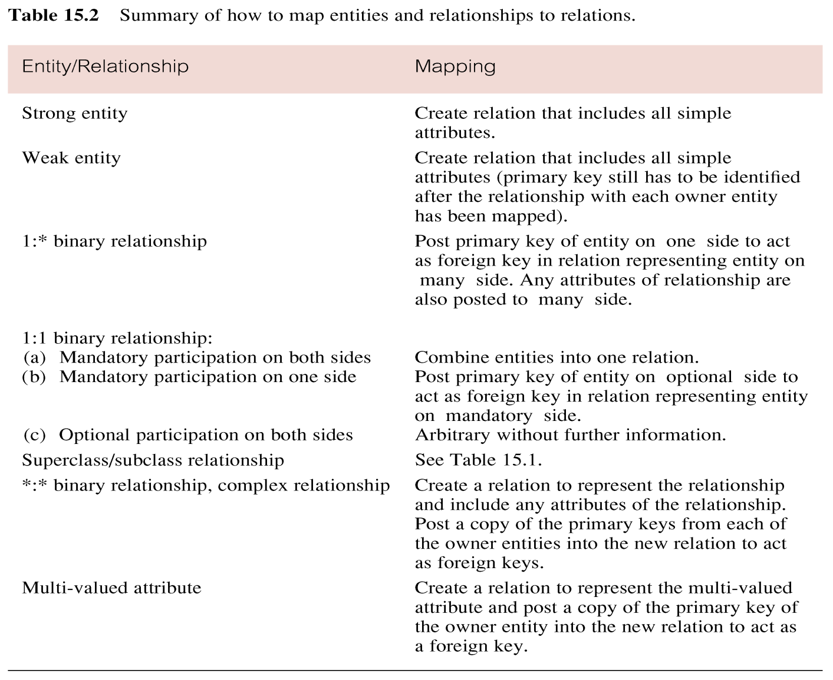
Summary of How to Map Entities and Relationships to Relations

Slide 30
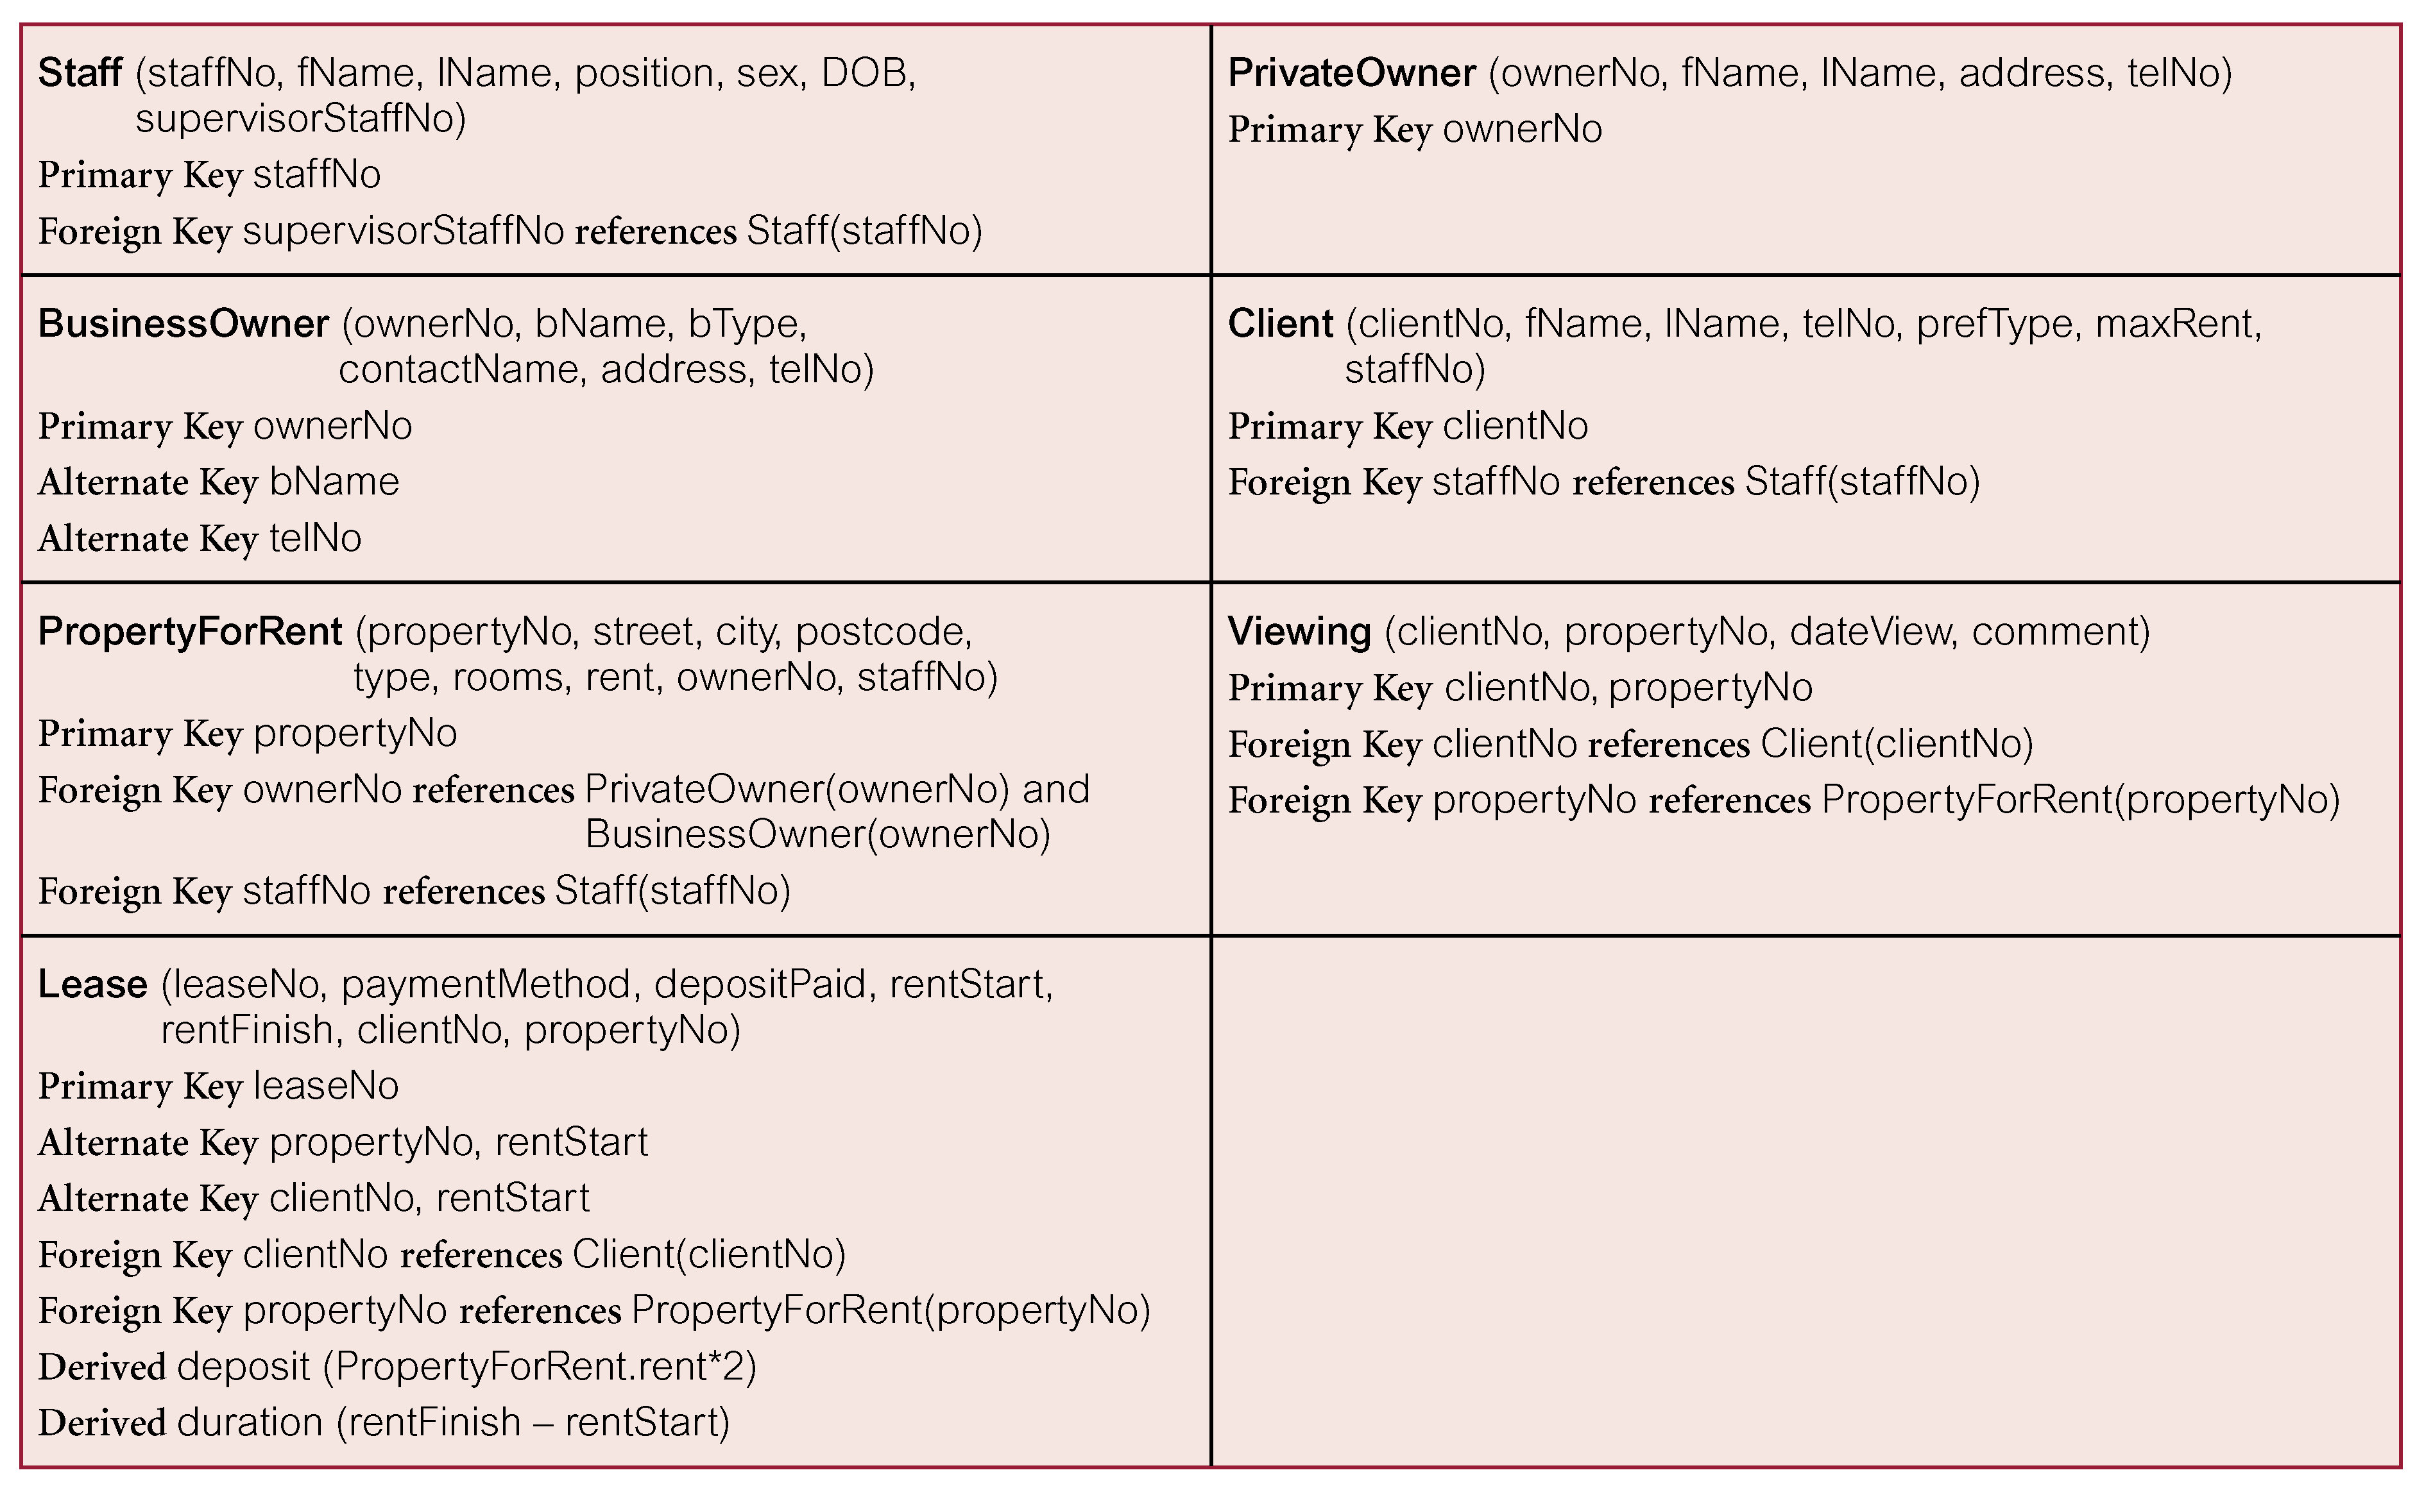
Relations for the Staff View of DreamHome

Slide 31
Step 2 Build and Validate Local Logical Data Model
Validate relations using normalization
  To validate the relations in the local logical data model using the technique of normalization.
Validate relations against user transactions
  To ensure that the relations in the local logical data model support the transactions required by the view.
Define integrity constraints
  To define the integrity constraints given in the view (i.e. required data, entity and referential integrity, domains, and enterprise constraints).

Slide 32
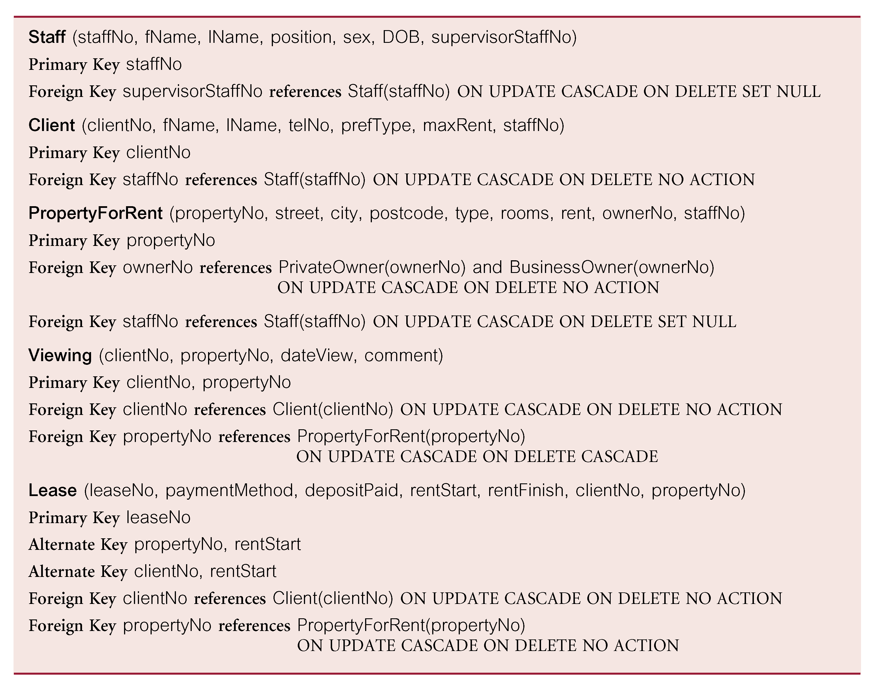
Referential Integrity Constraints for Relations in Staff View of DreamHome

Slide 33
Referential Integrity Constraints for Relations in Staff View of DreamHome

Slide 34
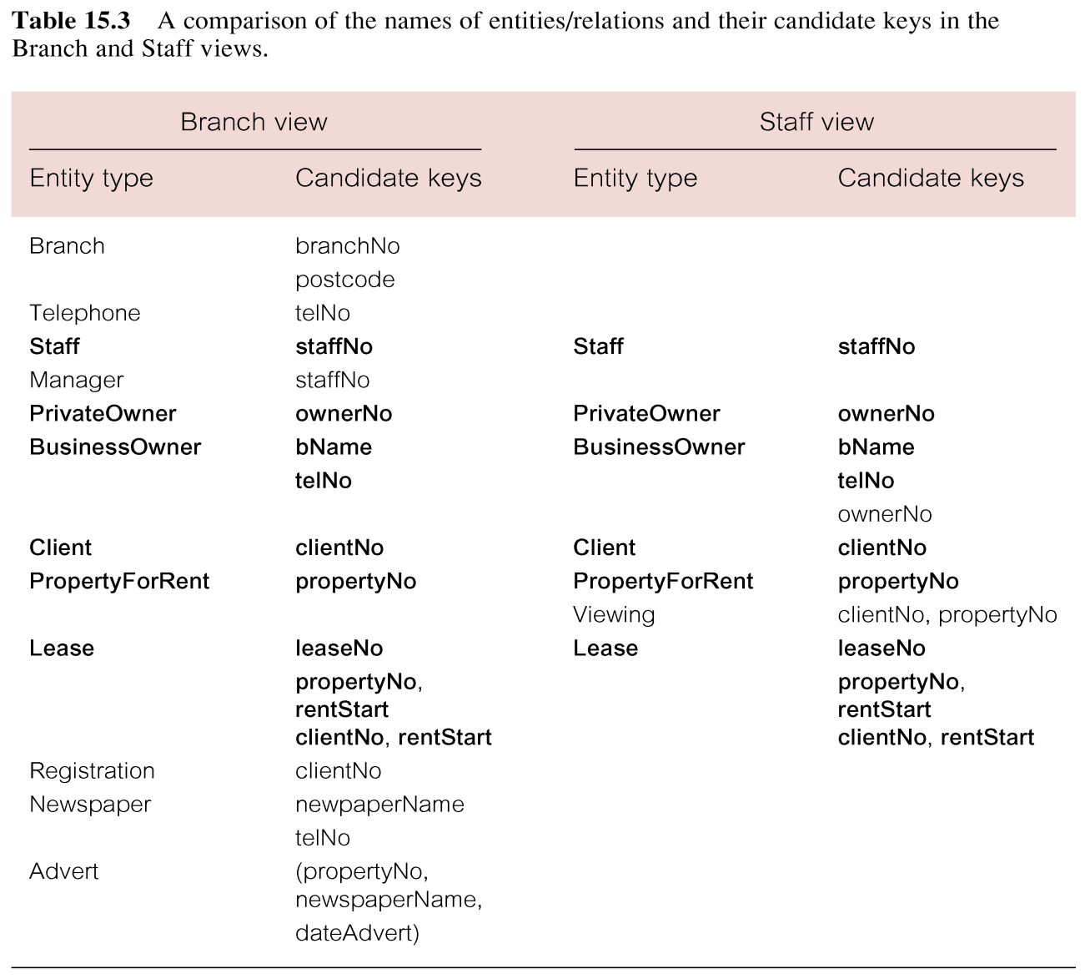
Step 3 Build and Validate Global Logical Data Model

Slide 35
Transforming E-R Diagrams into Relations
Merging Relations (View Integration)
  Purpose is to remove redundant relations
  View Integration Problems
    Synonyms
      Two different names used for the same attribute
      When merging, get agreement from users on a single, standard name
    Homonyms
      A single attribute name that is used for two or more different attributes
      Resolved by creating a new name
    Dependencies between nonkeys
      Dependencies may be created as a result of view integration
      In order to resolve, the new relation must be normalized

Slide 36
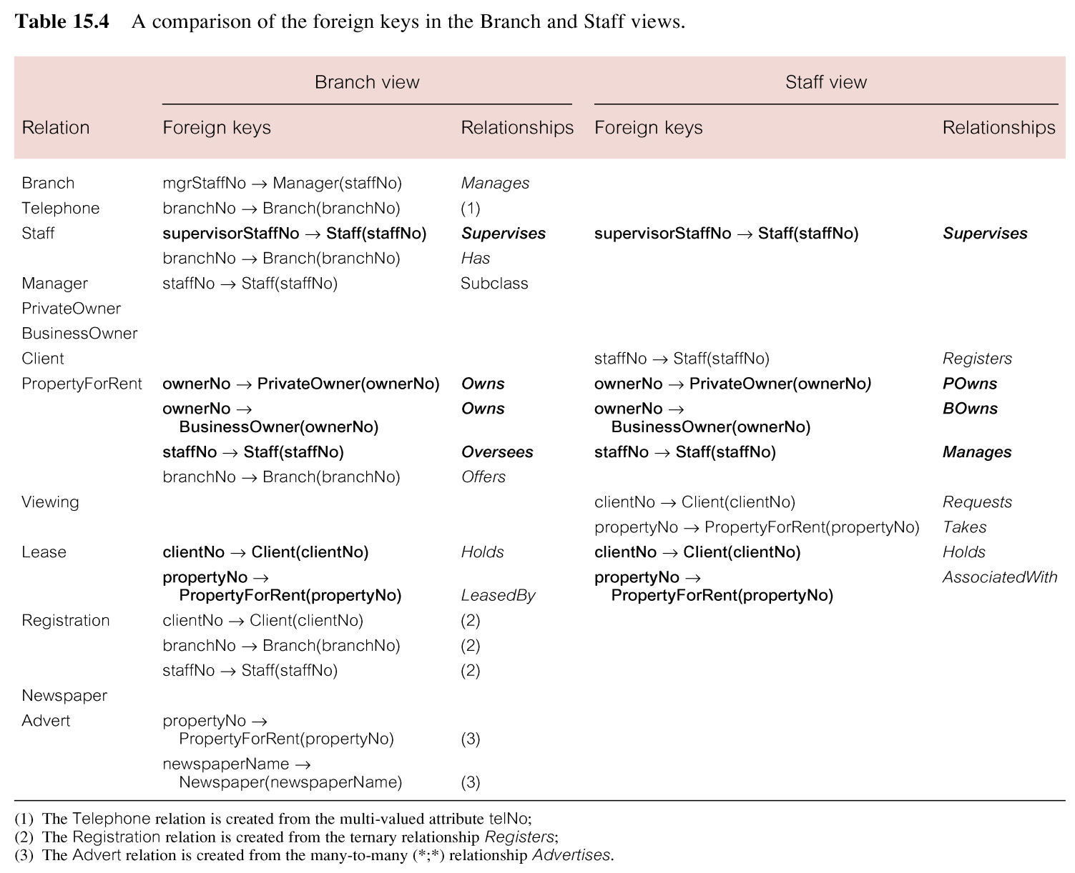
Build and Validate Global Logical Data Model

Slide 37
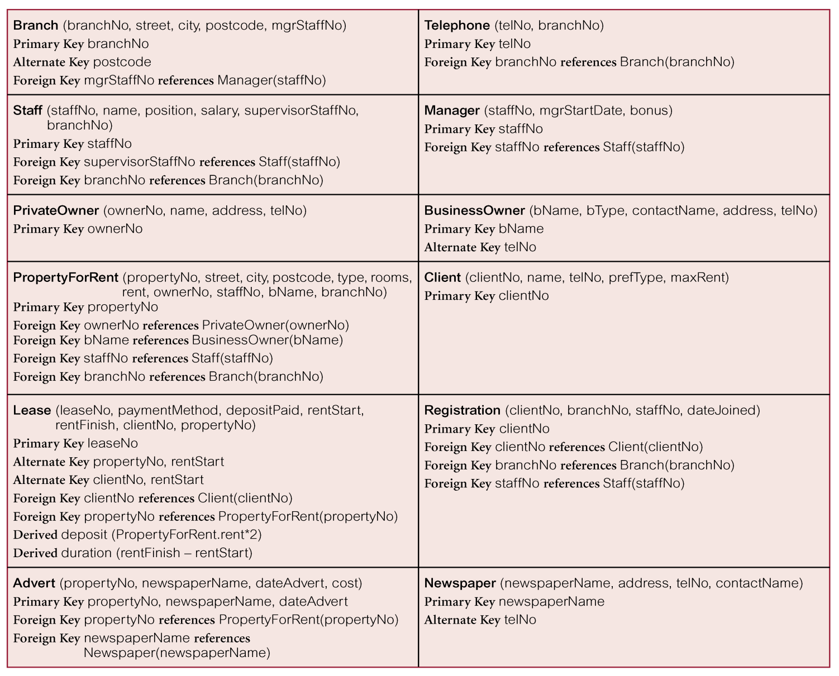
Relations for the Branch View of DreamHome

Slide 38
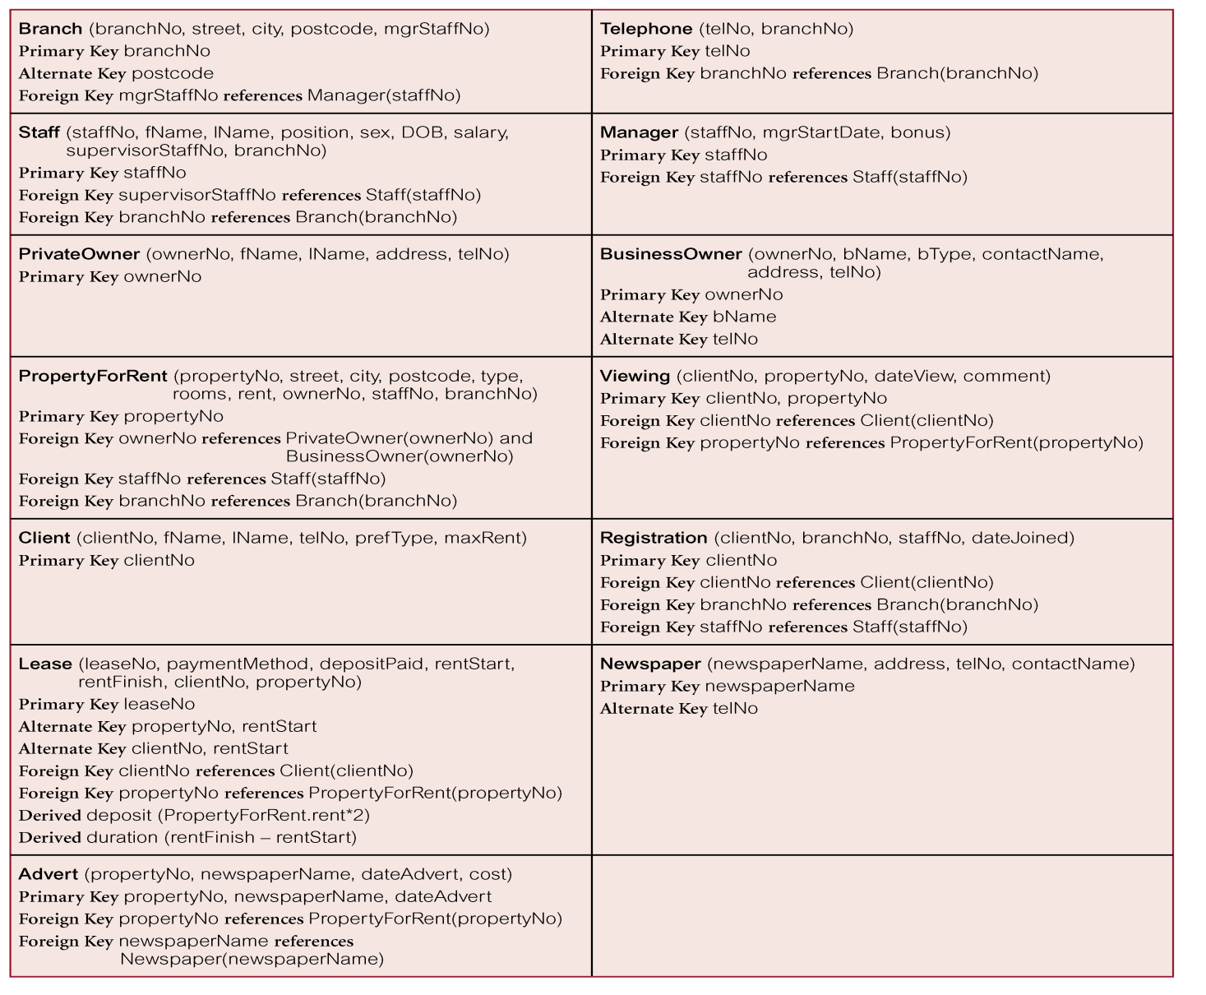
Relations that Represent the Global Logical Data Model for DreamHome

Slide 39
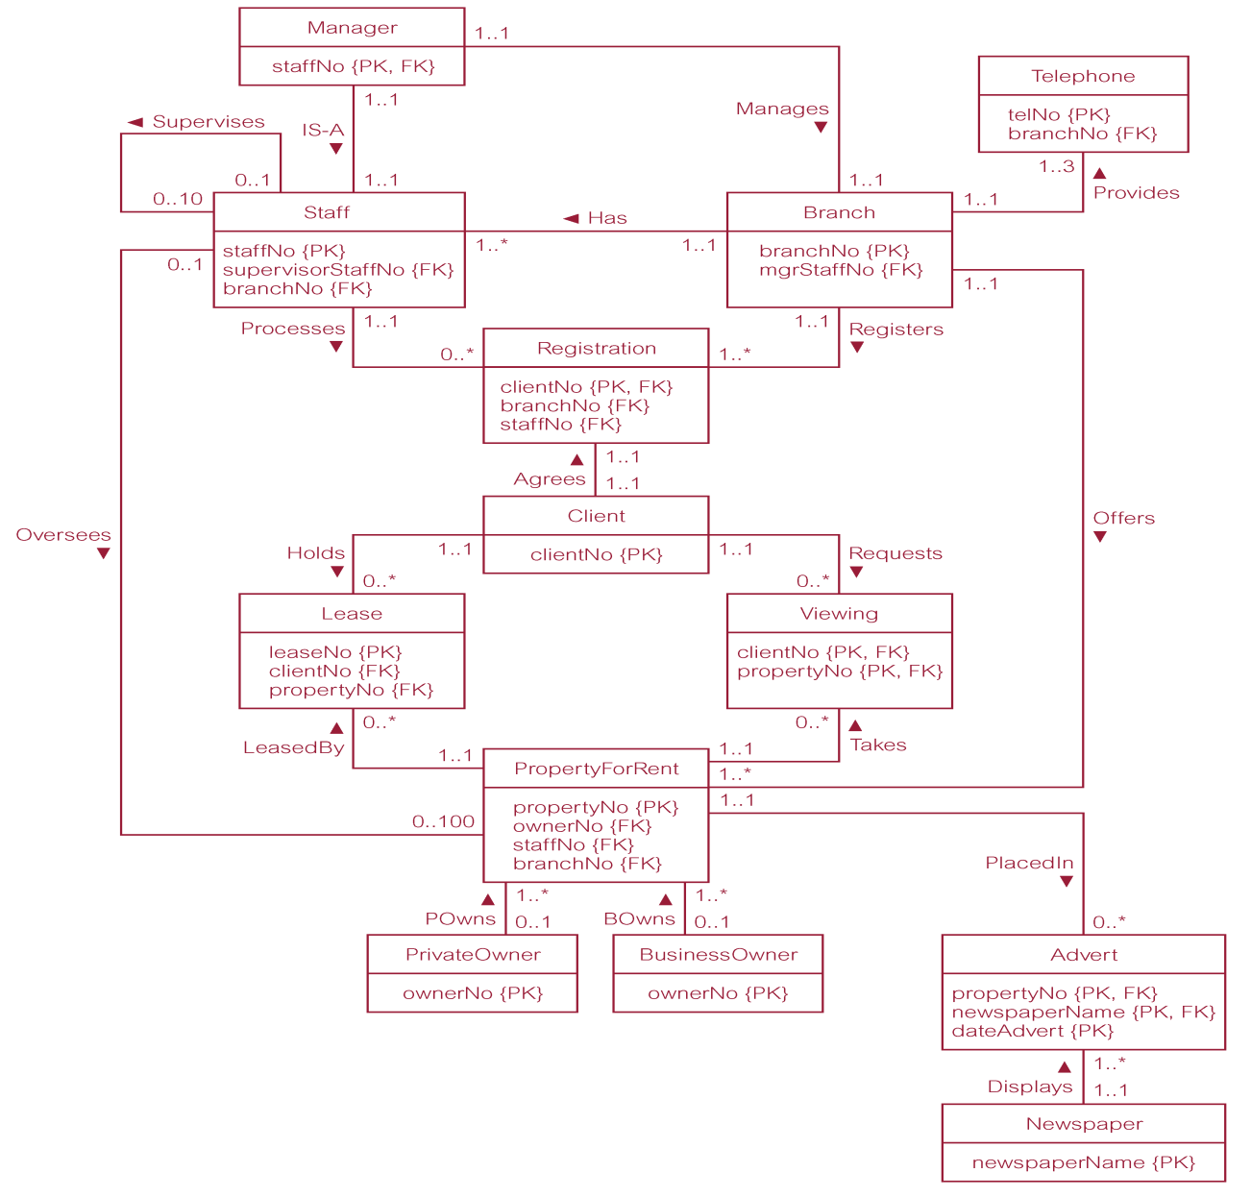
Global Relation Diagram for DreamHome

