Slide 1
File Systems Introduction to Databases

Slide 2
Learning Objectives
Introduction to class.
Introduction to databases.
Files and file structures.
Critique of the file system.
Database systems.
Database models.
Evolution of database models.

Slide 3
Introduction to Class
Syllabus
Schedule
Web-site http://www.oswego.edu/angel
Assignments
Project (can be team-based)

Slide 4
Introduction to Class
ISC 329 is a Database Applications course. Some of the objectives for this course include:
Understand fundamental database concepts and the different database systems.
Understand methodologies to conceptualize and design database systems.
Identify the key issues in developing database systems and applications.
Develop applications involving database systems with fourth-generation programming tools in MS Access.
Develop Web database applications with MySQL and PHP.

Slide 5
Introduction to Class
Fundamental concepts of files and databases
The different database models – hierarchical, relational, network
Relational databases
Conceptual data models – Entity-Relationship model, UML model
Normalization
Database system development methodology
SQL language commands and queries, query optimization
Development of database applications using fourth-generation programming techniques
Development of Web-based database systems
Database security
Ethical concerns
Transaction management and concurrency control

Slide 6
Acknowledgments
Some of these slides have been adapted from Thomas Connolly and Carolyn Begg

Slide 7
Examples of Database Applications
Purchases from the supermarket
Purchases using your credit card
Booking a holiday at the travel agents
Using the local library
Taking out insurance
Using the Internet
Studying at university

Slide 8
File-Based Systems
Collection of application programs that perform services for the end users (e.g. reports).
Each program defines and manages its own data.

Slide 9
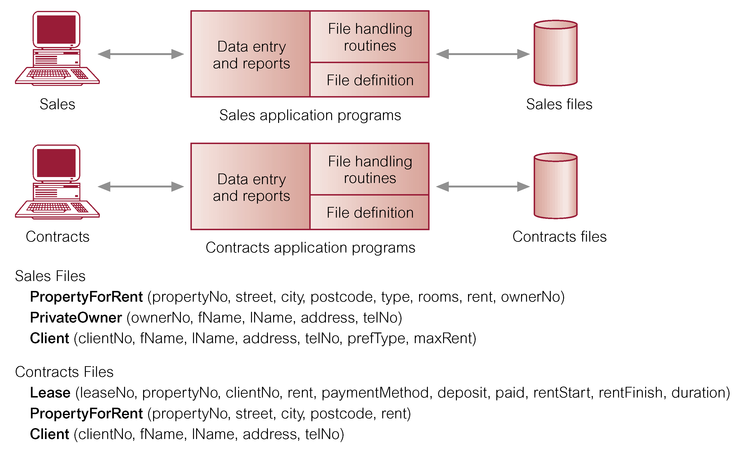
File-Based Processing

Slide 10
Limitations of File-Based Approach
Separation and isolation of data
Each program maintains its own set of data.
Users of one program may be unaware of potentially useful data held by other programs.
Duplication of data
Same data is held by different programs.
Wasted space and potentially different values and/or different formats for the same item.

Slide 11
Limitations of File-Based Approach
Data dependence
File structure is defined in the program code.
Incompatible file formats
Programs are written in different languages, and so cannot easily access each other’s files.
Fixed Queries/Proliferation of application programs
Programs are written to satisfy particular functions.
Any new requirement needs a new program.

Slide 12
Database Approach
Arose because:
Definition of data was embedded in application programs, rather than being stored separately and independently.
No control over access and manipulation of data beyond that imposed by application programs.
Result:
the database and Database Management System (DBMS).

Slide 13
Database
Shared collection of logically related data (and a description of this data), designed to meet the information needs of an organization.
System catalog (metadata) provides description of data to enable program–data independence.
Logically related data comprises entities, attributes, and relationships of an organization’s information.

Slide 14
Database Management System (DBMS)
A software system that enables users to define, create, and maintain the database and that provides controlled access to this database.

Slide 15
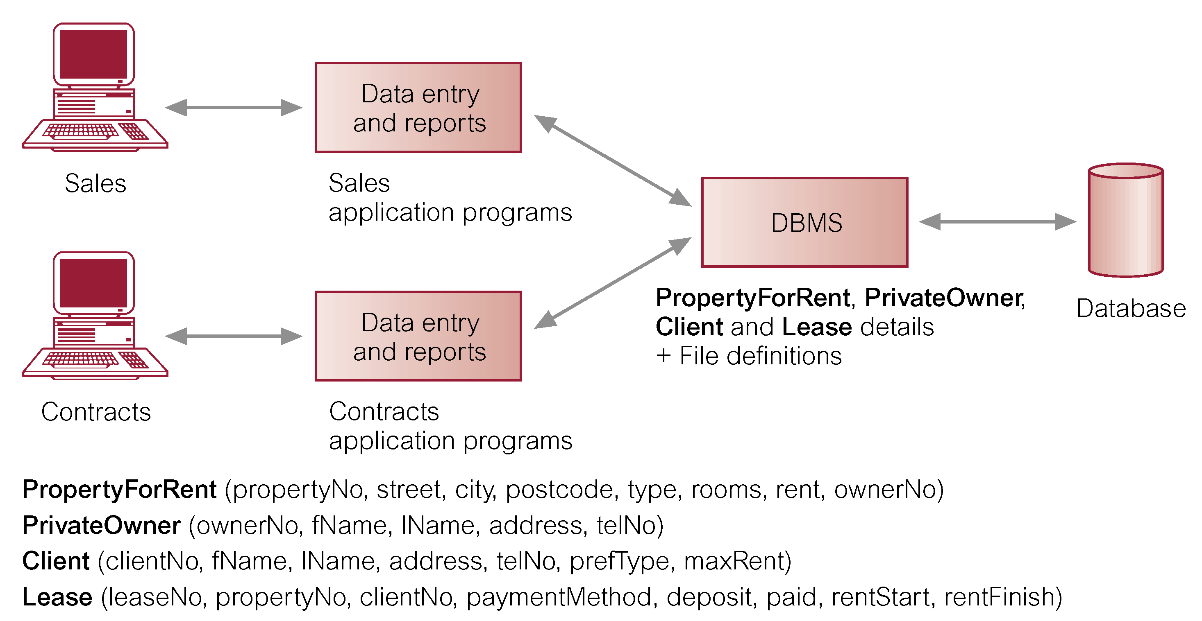
Database Management System (DBMS)

Slide 16
Database Approach
Data definition language (DDL).
Permits specification of data types, structures and any data constraints.
All specifications are stored in the database.
Data manipulation language (DML).
General enquiry facility (query language) of the data.

Slide 17
Database Approach
Controlled access to database may include:
A security system.
An integrity system.
A concurrency control system.
A recovery control system.
A user-accessible catalog.
A view mechanism.
Provides users with only the data they want or need to use.

Slide 18
Views
Allows each user to have his or her own view of the database.
A view is essentially some subset of the database.

Slide 19
Views
Benefits include:
Reduce complexity;
Provide a level of security;
Provide a mechanism to customize the appearance of the database;
Present a consistent, unchanging picture of the structure of the database, even if the underlying database is changed.

Slide 20
Components of DBMS Environment

Slide 21
Components of DBMS Environment
Hardware
Can range from a PC to a network of computers.
Software
DBMS, operating system, network software (if necessary) and also the application programs.
Data
Used by the organization and a description of this data called the schema.

Slide 22
Components of DBMS Environment
Procedures
Instructions and rules that should be applied to the design and use of the database and DBMS.
People

Slide 23
Roles in the Database Environment
Data Administrator (DA)
Database Administrator (DBA)
Database Designers (Logical and Physical)
Application Programmers
End Users (naive and sophisticated)

Slide 24
History of Database Systems
First-generation
Hierarchical and Network
Second generation
Relational
Third generation
Object Relational
Object-Oriented

Slide 25
The DBMS Marketplace
Relational DBMS companies – Oracle, Sybase – are among the largest software companies in the world.
IBM offers its relational DB2 system. With IMS, a nonrelational system, IBM is by some accounts the largest DBMS vendor in the world.
Microsoft offers SQL-Server, plus Microsoft Access for the cheap DBMS on the desktop, answered by “lite” systems from other competitors.
Relational companies also challenged by “object-oriented DB” companies.
But countered with “object-relational” systems, which retain the relational core while allowing type extension as in OO systems.

Slide 26
Hierarchical Database Model
History:
North American Rockwell developed GUAM (Generalized Update Access Method)
Mid 1960s Rockwell partner with IBM to create Information Management System (IMS)
IMS DB/DC lead the mainframe database market in 70’s and early 80’s
Represents well how components are decomposed into parts

Slide 27
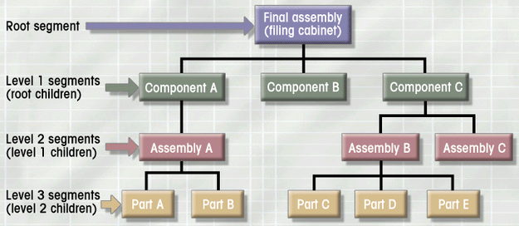
Hierarchical Database Model
Logically represented by an upside down tree
Each parent can have many children
Each child has only one parent

Slide 28
Hierarchical Database Model
Advantages
Conceptual simplicity
Database security and integrity
Data independence
Efficiency
Disadvantages
Complex implementation
Difficult to manage and lack of standards
Lacks structural independence
Applications programming and use complexity
Implementation limitations (no M:N relationship)

Slide 29
Network Database Model
History:
CODASYL (Conference on Data Systems Languages) created a group to work on standardization of databases: Database Task Group (DBTG)
Identified 3 database component:
Network schema (database organization)
Subschema (views of database per user)
Data management language

Slide 30
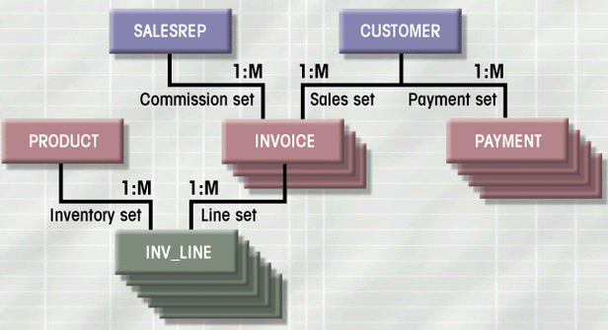
Network Database Model
Each record can have multiple parents
Composed of sets - relationships
Each set has owner record and member record
Member may have several owners
A set represents a 1:M relationship between the owner and the member
Figure 1.10

Slide 31
Network Database Model
Advantages
Conceptual simplicity
Handles more relationship types
Data access flexibility
Promotes database integrity
Data independence
Conformance to standards
Disadvantages
System complexity
Lack of structural independence

Slide 32
Relational Database Model
First developed by E.F. Codd (IBM) in 1970
First deployed on mainframe computers (DB2), then also personal computers
Oracle, Informix, SQL server, DB2

Slide 33
Relational Database Model
Perceived by user as a collection of tables for data storage
Tables are a series of row/column intersections (a row corresponds to a record, a column to a field)
Tables related by sharing common entity characteristic(s)
RDBMS

Slide 34
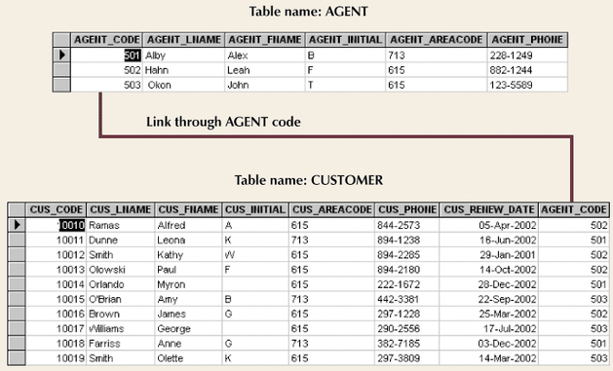
Relational Database Model (con’t.)
Figure 1.11

Slide 35
Relational Database Model
Advantages
Structural independence
Improved conceptual simplicity
Easier database design, implementation, management, and use
Ad hoc query capability with SQL
Powerful database management system

Slide 36
Relational Database Model
Disadvantages
Substantial hardware and system software overhead
Poor design and implementation is made easy
May promote “islands of information” problems

Slide 37
Advantages of DBMSs
Control of data redundancy
Data consistency
More information from the same amount of data
Sharing of data
Improved data integrity
Improved security
Enforcement of standards
Economy of scale

Slide 38
Advantages of DBMSs
Balanced conflicting requirements
Improved data accessibility and responsiveness
Increased productivity
Improved maintenance through data independence
Increased concurrency
Improved backup and recovery services

Slide 39
Disadvantages of DBMSs
Complexity
Size
Cost of DBMS
Additional hardware costs
Cost of conversion
Performance
Higher impact of a failure

Slide 40
Database Design
Database design deals with how to design a database
Importance of good design
Poor design results in unwanted data redundancy
Poor design generates errors leading to bad decisions
Practical approach
Focus on principles and concepts of database design
Importance of logical design

