Slide 1
Service-Oriented Programming
Basic Concepts/Standards/Technologies
SOA, XML, WSDL, SOAP, REST

Slide 2
SOP Basis: Service-Oriented Architecture (SOA)
Service
Registry
UDDI Registry
Publish
Web Browser
Find
UDDI Publication
UDDI Inquiry
Service
Consumer
message
has
defines
Service
Provider
Web Service
exchange
SOAP
Service Description
Web Service
WSDL

Slide 3
SOA: Roles of Interaction
Web services provider
  Owns Web service and implements business logic
  Hosts and controls access to the service
    Examples: Microsoft, Amazon, Facebook, …
Web services requestor
  Requires the certain functions to be satisfied
  Looks for and invokes the service
    Examples: a client, a server, or another web service
Web services registry
  Searchable directory where service descriptions can be published and searched
    Examples: UDDI registry

Slide 4
Operations in SOA
Publish operation
  Describes the Web Service itself
    Business information: information regarding the Web service provider or the implementer of the service
    Service information: information about the nature of the Web Service
    Technical information: information about implementation details and the invocation methods for the Web Service
  Actual registration of the Web Service
    Storing three basic categories of descriptive information about a service in Web Service registry

Slide 5
Operations in SOA (2)
Find operation
  Discovering services in discovery agency’s registry
    Search criteria: service type, preferred price range, products associated with service, company type
      Statically at the design time to retrieve a service’s interface description for program development, or
      Dynamically (at run-time) to retrieve a service’s binding and location description for invocation
  Select desired Web Service from search result
    Manual selection
    Automatic selection

Slide 6
Operations in SOA (3)
Bind operation
  Service requestor invokes or initiates an interaction at run-time using the binding details in the service description to locate and contract to the service
  Two possibilities
    Direct invocation of the Web service by the Web service requestor
    Mediation by the service agency when invoking the Web service

Slide 7
XML
XML: eXtensible Markup Language
Universal format for structured documents and data on the Web
Common data format of Web services
Supports semi-structured data model

Slide 8
XML: Key Concepts
Document
Elements
Attributes
Text
Others
  Namespace declarations, comments, processing instructions, …

Slide 9
Elements
Enclosed in tags:
  Book, title, author, …
  Start tag: <book> End tag: </book>
Empty element <red></red> OR <red/>
Elements are ordered, may be repeated or nested

Slide 10
Basic XML Tag Syntax
Tags written as with HTML, but …
  Case-sensitive names
  Always need end tags
  Special empty-element
  Always quote attribute values
Some other constraints for tags
  Start with a letter or underscore
  After first character, numbers, -, and . are allowed
  Cannot contain white-spaces

Slide 11
Attributes
Associated to Elements, …
  <book price=“20”>
Attributes
  Unordered
  Names must be unique
  Cannot be nested
  Provide metadata for element
  Value enclosed in “ ”
Multiple attributes separated by spaces
Same naming conventions as elements

Slide 12
Example
<book price = “95” currency = “USD”>
<title> Programming Language Pragmatics</title>
<author> Michael Scott </author>
<publisher> Morgan Kaufmann </publisher>
<edition> 3rd </edition>
…
<year> 2009 </year>
</book>

Slide 13
WSDL
WSDL: Web Service Description Language
Pronounced “Whiz Dull”
XML-based
Why we need WSDL for web services?
  Web services are designed to support machine-to-machine interaction
  No human in the loop
  Needs a specified and self-explanatory programming interface

Slide 14
Contents of a WSDL File (1)
WSDL describes a service’s functionality
  A service interface
    Operations that can be invoked by service users
  For each operation
    Input parameters whose values are provided by service users, such as zipcode, address, …
    Output parameters whose value will be returned to service users, such as directions, map image, …
By parsing a WSDL file, a program can …
  Determine if service is suitable, how to format the request, and how to handle the response

Slide 15
Contents of a WSDL File (2)
Describes how to bind a service
  Messaging style
  Formatting (encoding) style
  Transport protocol such as http, smtp, soap
Describes where to locate a web service
  A set of ports
    A port defines the location of a web service, e.g., network address location or URL
By parsing a WSDL file, a program can:
  Locate and bind a web service

Slide 16
WSDL Document Content
Abstract (interface) definitions
  <types> data type definitions
  <message> operation parameters
  <operation> abstract description of service actions
  <portType> set of operation definitions
Concrete (implementation) definitions
  <binding> operation bindings
  <port> association of endpoint with a binding
  <service> location/address for each binding
Example
  http://webservices.amazon.com/AWSECommerceService/AWSECommerceService.wsdl

Slide 17
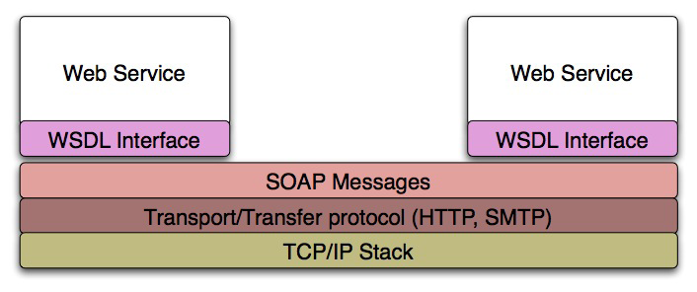
Simple Object Access Protocol
Standard messaging protocol used by web services
Supports inter-application communication

Slide 18
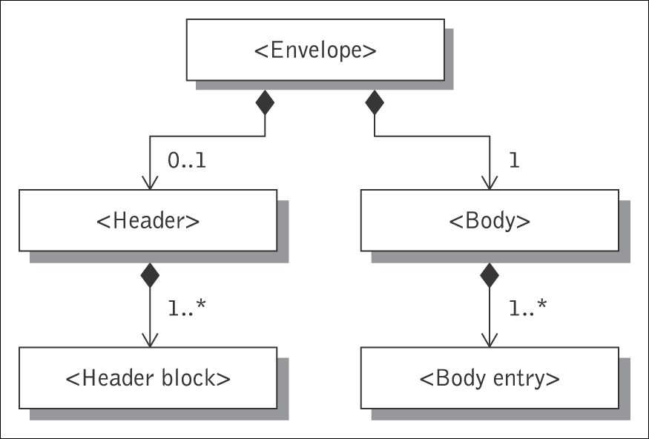
SOAP Message
SOAP envelope
SOAP header
header block
SOAP body
body block
SOAP messages are seen as enveloper where the application encloses the data to be sent
Consists of an <Envelope> element containing an optional <Header> and a mandatory <Body> element

Slide 19
SOAP Request (Example)
<SOAP-ENV:Envelope
xmlns:SOAP-ENV=“http://schemas.xmlsoap.org/soap/envelope/”
SOAP-ENV:encodingStyle="http://schemas.xmlsoap.org/soap/encoding/”>
<SOAP-ENV:Header>
<t:transId xmlns:t=“http://a.com/trans”>345</t:transId>
</SOAP-ENV:Header>
<SOAP-ENV:Body>
<m:Add xmlns:m=“http://a.com/Calculator”>
<n1>3</n1>
<n2>4</n2>
</m:Add>
</SOAP-ENV:Body>
</SOAP-ENV:Envelope>

Slide 20
SOAP Response (Example)
<SOAP-ENV:Envelope
xmlns:SOAP-ENV=“http://schemas.xmlsoap.org/soap/envelope/”
SOAP-ENV:encodingStyle="http://schemas.xmlsoap.org/soap/encoding/”>
<SOAP-ENV:Header>
<t:transId xmlns:t=“http://a.com/trans”>345</t:transId>
</SOAP-ENV:Header>
<SOAP-ENV:Body>
<m:AddResponse xmlns:m=“http://a.com/Calculator”>
<result>7</result>
</m:AddResponse>
</SOAP-ENV:Body>
</SOAP-ENV:Envelope>

Slide 21
Another Example
Sample SOAP Request and Response Message for Google's Web Service Interface
  http://www.w3.org/2004/06/03-google-soap-wsdl.html
For illustration only

Slide 22
REST (Representational State Transfer)
The Client references a Web resource using a URL
A resource representation returned (an HTML document)
Representation (e.g., Boeing747.html) puts client in new state
When client selects hyperlink in Boeing747.html, it accesses another resource
New representation places client into yet another state
Client transfers state with each resource representation
http://www.boeing.com/boeing/commercial/747family
Resource
Client
Fuel requirements
Maintenance schedule
...
Boeing747.html

Slide 23
Web Resources
Information from database
  invoice, resume, price, phone number,…
Image
  map, photo, ...
Audio
  song, speech, …
Video
  movie clip, …
Others

Slide 24
Resource Representation
Each resource is represented as a distinct Uniform Resource Identifier (URI)
  Uniform Resource Name (URN)
    e.g., isbn-10: 3642078885
  Uniform Resource Locator (URL)
    e.g., http://www.imdb.com/title/tt0068646/?ref_=fn_al_tt_1

Slide 25
REST Design Pattern
Create a resource for every service
Uniquely identify each resource with a logical URL
Design your information to link to other information
  That is, the information that a resource returns to a client should link to other information in a network of related information

Slide 26
REST Design Pattern (2)
All interactions between a client and a web service are done with simple operations
Most web interactions are done using HTTP and just four operations:
  Retrieve information (HTTP GET)
  Create information (HTTP PUT)
  Update information (HTTP POST)
  Delete information (HTTP DELETE)

Slide 27
An Example of RESTful Web Service
Service: Get a list of parts
  Web service makes an available URL to a parts list resource
  A client uses this URL to get the parts list
    http://www.parts-depot.com/parts
    Note
      How web service generates the parts list is completely transparent to the client
      This is loose coupling

Slide 28
Data Returned: Parts List
Each resource is identified as a URL
Parts list has links to get each part’s detailed info
Key feature of REST design pattern
  Client transfers from one state to next by examining and choosing from alternative URLs in the response document
<?xml version="1.0"?>
<Parts>
<Part id="00345" href="http://www.parts-depot.com/parts/00345"/>
<Part id="00346" href="http://www.parts-depot.com/parts/00346"/>
<Part id="00347" href="http://www.parts-depot.com/parts/00347"/>
<Part id="00348" href="http://www.parts-depot.com/parts/00348"/>
</Parts>

Slide 29
Second Web Service
Get detailed information about a particular part
  Web service makes available a URL to each part resource
    For example, here's how a client requests a specific part:
      http://www.parts-depot.com/parts/00345
    Data returned
<?xml version="1.0"?>
<Part>
<Part-ID>00345</Part-ID>
<Name>Widget-A</Name>
<Description>This part is used within the frap assembly</Description>
<Specification href="http://www.parts-depot.com/parts/00345/specification"/>
<UnitCost currency="USD">0.10</UnitCost>
<Quantity>10</Quantity>
</Part>

Slide 30
Web Service Examples
Weather service
  http://vhost3.cs.rit.edu/weather/Service.svc
IMDB service
  http://vhost3.cs.rit.edu/IMDB/Service.svc
Calculator service
  http://vhost3.cs.rit.edu/Calculator/Service.svc
Test the services via the following link
  http://vhost3.cs.rit.edu/Application/
Some source code and sample services
  http://vhost3.cs.rit.edu/CentralRepository/index.aspx

Slide 31
Response Formats of RESTful Web Services
XML: eExtensible Markup Language
  Universal format for structured documents and data on the Web
  Common data format of Web services
JSON: Javascript Object Notation
  Derived from the JavaScript scripting language
  Used for serializing and transmitting structured data

Slide 32
XML-Formatted Response Example
<root response="True">
<Movie Title="Titanic" Year="1997" imdbID="tt0120338" Type="movie"/>
<Movie Title="Titanic II" Year="2010" imdbID="tt1640571" Type="movie"/>
<Movie Title="Titanic: The Legend Goes On..." Year="2000" imdbID="tt0330994" Type="movie"/>
<Movie Title="Titanic" Year="1953" imdbID="tt0046435" Type="movie"/>
<Movie Title="Titanic" Year="1996" imdbID="tt0115392" Type="movie"/>
<Movie Title="Raise the Titanic" Year="1980" imdbID="tt0081400" Type="movie"/>
<Movie Title="Titanic" Year="2012" imdbID="tt1869152" Type="series"/>
<Movie Title="The Chambermaid on the Titanic" Year="1997" imdbID="tt0129923" Type="movie"/>
<Movie Title="Titanic: Blood and Steel" Year="2012" imdbID="tt1695366" Type="series"/>
<Movie Title="Titanic" Year="1943" imdbID="tt0036443" Type="movie"/>
</root>
(http://www.omdbapi.com/?s=titanic&r=xml)

Slide 33
Json-Formatted Response Example
{"Search":[{"Title":"Titanic","Year":"1997","imdbID":"tt0120338","Type":"movie"},{"Title":"Titanic II","Year":"2010","imdbID":"tt1640571","Type":"movie"},{"Title":"Titanic: The Legend Goes On...","Year":"2000","imdbID":"tt0330994","Type":"movie"},{"Title":"Titanic","Year":"1953","imdbID":"tt0046435","Type":"movie"},{"Title":"Titanic","Year":"1996","imdbID":"tt0115392","Type":"movie"},{"Title":"Raise the Titanic","Year":"1980","imdbID":"tt0081400","Type":"movie"},{"Title":"Titanic","Year":"2012","imdbID":"tt1869152","Type":"series"},{"Title":"The Chambermaid on the Titanic","Year":"1997","imdbID":"tt0129923","Type":"movie"},{"Title":"Titanic: Blood and Steel","Year":"2012","imdbID":"tt1695366","Type":"series"},{"Title":"Titanic","Year":"1943","imdbID":"tt0036443","Type":"movie"}]}
(http://www.omdbapi.com/?s=titanic)

