Slide 1
Noam Chomsky
By Zach Baker

Slide 2
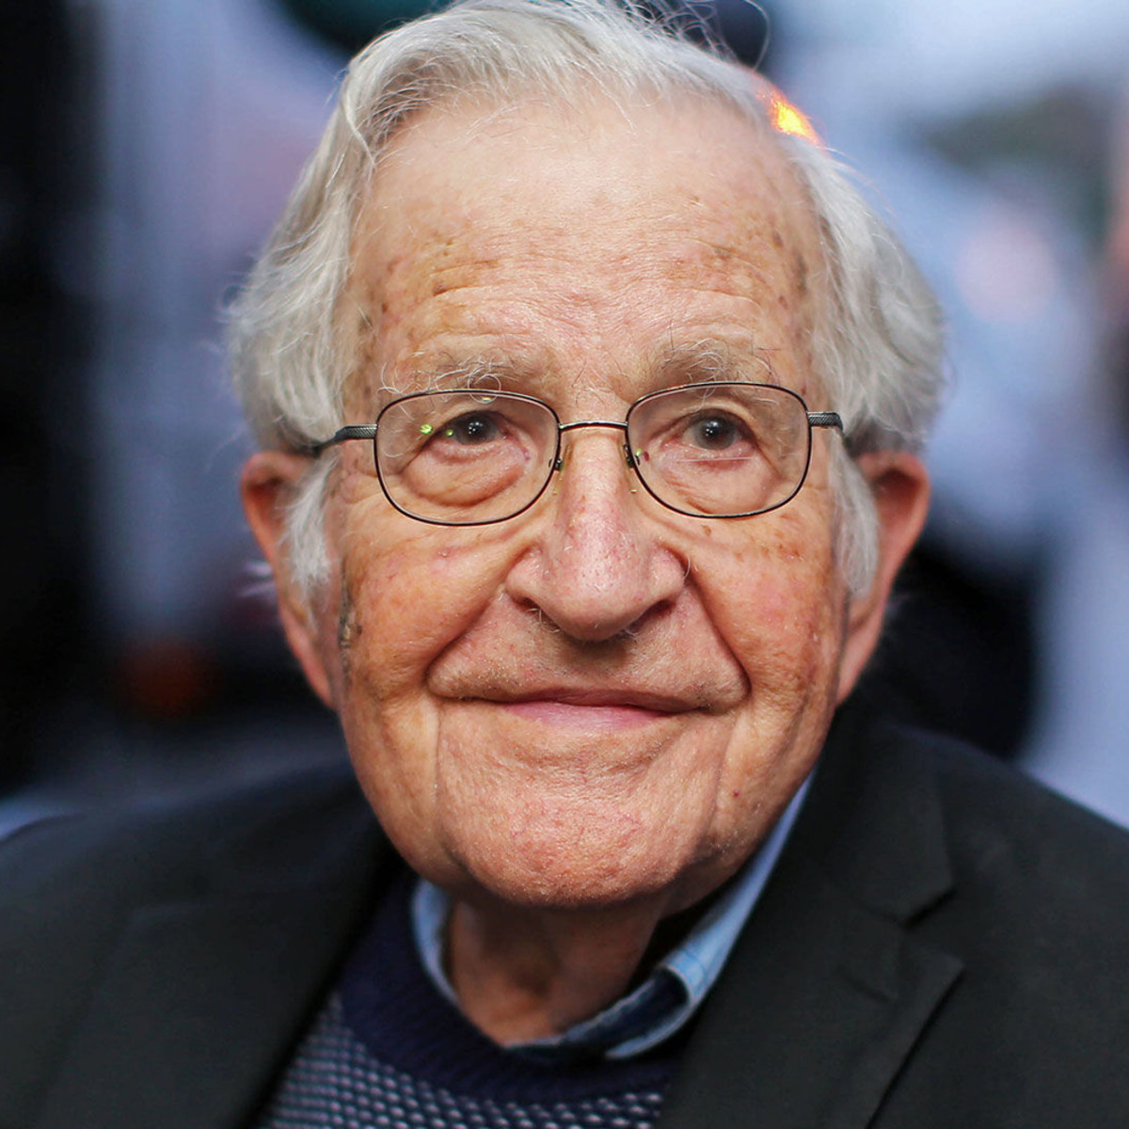
Noam Chomsky
“I was never aware of any other option but to question everything.”

Slide 3
Early life
Avram Noam Chomsky was born on December 7, 1928, in Pennsylvania
Interested in politics
Jewish upbringing
Had a younger brother

Slide 4
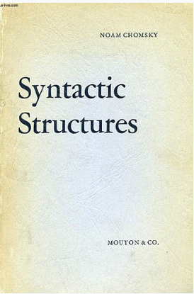
Life at M.I.T.
After graduating from the University of Pennsylvania, Chomsky went on to obtain a doctorate in linguistics from Harvard.
From there, he went on to study at M.I.T., where he became an assistant professor.
Published multiple books, papers, and reviews.
Argued for the separation of syntax from semantics.
Argued against B.F. Skinner, who said language is a learned behavior.
Argued humans must have some “language acquisition device,” since exposing an animal to language only resulted in an animal.

Slide 5
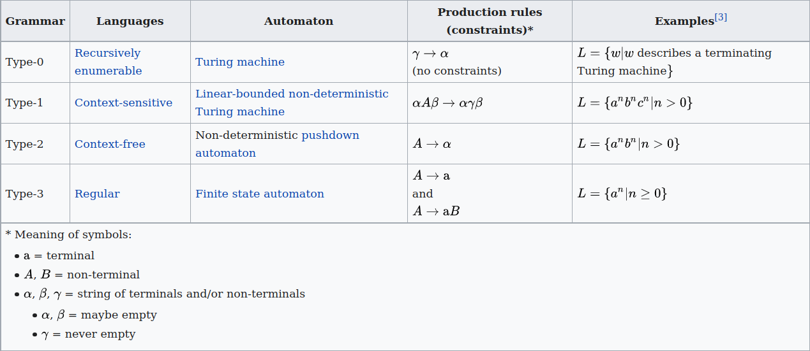
Contributions to Formal Systems
Chomsky developed a formal definition of a grammar, of which there are four types, and further organized them into Chomsky’s Hierarchy, where each type of grammar is a subclass of each grammar before it.

Slide 6
Unrestricted Grammar
An unrestricted (AKA recursively enumerable) grammar is a system which contains a set of possible symbols, a starting symbol, and a list of rules for transforming or substituting said symbols.
A property of such a system is that a turing machine is capable of listing all possible valid strings, if given infinite time.

Slide 7
Context-Sensitive Grammar
A context sensitive grammar contains symbols whose substitutions depend on the context of their placement in a string, so one may have a rule which replaces ‘b’ with ‘c’ - but only when there is a ‘b’ before ‘a’. So, [ab -> c].
An unrestricted grammar may have an empty substitution, such as [ab -> ], while a context-sensitive grammar cannot.

Slide 8
Context-Free Grammar
A context-free grammar is like a context-sensitive grammar, except it’s not context-sensitive. This means that each rule has only one left-hand argument. Ex. [a -> b, b -> bc, c -> ab].

Slide 9
Regular Grammar
A regular grammar has two qualifiers: each production rule must contain at most one non-terminal symbol, and that symbol is either always on the left (left-regular) or always on the right (right-regular).
As such, these grammars appear to only expand only either left or right.

