Slide 1
Alonzo Church

Slide 2
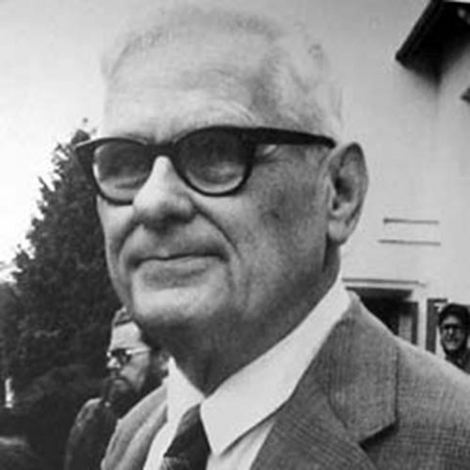
“The only thing that might have annoyed some mathematicians was the presumption of assuming that maybe the axiom of choice would fail, and that we should look into contrary assumptions.”

Slide 3
Early Life and Education
Born in Washington, D.C. - June 14, 1903.
Father was a judge, lost his position due to failing eyesight.
Alonzo Church’s uncle was also named Alonzo Church
Helped him attend school in Connecticut, and later he was able to attend Princeton
Graduated with a degree in mathematics
Continue to study at Princeton University under Oswald Veblen, earning his P.H.D. in Mathematics.
In 1941, Church wrote the monograph, The Calculi of Lambda-conversion
Useful in development of semantics for programming languages
Major research topic in theoretical computer science today

Slide 4
Accomplishments and Contributions
Church’s contribution to the Entscheidungsproblem (“decision problem” in German)
Church’s Theorem
Negative answer
Church proposed that “we define the notion … of an effectively calculable function of positive integers by identifying it with the notion of a recursive function of positive integers”
Concept of recursive function was due to Kurt Godel and Jacques Herbrand
The result was that the class of lambda-definable functions and the class of recursive functions, both of positive integers, are identical, proven by Church and Kleene.

Slide 5
Accomplishments and Contributions (continued)
Church-Turing thesis
States as “The assumption that the intuitive notion of computable functions can be identified with partial recursive functions.”
Lambda Calculus

Slide 6
Lambda Calculus
Formal system created by Church
According to wikipedia:
“Lambda calculus is a formal system in mathematical logic for expressing computation based on function abstraction and application using variable binding and substitution.”
Universal model of computation that can be used to simulate any Turing Machine
Influenced the design of the LISP programming language and functional programing languages in general.

