Slide 1
The Contributions of John Henry Holland
Jordan Bailey

Slide 2
Model building is the art of selecting those aspects of a process that are relevant to the question being asked. As with any art, this selection is guided by taste, elegance, and metaphor; it is a matter of induction, rather than deduction. High science depends on this art.
John H. Holland

Slide 3
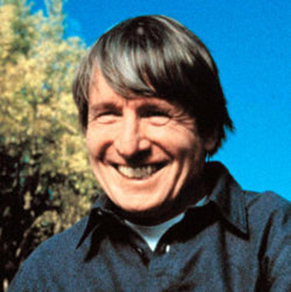
John Henry Holland (1929 - 2015) was a longtime professor of computer science, engineering, and psychology at the university of Michigan. Holland was also one of the first to get a PhD in what later became computer science in 1959.

Slide 4
Complex Systems and Genetic Algorithms
John Henry Holland was fundamental in the development of Michigan’s center for the study of complex/nonlinear systems, and what will eventually be known as genetic algorithms. In the mid-1960’s, John developed the programming technique known as the genetic algorithm, which was able to “evolve” in ways that resemble natural selection.

Slide 5
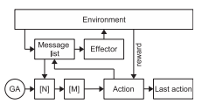
Genetic Code
Holland worked on creating a genetic “code” that would represent the structure of any computer program, which eventually became his classifier system.

Slide 6
Classifier System
Consists of a set of rules, each performing particular actions every time its conditions are satisfied by some piece of information
Represented with strings of bits, the number ‘1’ if the characteristic is present, ‘0’ if not present, and ‘*’ for undetermined.
The system starts with randomized strings of 1’s and 0’s, and rates them based on the quality of their result.
High-quality strings ‘mate’ while low-quality strings perish, and then the process is repeated.

Slide 7
Implicit Parallelism
Within Holland’s genetic algorithms, a single string belongs to all of the regions in which its bits appear.
Example: The string 11011001 is a member of many regions including 11******, 1******1, **0**00*, and so on.
Because of this, it allows the system to test multiple regions while manipulating relatively few strings. This characteristic is called implicit parallelism, which gives genetic algorithms and this classifier system an advantage over other problem-solving processes.

Slide 8
Modern day uses of Genetic Algorithms
Financial mathematics
Bug detection
Image processing
File allocation
Neural Networks
Mechanical Engineering
Medical Science (RNA structure prediction, protein prediction, etc.)
Many more…

Slide 9
Emergence
Holland’s work on genetic algorithms supports other research within the field of artificial intelligence emphasizing how lower-order activities are the building blocks for higher-level phenomenon. Holland argued that the complex physical systems are not the product of abstract rules but the consequences of diverse agents and their interactions in the world.

Slide 10
Sources
Encyclopædia Britannica, inc. (n.d.). John Henry Holland. Encyclopædia Britannica. Retrieved March 18, 2022, from https://www.britannica.com/biography/John-Henry-Holland
Holland, J. H. (1992). Genetic algorithms. Scientific American, 267(1), 66–72. https://doi.org/10.1038/scientificamerican0792-66
Staff, C. A. C. M. (2015, November 1). John H. Holland 1929-2015. ACM. Retrieved March 18, 2022, from https://cacm.acm.org/magazines/2015/11/193339-john-h-holland-1929-2015/fulltext
Obituary: John Henry Holland. The University Record. (n.d.). Retrieved March 18, 2022, from https://record.umich.edu/articles/obituary-john-henry-holland/

