Slide 1
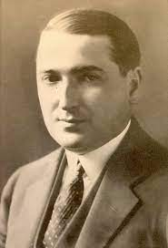
“Perhaps the greatest service the present account could render would stem from its stressing of its final conclusion that mathematical thinking is, and must be, essentially creative.” Emil Post

Slide 2
Early Childhood
Was born on February 11th, 1887.
Moved from Poland to New York City with Family at the age of eight.
Lost an arm as well at eight.
Attended The City College of New York.
Studied to become a mathematician and logician.

Slide 3
Post’s Twenty's
Began his postgraduate at Colombia University.
Studied the Principia Mathematica
He proved the propositional calculus using the truth table method that he created.

Slide 4
Contributions
Post became well known for the structure theory of recursively enumerable sets.
The introduction of Turing degrees in 1944
The ”Post Correspondence Problem” or undecidable decision problem

Slide 5
Contributions Cont.
Post also solved the incompleteness and unsolvable theorems that made Gödel and Turing famous.
Didn’t publish his work because he though the proof wasn’t highlighted enough for the scientific community.
Which worsened his condition of manic depression.

Slide 6
Lastly
Emil Post died in 1954 on April 21st
Although he suffered through mental illness not properly treated at the time, he was still able to make his well-known contributions to science.

