Slide 1
Aristid Lindenmayer
Daniel Petti

Slide 2
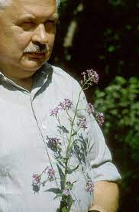
Biography
Lindenmayer was a Hungarian Biologist
He taught at many universities
Not much information

Slide 3
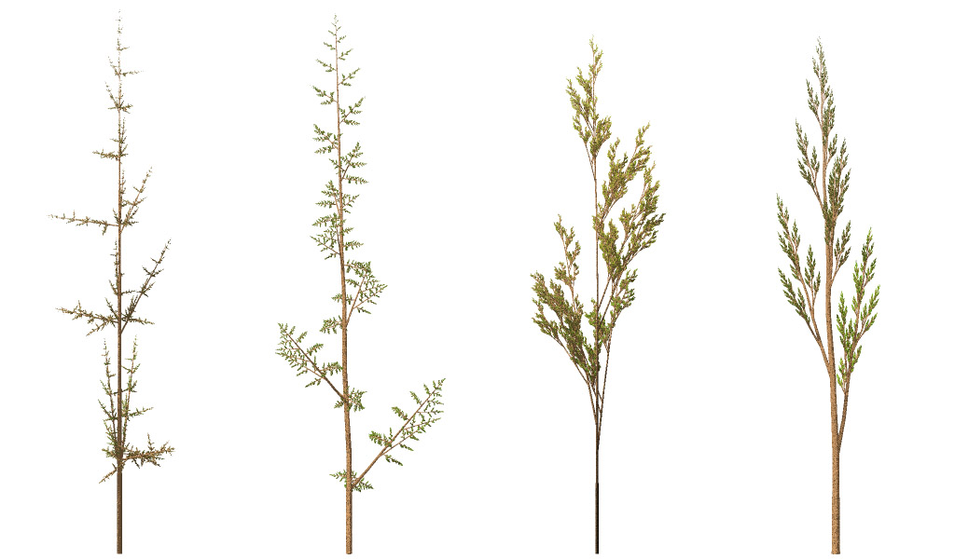
L-System Origins
Developed in 1968
Original intention - model yeast cells
Eventually ‘grew’ to include plants

Slide 4
The L-System
A formal grammar comprised of three components:
An alphabet {A, B, C}
A ruleset { A-> AA | B -> CC | C-> BC }
An Axiom { A, B, C}

Slide 5
Applications
Growth capacity grants flexibility
Plants, Fractals, Computer Graphics
Koch Curves, Sierpinski Triangles, and more

